Slide 1

Advanced Bioinformatics workflows
George Githinji & Phil Ashton

Slide 2

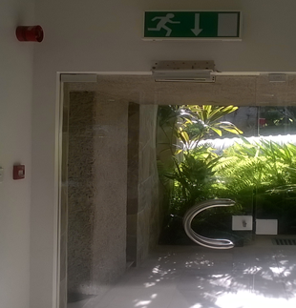
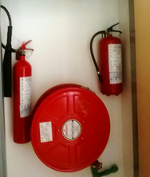

SAFETY First…always
OSH policy
Commitment by management
Operations guided by risk assessment
Watch out for
Slips and trips
Stairs, wet floor, uneven floor, trailing cables
Fire safety
Fire exits and the assembly point location
Fire evacuation procedure
Use the nearest safe exit when the alarm sounds
Follow instructions from fire marshals
Emergency arrangements;
First Aiders ;Staff clinic
Security: Access card, Loss of card etc.
WHAT NEXT?
Report any concerns
Be aware of your surroundings
PPE for visit to the labs
Raise suggestions for improvements

Slide 3
Course Overview
Day 1:
Day 2:
Day 3:
Day 4:
Day 5:

Slide 4
Training enviroment
Centos 7 ; - latest patch
Server IP: ip
ssh user@ip
Password: your_password

Slide 5
Login
Local accounts are only available via ssh
Users are train1, train2
You will be provided with an initial password
Change password on initial login

Slide 6
User evironment
/home
Keep all your files in /home

Slide 7
Software
Conda
Snakemake
Nextflow
Docker
Singularity

