Slide 1
Antimalarial drug resistance:
Use case for surveillance
29th August 2022
Notes:
dsyamuzu@ug.edu.gh | dsyamuzu@well.ox.ac.uk

Slide 2
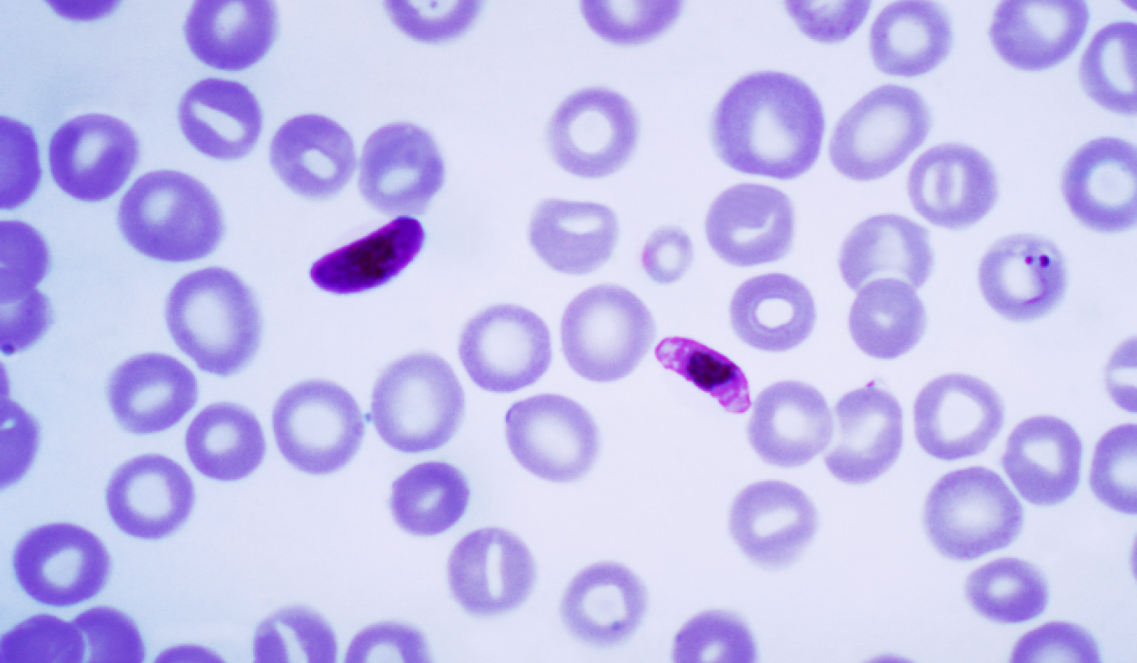
What is drug resistance?
Antimalarial drug resistance is the ability of Plasmodium spp to survive and/or mulitply in the presence of therapeutic or higher dose of drug
The emergence of drug resistance in Plasmodium spp depends on several factors
These factor include
the mutation rate of the parasite
the fitness cost associated with the resistance mutation
the overall parasite load
the treatment compliance
the strength of drug selection

Slide 3
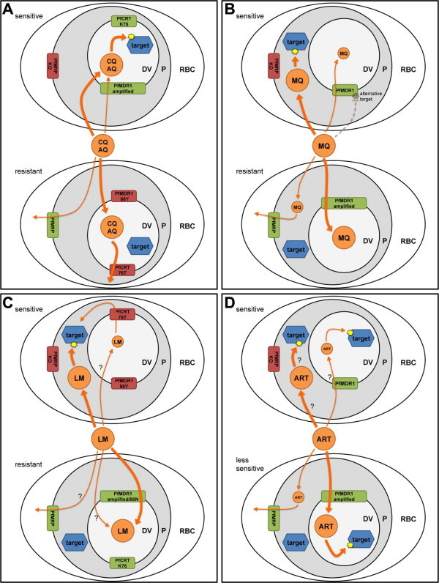
Drug resistance mechanisms
Chloroquine resistance (CQ):
Increased capacity (40-50x) of Plasmodium falciparum to expel CQ out of the digestive food vacoule (DV).
Mediated by CQ resistance transport (PfCRT)
Amodiaquine (AQ),Lumefantrine (LM), Mefloquine (M),
Piperaquine (PQ):
Similar mechanism of increased capacity to efflux of drug out of the DV.
Mediated by the multi-drug resistance transporter 1 (PfMDR1)
Pfmdr 1 gene encodes ATP-binding cassette (ABC) protein, residing in DV.

Slide 4
Drug resistance mechanisms
Artemisinin resistance (ART):
ART resistance is mediated Kelch 13 mutations-mechanism is based on quiescence state leading to parasite recrudescence as soon as drug pressure is removed.
Sulfadoxine – pyrimethamine (SP):
Sequential and synergistic blockade of 2 key enzymes involved with folate biosynthesis.
Pyrimethamine inhibit the step mediated by dihydrofolate reductase (DHFR).
Sulfadoxine (sulfones & sulfonamides) inhibit the step mediated by dihydropteroate synthase (DHPS)
Specific combinations of mutations in this bifunctional enzyme mediates varying degrees of restance to antifolate combination drugs

Slide 5
How mutations affect function
AATTTCGCTTATCGACTCAATTATAT
Change in DNA sequence
AATTTCGCTTATCGGCTCAATTATAT
AATTTCGCTTATCGGCTCAATTATAT
Change in protein sequence
LNITTKVLTAARKGISTCFAVTKTVT
LNITTKVLTAARTGISTCFAVTKTVT
LNITTKVLTAARTGISTCFAVTKTVT
Change in protein structure
Change in protein function
Change in phenotype
Drug resistant

Slide 6
Molecular markers of resistance
Chloroquine (CQ) resistance
CQ Resistance is mediated by mutations in pfcrt and pfmdr 1 transporters
Pf chloroquine resistance transporter gene:
The single mutation in Pfcrt gene resulting in PfCRT 76 (K/T) substitution in CRT protein
Most critical (basal) mutation for CQ resistance
Several other mutations then emerge with PfCRT 76T background to confer increased resistance CQ
These including mutations at position 72 to 76 in PfCRT protein that combine to form resistance haplotypes.

Slide 7
Molecular markers of resistance
Multi-drug (CQ, AQ, LM) resistance
CQ Resistance is mediated by mutations in pfcrt and pfmdr 1 transporters
Pf multi-drug resistance transporter gene 1 :
The single mutation in Pfmdr 1 gene resulting in PfMDR 86 (N/Y) substitution in CRT protein
Most critical (basal) mutation for multi-drug (CQ,AQ,L) resistance
Other mutations then emerge with PfMDR1 N86Y background to confer increased resistance different drugs
These including mutations at positions 86, 184 & 1246 in PfMDR protein that combine to form resistance haplotypes.
Also amplification of Pfmdr 1 (CNVs) associated with MQ (other drugs) resistance.

Slide 8
Haplotype combinations
PfCRT position and encoded amino acid
72 | 73 | 74 | 75 | 76 | Haplotype | Phenotype
C | V | M | N | K | CVMNK | Wild-type (sensitive)
C | V | I | E | T | CVIET | Resistant
PfMDR 1 position and encoded amino acid
86 |  | 184 |  | 1246 | Haplotype | Phenotype
N |  | Y |  | D | NYD | Wild-type (senstive)
Y |  | F |  | D | YFD | Single mutant
Y |  | Y |  | Y | YYY | Double mutation
Y |  | F |  | Y | YFY | Triple mutant
N |  | F |  | Y | NFY | Double mutant

Slide 9
Molecular markers of resistance
Antifolate resistance
Pyrimethamine (PYR) Resistance is mediated by mutations in pfdhfr
Pf dihydrofolate reductase gene:
The basal mutation conferring PYR-resistance is
Multiple mutations at positions 108, 59, 164, 51 of the DHFR protein
• combined into Single/double/triple/quad mutant haplotypes vary in phenotype
Sulfadoxine (SD) Resistance is mediated by mutations in pfdhps
Pf dihydropteroate synthase gene:
SD‐R caused by multiple mutations at positions 436, 437, 540, 581, 613
• Greater variation in haplotypes than for pfdhfr, more difficult to assess

Slide 10
Haplotype combinations
PfDHFR position and encoded amino acid
51 | 59 | 108 | 164 | 164 |  | Haplotype | Phenotype
N | C | S | I | I |  | NCSI | Wild-type (sensitive)
I | R | N | I | I |  | IRNI | Triple resistant
N | R | N | I | I |  | NRNI | Double resistant
I | C | N | I | I |  | ICNI | Double resistant
I | R | N |  | L |  | IRNL | Quadruple resistant
PfDHPS position and encoded amino acid
436 | 437 | 540 | 581 |  | 613 | Haplotype | Phenotype
S | A | K | A |  | A | SAKAA | Wild-type (sensitive)
A | A | K | A |  | S | AAKAS | Double mutant
A | G | K | A |  | A | AGKAA | Double mutant
S | G | K | A |  | S | SGKAS | Double mutant
A | G | K | G |  | S | AGKGS | Triple mutant
A | G | E | G |  | S | AGEGS | Quintuple mutant

Slide 11
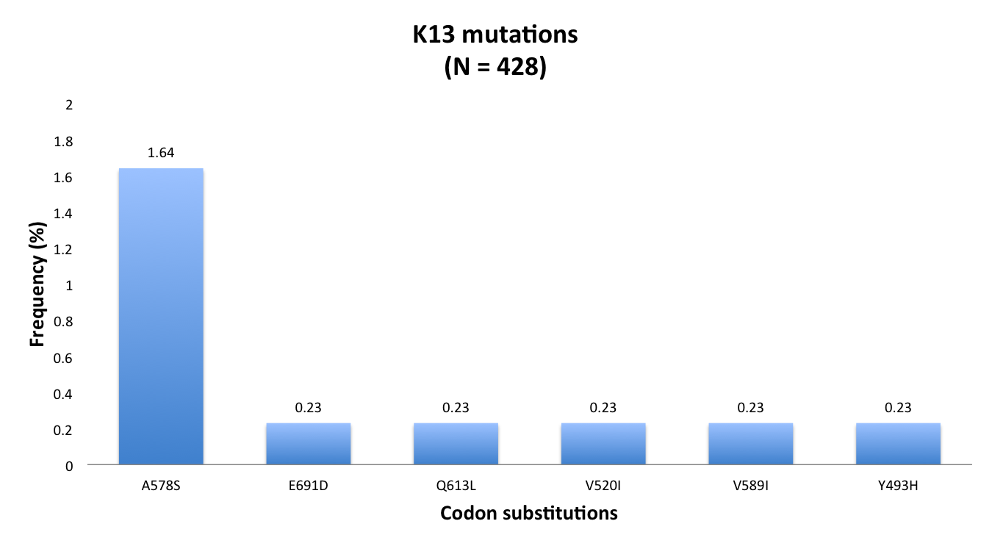
ART resistance
Markers | status classification
P441L | Candidate
F446I | Candidate
G449A | Candidate
N458Y | Candidate
Y493H | Validated
R539T | Validated
I543L | Validated
P553L | candidate
R561H | validated
V568G | Candidate
P574L | Candidate
A578S | Candidate (not associated)
C580Y | Validated
A675V | Candidate
Pf Kelch 13 gene:
ART-resistance in south-east Asia
Growing evidence of partial resistance in Africa
Epicentre is East Africa great lakes region and horn of Africa

Slide 12
Molecular surveillance of malaria
Use cases
Temporal prevalence of resistance markers
Pfmdr 1
Drug resistance surveillance
Sampling over time for trends
Multiple locations for epidemiology

Slide 13

Merci, Question sil vous plait

