Slide 1
Population genetics of malaria vectors
December 1, 2022
Notes:
dsyamuzu@ug.edu.gh | dsyamuzu@well.ox.ac.uk

Slide 2
Learning objectives
Trainees to understand
the kinds of sampling techniques that can be used to study vector populations
the mutations that are relevant for tracking insecticide resistance alleles
how to assess the population structure of major malaria vectors.
how to perform genome-wide scans for signals of recent evolutionary selection in the vector populations

Slide 3


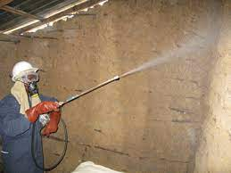

Introduction
There is the need to for an indepth of the vector ecology.
What are some of the major vectors within the population of interest
What strategic interventions target vectors that could impose some selection pressure on the population:
Long lasting insecticide treated bed nets
Standard vs standard plus Piperonyl Butoxide (PBO)
Pre-and post PBO net distribution
Indoor Residual spraying (IRS)
Time points for IRS
Strategy and chemicals used
Wide spread use of branded pyrethroid-based aerosols

Slide 4
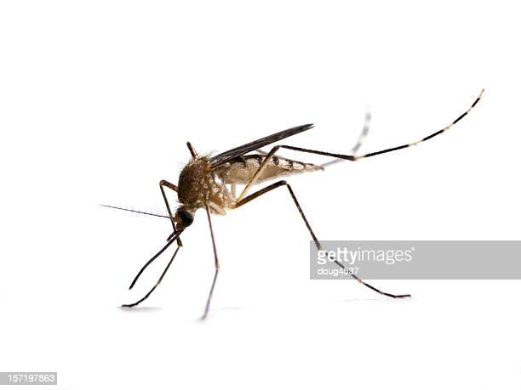

Field sampling methods
Mosquito sampling techniques wild adult mosquitoes:
CDC Light trap catches
Pyrethroid spray catches, and
Human landing catches
Basic metadata that helps to strengthen the testing of your research hypothesis
Later genetic identification and confirmation using ANOSPP from MalariaGEN
Morphological identifcation and storage in 70% ethanol

Slide 5
Sequencing and variants datasets
Choose an appropriate platform for sequencing e.g Illumina HiseqX platform
Three types of data can potentially be produced for each sample:
Single Nucleotide Polymorphisms (SNPs)
Copy number variant (CNV)
SNPs passing QC can be phased into haplotypes
There are existing MalariaGEN pipelines for curation and quality control.

Slide 6
What types of analysis can be performed?

Slide 7
Vector Abundance
Number of samples sequenced per year by location in the KNDs from 2016- 2018
 |  |  | Species observed
Village | Year |  | An. arabiensis | An. coluzzii | An. gambiae
 |  | N | n (%) | n (%) | n (%)
 | 2016 | 136 | 2 (1.5) | 127(93.4) | 7 (5.2)
Bonia | 2017 | 252 | 3 (1.2) | 247 (98.0) | 2 (0.8)
 | 2018 | 42 | 0 (0.0) | 42 (100) | 0 (0.0)
 | 2016 | 34 | 1 (2.9) | 20 (58.8) | 13 (38.2)
Kandiga | 2017 | 111 | 6 (5.4) | 84 (75.7) | 21 (18.9)
 | 2016 | 34 | 1 (2.9) | 33 (97.1) | 0 (0.0)
Kayoro | 2017 | 161 | 6 (3.7) | 130 (80.7) | 25 (15.5)
 | 2018 | 8 | 2 (25.0) | 6 (75.0) | 0 (0.0)
 | 2016 | 29 | 0 (0.0) | 24 (82.8) | 5 (17.2)
Naaga | 2017 | 132 | 9 (6.8) | 96 (72.7) | 27 (20.0)
 | 2018 | 3 | 2 (66.7) | 1 (33.3) | 0 (0.0)
 | Total | 945 | 32 (3.4) | 810 (86.0) | 100 (10.6)

Slide 8
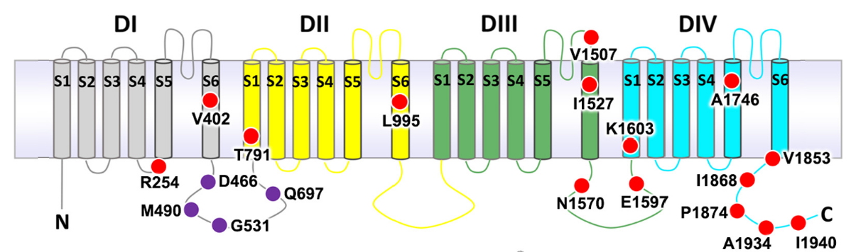
Pyrethroid target-site resistance in An. gambiae
Multiple SNPs and SNP combinations are evolving within the Vgsc gene targeted by pyrethroids-- Clarkson et al. (2021) https://doi.org/10.1111/mec.15845

Slide 9
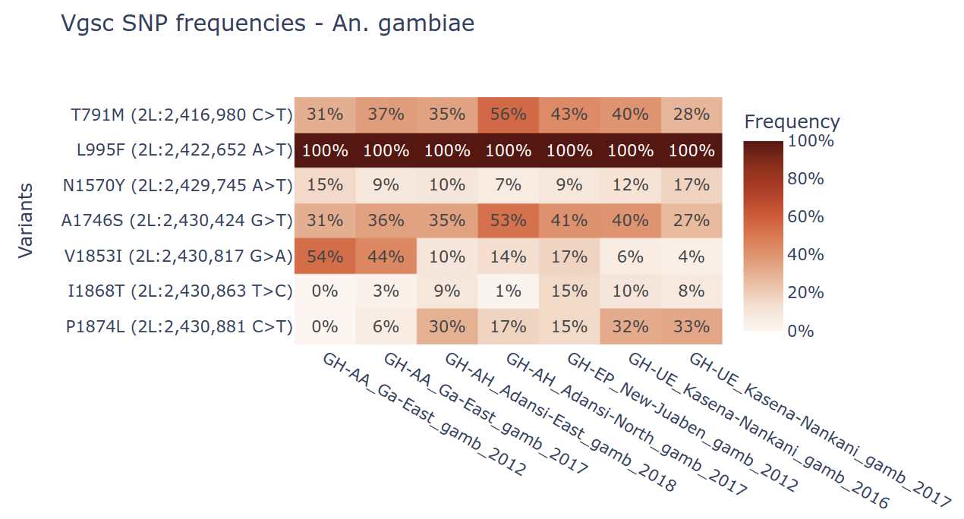
Pyrethroid target-site resistance –An. gambiae
Southern
Northern
L995F ("kdr west") fixed in all
locations

Slide 10
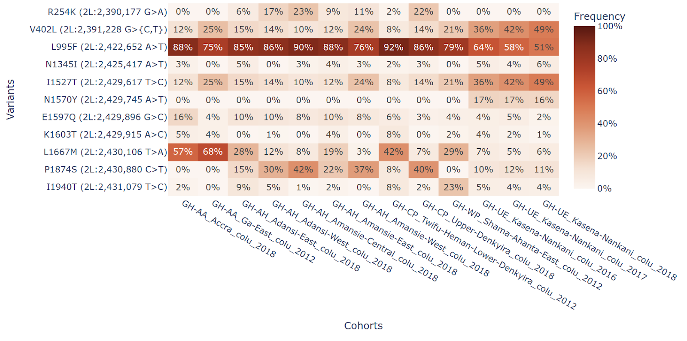
Pyrethroid target-site resistance – An. coluzzii
Southern
Northern
Pyrethroid target-site resistance is fixed in all locations - all mosquitoes have either L995F or V402L+I1527T
V402L+I1527T is increasing only in northern locations

Slide 11
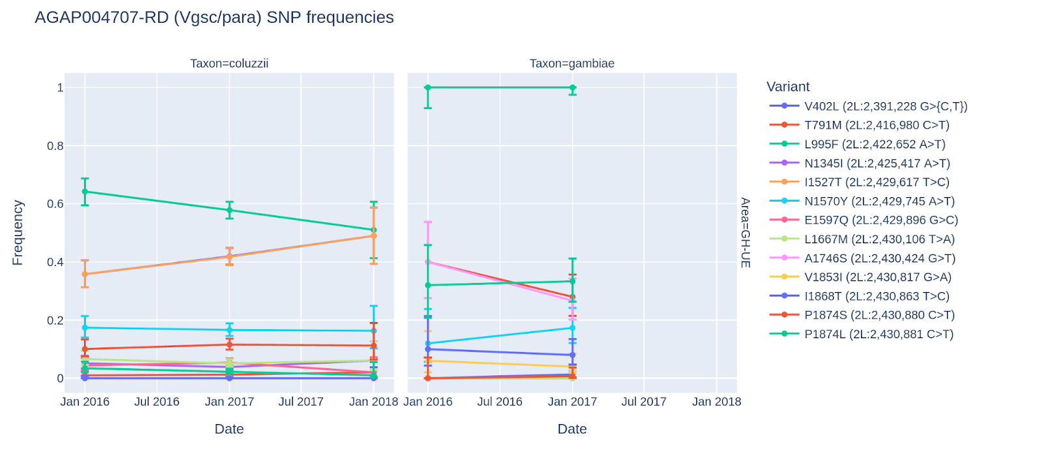
Trends in Pyrethroid target-site resistance over time
Decreasing
L995F-kdr
Increasing
V402L + I1527T
It appears that in northern Ghana coluzzii, the double mutant (V402L + I1527T) is outcompeting the widespread kdr allele L995F.
Notes:
The increase in both V402L and I1527T alleles , and concomitant drop in L995F from 2016 to 2018 is obsvious

Slide 12
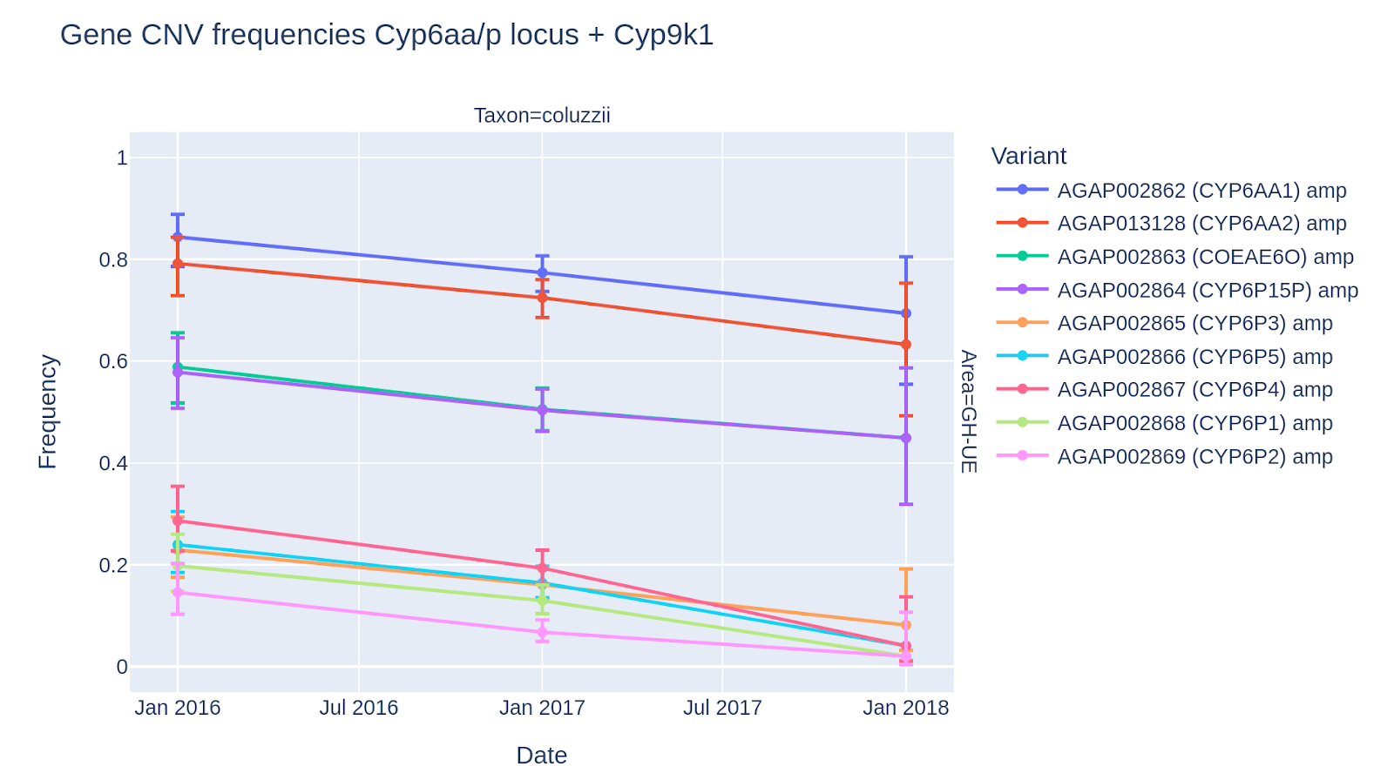
Pyrethroid metabolic resistance over time
Gene copy number variant frequencies for Cyp6aa/p locus, over time, in northern coluzzii.
Could the consistent decrease of all CNVs at this locus be linked with the increase in pyrethroid target-site allele combination V402L + I1527T over the same period?
Notes:
Interestingly all CNVs at this locus decrease over time in northern An. coluzzii

Slide 13
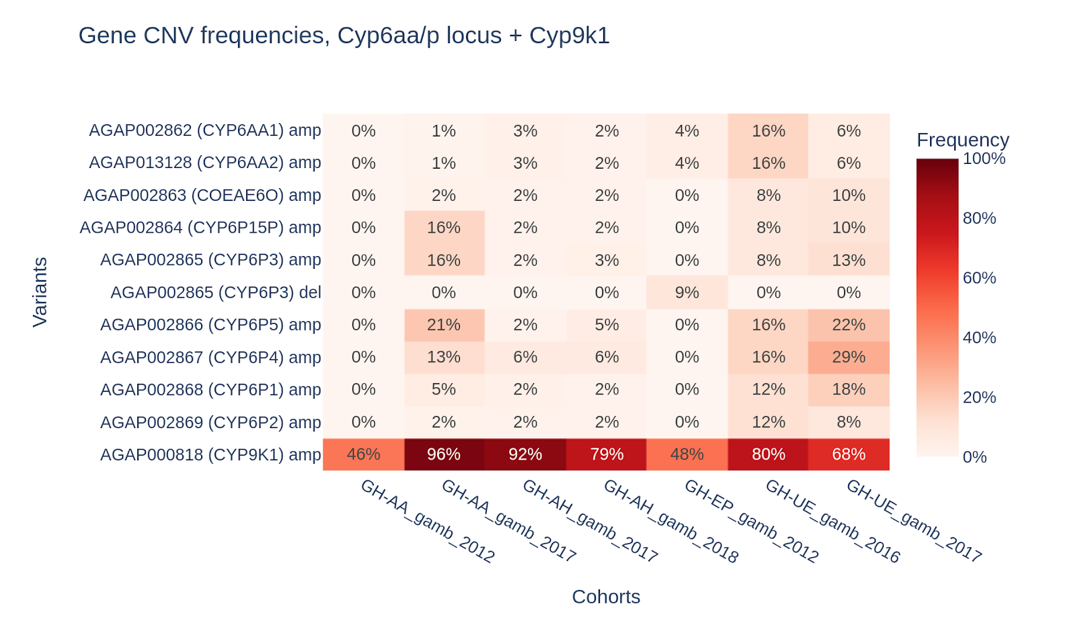
Pyrethroid metabolic resistance in An. gambiae
Gene copy number variant frequencies for genes with links to pyrethroid resistance.
*
*
Results suggest that An. gambiae from across Ghana are increasing pyrethroid metabolism using amplification of the CYP9K1 gene.

Slide 14
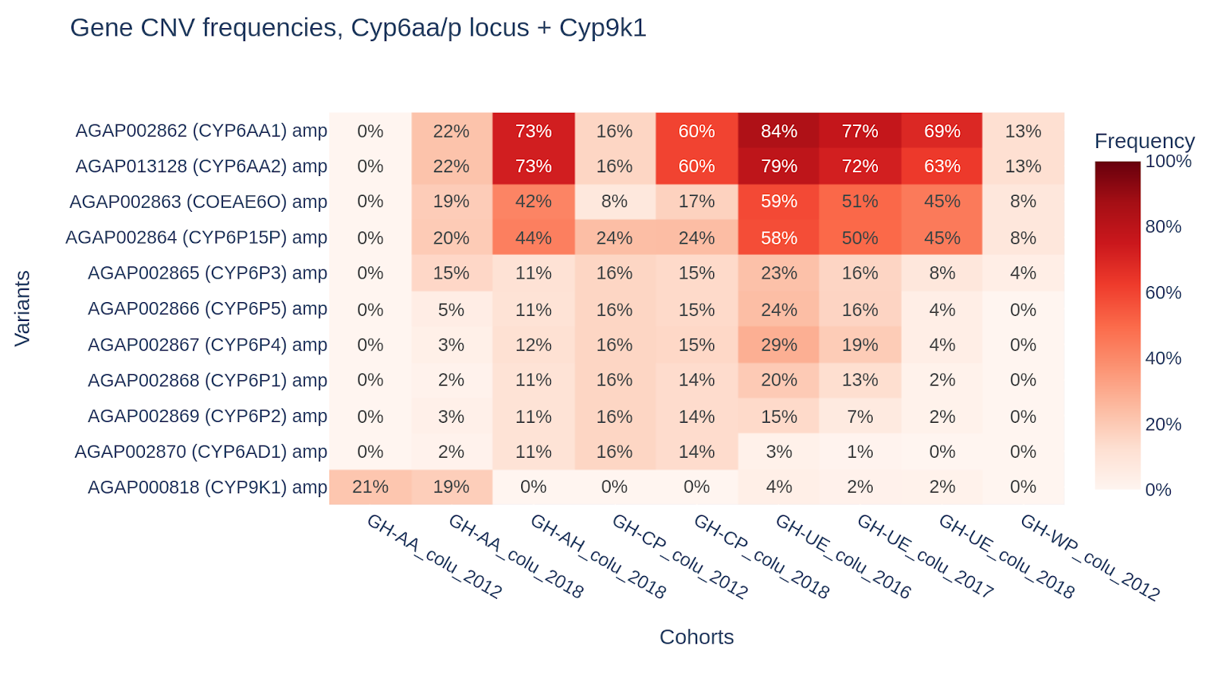
Pyrethroid metabolic resistance in An. coluzzii
Gene copy number variant frequencies for genes with links to pyrethroid resistance.
*
*
*
An. coluzzii cohorts from Ghana are generally increasing pyrethroid metabolism using amplification of the genes in the CYP6AA1/P cluster.

Slide 15
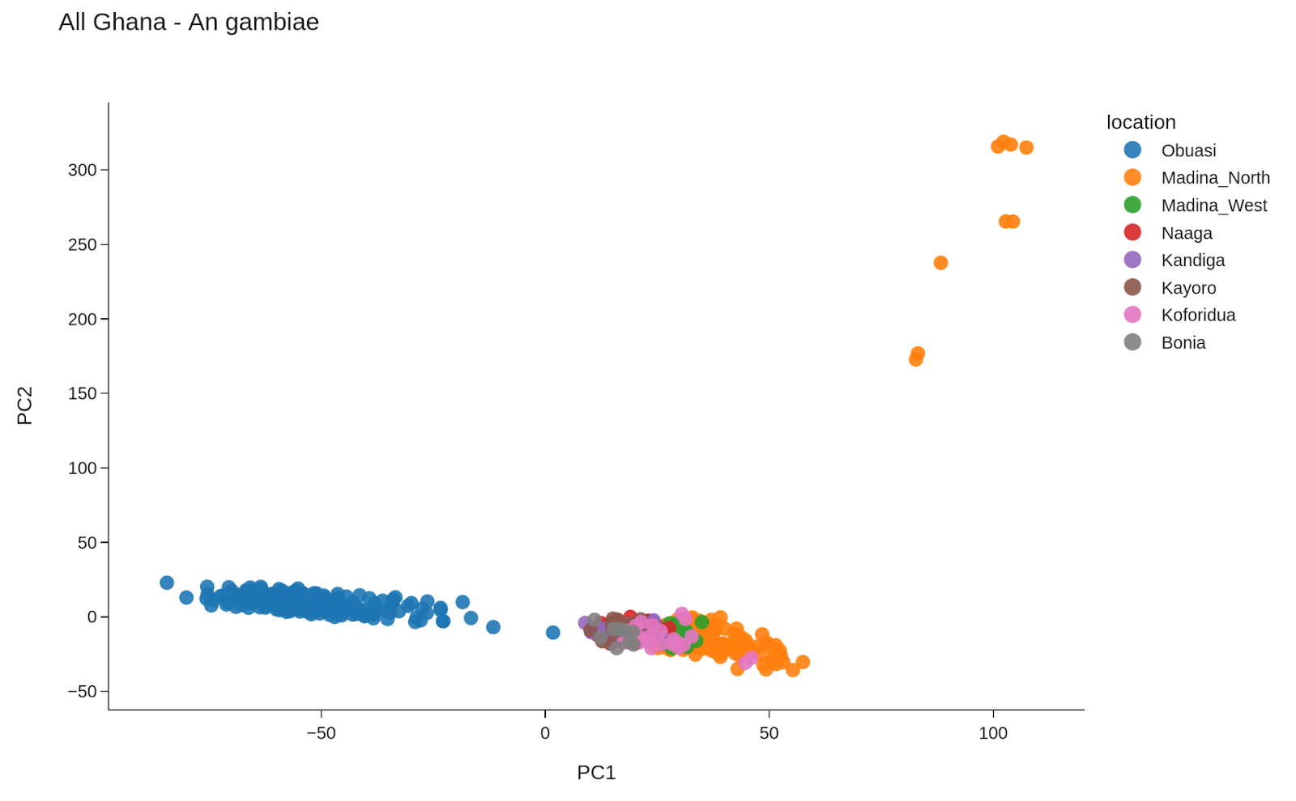
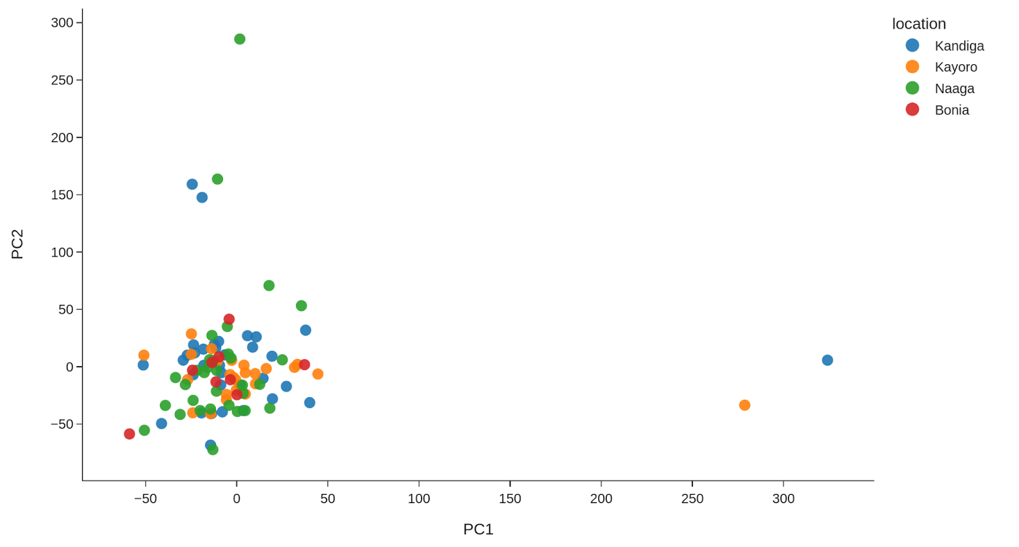
Population structure – An gambiae
No systematic population structure between nortthern and southern Ghana, but …..
Structure between samples from Obuasi and all other samples
No structure was evident in northern samples
Obuasi is mining town which underwent intense IRS and larviciding activities by AGAMAL Malaria Control LTD in collaboration with the NMCP

Slide 16
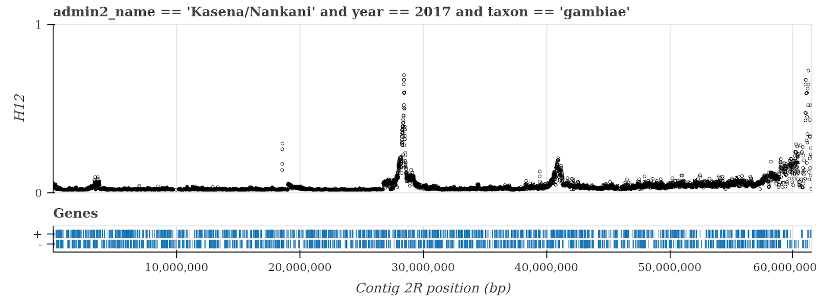
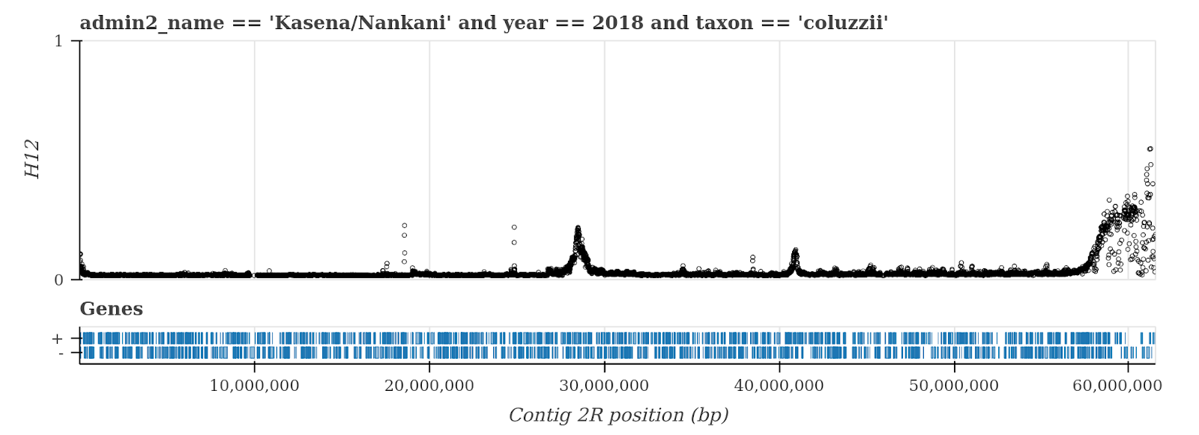
Genome-wide signals of selection
Cyp6p3 locus
Keap 1 gene
On the 2R chromosome arm we find signals of recent selection in both gambiae and coluzzii from northern Ghana, using the H12 statistic.
One of these signals sits on the Cyp6p3 locus, known to metabolise pyrethroids.
A second signal, covers a region containing the Keap1 gene.
Notes:
Recent research (Ingham et al. 2017) has shown Keap 1 gene to be an upstream regulator of metabolic genes including Cyp6m2 and as such this result may be evidence of a novel insecticide resistance mechanism in Ghana.

Slide 17
Summary
Produce summary statistics of vector abundance
Use SNP and CNV datasets to :
Insecticide resistance (target site resistance)
Copy number variant (metabolic resistance)
Genetic diversity
Population structure analysis (Pca, Fst etc)
Perform population scans for recent signatures of selection.

Slide 18
Questions or clarifications

