Slide 1
When edge and deep learning unite
Neural models deployment on STM 32 f40*/H745
Oleh sinkevych, assistant professor
Yaroslav Boyko, Ph.D., associated professor
Radioelectronic and computer systems department​

Slide 2
Content
Part 1.
Introduction: data saturation, edge/mist computing; why it matters.
Problem domains.
Data flow and pre-processing.
Data Processing classes.
Sequence model: LSTM intuition and development.
Part 2.
STM32 F40*/H745: architecture, AI solutions.
Introduction to X-CUBE-AI.
Model conversion, import and deployment on STM32.
Model inference.
Conclusions and future work.

Slide 3
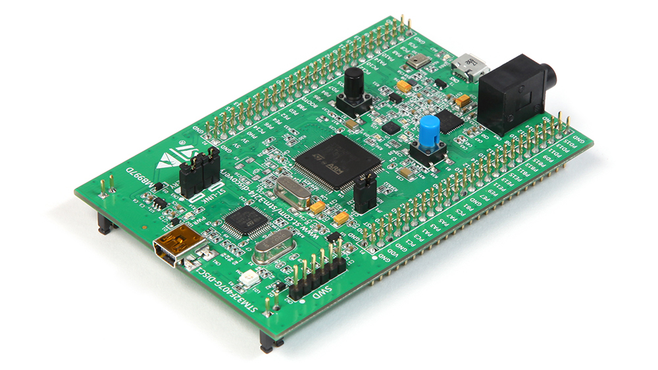
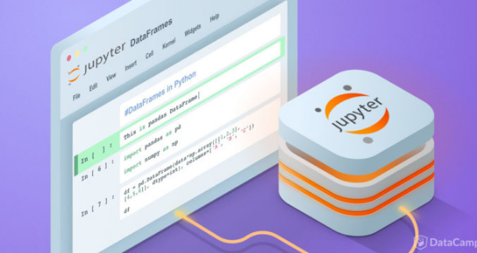


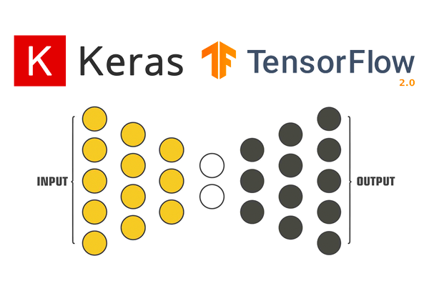
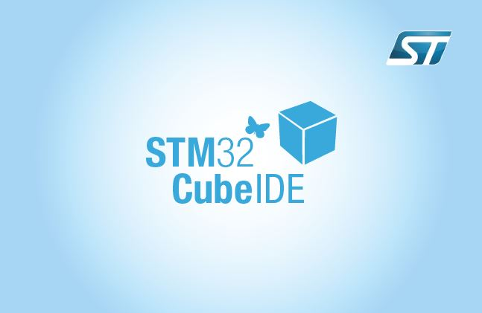

Requirements

Slide 4

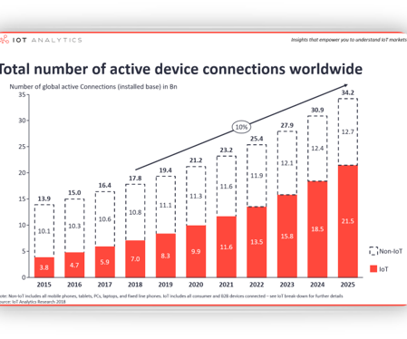
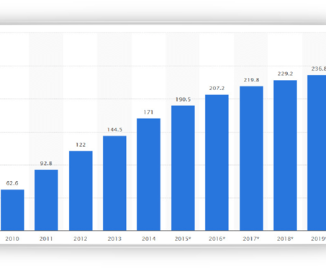
Introduction. Data saturation
Significant amount of generated data via sensors and smartphones.
Increase of the number of cheap data accumulation devices, e.g., smart home and industry controllers.
Data constantly motivate to improve existing approaches.

Slide 5
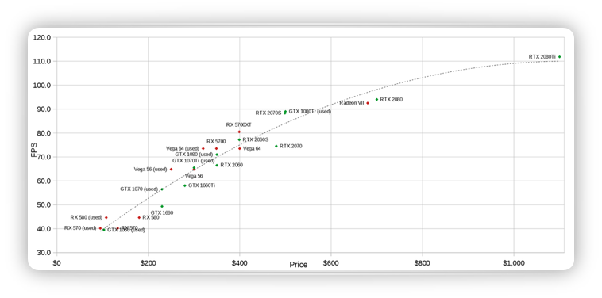
Introduction. GPU's
GPUs prices are slowly increasing.
GPUs performance is rising:
NVIDIA RTX 3090:
10496 CUDA cores;
24 GB GDDR6X;
325 tensor cores

Slide 6
Introduction. Infrastructure story
Deep learning is the solution to almost all industry scaled problems.
Nevertheless, deep learning’s high accuracy comes at the expense of high computational and memory requirements (inference phase).
Cloud computing as the solution?
Latency?
Scalability?
Privacy?
Edge computing
Edge-cloud computing
Issues are still there:
Computational resources.
Edge devices coordination.

Slide 7
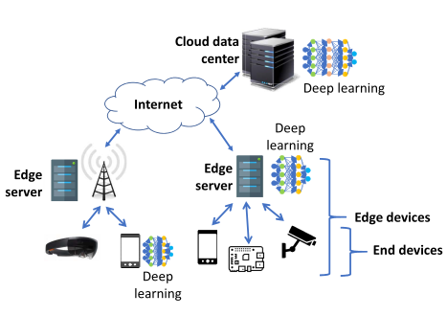
Introduction. Hardware solutions.
Expensive microcomputers: NVIDIA Jetson AGX Xavier, Xavier NX.
Low price microcomputers: Raspberry Pi 4, Asus Tinker.
Microcontrollers: STM32 etc.

Slide 8
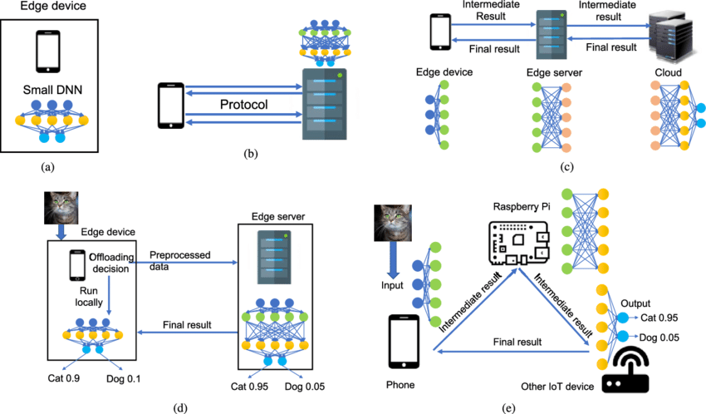
Problem domains
Computer vision (video surveillance, object counting).​
Natural language processing (machine translation, voice assistants, wakeword detection).​
Network functions (intrusion detection, in-network caching: deep learning for content popularity prediction or use deep reinforcement learning to decide a caching policy).​
Internet of Things (human activity recognition from wearable sensors, pedestrian traffic in a smart city and electrical load prediction in a smart grid).​
Virtual reality and augmented reality.

Slide 9

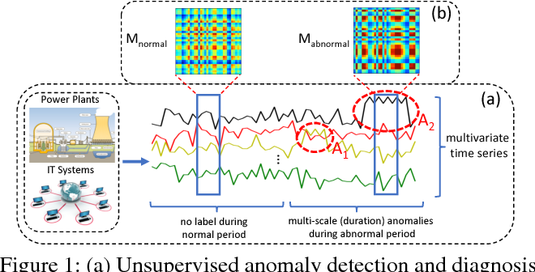
Problem domain
Pre-requires: assume sequential sensory data are available – temperature, energy readings or device performance indicators.
Data can be univariate or multivariate (more realistic).
TODO: Implement deep learning sequence models to predict/encode/decode sensor data flow in order to optimize/recommend/predict/analyze specific state.
Fig. 1. Unsupervised anomaly detection via DL

Slide 10
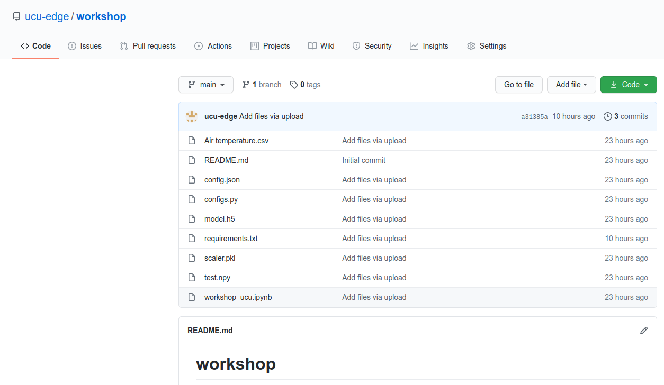
Problem domain. Let's get started
https://github.com/ucu-edge/workshop
Given: cleaned temperature data obtained via smart device.
Implement: neural net model in order to model data.
Model must be small enough to be deployed on STM32 microcontroller with the limited memory.

Slide 11
1D sequence
T=[time, value]
Statistical analysis*
Investigate sequence
Test/Val/Test
Prepare for training
Scaling
Standardization
Normalization
Transformation
Classification: [[sample, lag]]
Windowing [[...]]
3D reshaping
[[sample, lag, feature]]
Data flow and pre-processing.
DB
External tools
Implemented tools

Slide 12
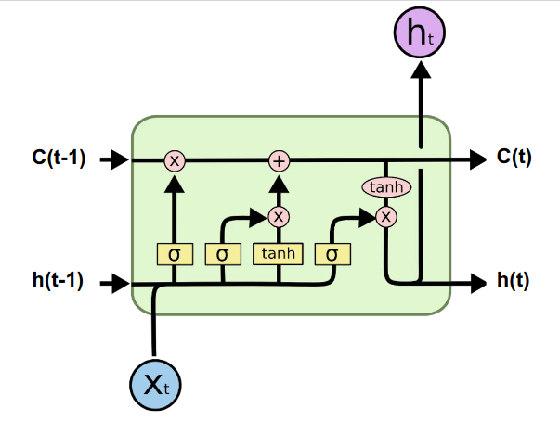
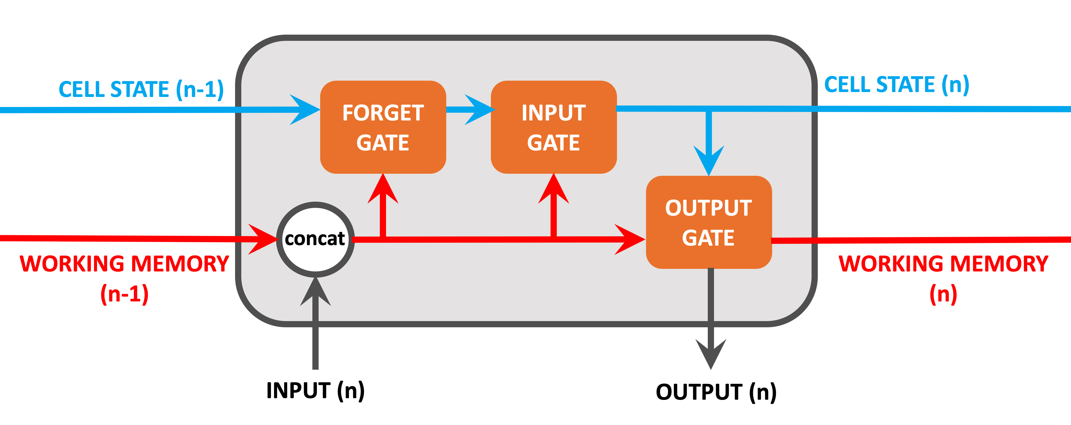
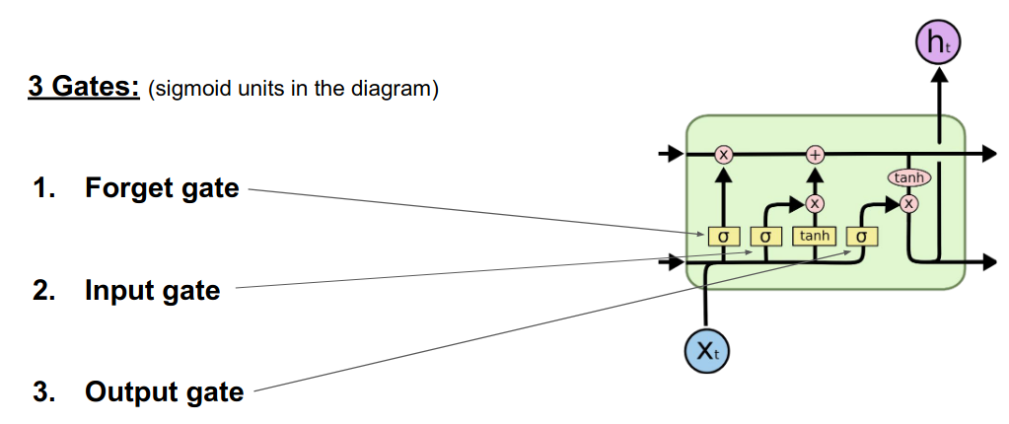
Sequence model: LSTM intuition
Hochreiter, Sepp & Schmidhuber, Jürgen. (1997). Long Short-term Memory. Neural computation. 9. 1735-80. 10.1162/neco.1997.9.8.1735.
Source: colah.github.io, http://blog.echen.me/2017/05/30/exploring-lstms

Slide 13
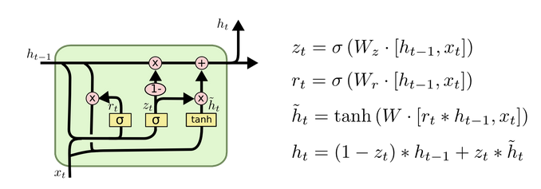
Sequence model: LSTM intuition
Drawbacks:
Computationally heavy;
Prone to overfitting;
LSTMs get affected by different random weight initializations;
Difficult to apply the dropout algorithm.
https://medium.com/mlreview/understanding-lstm-and-its-diagrams-37e2f46f1714
https://towardsdatascience.com/illustrated-guide-to-lstms-and-gru-s-a-step-by-step-explanation-44e9eb85bf21

Slide 14
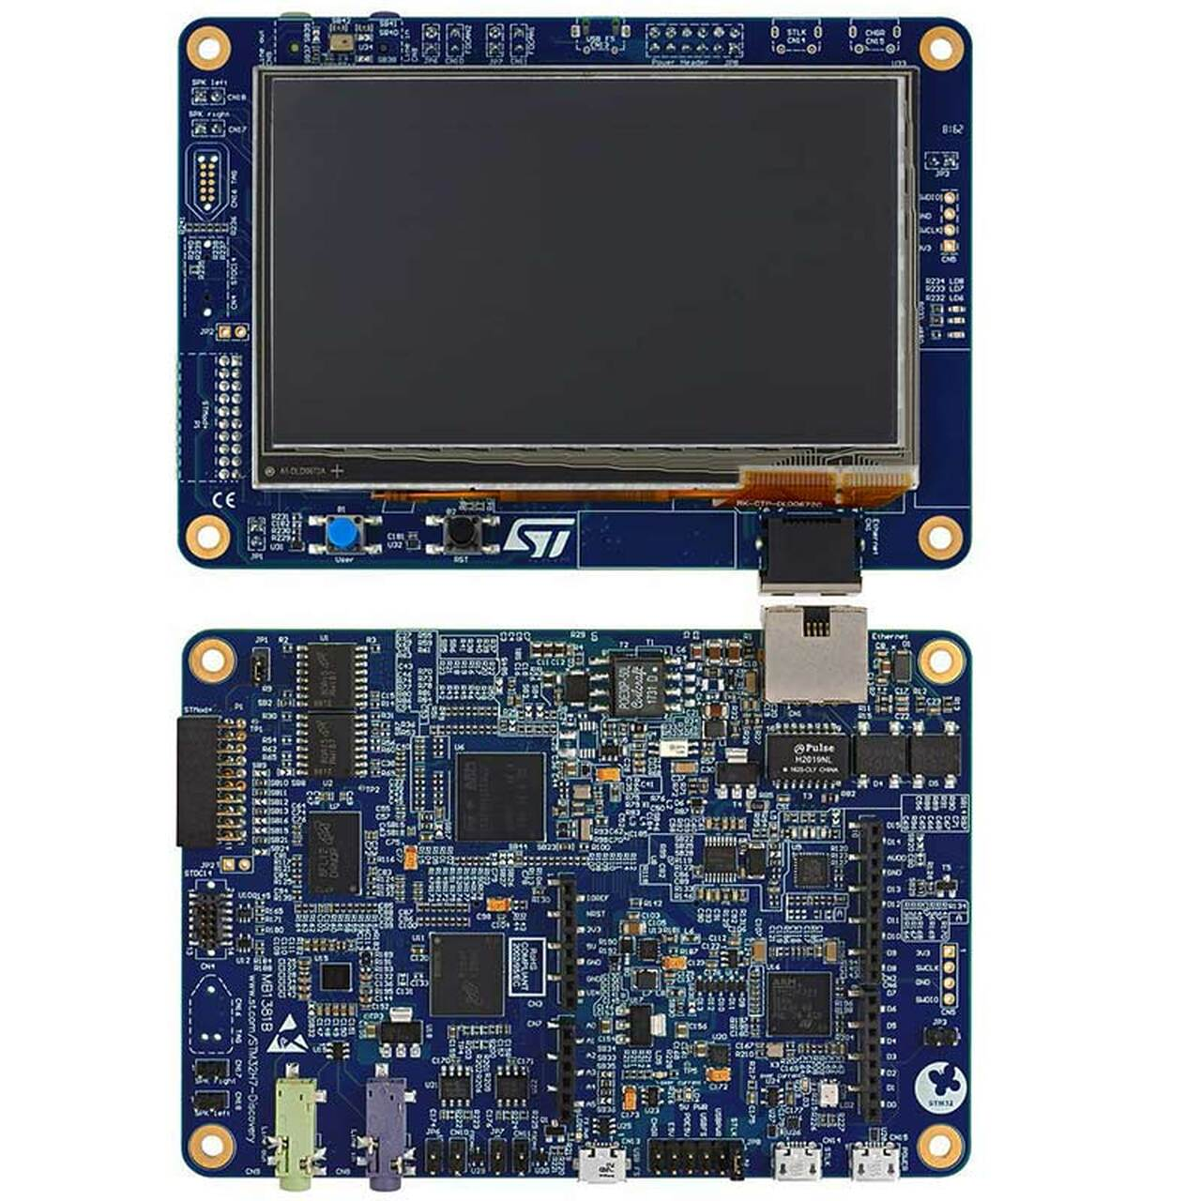
Stm32
STM32 is the family of microcontrollers produced by STMicroelectronics. They are widely used in many of IoT applications and have a perspective as a core part of mist computing.
X-CUBE-AI is the extension package that allows one to embed and use neural networks on STM32 microcontrollers. This extension provides the possibility to automatically transform pre-trained neural networks with the subsequent integration into the user's project even with limited hardware resources.
https://www.st.com/content/st_com/en.html

Slide 15
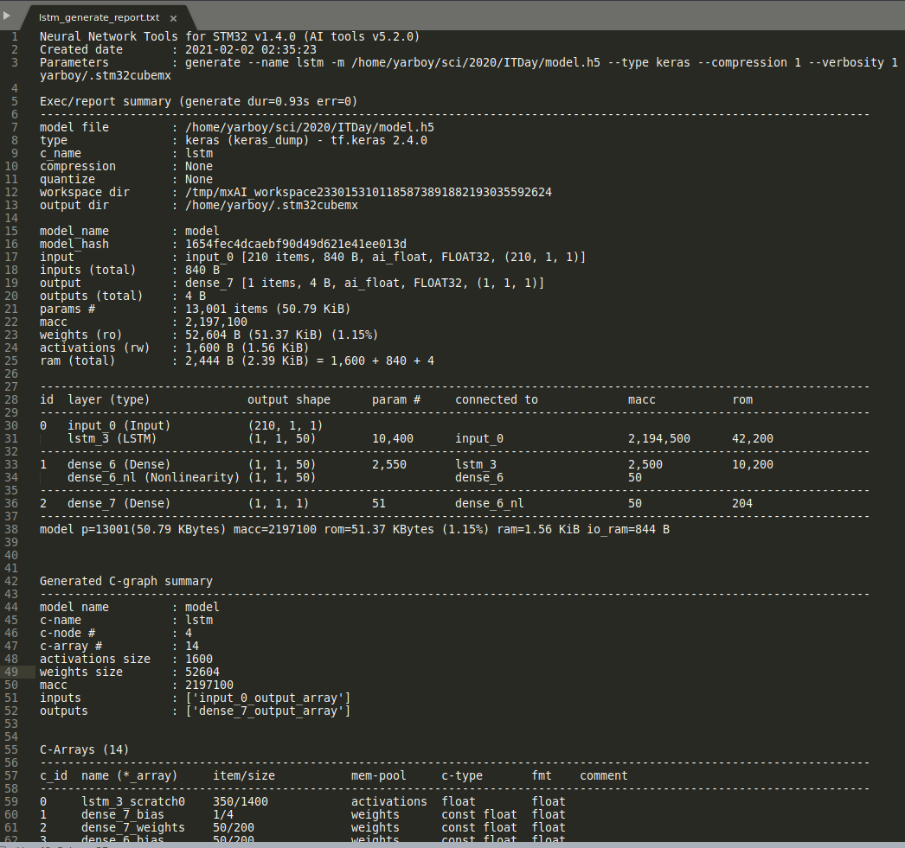
Stm32. Preparation and deployment
Trained model -> .h5.
STM32CubeIDE + X-CUBE-AI should be installed.
X-CUBE-AI is integrated with STM32CubeMX, which allows to import and configure model. STM32CubeMX generates code for validation/inference. All weights are converted into C/C++ arrays.

Slide 16
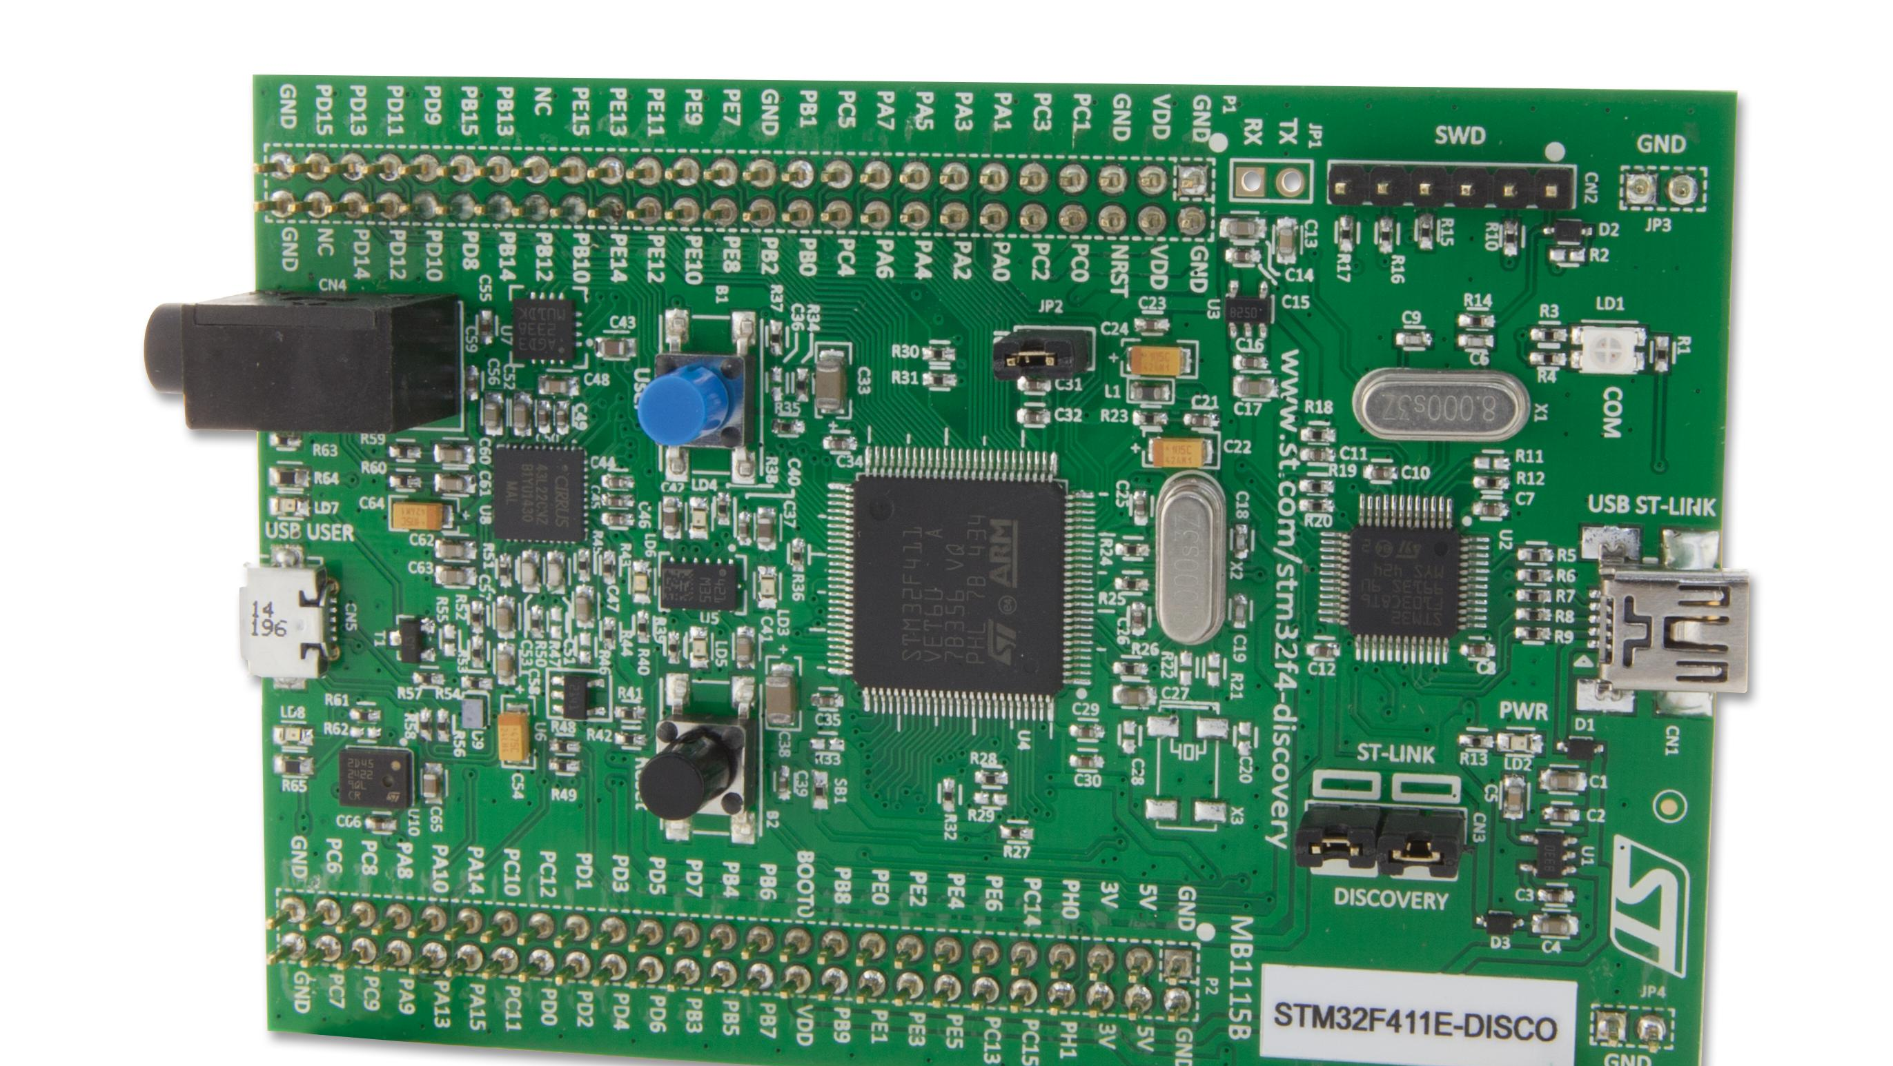
STM3232F411E DISCOVERY
STM32F411VET6 microcontroller featuring 512 Kbytes of Flash memory and 128 Kbytes of RAM in an LQFP100 package.
USB OTG FS.
ST MEMS 3-axis digital output gyroscope.
ST MEMS 3D digital linear accelerometer and magnetic sensor.
ST MEMS digital microphone.
Audio DAC with integrated class‑D speaker driver.
Eight LEDs:
LD1 (red/green) for USB communication
LD2 (red) for 3.3 V power on
Four user LEDs: LD3 (orange), LD4 (green), LD5 (red) and LD6 (blue)
Two USB OTG LEDs: LD7 (green) V_{BUS} and LD8 (red) over-current.

Slide 17

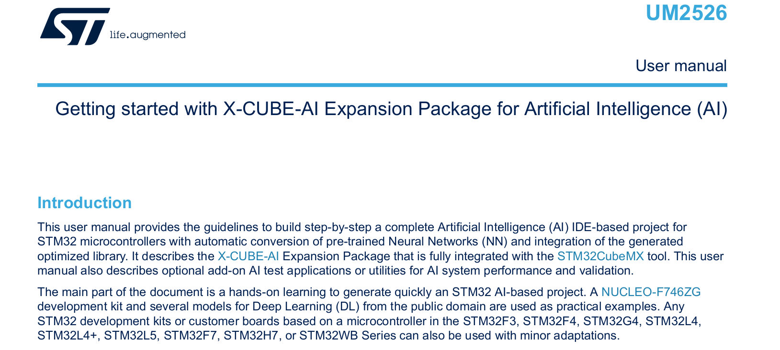
X-CUBE-AI
Generation of an STM32-optimized library from pre-trained Neural Network models.
Native support of various Deep Learning frameworks such as Keras, TensorFlow Lite, Caffe, ConvNetJs and Lasagne, and suppport of all frameworks that can export to the ONNX standard format such as PyTorch, Microsoft Cognitive Toolkit, MATLAB and more.
Supports 8-bit quantization of Keras networks and TensorFlow™ Lite quantized networks.
Allows the use of larger networks by storing weights in external Flash memory and activation buffers in external RAM.
Easy portability across different STM32 microcontroller series through STM32Cube integration.
Free, user-friendly license terms.

Slide 18
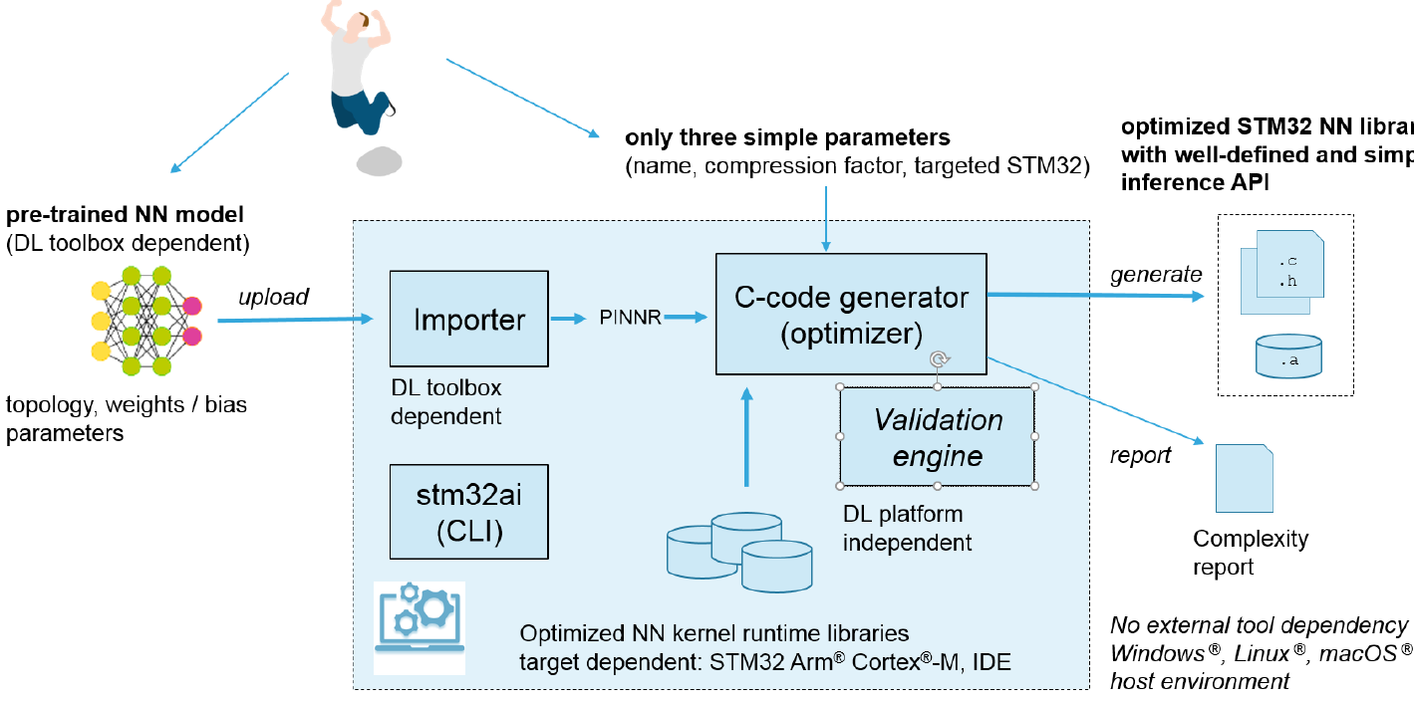
X-CUBE-AI core engine

Slide 19
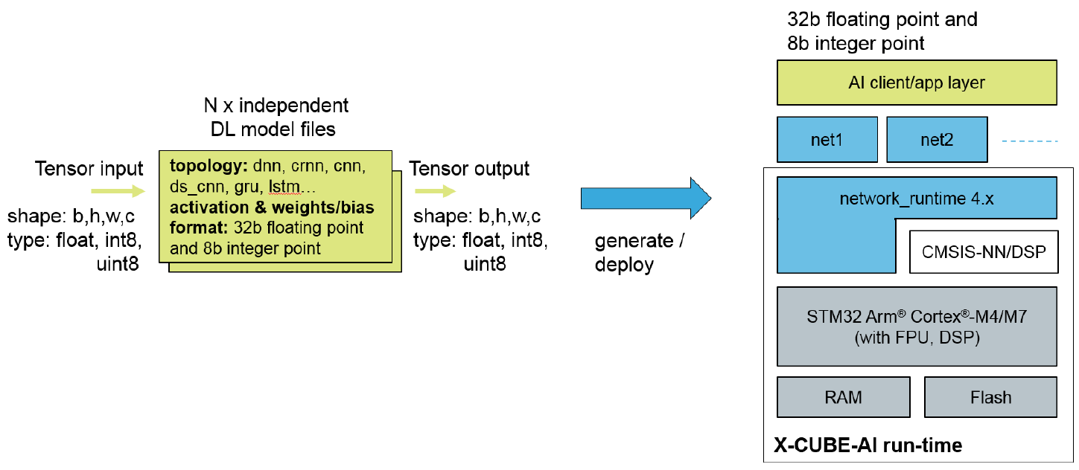
main supported features

Slide 20
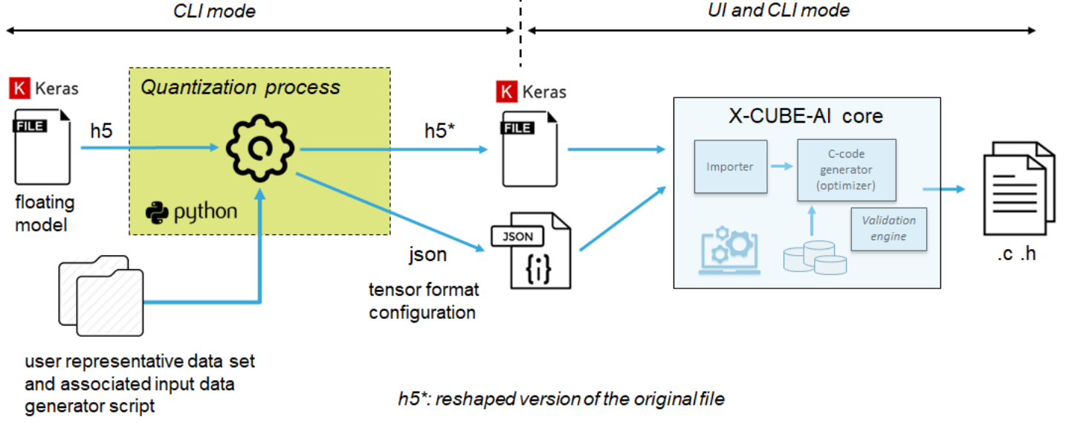
Quantization flow

Slide 21
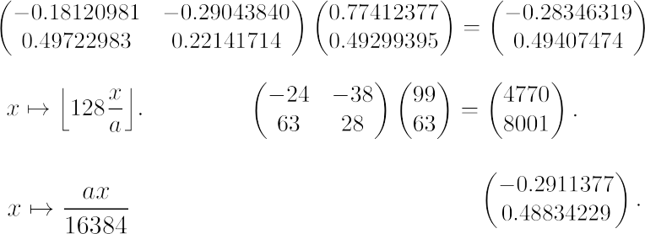
Simple quantization example

Slide 22
Conclusions and future work
Nowadays it is possible to develop good performance deep learning models on the edge (mist) devices.
STM32 latest microcontrollers allow to run deep learning models in inference phase.
It is necessary to conduct the research in 'deep learning on the edge':
Transformer's optimization;
Swarm AI;
Reinforcement learning;
Nature inspired metaheuristics;
Edge parallel computing.
TO DO:
Implement different models and compare them.
Investigate hyperparameters optimization via swarm approaches.
Enhance model logic: anomaly detection, PID controller prediction etc.

Slide 23
Thank you for attention!
Q&A

