Slide 1

Floating Point Arithmetics + Posits (Part 1)
by Uğur Çayoğlu 05. February 2020
STEINBUCH CENTRE FOR COMPUTING (SCC) & INSTITUTE FOR METEOROLOGY AND CLIMATE RESEARCH (IMK-ASF)
KIT - The Research University in the Helmholtz Association
www.kit.edu

Slide 2

Agenda
Floating Point Arithmetics (Part 1)
Posits (Part 2)
STEINBUCH CENTRE FOR COMPUTING (SCC) INSTITUTE FOR METEOROLOGY AND CLIMATE RESEARCH (IMK-ASF)
4th PhD Progress Meeting

Slide 3
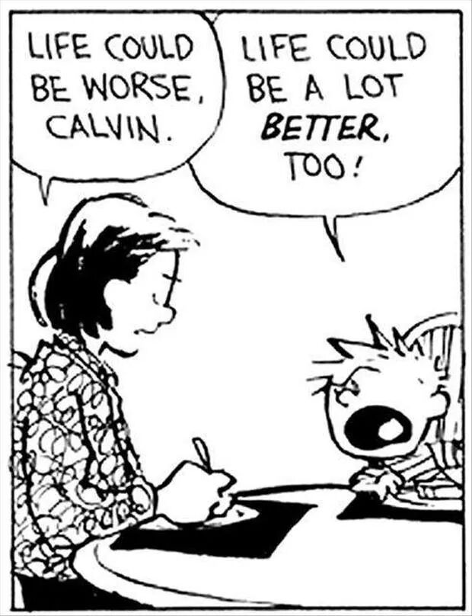
Take-home message of today!
0.1 + 0.2 != 0.3
The correct answer is not of interest
Accept life and get over it!
“If life gives you lemons, …”
Be consistent and repeat mistakes!
Repeat mistakes within one build, across multiple builds, and across multiple platforms
Source_1
STEINBUCH CENTRE FOR COMPUTING (SCC) INSTITUTE FOR METEOROLOGY AND CLIMATE RESEARCH (IMK-ASF)
Ugur Cayoglu

Slide 4
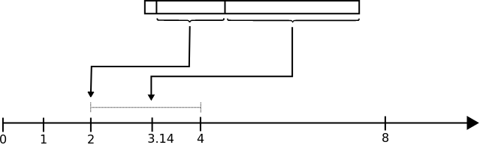
Structure and Format of Floating-Point Data
Sign (1) + Exponent (8) + Mantissa (23) = IEEE Floating-Point Data (32)
Sign = Negative/Positive
Exponent = Power of two
Mantissa = Fraction (1/2^23 = 1/8,388,608 = eps)
x = (-1)^s * 2^(exp-127) * (1+f)
Source_2
STEINBUCH CENTRE FOR COMPUTING (SCC) INSTITUTE FOR METEOROLOGY AND CLIMATE RESEARCH (IMK-ASF)
Ugur Cayoglu

Slide 5
Some Weird Properties of Floating-Point Data
There are some special values (i.e. denormals):
+infinite, -infinite,
+zero, -zero,
NaN (there are actually 16,777,216 NaN values (2 * mantissa))
Source_2
STEINBUCH CENTRE FOR COMPUTING (SCC) INSTITUTE FOR METEOROLOGY AND CLIMATE RESEARCH (IMK-ASF)
Ugur Cayoglu

Slide 6
Guarantees while using Floating-Point Arithmetics
These operations are determined and will produce reproducible results…
Addition
Subtraction
Division
Multiplication
Square root computation
… if we use the same rounding mode, same inputs, same global settings and same destination precision
STEINBUCH CENTRE FOR COMPUTING (SCC) INSTITUTE FOR METEOROLOGY AND CLIMATE RESEARCH (IMK-ASF)
Ugur Cayoglu

Slide 7
A Set of Problems Ordered by Your Likelihood of Experiencing it
Rounding modes
Composition
Per processor code
Precision modes
Denormals
Compiler differences / uninitialised data / transcendentals / square root estimates / conversions
Please check the trusted documentation of your programming language and compiler of choice for possibilities to prevent these problems
STEINBUCH CENTRE FOR COMPUTING (SCC) INSTITUTE FOR METEOROLOGY AND CLIMATE RESEARCH (IMK-ASF)
Ugur Cayoglu

Slide 8
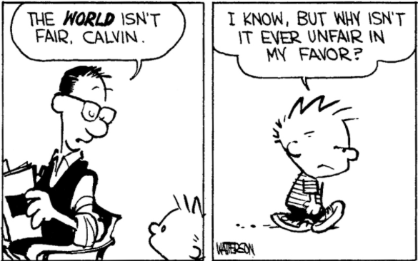
Please check your code before you blame floating point arithmetics…
Check your algorithms and data structures before you blame floating point arithmetics about missing determinism
Random number generator working properly?
Flexible timing with thread scheduling?
Simulation time variable?
Code with undefined behaviour?
Source_3
STEINBUCH CENTRE FOR COMPUTING (SCC) INSTITUTE FOR METEOROLOGY AND CLIMATE RESEARCH (IMK-ASF)
Ugur Cayoglu

Slide 9
Five Rounding modes
Rounding mode for values in between two floating point values
Runtime check necessary
Thread bound
C/C++: #include <fenv.h>
 | 11.5 | 12.5 | - 11.5 | - 12.5
TO_NEAREST_EVEN | 12 | 12 | -12 | -12
TO_NEAREST_AWAY_ZERO | 12 | 13 | -12 | -13
TOWARD_ZERO | 11 | 12 | -11 | -12
PLUS_INFINITY | 12 | 13 | -11 | -12
MINUS_INFINITY | 11 | 12 | -12 | -13
STEINBUCH CENTRE FOR COMPUTING (SCC) INSTITUTE FOR METEOROLOGY AND CLIMATE RESEARCH (IMK-ASF)
Ugur Cayoglu

Slide 10
Composition
Optimization error
Reordering of operations based on register/cache availability
Throughput vs precision
Use parenthesis for operation ordering
C/C++: fp/fast vs fp/precise
a + b + c = ?
a + (b + c) != (a + b) + c
STEINBUCH CENTRE FOR COMPUTING (SCC) INSTITUTE FOR METEOROLOGY AND CLIMATE RESEARCH (IMK-ASF)
Ugur Cayoglu

Slide 11
Precision Modes
Different precisions for intermediate representations
In most common architectures (i.e. Intel, AMD) this is 24-, 53-, 64-bit for representing mantissa
Depends on the feature set one uses
C78: Floats are doubles where fraction part is filled with zeros
C++98: Only if one of the operands is a double
C99: “Evaluation type may be wider than semantic type”
… basically it is up to the compiler and the compilation flags used.
STEINBUCH CENTRE FOR COMPUTING (SCC) INSTITUTE FOR METEOROLOGY AND CLIMATE RESEARCH (IMK-ASF)
Ugur Cayoglu

Slide 12
Per processor code
Depending on the feature optimizations available the results might differ
SSE = 32bit intermediate precision
SSE2 = 64bit intermediate precision
Special instructions
i.e. fmadd
fmadd(a,b,c) = a * b + c
a * b + c * d = ?
t = c * d
fmadd(a,b,t) != a * b + c * d
STEINBUCH CENTRE FOR COMPUTING (SCC) INSTITUTE FOR METEOROLOGY AND CLIMATE RESEARCH (IMK-ASF)
Ugur Cayoglu

Slide 13
Denormals
Special values from 0 to 1
x = (-1)^s * 2^(exp-127) * (1+f)
Smallest possible value is for f = 0, exp = 1 (since exp=0 is +zero)
2^-126 = 1.175E-38 (realmin)
2^-126 * 2^-23 = 1.4013e-45 (eps*realmin)
All values between realmin and eps*realmin are called denormals
Computations between these values are not hardware supported
There is a flag to turn calculation of denormals off
All values below realmin will be set to 0
Turn off if you want speed up, but results will change (> better don’t)
STEINBUCH CENTRE FOR COMPUTING (SCC) INSTITUTE FOR METEOROLOGY AND CLIMATE RESEARCH (IMK-ASF)
Ugur Cayoglu

Slide 14
Compiler differences / transcendentals / square root estimates / conversions
Compile time/Runtime calculations (e.g. sin, tan, cos)
Compiler: gcc, clang, visual c++, ...
Square root estimates
There are square root estimates that are implemented by hardware manufacturers (rcpss, rcpps, rsqrtps, rsqrtss)
Transcendentals like sin, cos, tan, pi, e can be hardware supported and might differ based on manufacturer
Conversions e.g. printing commands might differ in output depending on operation order
STEINBUCH CENTRE FOR COMPUTING (SCC) INSTITUTE FOR METEOROLOGY AND CLIMATE RESEARCH (IMK-ASF)
Ugur Cayoglu

Slide 15
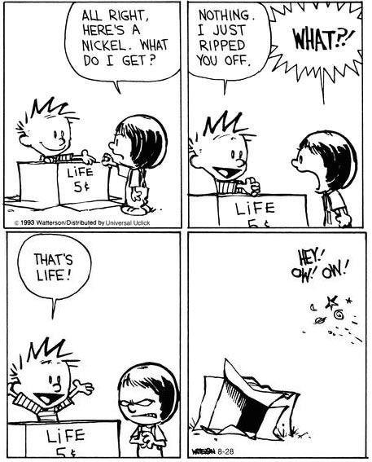
That’s all folks. Thank you…
https://0.30000000000000004.com/
Source_4
STEINBUCH CENTRE FOR COMPUTING (SCC) INSTITUTE FOR METEOROLOGY AND CLIMATE RESEARCH (IMK-ASF)
Ugur Cayoglu

Slide 16
Resources
Main source for presentation: http://randomascii.wordpress.com
What Every Computer Scientist Should Know About Floating-Point Arithmetic https://docs.oracle.com/cd/E19957-01/806-3568/ncg_goldberg.html
Float Converter https://www.h-schmidt.net/FloatConverter/IEEE754.html
Pics:
https://i.imgur.com/SgnwoIn.jpg
https://fabiensanglard.net/floating_point_visually_explained/floating_point_window_pi.svg
https://static.inspiremore.com/wp-content/uploads/2017/01/24092529/Screen-Shot-2017-01-24-at-3.10.33-PM.png
https://twitter.com/calvinn_hobbes/status/528720685771026432
STEINBUCH CENTRE FOR COMPUTING (SCC) INSTITUTE FOR METEOROLOGY AND CLIMATE RESEARCH (IMK-ASF)
Ugur Cayoglu

