Slide 1


Introducing Brussels United FC
More than a club

Slide 2

The Players
Player Name | Player Name
L. Messi | Isco
L. Suárez | J. Rodríguez
L. Modrić | Sergio Busquets
Cristiano Ronaldo | S. Agüero
Sergio Ramos | Neymar Jr
T. Kroos | David Silva
G. Bale | Casemiro
K. De Bruyne | Marcelo
E. Hazard | P. Aubameyang
Coutinho | I. Rakitić

Slide 3
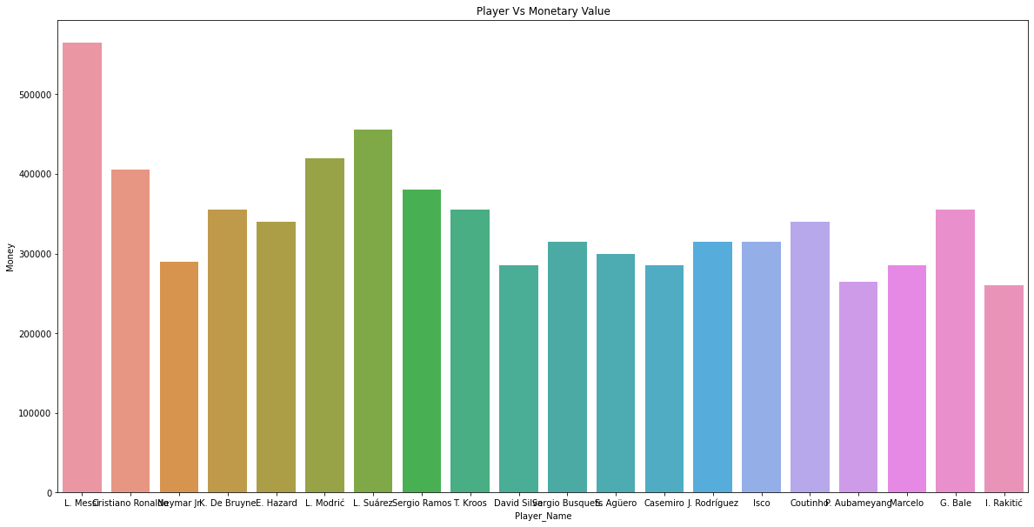
Player Vs Money
As inferred from the graph we can conclude that the total expenditure for building the ultimate team with the special players in each of their forte will be 6885000.

Slide 4
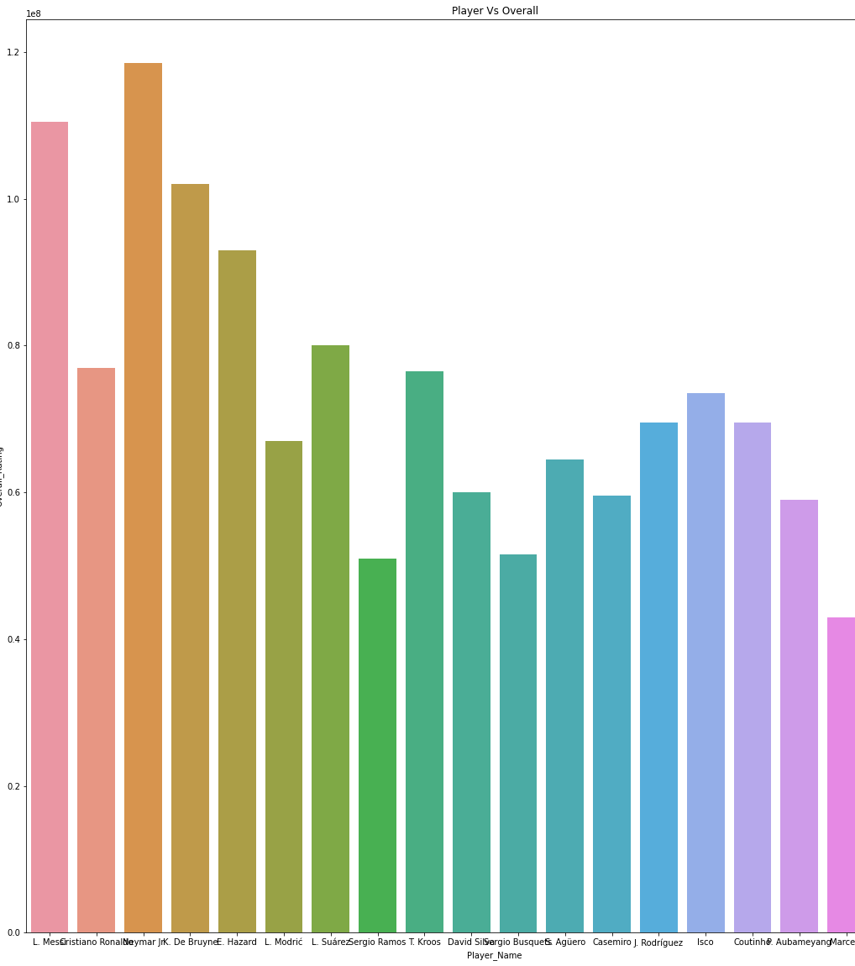
Winning Probability
With the players with the best overall which cannot be outplayed by anyone the winning possibility is almost equal to 100%

Slide 5

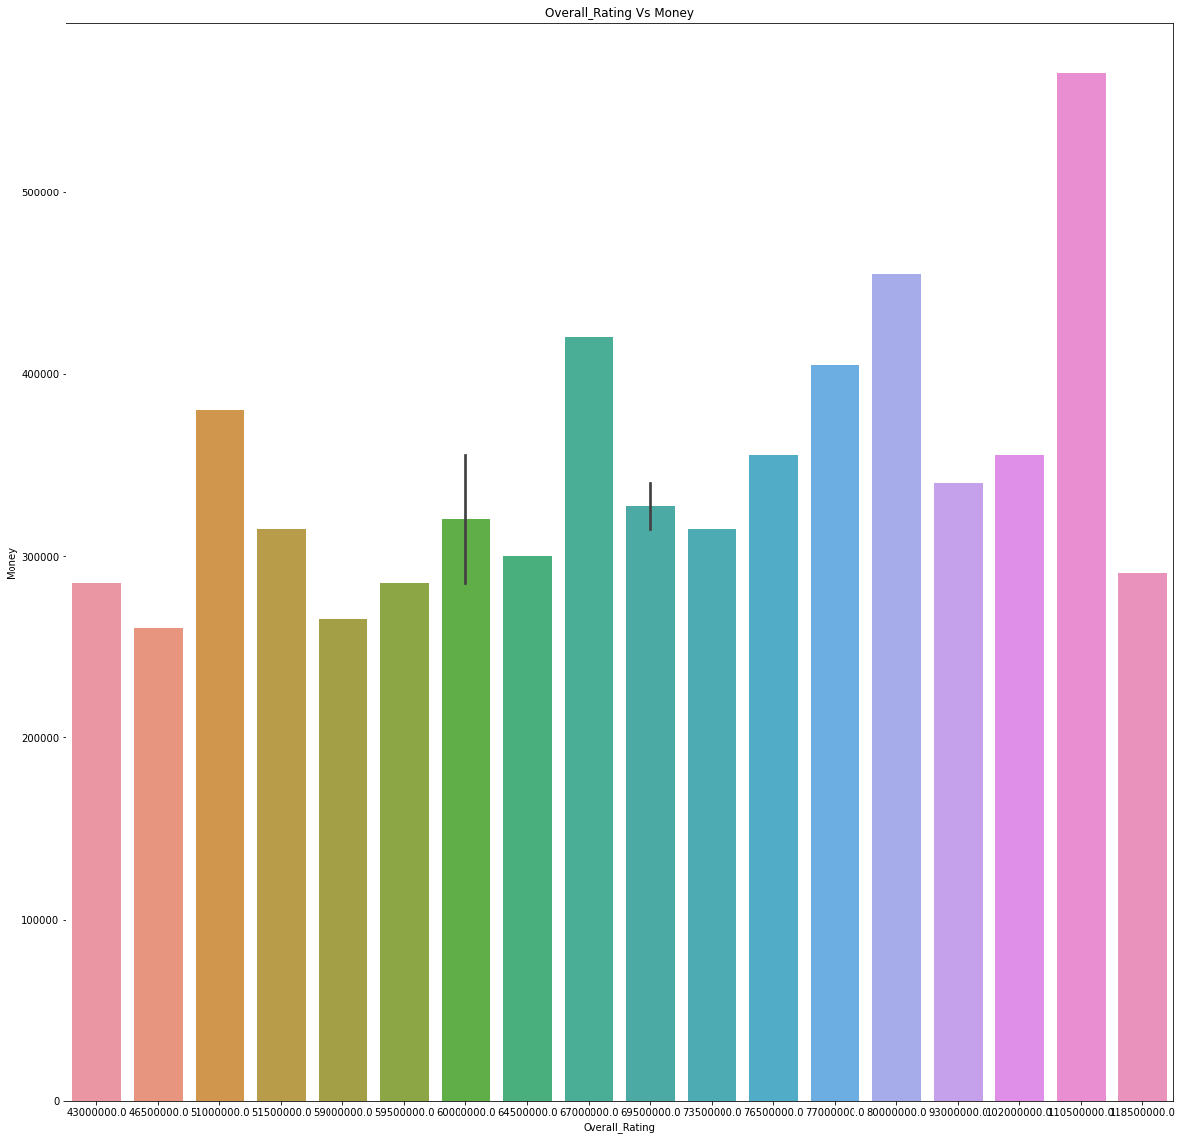
Overall VS Monetary Value

