Slide 1
PROJECT TITLE: Secure data hiding in images using steganography
CAPSTONE PROJECT
Presented By: Udit Sharma
Student Name : Udit Sharma
College Name & Department : Amity University Noida

Slide 2
OUTLINE
Problem Statement
Technology used
Wow factor
End users
Result
Conclusion
Git-hub Link
Future scope

Slide 3
Problem Statement
The Increasing reliance on digital Communication has created a growing needs for methods that not only secure information but also ensure its transmission remains undetected. As cyber threats is increasing day by day. We have to adapt (Secure) our message in such a way that no body except (Receiver) can read it. This project seeks to address this challenge by developing a steganography based solution. By utilizing LSB encoding , this project aims to create a tool capable of embedding a secret messages within images, email, text, audio and video.

Slide 4
Technology used
Python 3x- Main Programming Language
Open Cv- Image Processing and Evaluation
Bitwise Operations- LSB Encoding and extraction
File Handling – Read/Write Encrypted Messages.

Slide 5
Wow factors
Passcode Protection : Only authorised user can access it
Data in Image: How Private Data/Message is hidden in Image That no one can see it. Brilliant work.
Run on multi factors : Works on windows, Linux and MacOS.
LSB Encoding : Use LSB encoding to hide message that is helpful tool for protection of image as we saw that how MSB bit can destroy/Corrupt whole image

Slide 6
End users
Cyber Security People: Cyber Security People are end users which can learn steganography and implement it in their work.
Everyday Users: Who sends data on bulk. They can learn and adopt these technologies.
Corporate Organization : Used for securing confidential Businesses.
Hackers & Criminals: Helps in securing data Privately without detection.
Individuals : Can be used for sending messages privately.

Slide 7
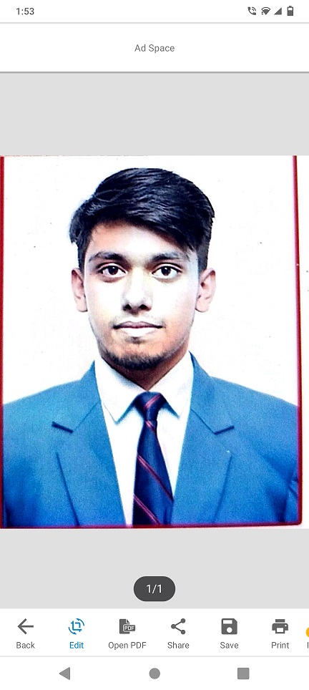
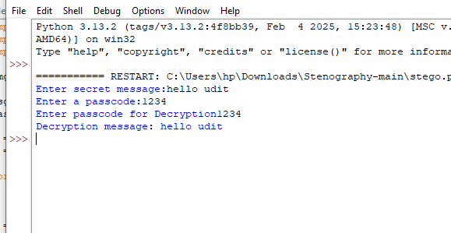
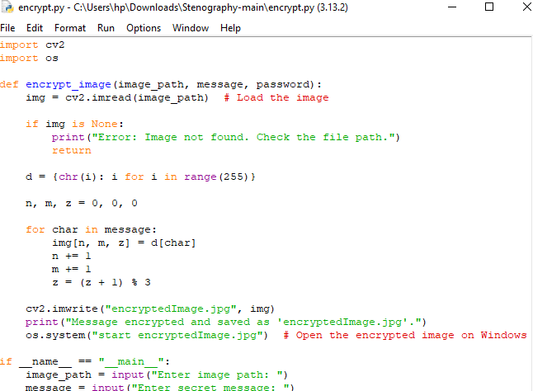
Results

Slide 8
Conclusion
Steganography provides simple yet powerful way to conceal sensitive messages within images using LSB steganography. This method enhances data security and privacy , ensuring that secret communications remains undetected.

Slide 9
GitHub Link
https://github.com/ud30/ud_project.git

Slide 10
Future scope(optional)
Support for audio & Video : Extending the project to embed data in audio/video files.
GUI based Implementation : Creating a user friendly interface for non-technical users.
Mobile App Version : Developing an Android/ios application for on –the- go usage.

Slide 11
THANK YOU

