Slide 1
CSR Auditing Application
Product Demo & Application Walkthrough
Functional MVP demonstration — quarterly CSR & Quarter Close checklists, governed end to end
Interactive demo — illustrative data
October 2026
Notes:
Welcome. Today: a working demonstration of the CSR Auditing Application — the replacement for the Excel/SharePoint quarterly checklist process. Everything shown is interactive; the content on screen is your own 2021-3Q checklist material.

Slide 2
From spreadsheets to a governed workflow
Today
With the CSR Auditing Application
Chasing checklists by e-mail, opening each file to see progress
→
One worklist: status, due dates and progress for every checklist, live
Incomplete checklists discovered at review time
→
Submission is blocked until every requirement is met — itemized, fixable on the spot
Sign-off via spreadsheet macro and screenshots
→
Electronic signature with server timestamp; the record locks permanently
Evidence scattered across SharePoint folders
→
Files attach to the exact procedure they prove — exportable for Canvas / Optro
Every submission read manually, cold
→
AI pre-review flags weak responses for the reviewer — advisory, never blocking
Annual question update = a new spreadsheet template
→
Versioned question catalog with a governed draft-and-release cycle
Notes:
Each pain from the requirements meeting, and what replaces it. These six are the demo's storyline.

Slide 3
The application at a glance
Analyst
Reviewer
Administrator
Auditor
Completes assigned checklists, attaches evidence, signs & submits
Reviews submissions with AI support; returns or completes
Generates each quarter, reassigns, maintains the question catalog
Read-only access to completed, locked records and evidence
Checklist lifecycle — status can only move along these paths, enforced by the server
Not Started
→
In Progress
→
Submitted
→
Under Review
→
Completed
Returned
← back to the analyst with mandatory notes — fixed and resubmitted
Signed & locked
Versioned questions
AI is advisory
Submission = electronic signature (user + server timestamp). Completed checklists are immutable audit records.
Each quarter binds a released catalog version — history stays answerable against exactly the questions asked.
Flags direct reviewer attention. Nothing is auto-approved; nothing is ever blocked by AI.
Notes:
Four roles, one lifecycle. The three principles at the bottom are the compliance guarantees — worth saying out loud before showing screens.

Slide 4
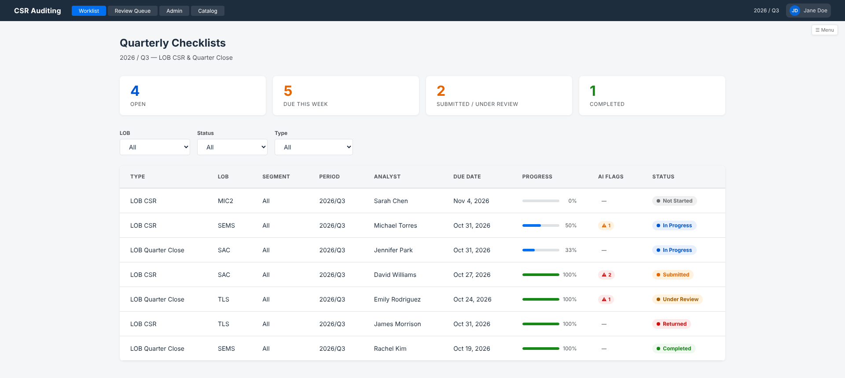
Worklist — every checklist, one screen
1
1
Navigation — work areas by role: Worklist, Review Queue, Admin, Catalog
2
2
KPI strip — open / due this week / submitted / completed — live counts
3
4
5
6
7
3
Filters — LOB → Market Segment (cascading) and status
4
Checklist rows — type, scope, period, analyst, due date
5
Progress — completion per checklist, computed from its procedures
6
AI flags — advisory findings already waiting for the reviewer
7
Status — always text + color — the five lifecycle states
Notes:
The analyst's home. Point out: due dates and progress visible without opening anything — this is the end of checking spreadsheets one by one. Click the In Progress row to open it.

Slide 5
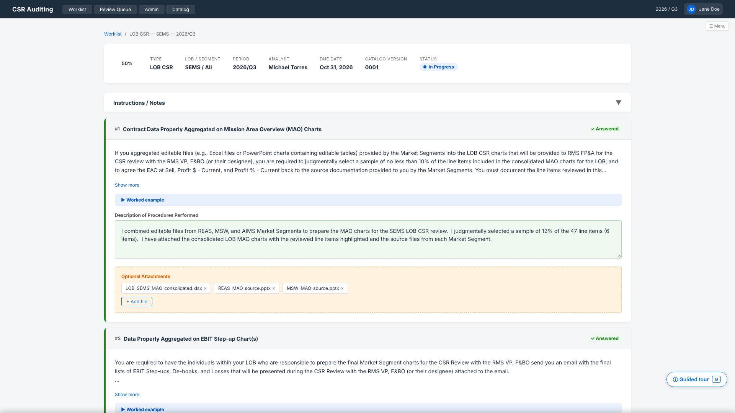
Checklist detail — the procedure card
1
Header — scope, period, analyst, due date, bound catalog version, progress
1
2
Instructions / Notes — the template's guidance — expanded on first open
2
3
3
Procedure card — one per audit procedure, numbered, with completion state
4
4
Requirement — full template text, collapsed to 3 lines — “Show more” expands
5
6
5
Worked example — the template's example column, one click away
7
6
Response (green) — “Description of Procedures Performed” — autosaves as you type
7
Evidence (yellow) — files attached to this exact procedure; “Required” vs “Optional”
Notes:
The heart of the application. The card IS the template row — green response cell, yellow attachment cell, same colors analysts already know. Requirement texts are word-for-word from the 2021-3Q template.

Slide 6
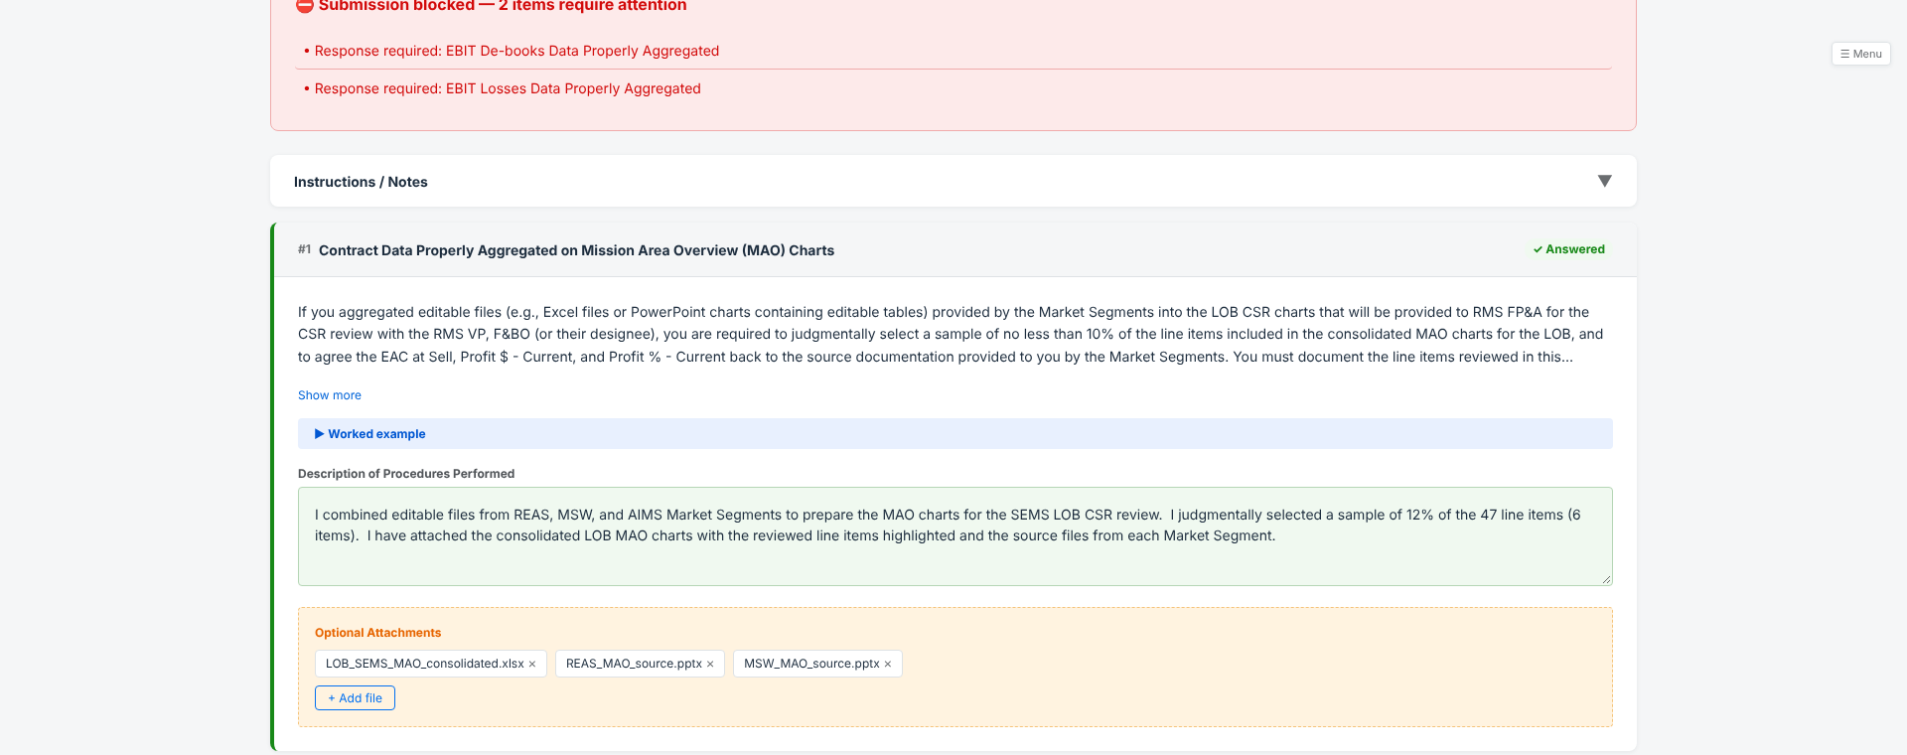
Nothing incomplete gets through
Sign & Submit validates everything
Every unmet requirement listed at once — not one at a time
Each entry clicks through to its procedure card
A response, a permitted N/A, or required evidence clears it
The server enforces the same rules — the UI can never bypass them
The pain this kills: incomplete checklists discovered at review time. Here they are caught at the moment of submission, with the fix one click away.
Notes:
Live demo beat 1: click Sign & Submit with two procedures still open — the itemized panel appears. Click an entry, it scrolls to the card. Fill it, submit again.

Slide 7
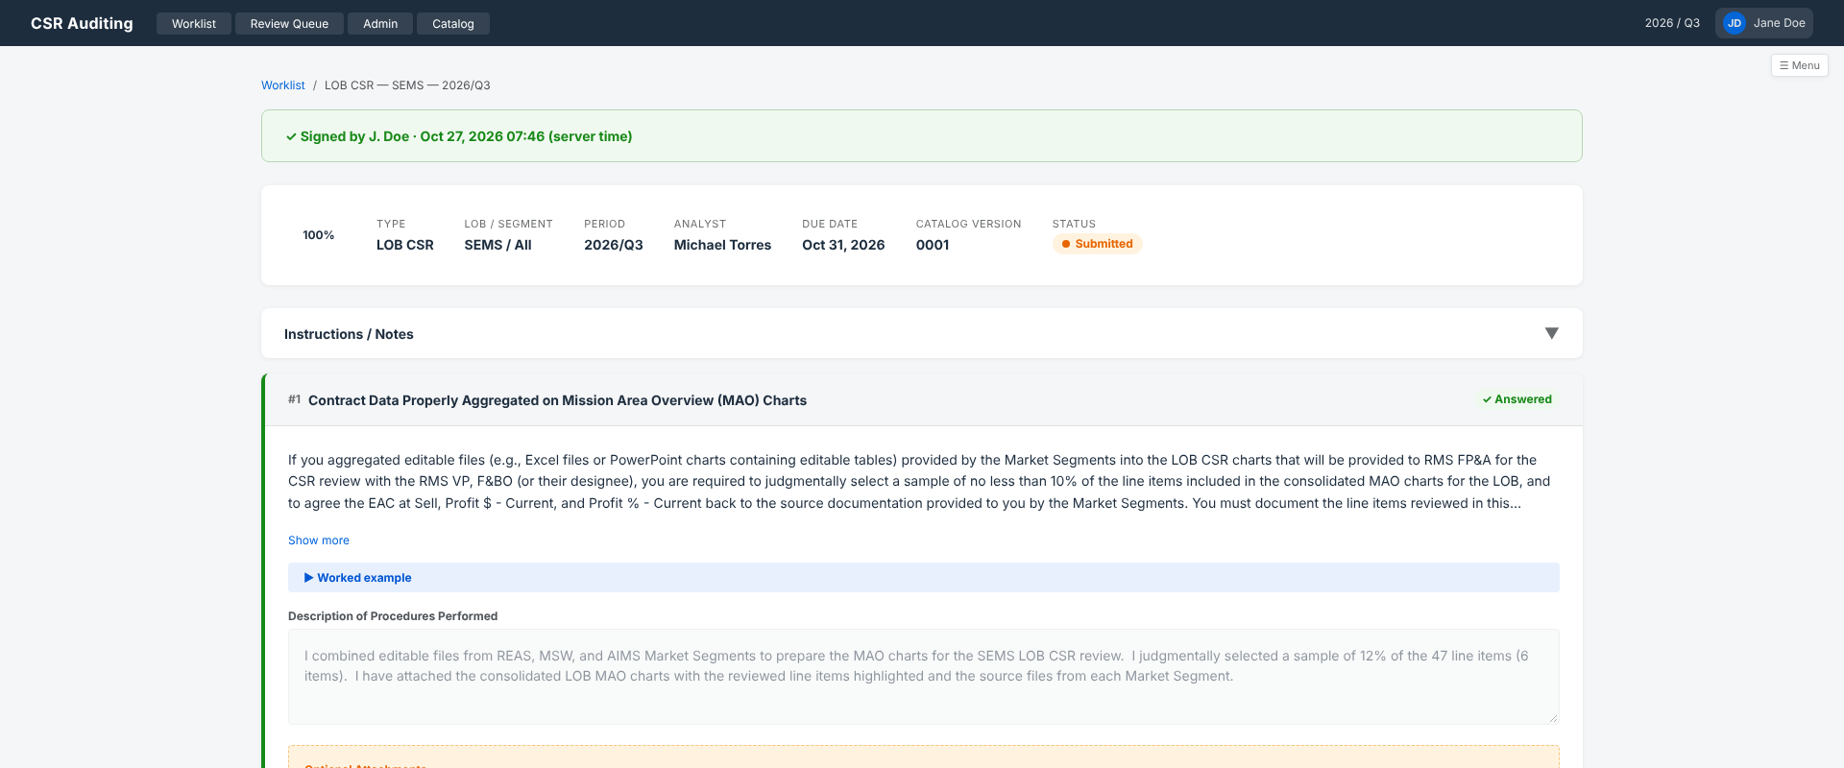
Signed, time-stamped, locked
Electronic signature
User + server timestamp recorded at submission — replaces the spreadsheet signing macro
Form locks
Responses and evidence become read-only the moment it’s signed
Audit record
Once review completes, the checklist is immutable — the evidence package for Canvas / Optro
Notes:
The green banner is the signature: who, and exactly when, server time. Status is Submitted; everything is read-only. This record is now on its way to review.

Slide 8
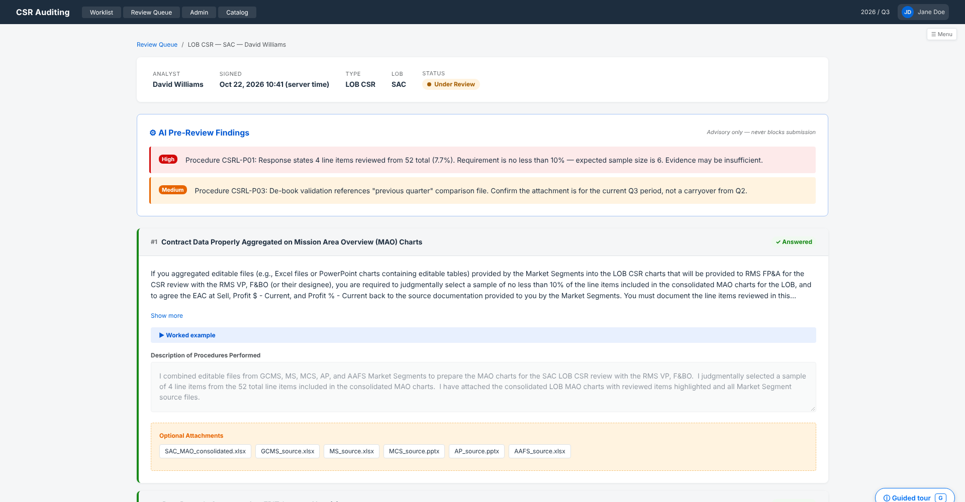
Review — with AI doing the first read
1
Signed submission — who signed and when — the reviewer sees the sealed record
1
2
AI pre-review findings — each flag cites its procedure and the gap it sees — e.g. a 7.7% sample against a 10% requirement
4
2
3
3
Severity — High / Medium / Low — the queue sorts by it, worst first
4
Advisory only — stated on the panel: flags never block, nothing auto-approves
The decision: Complete Review — or Return to Analyst with mandatory notes, shown to the analyst as a banner on reopening.
Notes:
Live demo beat 2. The AI has read the submission against the requirements: it caught a sample-size miss. The reviewer decides — return with notes, or complete. Show the return loop: notes are mandatory, the analyst sees them in a banner.

Slide 9
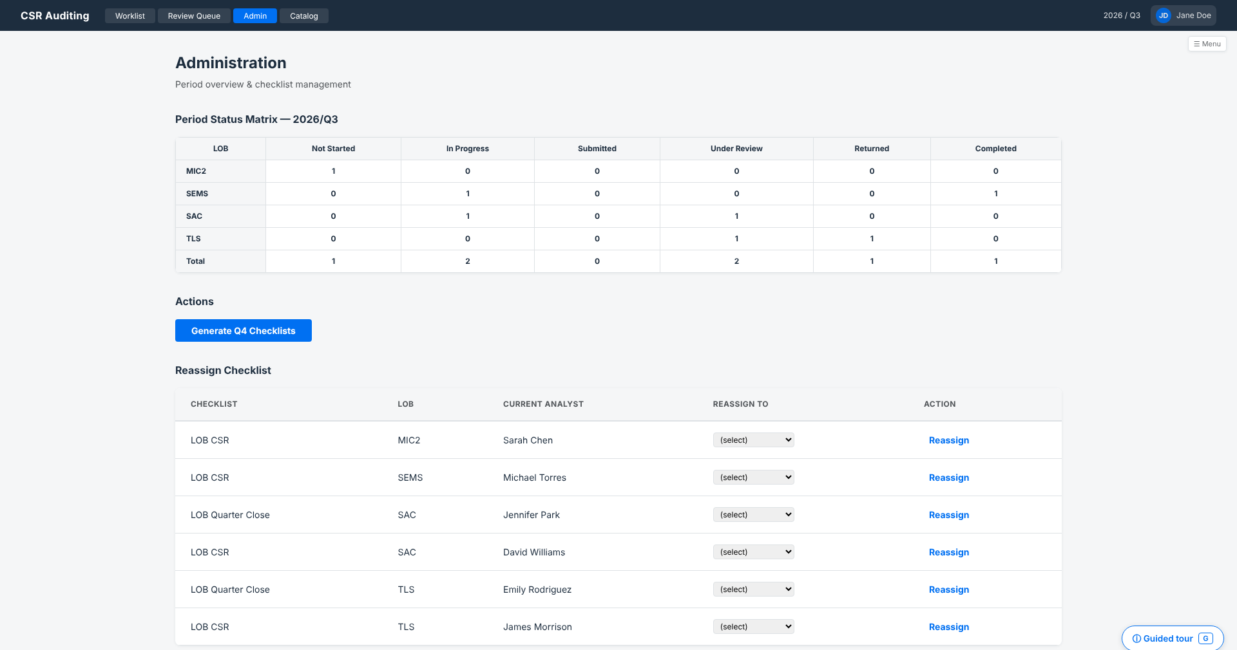
Administration — the quarter at a glance
Status matrix
Every checklist, every LOB, every status — the chasing work, replaced by a glance
Generate next quarter
One action creates Q4’s checklists from the released catalog, pre-assigned
Reassign
Analyst unavailable at close? Move the checklist; work and history stay intact
Notes:
Ray's screen. The matrix is the whole quarter; generation and reassignment are single actions instead of file-copying rituals.

Slide 10
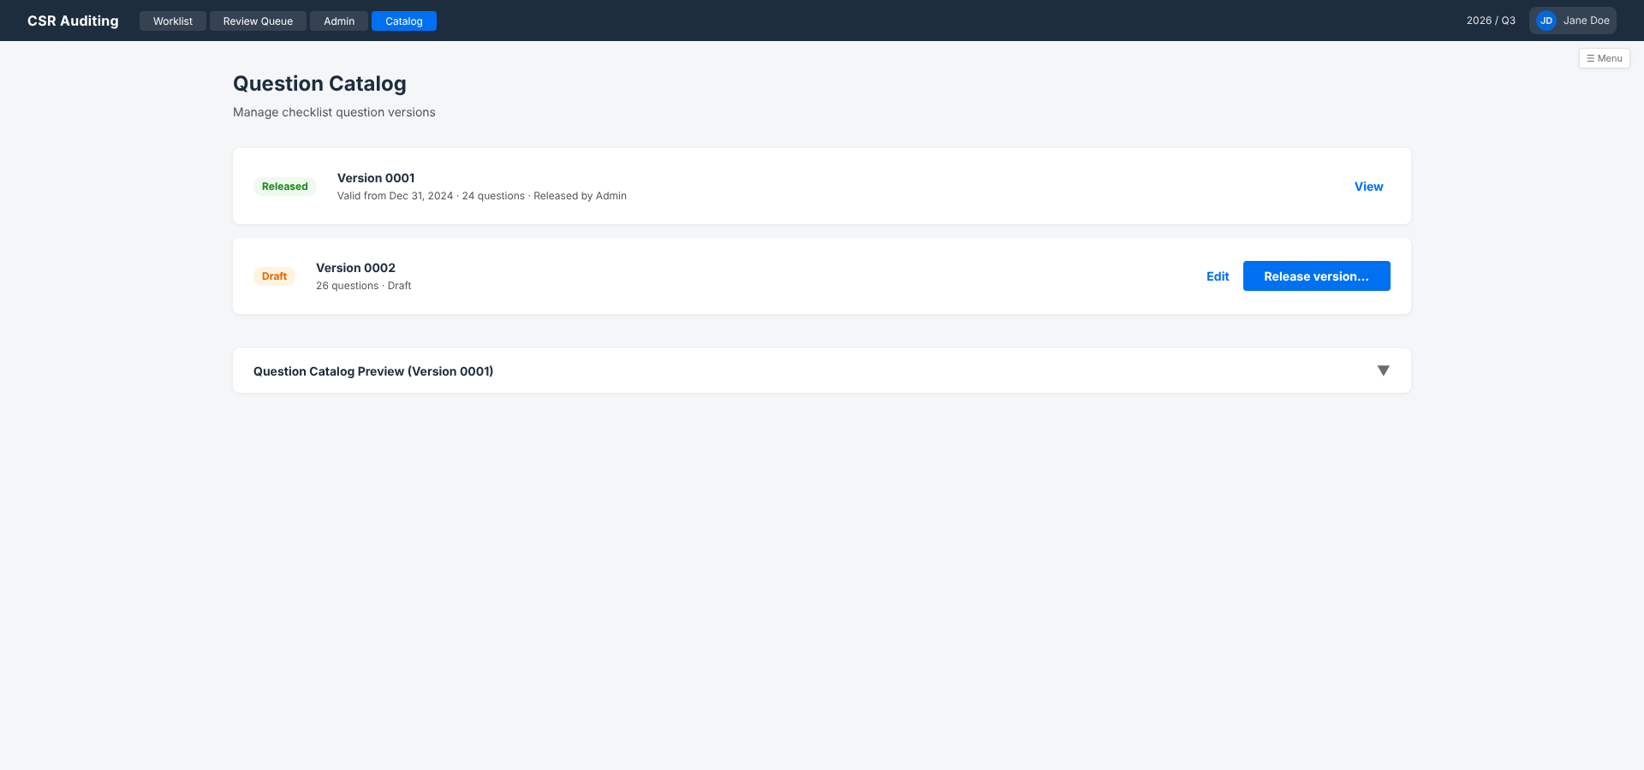
The annual question update, governed
Released = frozen
Historical checklists stay answerable against exactly the questions they were asked.
Draft = safe
Audit-driven edits happen in a copy; nothing live changes.
Release = the switch
A valid-from date; next quarter generates from the new version automatically.
Notes:
The yearly 'new template' exercise becomes: copy, edit the draft, release with a date. Version 0001 stays frozen forever — that's the audit guarantee.

Slide 11
A quarter in the life of an analyst
1
Open
2
Read
3
Work each procedure
Your checklist appears in the Worklist when the quarter is generated — reminder e-mails deep-link straight to it
Instructions / Notes panel first — the guidance that used to hide on another tab
Describe what you performed in the green field, or mark N/A where permitted; attach evidence to the exact procedure
4
Autosave
5
Sign & Submit
6
If returned
Every pause saves the draft — leave and come back anytime
Anything incomplete is listed and clickable; when it’s clean, you sign electronically and the record locks
The reviewer’s notes greet you in a banner — fix, resubmit, done
Notes:
The analyst never learns 'an application' — they follow the checklist exactly as before, with the template's own colors, plus autosave and a safety net at submit.

Slide 12
Reviewer and administrator workflows
Reviewer — each quarter
Administrator — quarterly & yearly
1
Open the Review Queue — submissions sorted by AI flags, worst first
1
Generate the quarter — all checklists created from the released catalog, assigned
2
Open a checklist — it moves to Under Review — colleagues see it’s handled
2
Watch the matrix — chase by glance, reassign when someone’s out
3
Check findings & evidence — AI directs attention; the record tells the story
3
Yearly: draft the update — copy the catalog, apply audit feedback in the draft
4
Decide — Return with notes (analyst sees them) — or Complete: locked for audit
4
Release — set valid-from; next quarter uses the new version automatically
Notes:
Two rhythms: the reviewer's quarterly pass with AI triage, and the admin's quarter-generation plus the annual catalog release.

Slide 13
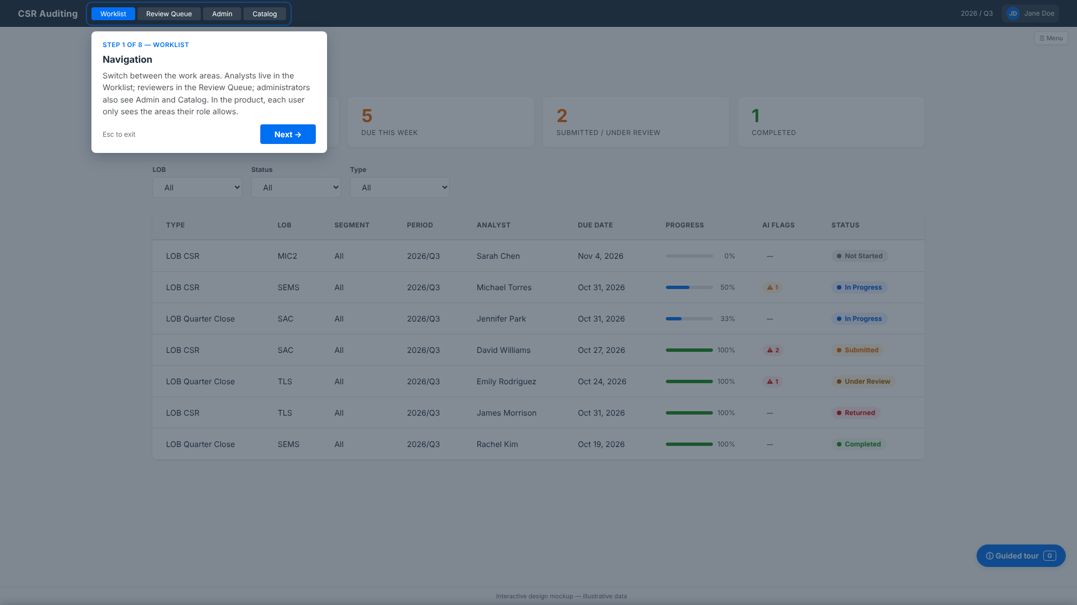
Built-in guided tour — the app explains itself
Launch with ?guide=1
A “Guided tour” button (or the G key) walks through the current screen, element by element
Spotlight + plain-language explanation for every control — the same wording as this walkthrough
Available on every screen: worklist, checklist, review, admin, catalog
Zero setup — ideal for stakeholders exploring the demo on their own, and a preview of in-app onboarding for rollout
Notes:
For anyone who wants to explore after the meeting: same demo, add ?guide=1 to the address — the app walks them through itself. No instructions document needed.

Slide 14
From demo to your MVP
Already real today
Acceptance unlocks
The backend is live on the development system: data model, validation, electronic signature, versioned catalog, AI triage pipeline
This demo’s screens mirror the production design 1:1 — what you accept is what gets built
Your checklist content is already loaded: the procedures you saw are the real 2021-3Q texts
Production UI build on SAP Fiori, phase-gated with working software at every step
Catalog maintenance app for the annual question update
Integration test on the live service, then UAT with your analysts
We need from you: acceptance of this design · the Market Segment checklist templates (to complete the question catalog) · a pilot group of analysts for UAT
Notes:
Close on the ask: design acceptance, the Market Segment templates, and a pilot group. The backend being live means acceptance converts to working software quickly.

