Slide 1
AI in the CSR Auditing Application
A second pair of eyes on every submission — with people in charge of every decision
Runs on your own in-house AI platform — no external AI services, nothing leaves your network
Advisory only — it can point, it cannot approve, reject, block, or change anything
Fails safe — if the AI is unavailable, the checklist process runs exactly as before
Notes:
Open with the three sentences on this slide — they answer the three questions every stakeholder silently asks about AI: Where does our data go? (nowhere — your own platform, your own network.) Can it overrule people? (no — it cannot approve, reject, or block.) What if it breaks? (nothing stops.) Everything else in this briefing is detail behind these three.

Slide 2
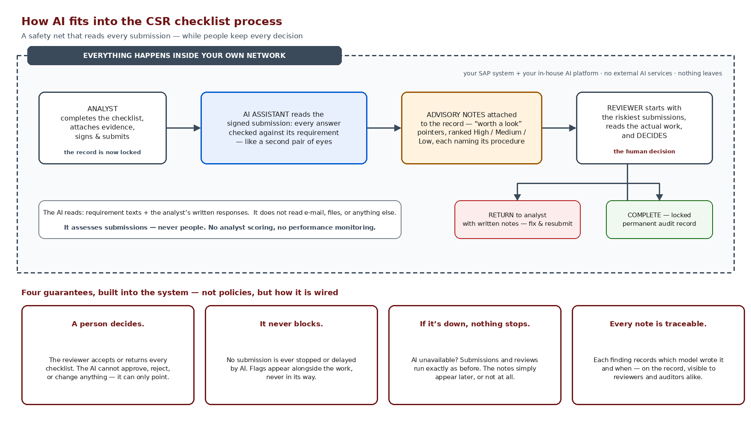
What the AI does — in one picture
Notes:
Walk left to right. 1) The analyst finishes and signs — at that moment the record locks; the AI only ever sees finished, signed work, never drafts in progress. 2) The AI reads each answer against the requirement it responds to — like a second pair of eyes doing a first pass. 3) It attaches advisory notes to the record — 'worth a look' pointers ranked High/Medium/Low, each naming the exact procedure it concerns. 4) The reviewer starts with the riskiest submissions and makes the only decision that exists: return with notes, or complete. Then the two boxes that matter most: the dashed border — everything inside your network, nothing to any external AI service — and the white box: it reads requirements and responses, nothing else, and it assesses submissions, never people. Close on the four guarantees: these are wired into the system, not written in a policy.

Slide 3
What a finding actually looks like
The requirement (from your checklist, verbatim)
“… you are required to judgmentally select a sample of no less than 10% of the line items included in the consolidated MAO charts for the LOB, and to agree the EAC at Sell, Profit $ and Profit % back to the source documentation …”
Why this matters
This is exactly the kind of miss that surfaces in external audit — caught the day it was submitted, not months later
The note cites the procedure, the numbers, and the gap — the reviewer verifies in seconds
The reviewer still reads the actual work and decides — maybe the sampling was justified; the AI only raised a hand
If the note is wrong, the cost is one minute of reviewer attention — that asymmetry is why advisory-only is the right design
What the analyst wrote
“I judgmentally selected a sample of 4 line items from the 52 total line items included in the consolidated MAO charts …”
The AI’s note to the reviewer
High
“Response states 4 line items reviewed from 52 total (7.7%). Requirement is no less than 10% — expected sample size is 6. Evidence may be insufficient.”
Notes:
Make it concrete — this example is from the demo, using your real procedure text. The requirement says a 10% minimum sample; the analyst wrote 4 of 52 — 7.7%. The AI did the arithmetic and raised a hand. Spend a moment on the last bullet: the worst case of a wrong AI note is one minute of reviewer time. The worst case of a missed shortfall is an audit finding. That asymmetry is the business case in one sentence.

Slide 4
The guardrails — wired in, not written down
A person decides — always
It never blocks, never delays
Your data stays home
The reviewer accepts or returns every checklist. The AI has no approve button, no reject button, and no way to change a status or a record. This is not a policy that could drift — the capability does not exist in the system.
Submissions complete at full speed whether the AI responds in two seconds, twenty, or not at all. Notes attach alongside the work; they are never in its way.
The model is your own platform, inside your network. No data to external AI vendors, no training on your content without your say-so — we will hold written confirmation of the platform’s retention policy in the audit file.
Traceable like everything else
It reviews work, not workers
Off switch included
Every note records which model version wrote it and when, stored on the checklist record itself — reviewers and auditors see the same thing. Nothing the AI does is off the books.
The AI reads requirements and responses — nothing else. No analyst scoring, no performance dashboards, no monitoring angle. Its output is about the submission, and only the submission.
The AI layer can be paused or switched off entirely at any time — the application runs identically without it. Adopting it is reversible, which makes trying it low-risk.
Notes:
Six guardrails, and the phrasing matters: these are properties of how the system is built, not policies someone promises to follow. The two that land hardest with compliance audiences: 'it reviews work, not workers' — this is not employee monitoring, and saying so explicitly prevents the quiet resistance that kills rollouts; and 'off switch included' — adopting the AI is a reversible decision, which makes saying yes easy.

Slide 5
What it means for each of you
Analysts
Reviewers
Nothing new to learn, nothing watching over your shoulder
Start where the risk is
The AI never touches your work while you write — it reads only finished, signed submissions
A returned checklist comes back with the reviewer’s written notes — same as today, just faster and better aimed
The queue arrives pre-sorted — highest-flag submissions first
Each note cites the procedure and the gap; verifying takes seconds
Your judgment is the decision — the AI never pre-decides anything
Ray / process owners
Audit & compliance
The chasing is over; the quality floor rises
A stronger file, not a black box
Incomplete work can’t be submitted at all — and weak-but-complete work gets flagged on day one
Quarter-close risk surfaces while there is still time to fix it
Every finding is on the record with model version and timestamp
Human decision-making is demonstrable — flags advised, people decided
Written platform retention confirmation lives in the audit file
Notes:
Tailor emphasis to who is in the room. For analysts the message is reassurance: nothing watches them type, flags are about submissions. For reviewers it's leverage: pre-sorted queue, seconds to verify a citation. For Ray it's the end of chasing plus an earlier quality signal. For compliance it's a better audit file: every AI note is itself an auditable record, and the human decision trail is explicit.

Slide 6
Your controls — and what we ask of you
You stay in control
To move forward
Switch the AI layer on, off, or pause it — anytime, no side effects on the process
Choose and change the model it uses — an operations setting, not a project
See everything it produces — every note, on the record, nothing hidden
Tune what it looks for — the review instructions are yours to evolve each cycle
Your blessing on the advisory-only design shown today
Platform team confirmation on data retention — in writing, for the audit file
Two or three reviewers for a pilot quarter — their verdict on flag quality decides how far we lean on it
The bottom line: the AI makes your reviewers faster and your audit file stronger — and if it ever disappoints, you turn it off and have lost nothing.
Notes:
Close with reversibility — it is the single strongest buy-in argument for cautious stakeholders: this is not a bet, it's a trial with an off switch and an audit trail. The pilot framing gives them ownership: their reviewers judge flag quality, and that judgment steers how much weight the AI gets. Ask for the three things on the right and stop talking.

