Slide 1

Udapeople
Speaker: Phong Tran
Developer Leader

Slide 2
Outline
1. What’s CI/CD
2. Business Benefits of CI/CD

Slide 3
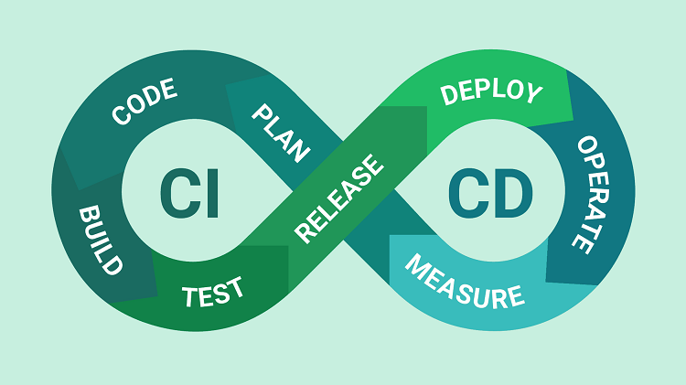
What’s CI/CD

Slide 4

Business Benefits of CI/CD
Build software faster.
As we know "time is money", so integrating CI and CD will produce faster builds and deliver faster results. With deployments running on a continuous cycle, this will allow you to monitor the project and provide real-time feedback and fix deficiencies with your team whenever necessary. With consistent reviews, the product will be more improved and more in line with end-user expectations.
So with this automation, your team will be able to get faster test results for their product build and see their product deployed faster at any time.

Slide 5

Business Benefits of CI/CD
Time to market.
By deploying your app to market at the right time, this not only better engages your customers, but also ensures profitability, supports pricing, and enhances market goals.
With a reduced time to market, businesses can be confident that their software will release well in the face of market changes or growing user demand.

Slide 6

Business Benefits of CI/CD
Code quality improvement.
This will help build a high-quality app. CI allows developers to integrate their code into a common repository. With the help of this repository, developers can share their builds multiple times a day instead of working individually. In turn, this reduces integration costs, as developers can share their builds on a more frequent basis. For example, a developer may encounter conflicts between new and existing code during integration. If these conflicts are resolved in real time, it will be easier to implement resolution decisions.
However, the highlight is that such fixes mainly rely on manual processes to ensure that new code does not introduce new bugs or break existing code. To minimize such collisions, CI facilitates automated tests. This not only saves time, but also requires minimal human intervention, thus reducing the risk of system failure.

