Slide 1
Quantum Graph Convolutional Network
Power Grid Reliability Prediction
Final Project Presentation (12 Slides)

Slide 2
1. Problem Statement and Objective
Goal: predict unstable grid states before cascading failures.
Grid modeled as a graph: substations = nodes, lines = edges.
Need to combine node signals + network connectivity patterns.
Deliverable target: reproducible CPU run with zero training epochs.
Project scope: phase-wise implementation, outputs, baselines, documents.

Slide 3
2. End-to-End Pipeline
Phase 1: build IEEE 14-bus graph + synthetic operational data.
Phase 2: encode node features into quantum states.
Phase 3: variational quantum circuit + graph message passing.
Phase 4: hybrid readout, metrics, visual outputs.
Execution mode used: CPU-only, num_epochs = 0 (no training loop).

Slide 4
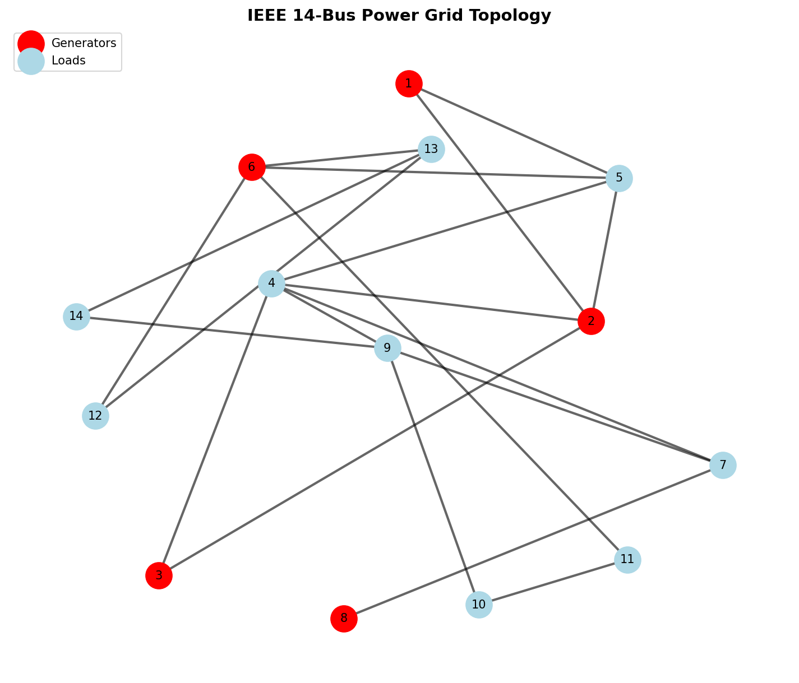
3. Phase 1 - Graph Modeling (Code + Output)
# phase1_data_modeling.py grid = PowerGridSimulator(config=GRID_CONFIG) X, y = grid.generate_node_features(num_samples=250) grid.visualize_grid(save_path='outputs/01_grid_topology.png')
Output proof: IEEE 14-bus topology image generated.
Dataset shape: (samples, 14 nodes, 5 features).

Slide 5
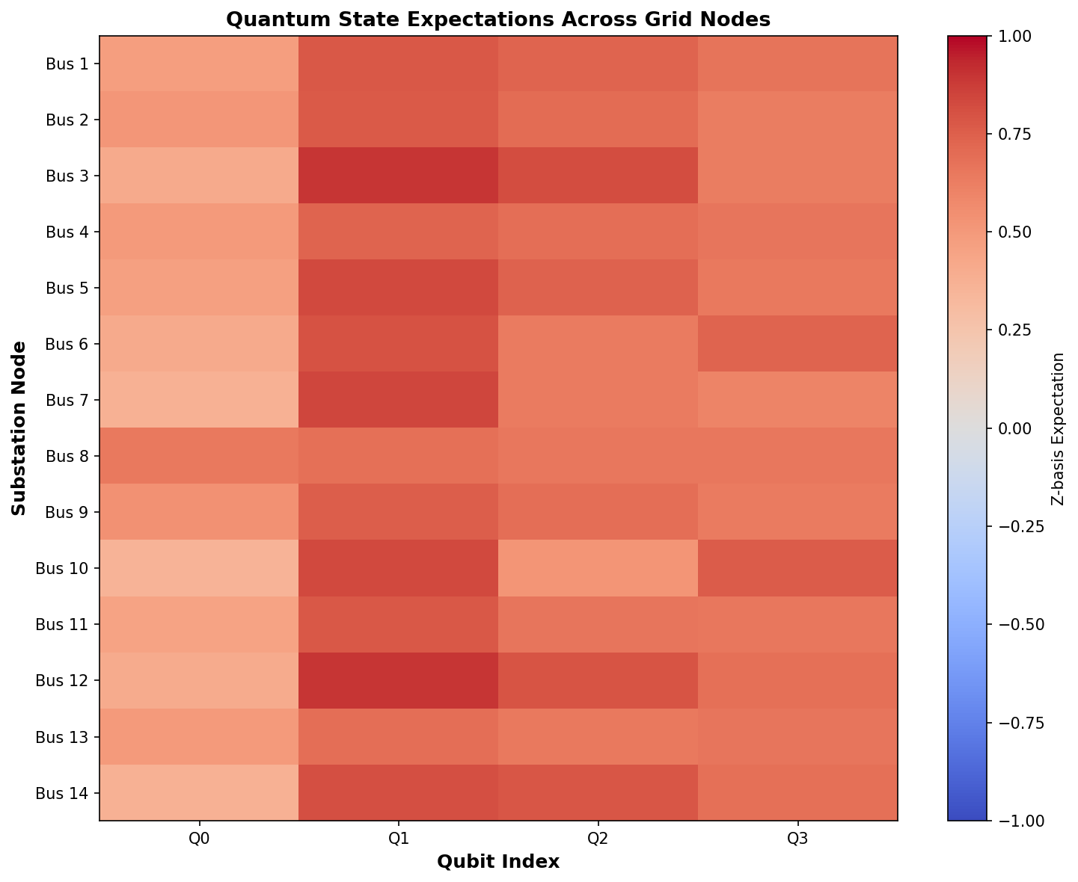
4. Phase 2 - Quantum Feature Embedding
# phase2_quantum_embedding.py for each qubit i: qml.RX(theta_i, wires=i) qml.RY(phi_i, wires=i) entangle with CNOT ladder measure [expval(PauliZ(i))]
Fix applied: removed constant embedding collapse from old encoding.
Now each node gets informative 4-value quantum representation.

Slide 6
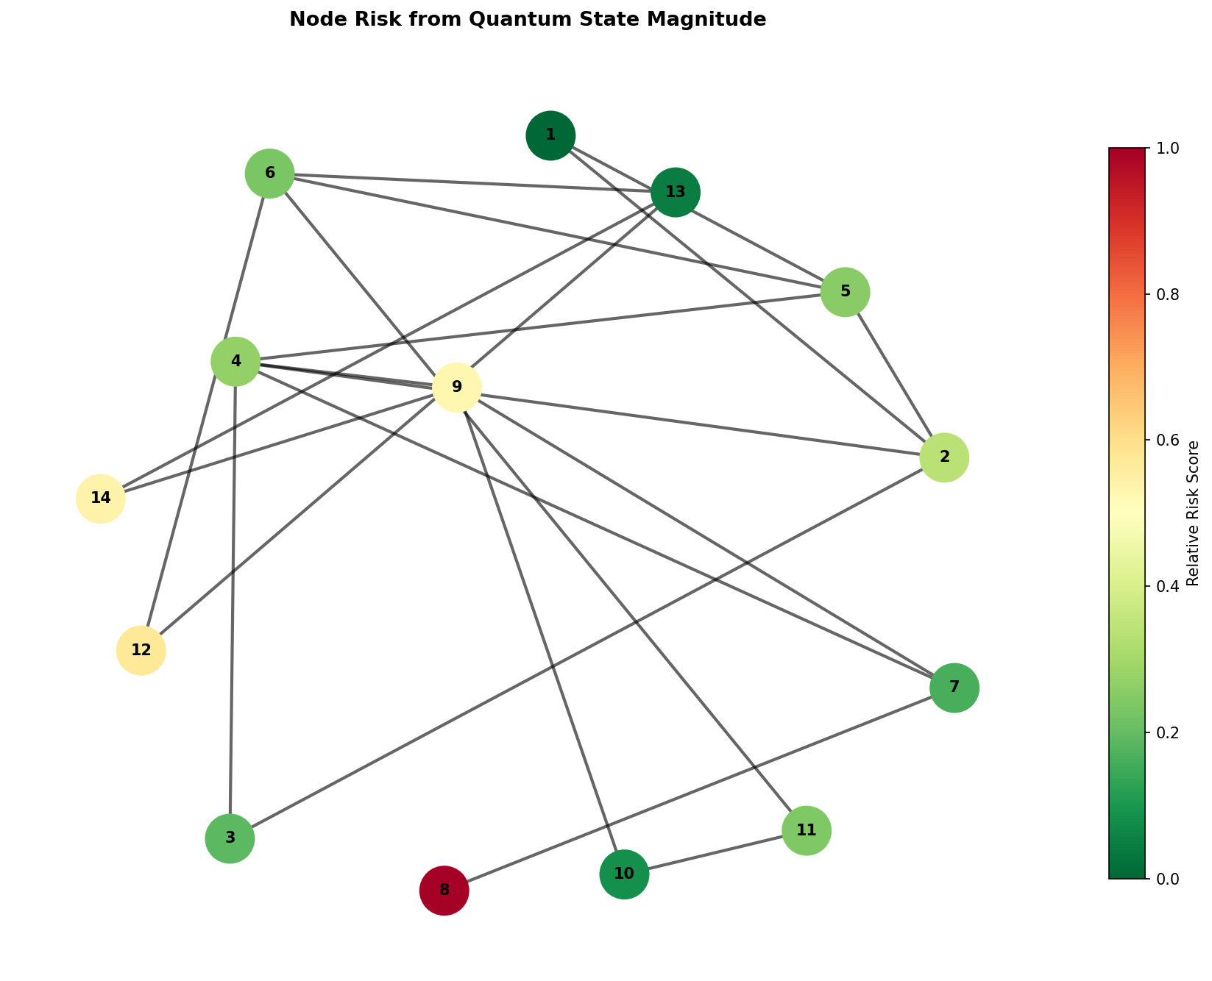
5. Phase 3 - QGCN Layer and Message Passing
# phase3_quantum_layer.py node_output = VQC(node_embedding) neighbor_msg = mean(neighbor_embeddings) updated = 0.7 * node_output + 0.3 * neighbor_msg classical = dot(updated, output_weights) + bias
Quantum part extracts non-linear node features.
Graph part propagates neighborhood context.
Hybrid readout returns per-node risk scores.

Slide 7
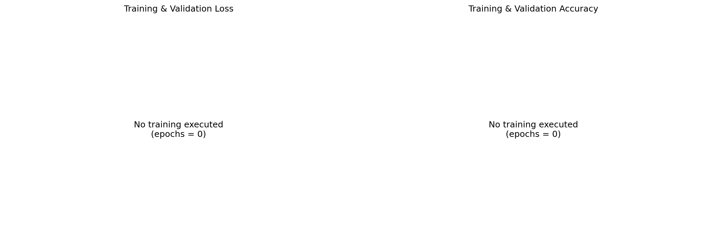
6. Phase 4 - CPU-Friendly Inference Mode
# config.py TRAINING_CONFIG = { 'num_epochs': 0, ... } # phase4_training.py if epochs <= 0: return
No GPU needed: full pipeline runs with zero epochs.
Still executes real quantum forward path for demonstration.

Slide 8
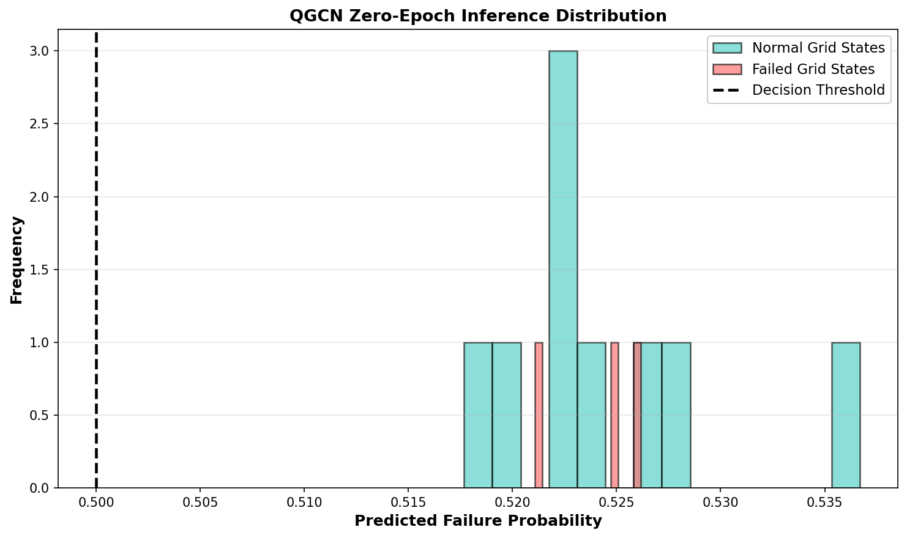
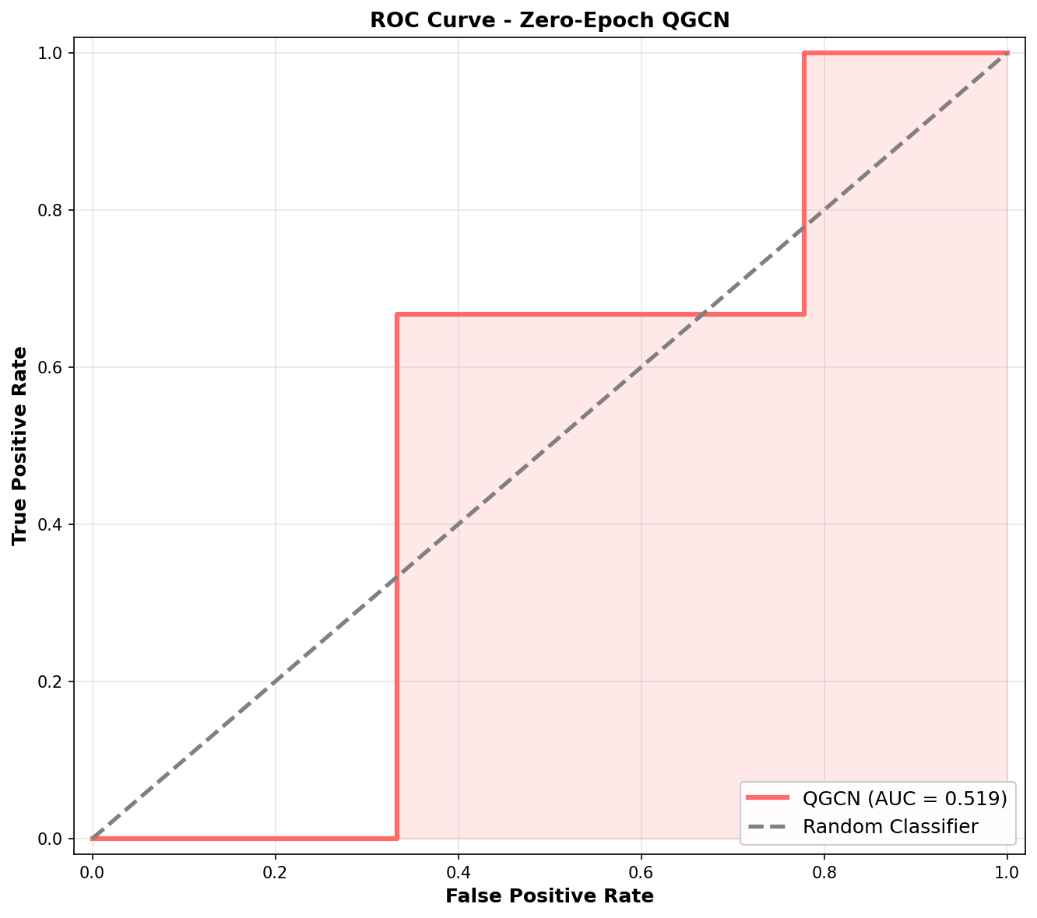
7. Output Demonstration A
Left: probability distribution for normal vs failed states.
Right: ROC plot generated from inference outputs.

Slide 9
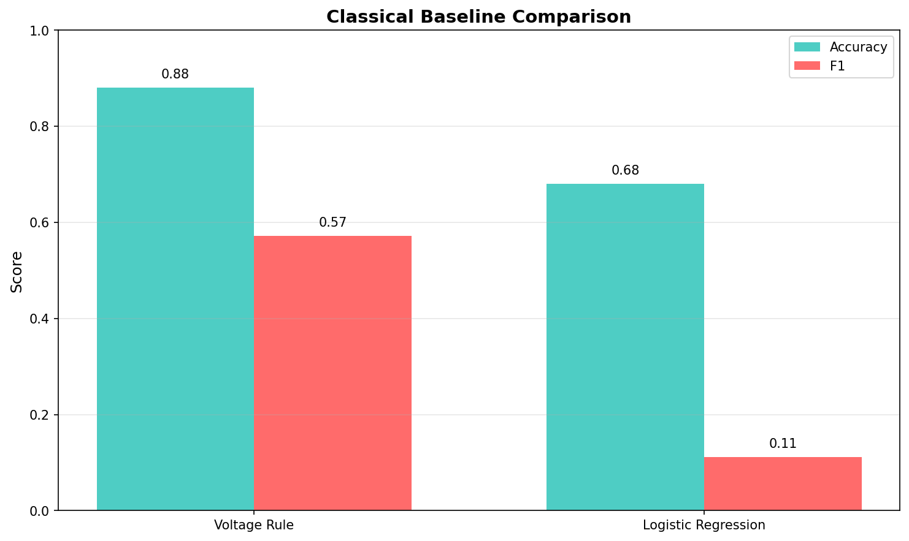
8. Output Demonstration B
Heatmap highlights relative node-level risk in the grid.
Baseline chart compares voltage-rule and logistic models.

Slide 10
9. Run Results (Current CPU Execution)
QGCN (zero-epoch inference):
Accuracy 0.1400 | Precision 0.1400 | Recall 1.0000
F1 0.2456 | AUC 0.5615
Classical baselines:
Voltage Rule -> Accuracy 0.880, Recall 0.400, F1 0.571
Logistic Regression -> Accuracy 0.680, Recall 0.100, F1 0.111
Reference file: docs/EXECUTION_SUMMARY.md

Slide 11
10. Work Completed and Fixes
Implemented full 4-phase project structure.
Fixed quantum embedding collapse in angle encoding.
Made pipeline stable with no-epoch CPU mode.
Replaced synthetic demo with real QGCN inference outputs.
Updated reports/presentation to remove fabricated static metrics.
Verified one-click deliverables script end-to-end.

Slide 12
11. Deliverables and Demo Commands
Main deliverables:
deliverables/QGCN_PowerGrid_Presentation_12_Slides.pptx
deliverables/QGCN_Project_Writeup_Udai_Ratinam_G.docx
docs/EXECUTION_SUMMARY.md
outputs/01..07 PNG figures
Demo commands:
python src/demo.py
python src/baseline_comparison.py
powershell -ExecutionPolicy Bypass -File ./run_deliverables.ps1

Slide 13
12. Conclusion and Next Steps
Project is complete, reproducible, and CPU-friendly.
Quantum implementation is now demonstrable from real code paths.
Outputs and reports are regenerated and submission-ready.
Next: optional non-zero epoch experiments on stronger hardware.
Next: larger IEEE grids and stronger ablation studies.
Thank You

