Slide 1
Data Science and Machine Learning Project - House Prices Dataset

Slide 2
Exploratory Data Analysis
Understand the problem
Explore the data and deal with missing values
Select and transform variables, especially categorical ones

Slide 3
With 79 explanatory variables describing (almost) every aspect of residential homes in Ames, Iowa, this competition challenges you to predict the final price of each home.
we are going to explore the dataset, try to get some insights from it, and use some tools to transform the data into formats that make more sense

Slide 4
Importing Libraries
The standard math module provides access to the mathematical functions.
The NumPy lib is fundamental for any kind of scientific computing with Python.
pandas is a must-have tool for data analysis and manipulation.
matplotlib is the most complete package in Python when it comes to data visualizations.
seaborn is based on matplotlib as a higher-level set of visualization tools, not as powerful as matplotlib, but much easier to work with and delivers a lot with less work.

Slide 5
Loading Data
since the format is CSV (Comma-Separated Values), we use the read_csv() function from pandas.
we have 1169 rows in the CSV file, but the header that describes the columns doesn’t count.

Slide 6
Looking at the Data
Using the head() function from pandas with an argument of 3, we can take a look at the first 3 records.
The .T means Transpose, this way we visualize rows as columns and vice-versa.
train.head(3).T

Slide 7
The describe() method is good to have the first insights of the data.
It automatically gives you descriptive statistics for each feature: number of non-NA/null observations, mean, standard deviation, the min value, the quartiles, and the max value.
Note that the calculations don’t take NaN values into consideration.

Slide 8
Data Cleaning
The id column The id column is only a dumb identification with no correlation to SalePrice.
So let’s remove the id:
train.drop(columns=['Id'], inplace=True)

Slide 9
Missing values
When we used info() to see the data summary, we could see many columns had a bunch of missing data.
isna() from pandas will return the missing values for each column, then the sum() function will add them up to give you a total.

Slide 10
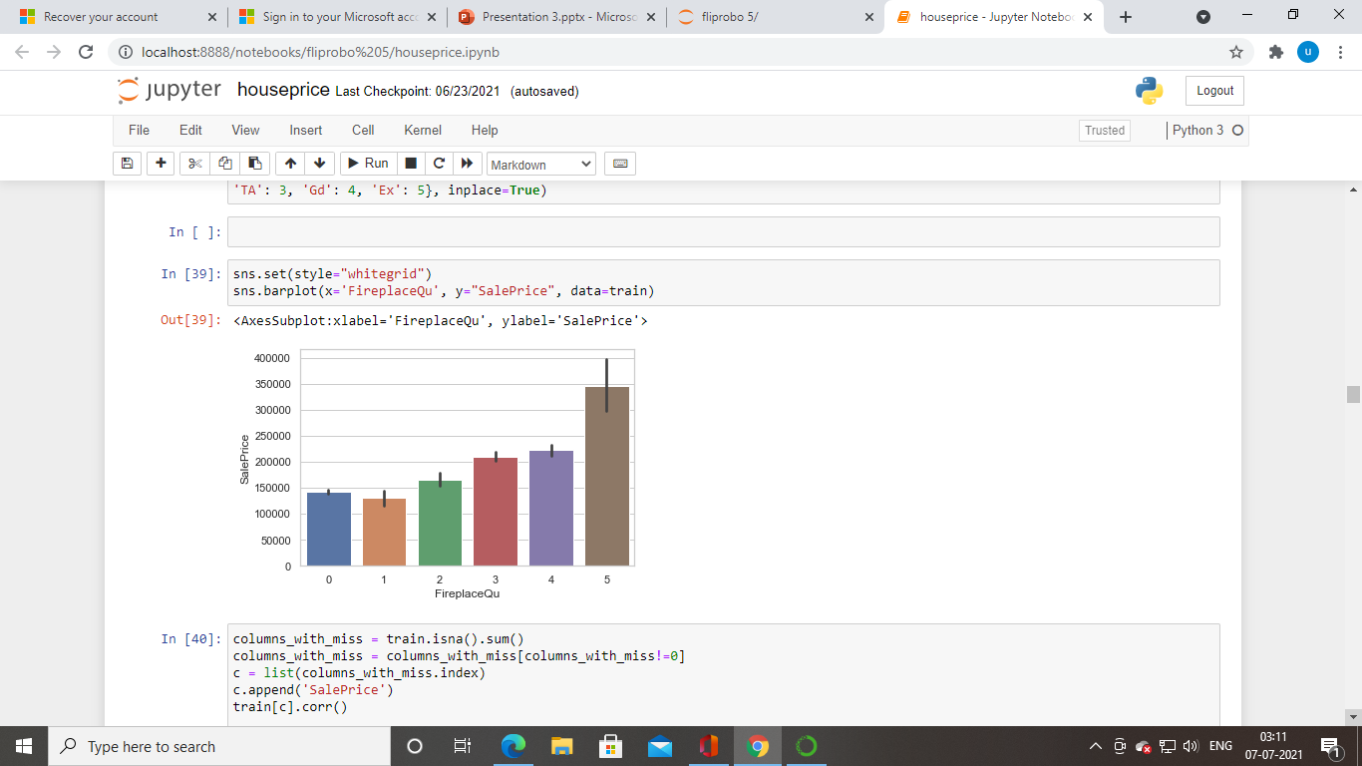

Slide 11
we can see how the category of the FirePlace increases the value of SalePrice.
It is also worth noting how much higher the value is when the house has an Excellent fireplace.
This means we should keep FireplaceQu as feature.

Slide 12
Missing values in numeric columns
Another feature with a high number of missing values is LotFrontage with a count 204.
Columns with missing values: 11

Slide 13
Categorical variables
Dealing with missing values
# Fills NA in place of NaN for c in ['GarageType', 'GarageFinish', 'BsmtFinType2', \ 'BsmtExposure', 'BsmtFinType1']: train[c].fillna('NA', inplace=True) # Fills None in place of NaN train['MasVnrType'].fillna('None', inplace=True)

Slide 14
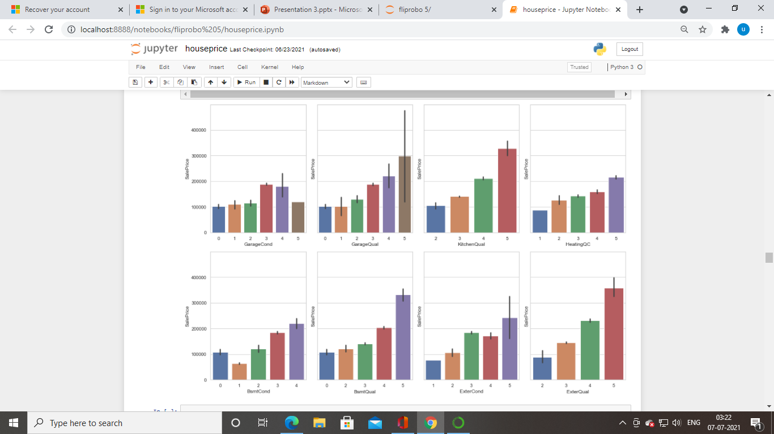
Ordinal

Slide 15
Zero values
Another quick check is to see how many columns have lots of data equals to 0.
train.isin([0]).sum().sort_values(ascending=False).head(25)
, even though there are many 0’s, they have meaning.
For instance, PoolArea (Pool area in square feet) equals 0 means that the house doesn’t have any pool area.
This is important information correlated to the house and thus, we are going to keep them

Slide 16
Outliers
There are a lot of outliers in the dataset. But, if we check the data description file, we see that, actually, some numerical variables, are categorical variables that were saved (codified) as numbers. So, some of these data points that seem to be outliers are, actually, categorical data with only one example of some category. Let’s keep these outliers

Slide 17
Saving cleaned data
We have no more missing values:
columns_with_miss = train.isna().sum() columns_with_miss = columns_with_miss[columns_with_miss!=0] print(f'Columns with missing values: {len(columns_with_miss)}') columns_with_miss.sort_values(ascending=False)

Slide 18
After cleaning the data, we are left with 73 columns out of the initial 81. (1168, 73) Let’s take a look at the first 3 records of the cleaned data.

Slide 19
Conclusions
We dealt with missing values and removed the following columns: ‘Id’, ‘PoolQC’, ‘MiscFeature’, ‘Alley’, ‘Fence’, ‘LotFrontage’, ‘GarageYrBlt’, ‘MasVnrArea’.
We also:
Replaced the NaN with NA in the following columns: ‘GarageType’, ‘GarageFinish’, ‘BsmtFinType2’, ‘BsmtExposure’, ‘BsmtFinType1’. Replaced the NaN with None in ‘MasVnrType’. Imputed the most frequent value in place of NaN in ‘Electrical’.

Slide 20
Data Cleaning Script
the final decisions made to clean the data in the Exploratory Data Analysis into a single Python script that will take the data in CSV format and write the cleaned data also as a CSV.

Slide 21
Code
You can save the script on a file ‘data_cleaning.py’ and execute it directly with python3 data_cleaning.py or python data_cleaning.py, depending on your installation.
The script expects the ‘raw_data.csv’.
The output will be a file named ‘cleaned_data.csv’.
It will also print the shape of the original data and the shape of the new cleaned data
Original Data: (1168, 81)
After Cleaning: (1168, 73)

Slide 22
Machine Learning Model
Now we are going to use the ‘cleaned_data.csv’ file generated with the data cleaning script to generate the Machine Learning Model.

Slide 23
Training the Machine Learning Model
You can save the script on a file train_model.py and execute it directly with python3 train_model.py or python train_model.py, depending on your installation.
It expects you to have a file called ‘cleaned_data.csv’.

Slide 24
The script will output three other files:
model.pkl: the model in binary format generated by pickle that we can reuse later train.csv:
the train data after the split of the original data into train and test test.csv:
the test data after the split of the original data into train and test

Slide 25
The output on the terminal will be similar to this:
Train data for modeling: (934, 74)
Test data for predictions: (234, 74)
Training the model ...
Testing the model ...
Average Price Test: 175652.0128205128
RMSE: 10552.188828855931
Model saved at model.pkl
It means the models used 934 data point to train and 234 data points to test.

Slide 26
The average Sale Price in the test set is 175k dollars.
The RMSE (root-mean-square error) is a good metric to understand the output because in you can read it using the same scale of you dependent variable, which is Sale Price in this case.
A RMSE of 10552 means that, on average, we missed the correct Sale Prices by a bit over 10k dollars.
Considering an average if 175k, missing the mark, on average, by 10k, is not too bad.

