Slide 1

MALIGNANT COMMENTS CLASSIFICATION

Slide 2
Problem Statement
The proliferation of social media enables people to express their opinions widely online. However, at the same time, this has resulted in the emergence of conflict and hate, making online environments uninviting for users. Although researchers have found that hate is a problem across multiple platforms, there is a lack of models for online hate detection.

Slide 3
Data Set Description
The data set contains the training set, which has approximately 1,59,000 samples and the test set which contains nearly 1,53,000 samples. All the data samples contain 8 fields which includes ‘Id’, ‘Comments’, ‘Malignant’, ‘Highly malignant’, ‘Rude’, ‘Threat’, ‘Abuse’ and ‘Loathe’.

Slide 4
Malignant: It is the Label column, which includes values 0 and 1, denoting if the comment is malignant or not.
Highly Malignant: It denotes comments that are highly malignant and hurtful.
Rude: It denotes comments that are very rude and offensive.
Threat: It contains indication of the comments that are giving any threat to someone.
Abuse: It is for comments that are abusive in nature.
Loathe: It describes the comments which are hateful and loathing in nature.
ID: It includes unique Ids associated with each comment text given.
Comment text: This column contains the comments extracted from various social media platforms.

Slide 5
Importing library file
#import all the library file
import numpy as np
import matplotlib.pyplot as plt
import seaborn as sns
import sklearn
from sklearn.linear_model import LinearRegression
from sklearn.metrics import accuracy_score

Slide 6
Dataframe shape
#shape of the dataframe
Df1.shape
(153164, 2)
#shape of the dataframe
Df.shape
(143346, 7)

Slide 7
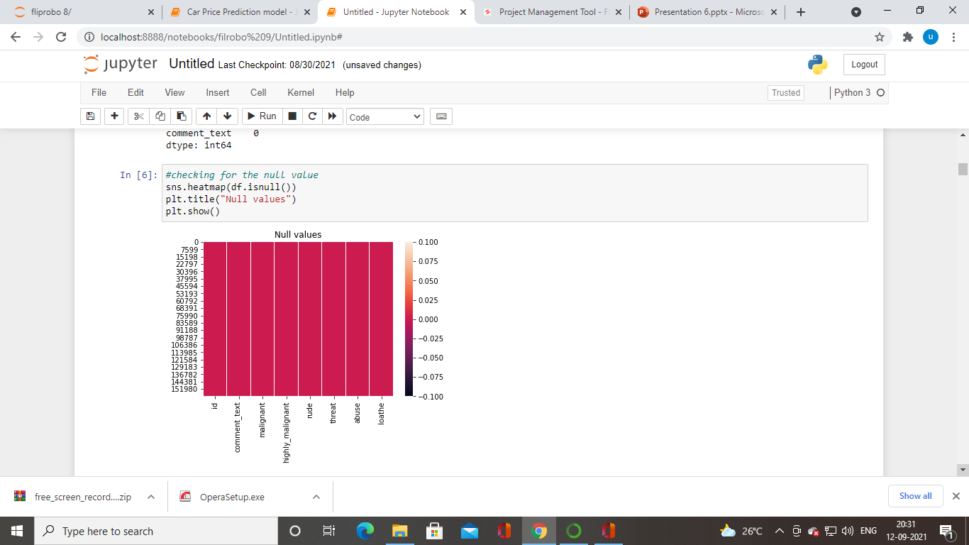
Checking for null value

Slide 8
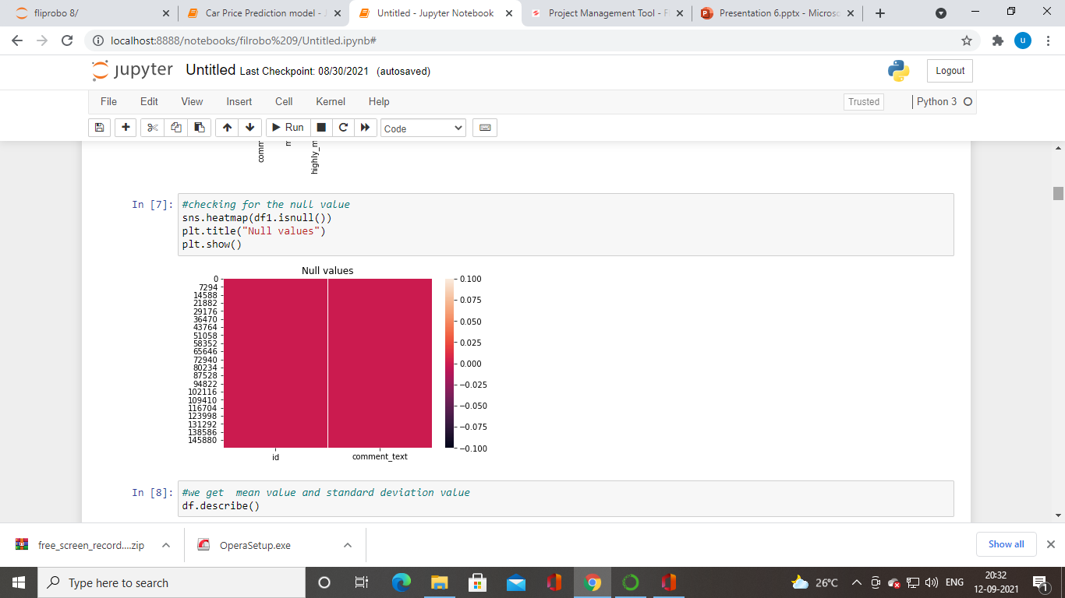
Checking for the null value

Slide 9
describe
#we get mean value and standard deviation value
df.describe()
Which will give the mean value,standard,min,25,50,75,max

Slide 10
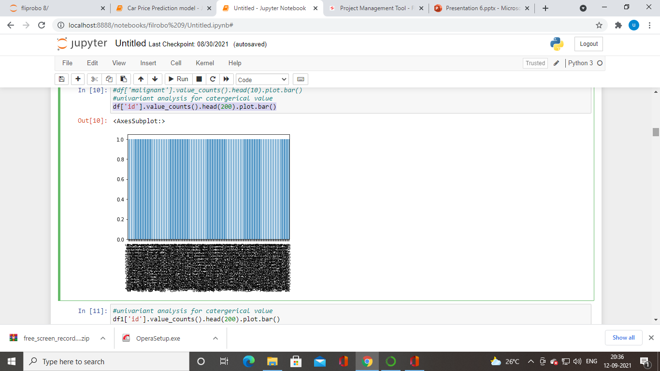
Univariant analysis
df['id'].value_counts().head(200).plot.bar()

Slide 11
Univariant analysis for numercial value
#in highly_malignant o which high value and 1 has low value
df['highly_malignant'].value_counts().head(10).plot.bar()
#in rude o which high value and 1 has low value
df['rude'].value_counts().head(10).plot.bar()
#in threat o which high value and 1 has low value
df['threat'].value_counts().head(10).plot.bar()
#in abuse o which high value and 1 has low value
df['abuse'].value_counts().head(10).plot.bar()

Slide 12
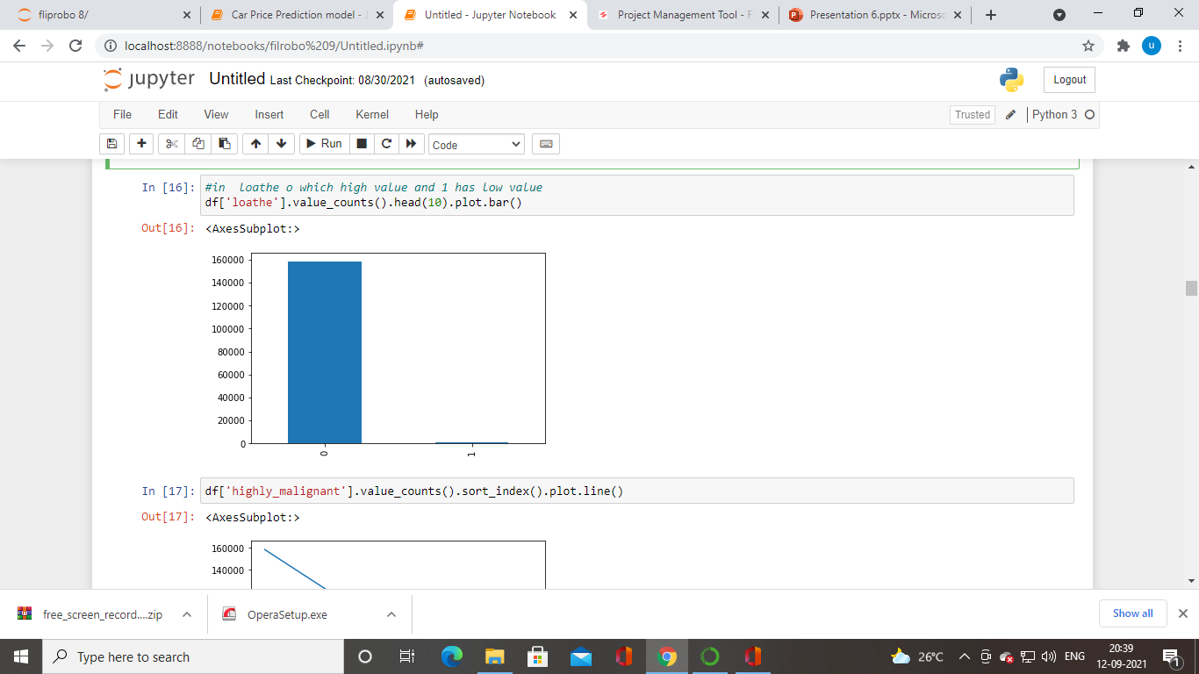

Slide 13
Numerical categorical
#getting value of numerical data and categorical
numeric_data = df.select_dtypes(include=[np.number])
categorical_data = df.select_dtypes(exclude=[np.number])

Slide 14
Numerical data
#numerical data
numeric_data.columns
Index(['malignant', 'highly_malignant', 'rude', 'threat', 'abuse', 'loathe'], dtype='object')
#categorical data
categorical_data.columns
Index(['id', 'comment_text'], dtype='object')

Slide 15
Counting the value
#counting the value data from train.csv
df.stack().value_counts()

Slide 16
correlation
rude and malignant are highly correlated
abuse and malignant are highlt correlated
abuse and rude are highly correlated

Slide 17
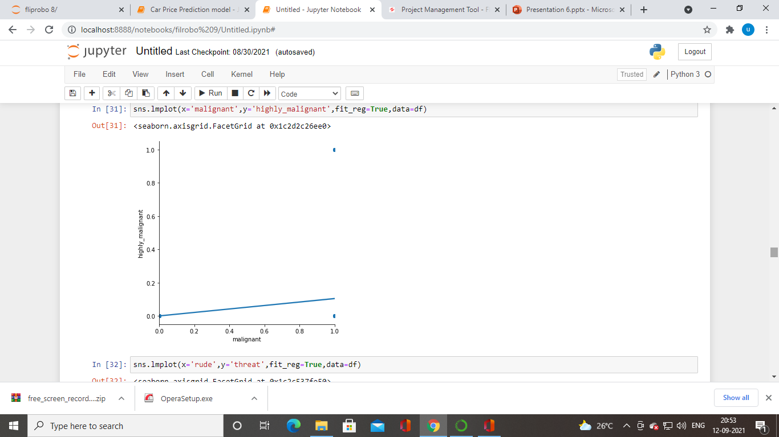
multivariant analaysis &bivariant analaysis
sns.pairplot(df)

Slide 18
Catagerical to numerical value
#coverting catagerical value to numerical value
from sklearn.preprocessing import LabelEncoder
le=LabelEncoder()
list1=['id', 'comment_text']
for val in list1:
df[val]=le.fit_transform(df[val].astype(str))

Slide 19
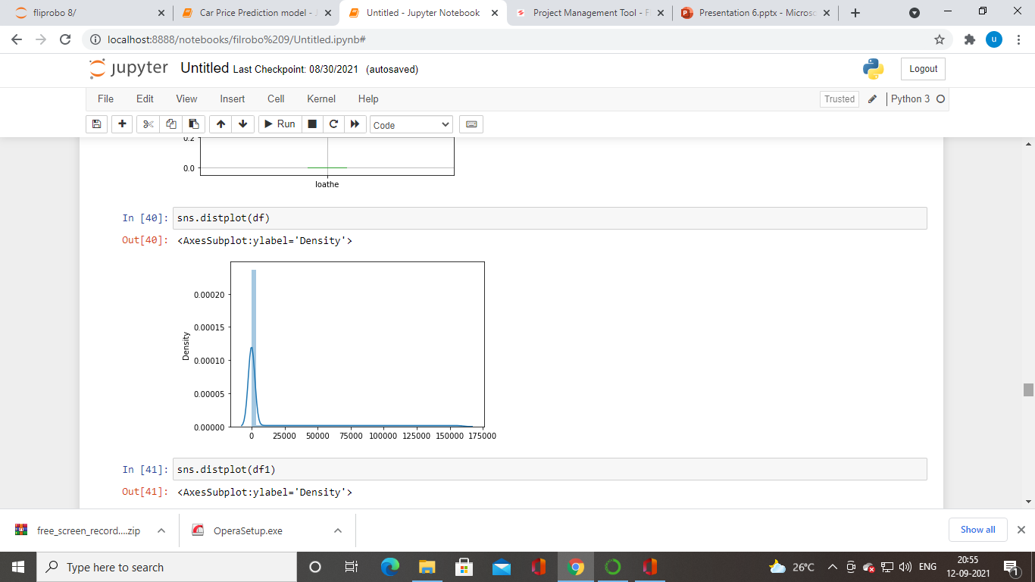

Slide 20
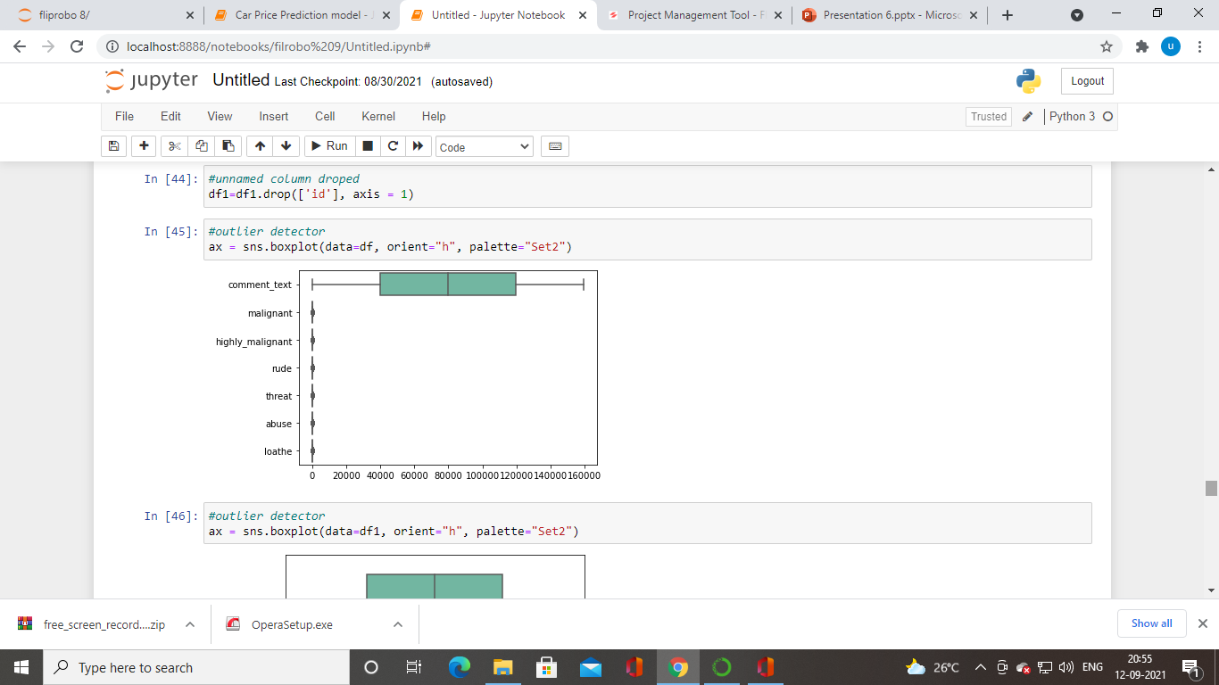
Outlier detector

Slide 21
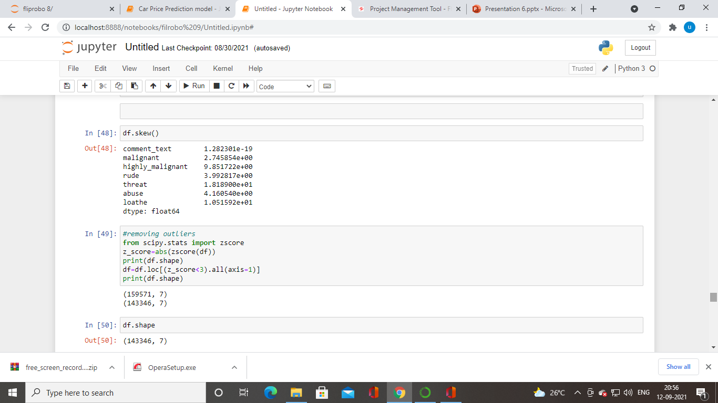
Skewness &zscore

Slide 22
models
from sklearn.linear_model import LogisticRegression
from sklearn.neighbors import KNeighborsClassifier
from sklearn.naive_bayes import GaussianNB
from sklearn.tree import DecisionTreeClassifier
from sklearn.svm import SVC
from sklearn.ensemble import RandomForestClassifier
All the value 1,1,1,1,1,1

Slide 23
Cross value score
score=cross_val_score(rf,X,y,cv=5)
print(score)
print(score.mean())

Slide 24
GridSearchCV
GCV_pred=GCV.best_estimator_.predict(x_test)
accuracy_score(y_test,GCV_pred)
1.0
import joblib
joblib.dump(GCV.best_estimator_,"predict.pkl")

