Slide 1
SocketPro -- An Asynchronous Communication Framework on TCP/IP
Cross Operation Systems
Cross Development Languages
Multiple Communication Models Integrated
Great Freedoms for Design and Development

Slide 2
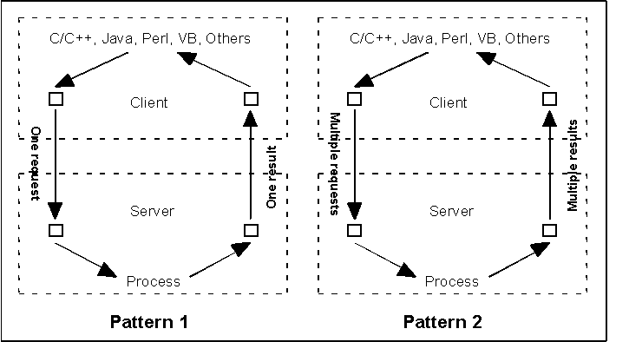
SocketPro History (2001)
http://www.codeproject.com/Articles/1773/Fundamentals-about-data-communication-using-socket

Slide 3
SCF (Synchronous Communication Frameworks) | ACF (Asynchronous Communication Frameworks)
Good for typical applications Easy to get started Many free SCFs available Good for Local Area Networks (LAN) Simple in coding logic and better code readability Easy in debugging | Great for high-quality applications Great for challenging tasks Multiple communication models integrated Great for both LAN and WAN Great performance, latency, UI response and scalability Great dev/design freedom Less threading-related problems Better user-code consistence
Bad for high-quality applications Bad for challenging tasks One communication model only Bad for Wide Area Networks (LAN) Bad performance, latency and UI response No dev/design freedom Many threading-related problems Bad scalability | Difficult to get started Few high quality ACFs available Slightly more complex in coding logic and readability Slightly more difficult in debugging Difficult to create an ACF

Slide 4
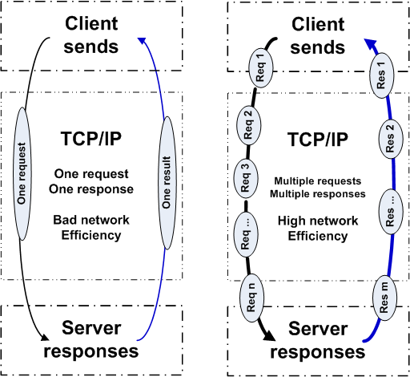
One vs multiple concurrency processing

Slide 5
SocketPro Communication Architecture and Components
Client Core
cross-platform
native code
Server Core
cross-platform
native code
Request batching and streaming, asynchrony, secure, parallel communication on TCP/IP
C++
Adapter
.Net
Adapter
Java
Adapter
Python
Adapter
JavaScript
Adapter
PHP
Adapter
Node.js
Adapter
C++
Adapter
.Net
Adapter
Python
Adapter
Java
Adapter
User Client Code
User Server Code

Slide 6
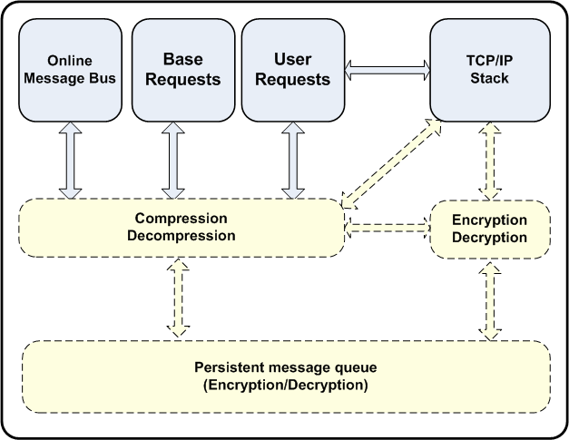
Client Core for Single Session

Slide 7
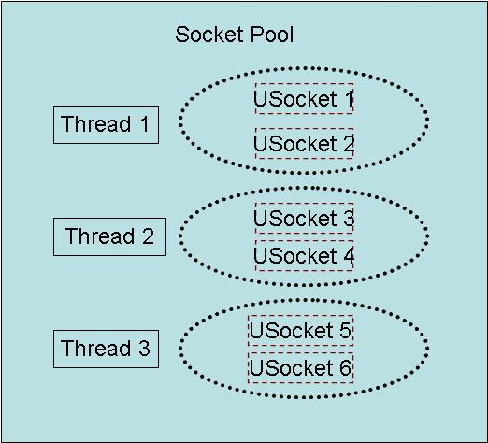
Client Socket Pool
SocketPro provides loading balancing through persistent queue at client side, and routing service at server side

Slide 8
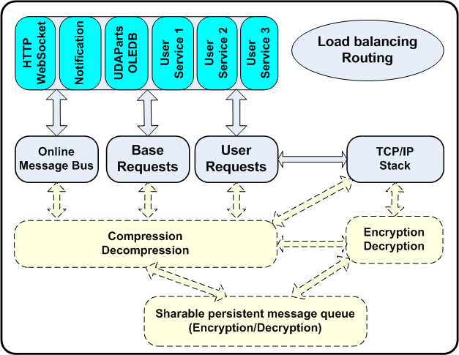
Server Core

Slide 9
SocketPro
Integrated Communication Models
Client/server model
Bi-directional messaging push
Routing at server side for load balancing
Bi-directional persistent queue
Replication
Async (default) and sync

Slide 10
SocketPro
One port for multiple services
HTTP
WebSocket
Chat/notification service
Persistent message queue
Database messaging (online and offline)
Routing
UDAParts’ services
User-defined services

Slide 11
SocketPro
Great speed and scalability
Requests streaming and batching for best network efficiency
Socket pool
Native codes for core components
15-year experience for TCP/IP socket programming
SocketPro is far faster than WCF, HTTP, Java RMI, Kafka and RabbitMQ, ……

Slide 12
SocketPro Adapters for more developers
C++ adapters – a few header and cpp files
One .NET adapter
One JavaScript adapter for browsers
Python adapter
Java adapter
PHP adapter in the near future
Node.js adapter in the near future

Slide 13
SocketPro Current Status
Server and client cores
  Client server
  Persistent message queue
  HTTP/WebSocket service
  Chat (or online publish/subscribe) service
  Bidirectional routing and loading balance
Windows and Linux (x86 and x64)
Adapters: C++, .NET, Java, Python and JavaScript
Applications
  High performance persistent queue (faster than Kafka)
  SQL streaming
  Middle-tier cluster with real-time cache (developing)

Slide 14
Async-to-sync Conversion
public string EchoString(string str)
{
string s = null;
//send a request asynchronously with a callback
bool ok = SendRequest(EchoConst.idEchoString, //a request id
str,
(CAsyncResult ar) => { ar.Load(out s); } //a callback
) && WaitAll();
return s;
}
All asynchronous requests can be converted into synchronous ones.
Refer to CAsyncServiceHandler::ProcessRx (x = 0, 1, 2, ……, 5)

Slide 15
Requests Batching
public bool Echo(string str, int nData, double dData, out string strOut, out int nOut, out double dOut)
{
string s = null;
int n = 0;
double d = 0.0;
//batch three async requests, and send them in one packet
bool ok = (StartBatching() &&
SendRequest(EchoConst.idEchoString, str, (CAsyncResult ar) => { ar.Load(out s); }) &&
SendRequest(EchoConst.idEchoInt32, nData, (CAsyncResult ar) => { ar.Load(out n); }) &&
SendRequest(EchoConst.idEchoDouble, dData, (CAsyncResult ar) => { ar.Load(out d); }) &&
CommitBatching(true) && //true -- ask server to return all three results in one shot
WaitAll());
strOut = s;
nOut = n;
dOut = d;
return ok;
}
Best network efficiency and great for WAN

Slide 16
Data Push from Server
[RequestAttr(DoSumConst.idDoSum, true)]
private int DoSum(int start, int end)
{
int sum = 0;
for (int n = start; n <= end; ++n)
{
sum += n;
System.Threading.Thread.Sleep(100); //simulate slow request
//push results onto client
uint rtn = SendResult(DoSumConst.idReportProgress, n, sum);
if (rtn == CClientPeer.REQUEST_CANCELED ||
rtn == CClientPeer.SOCKET_NOT_FOUND)
break; //check socket closed or cancel request
}
return sum;
}
One client request with multiple pushed server results.
Large collection objects (DataSet, DataTable, IDataReader, List, Dictionary ……)
Low latency and fast response UI

Slide 17
SocketPro Message Bus
public interface IUPush
{
bool Publish(object Message, params uint[] Groups);
bool Subscribe(params uint[] Groups);
bool Unsubscribe();
bool SendUserMessage(object Message, string UserId);
}
public interface IUPushEx : IUPush
{
bool Publish(byte[] Message, params uint[] Groups);
bool SendUserMessage(string UserId, byte[] Message);
}
public interface IUPushClient : IUPushEx
{
event DOnPublish OnPublish;
event DOnPublishEx OnPublishEx;
event DOnSendUserMessage OnSendUserMessage;
event DOnSendUserMessageEx OnSendUserMessageEx;
event DOnSubscribe OnSubscribe;
event DOnUnsubscribe OnUnsubscribe;
}

Slide 18
Queues on Client and Server
public interface IMessageQueueBasic
{
void StopQueue(bool permanent = false);
uint CancelQueuedRequests(params ushort[] ids);
ulong CancelQueuedRequests(ulong startIndex, ulong endIndex);
uint PeekQueuedRequests(params CQueuedRequestInfo[] RequestInfo);
uint MessagesInDequeuing { get; }
ulong MessageCount { get; }
ulong QueueSize { get; }
bool Available { get; }
bool Secure { get; }
string QueueFileName { get; }
string QueueName { get; }
bool AbortJob();
bool StartJob();
bool EndJob();
ulong JobSize { get; }
bool DequeueShared { get; }
ulong LastIndex { get; }
}

Slide 19
Parallel Communication
static void TestHelloWorldInParallel(CConnectionContext cc) {
using (CSocketPool<CHwAsyncHandler> hwPool = new CSocketPool<CHwAsyncHandler>()) {
object cs = new object();
bool ok = hwPool.StartSocketPool(cc, 1, 3);
CHwAsyncHandler hw0 = hwPool.Lock();
if (hw0 == null) {
Console.WriteLine("Hello world service not connected");
return;
}
CHwAsyncHandler hw1 = hwPool.Lock();
CHwAsyncHandler hw2 = hwPool.Lock();
hw0.SendRequest(HwConst.idSayHello, "Hello world 0", (CAsyncResult ar) => {
string res; ar.Load(out res);
lock (cs) Console.WriteLine(res);
});
hw1.SendRequest(HwConst.idSayHello, "Hello world 1", (CAsyncResult ar) => {
string res; ar.Load(out res);
lock (cs) Console.WriteLine(res);
});
hw2.SendRequest(HwConst.idSayHello, "Hello world 2", (CAsyncResult ar) => {
string res; ar.Load(out res);
lock (cs) Console.WriteLine(res);
});
hw0.WaitAll();
hw1.WaitAll();
hw2.WaitAll();
}
}

Slide 20
SocketPro Router
CSocketProServer.Router.SetRouting(idRouteSvs0, idRouteSvs1);
Bi-directional routing with SocketPro server as a man in middle

Slide 21
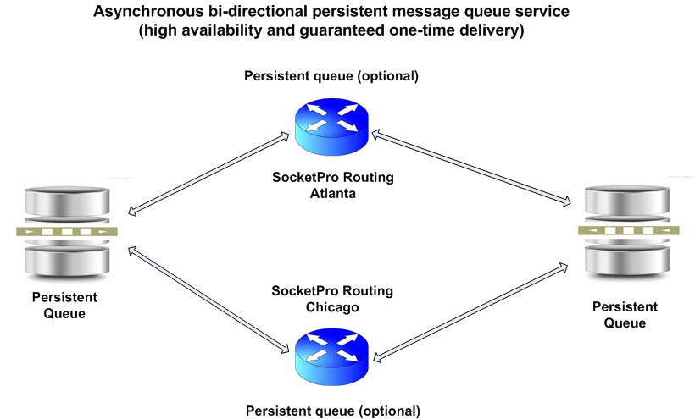

Slide 22
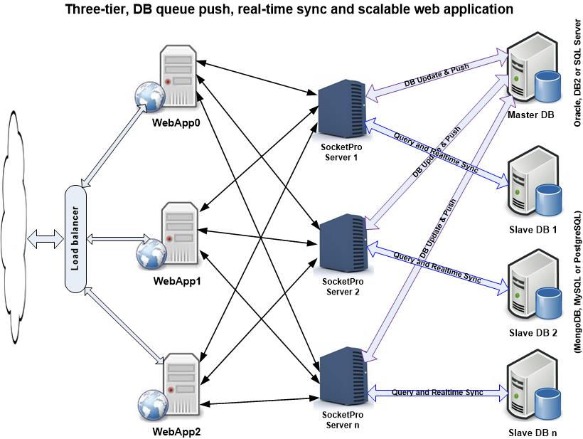
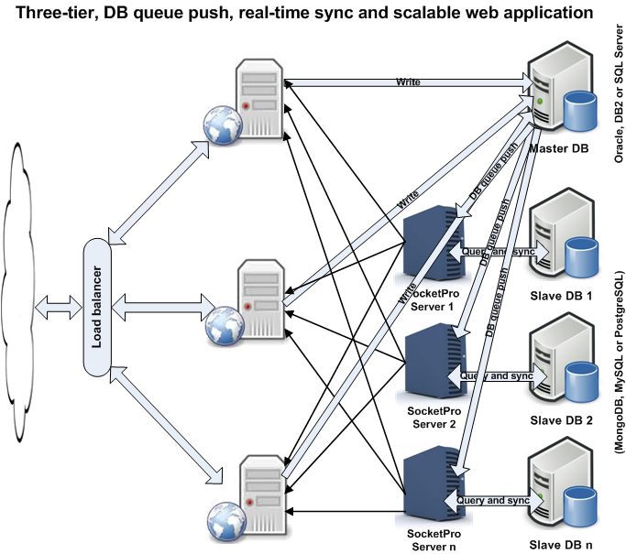

Slide 23
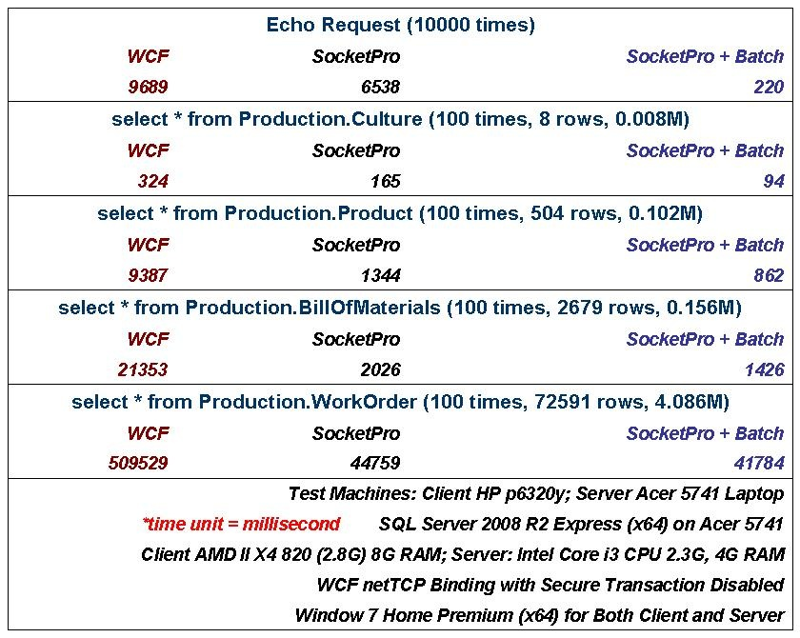
Performance Comparison

Slide 24
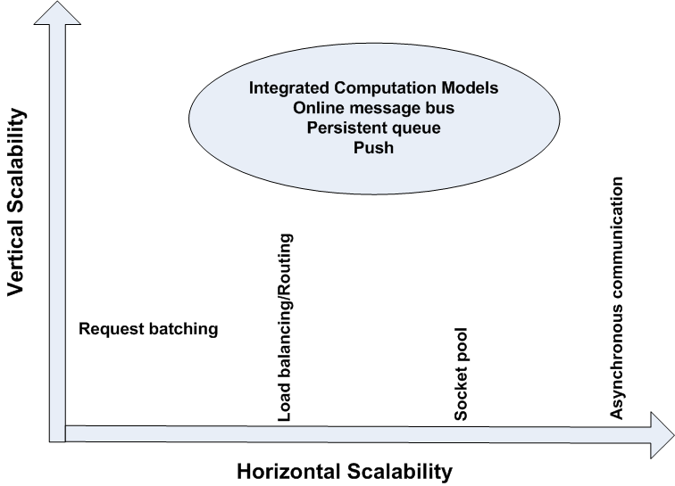
SocketPro Scalability

Slide 25
Simplification of design and architecture
(Async/sync, integrated computation modes, freedom, flexibility and rich features)
Great for tough tasks
(Great UI response, cache, lots of items, unstable/slow WAN, threading, and stability)
Great integration
Unified but simple interfaces for different dev languages and Oss
Excellent with performance and scalability
+ Great interoperation among different environments
Simple but fast development

Slide 26
SocketPro Competitors
WCF (window platforms and mono)
Java RMI (Java only and cross-OSs)
Message bus and queue (RabbitMQ, Qpid, IronMQ, Kafka)
HTTP service
CORBA (outdated, cross-OSs)
DCOM (outdated, window only)
.NET remoting (outdated, windows)

Slide 27
SocketPro Key Advantages
An ACF on TCP/IP
One port for integrated communication models and multiple services
Superior latency, performance and scalability
Cross operation systems and cross development languages supported
Simplicity and fast development
Great for challenging tasks (unstable WAN, large collection items, cache real-time update and small messages)
Great freedom to architecture design and development
Persistent queue for data replication, fault-tolerance and data durability
Secure (SSL3/TLSv1)

Slide 28
Business Projects
Global message queue services
(1 year + a few software developers)
WAN/Hybrid-cloud DB and cache real-time synchronizer
(1.5 years + 6 software developers)
http://www.rackspace.com/knowledge_center/whitepaper/the-future-of-cloud-is-hybrid-over-distance

Slide 29
Business Models
Global queue services for small-middle companies
Annual app license fees for large companies
Consulting services

Slide 30
A list of customers

Slide 31
Major Challenges
Funding/Human Resources
Better documentations
More QA tests
Not available for MacOS, IPhone, Android and Win8 Phone
Demonstrations and examples
Many adapters not completed yet
Fine tune on simplicity, feature, performance and scalability
A number of features not completed yet
Persistent queue features not completed yet
Create services for customers
  Remote database service
  Remote file service
  Remote message queue service
  Routing service

