Slide 1
AsyncOpenStack (TBD)
A business proposal
By Yuancai Ye
Secret!

Slide 2
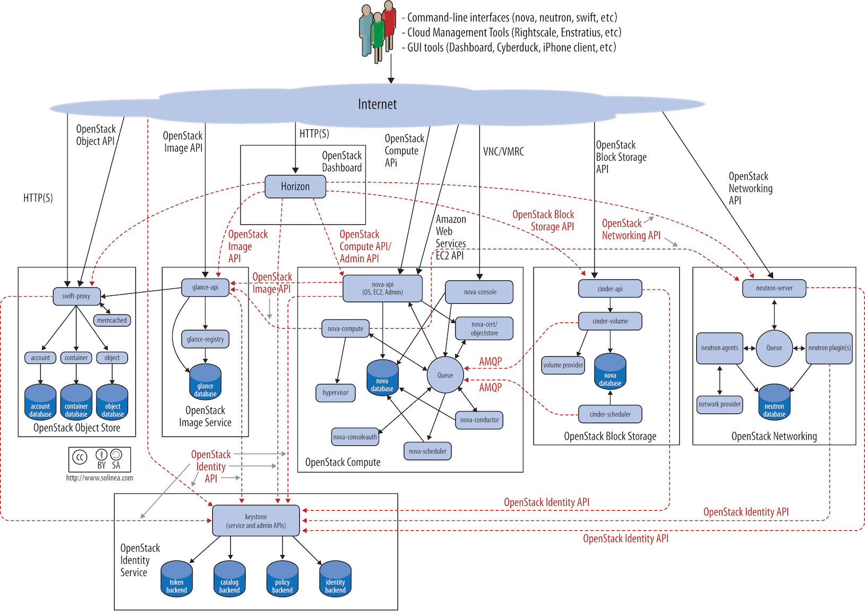
Original OpenStack Architecture

Slide 3
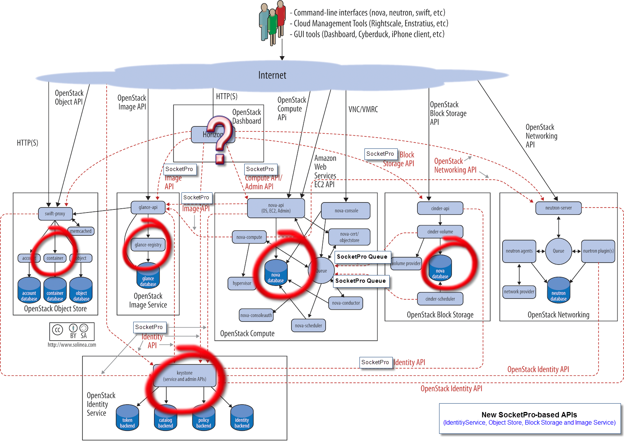
SocketPro-based OpenStack Architecture

Slide 4
Openstack Cores Modified
Keystone – Identity Service
Glance – Image Service
Swift – Object Storage
Cinder – Block Storage
Nova – OpenStack Computing Engine
Horizon – Openstack Dashboard

Slide 5
Communication Frameworks
1. SocketPro for best performance, rich features and simplicity (Internal)
2. HTTP for 100% compatibility (External)
3. Two sets of APIs for external accessing

Slide 6
Good Points for Our Reverse Engineering
1. Reuse of existing architecture without new design
2. Opened source codes and documents
3. Openstack modular/plug-in design

Slide 7
AsyncOpenstack Goals
100% compatible to OpenStack
Significant speed improvement
Huge cloud availability improvement
Reducing deployment issues
Reducing software upgrade issues
Reducing configuration settings
Reducing learning curve
Reducing software dependency

Slide 8
AsyncOpenStack Must-have Selling Points
100% compatibility to OpenStack
Huge performance improvement
Intelligence and simplicity (deployment and software maintenance)

Slide 9
Our Potential Customers
Middle Enterprise (AsyncOpenStack-Ironic)
Middle/Large Enterprise OpenStack (AsyncOpenStack)
Large Government Specific Projects

Slide 10
Three Business Stages
Initial Stage – Initial Development (2 years)
Growing Stage (2-3 years)
Maintenance Stage (forever)

Slide 11
Major Challenges at Initial Stage
Funding
Openstack Engineers (Security + Java/.NET + Python + Linux/Windows)
Enterprise Leaders

Slide 12
Revenue Sources
(Growing and Maintenance Stages)
AsyncOpenStack application license fees
Customer service fees
Cloud service incomes (maintenance stage)

Slide 13
Hybrid Cloud
SocketPro Great Future!

Slide 14
Reference Sites
http://blogs.cisco.com/datacenter/the-top-5-openstack-adoption-challenges-view-from-cisco-services-experts
https://www.openstack.org/summit/openstack-summit-hong-kong-2013/session-videos/presentation/openstack-performance
https://www.packet.net/blog/how-we-failed-at-openstack/
https://virtualizationreview.com/articles/2014/10/01/openstack.aspx
http://wikibon.com/openstack-enters-its-second-epoch/

