Slide 1





Stream Media Website May 12, 2020 By Jeanne D Uwimana

Slide 2
Inspiration
My Boy Friend has a small Video production business
He also has a novel and several movies and has a messy website that presents all the content.
I wanted to create something more presentable and in one place.

Slide 3
Main Functionalities
User Login and Registration
CRUD for :
Book
Book Category
Film
Film Genre
Crew Of the film
Trailer
Short Story
FAQ
Service : Java Mail
Contact Us

Slide 4
What I will do in Version 2
Spring version of this website
Secondary hosting for media
Validation toff all java classes
I would improve accessibility
Include change password/reset password
Include hibernate search
Add more features

Slide 5
Key Take away
Set high goals helped to learn more.
I should have used a framework
Not including validation later
Validate things as you create them.
Always write unit test because it helps to debug/reduce errors

Slide 6
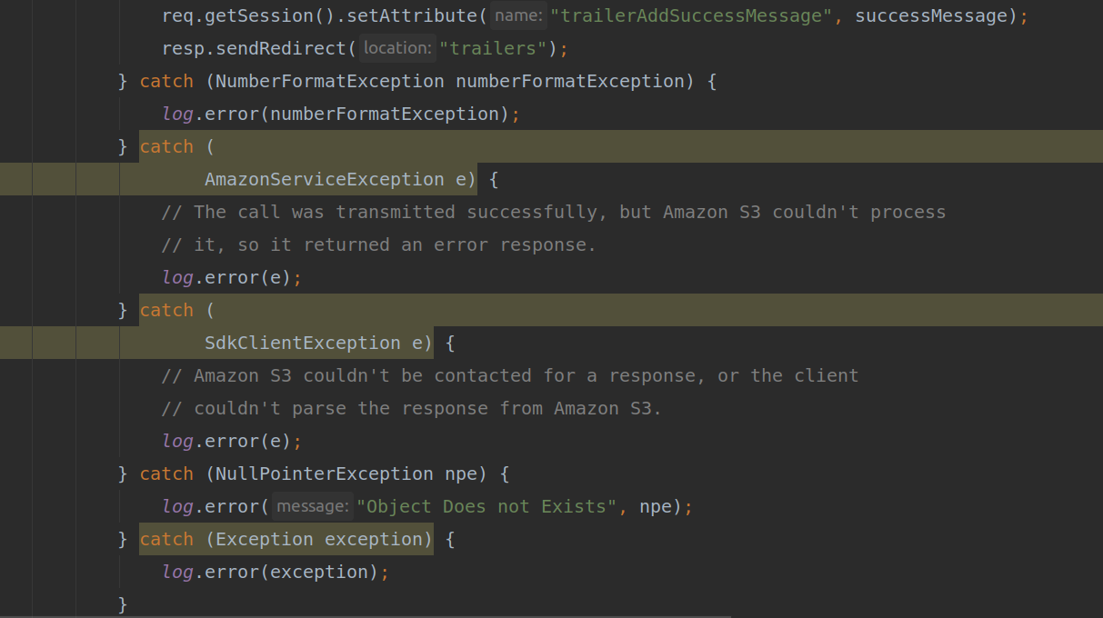
Error Handling Example

Slide 7
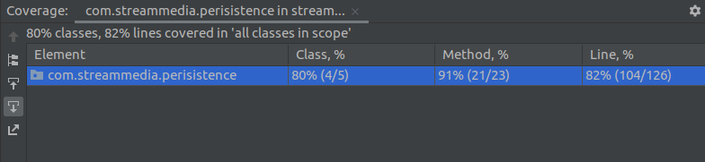
Test Coverage
Unit Test

Slide 8
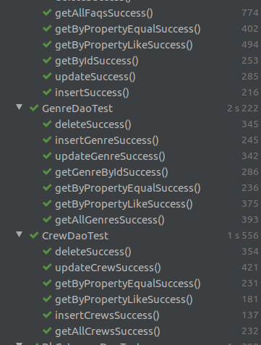
Unit testing

Slide 9
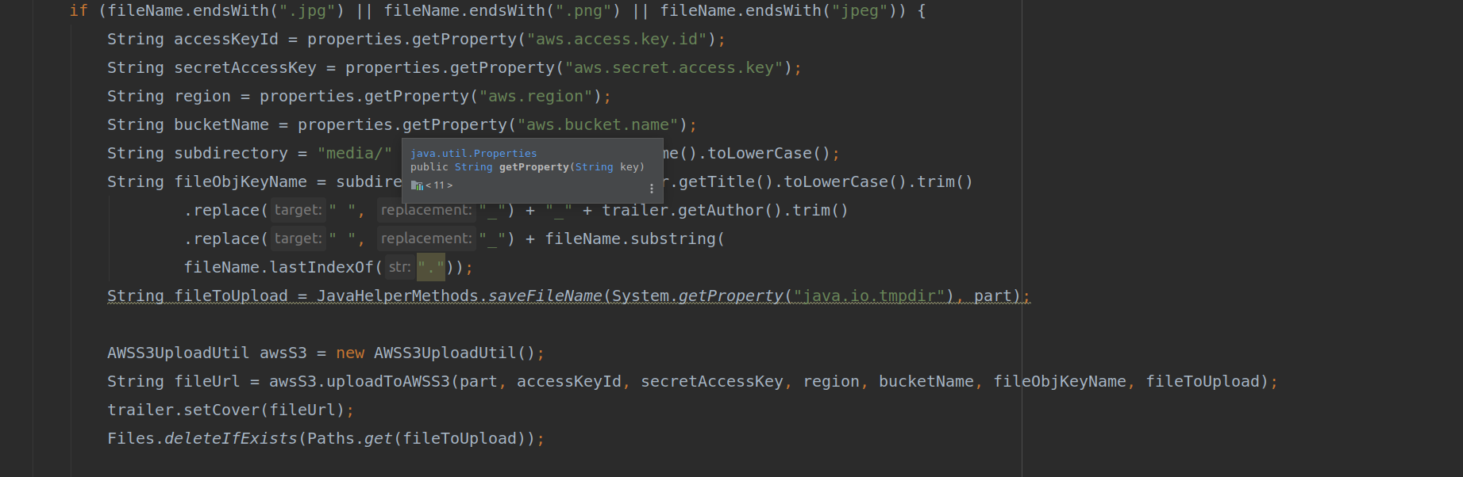
AWS Upload servlet

Slide 10
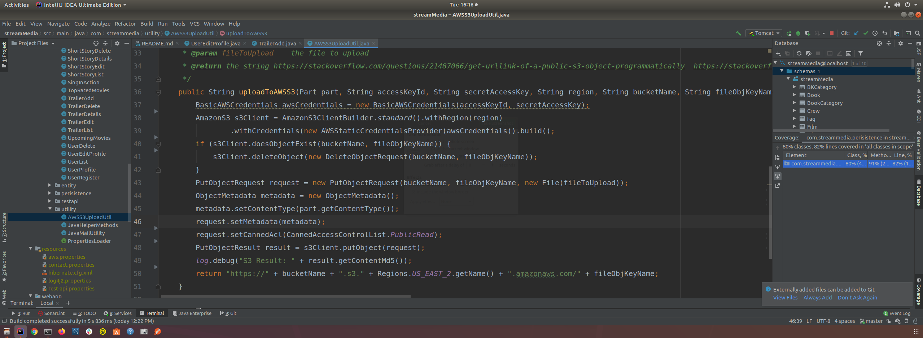
AWS Upload
Unit Test

Slide 11
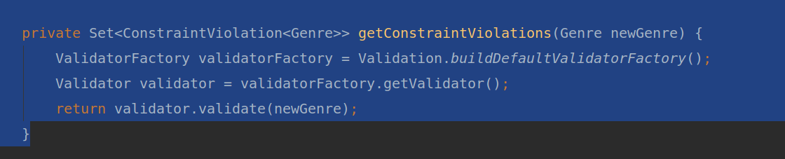
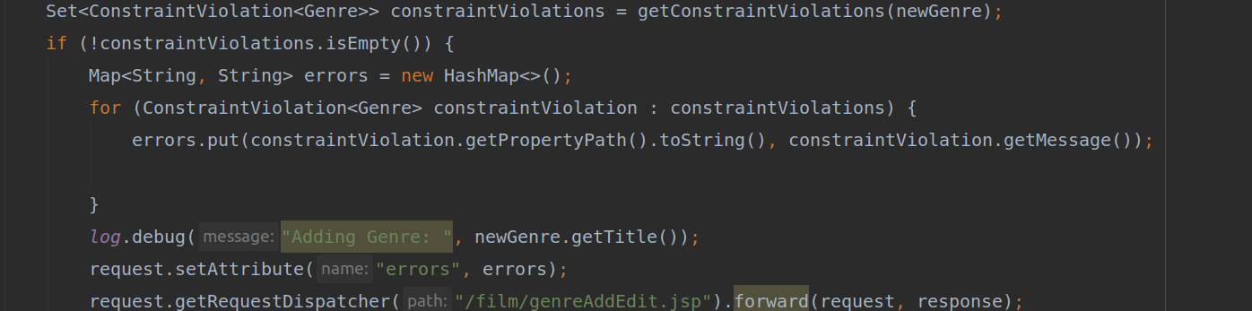
Java Bean Validation

Slide 12
Resources
https://www.w3schools.com/bootstrap4/bootstrap_forms.asp
https://www.w3schools.com/bootstrap4/bootstrap_forms.asp
https://www.journaldev.com/3626/hibernate-validator-jsr303-example-tutorial
https://www.linkedin.com/learning/java-ee-bean-validation/null-constraints-implementation?u=74652290
https://projectlombok.org/

