Slide 1



Enterprise Search using AWS Kendra usecase:BBC-politics dataset
Aptus Data Labs
Internship Project-2
Group-c
Submission by
1.Mr. Uday Chandu Bachina (19FTDDS020)
2.Mr. Mohd. Afzal Ramiz (19FTDDS018)
3.Mr. Sourav Sambit Panda (19FTDDS003)
Under the Esteemed Supervision of
1.Mr. Ravindra Swamy
2.Mr. Pramit Kumar Patra
3.Mr. Akshay Barik &
4.Mr. Siddharth

Slide 2
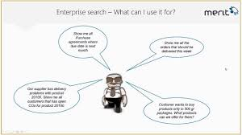


Contents:
What is Enterpise Search
Enterprise Search Features & Capabilities
History
Current Scenario & Trends
UseCase understanding
Solving with AWS Kendra
Results
Conclusion

Slide 3
What is Enterprise Search…?
Enterprise search is the practice of making content from multiple enterprise-type sources, such as databases and intranets, searchable to a defined audience.
Some of the most Enterprise Softwares are:
Algolia.
IBM Watson Discovery.
Swiftype.
Microsoft Bing Image Search API.
Elasticsearch.
iManage.
AddSearch Site Search.
X1 Search.

Slide 4
Enterprise Search Features & Capabilities
An interface through which to search for and retrieve data
Indexing and/or archiving of data
Collecting and updating of information from different data sources, categories, and formats
Intelligent search options to auto-complete, find same/similar or rank by relevance
Search refine using advanced faceted and filter search
Defined user permissions for accessing information

Slide 5
History of ES
search engines with advanced capabilities can be a great tool to improve problem solving, learning and decision making.
Pre-1970: Layering the early foundations of enterprise search.
In 1967, the ORBIT online search service was launched, allowing researchers to quickly search through databases to find research literature.
1970s and 80s: Enterprise search emerges.
In 1970, IBM launched its STAIRS (Storage and Information Retrieval System), which allowed users to search indexed text files.
Contd…

Slide 6
The 1990s: The rise of the Internet and the proliferation of the PC.
In the 1990s, and, as a result, the amount of data held by organizations began to surge. At the same time, the Internet and e-commerce grew rapidly in popularity. As a result, an increasing number of companies and researchers invested in search technology.
In 1991, the World Wide Web went public. Information websites, ecommerce stores, and others quickly emerged online.
The 2000s: Enterprise search moves to the forefront.
While much of the technology still used today is decades old, or at least based on older concepts, new technologies are also emerging that could shake up the industry. MachineLearning and Artificial Intelligence, in particular, could introduce radical change to enterprise search.

Slide 7
Current Scenario’s and Trends
Enterprise Search Software Market reports offers important insights which help the industry experts, product managers, CEOs, and business executives to draft their policies on various parameters including expansion, acquisition, and new product launch as well as analyzing and understanding the market trends.
“The Number Games” - Search Accuracy with Engine Scoring
“For Your Eyes Only” - Search Result Personalization
“Context is King” - Semantic Search
“The Mind of the Machine” - Deep Learning

Slide 8


Use Case Understanding
we have a dataset that resembles a real-world politics content. In the dataset there are 417 unstructured text files which are the sentences about the political parties and their oaths to people.
…..

Slide 9
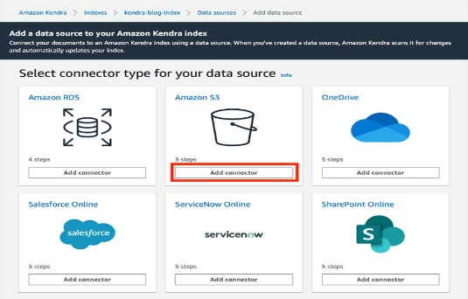

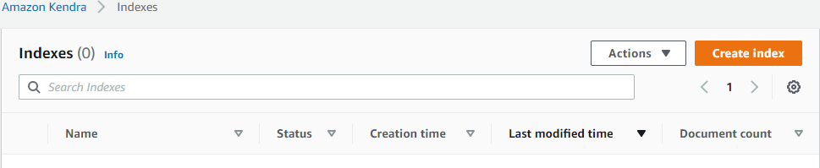


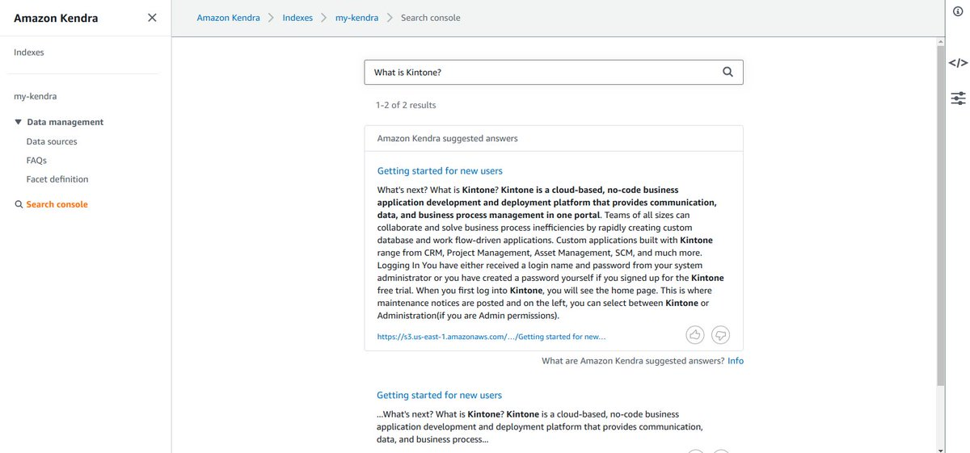


Solving with AWS Kendra
Syncing the documents and indexing them comes under the job.
Store the data into s3 bucket.
Add data source to the index
Create an index
If the user is interested to know save the most asked questions, Kendra has FAQ’S option to create one. It is optional
The results of each query is observed and can assess how relevant the information was retrived from AWS Kendra.

Slide 10
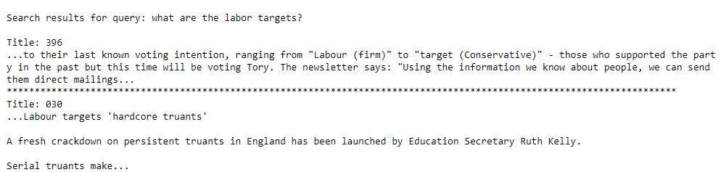
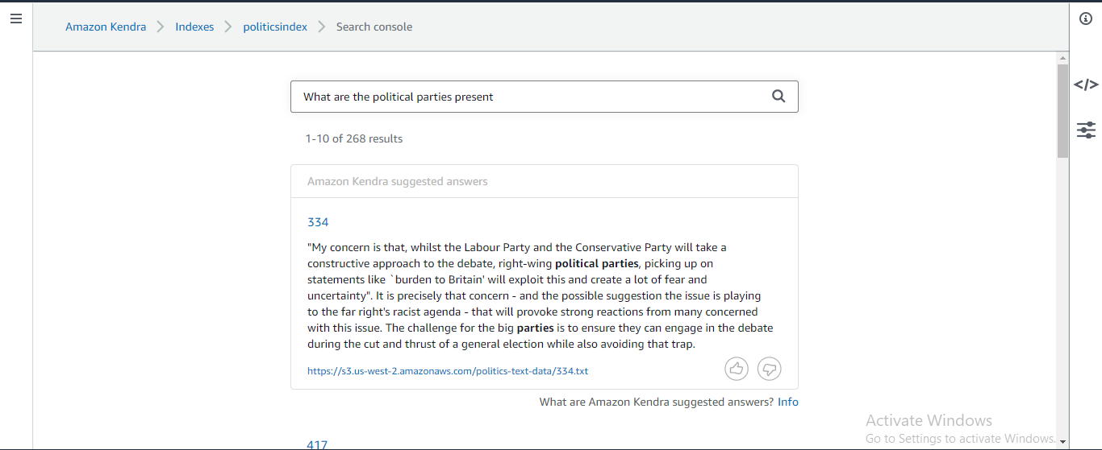
Results
The results for each query can be visualized in set of documents and their indexed number.
The notebook print for a query looks like,
The console image looks like,

Slide 11
Conclusion
Thus, with help of Enterprise Search, we can have,
Quick and easy access to large sets of data help users (especially decision makers) make use of the data stored within their databases. Whether to make predictions based on historical data or to access old documents, search engines with advanced capabilities can be a great tool to improve problem solving, learning and decision making.
Enterprise search engines are crucial for organizations as they help businesses improve productivity by providing access to large sets of data in a quick and timely manner.

Slide 12


