Slide 1
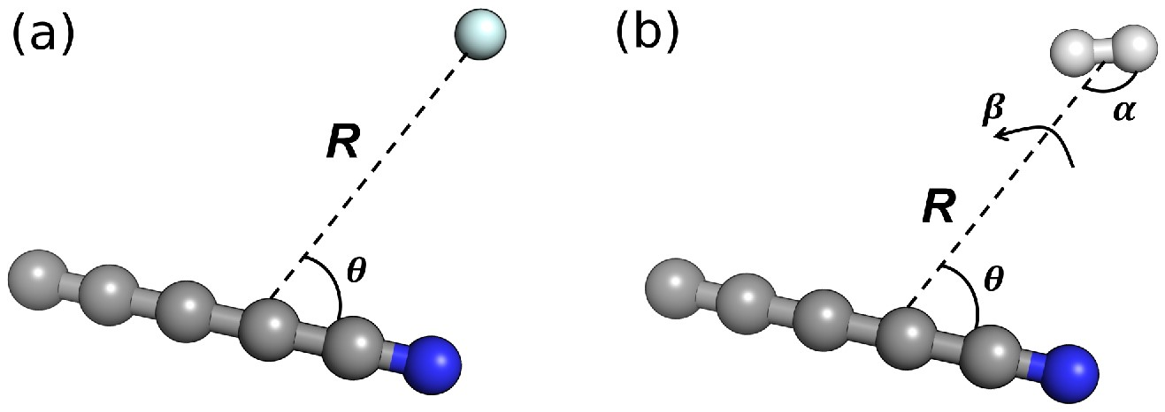

Figure 1. Illustration of (panel a) the polar coordinates (R, θ) used for the C₅N⁻–He system and ...
Notes:
Figure 1. Illustration of (panel a) the polar coordinates (R, θ) used for the C5N−–He system and (b) the four variables (R, θ, α, and β) used for the C5N−–H2 system. The N− atom of the chain is indicated in blue.
Unless provided in the caption above, the following copyright applies to the content of this slide: © The Author(s) 2023. Published by Oxford University Press on behalf of Royal Astronomical Society.This is an Open Access article distributed under the terms of the Creative Commons Attribution License (https://creativecommons.org/licenses/by/4.0/), which permits unrestricted reuse, distribution, and reproduction in any medium, provided the original work is properly cited.

