Slide 1
RETAIL ANALYTICS · MANAGEMENT VIEW
Customer Shopping Behaviour Analysis
Turning retail data into actionable business insights for management decisions.

Slide 2
THE BUSINESS QUESTION
Management needs a sharper view of where purchase value comes from
01
02
03
04
05
3,900 records
SQL analysis
Visualisation
Implications
Controlled tests
18 fields
Structure the evidence
See the patterns
Translate to decisions
Turn evidence into learning
Scope: recorded purchase value — not profit, ROI, retention or lifetime value.

Slide 3
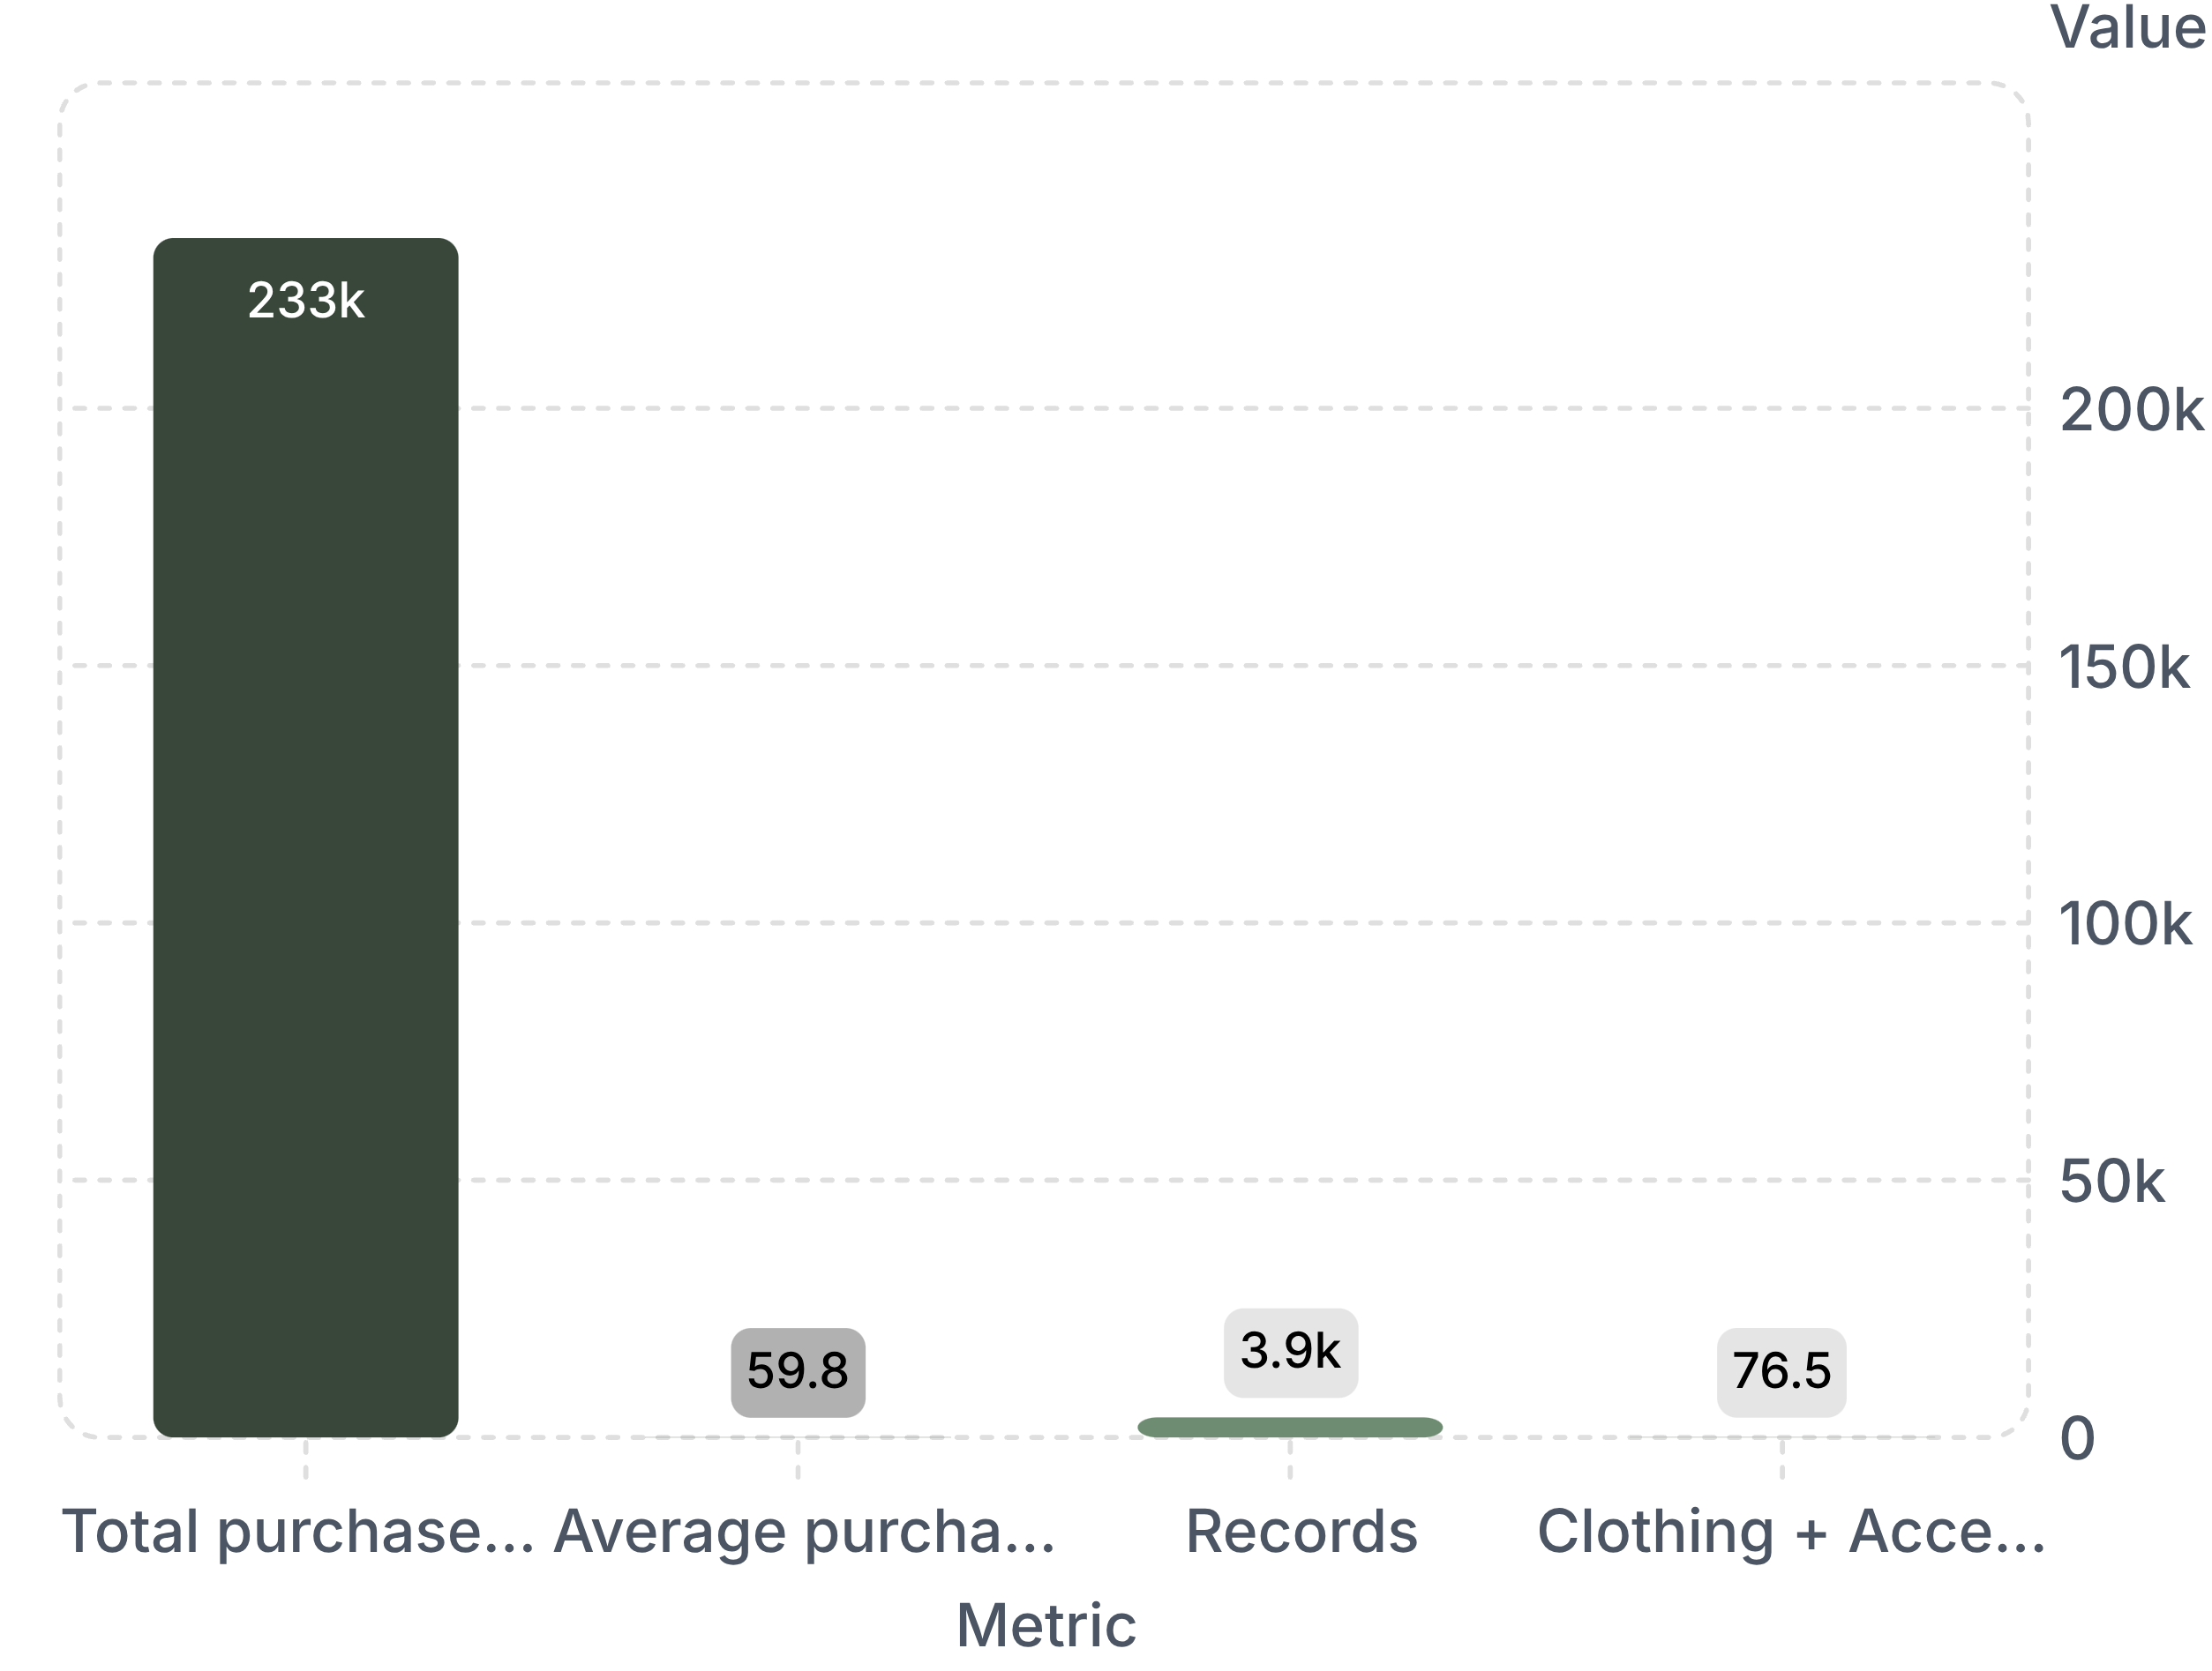
OVERALL PERFORMANCE
$233,081 recorded purchase value sets a $59.76 baseline
Overall performance is healthy enough to prioritise experiments, but average differences are modest and should be validated rather than over-interpreted.
Clothing and Accessories together represent about 76.5% of recorded value.
Executive KPIs · values shown exactly as recorded

Slide 4
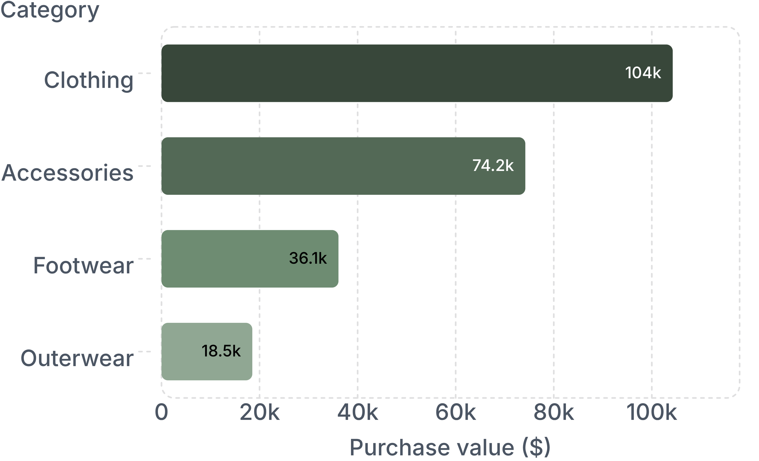
CATEGORY AND PRODUCT MIX
Clothing and Accessories carry the commercial centre of gravity
Top items: Blouse $10,410 · Shirt $10,332 · Dress $10,320 · Pants $10,090 · Jewelry $10,010
Average category value: Footwear leads at $60.26, followed closely by Clothing at $60.03.
Inventory signal: Medium is the most purchased size at 1,755 records; Olive leads at 177.
Implication: scale opportunities sit in the two largest categories; Footwear is a candidate for volume-building tests.
Category contribution · purchase value ($)

Slide 5
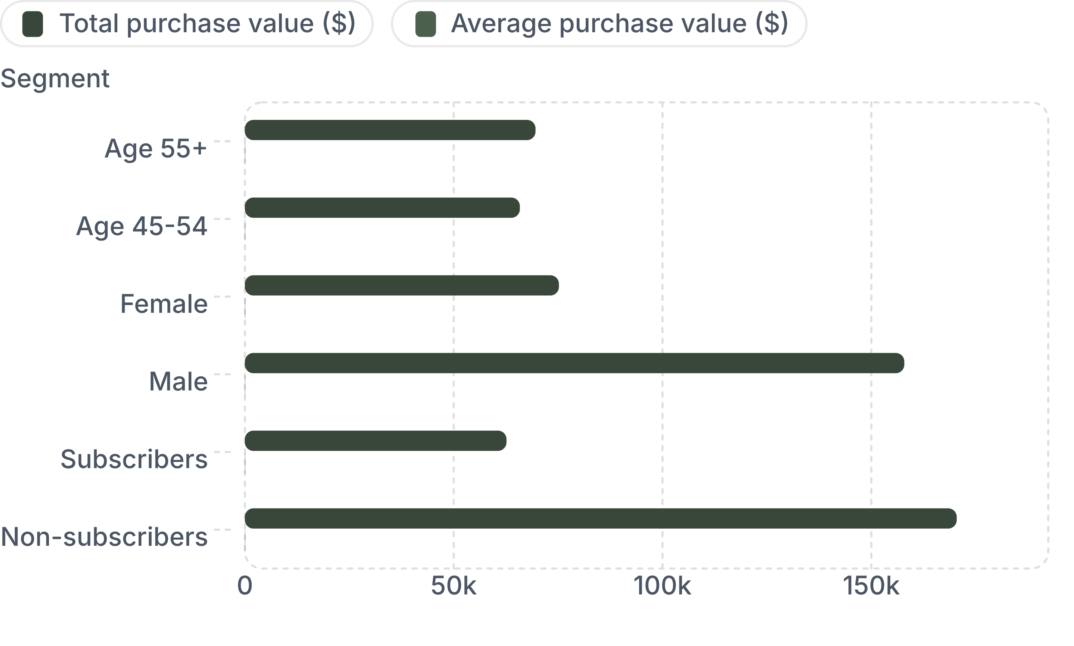
SEGMENT READ
Volume explains more of the gap than customer identity
Age: 55+ contributes the highest total at $69,590 across 1,178 records; ages 45–54 lead average value at $60.33.
Gender: female averages $60.25 versus $59.54 for male customers; male total is larger because there are more records.
Subscription: non-subscribers contribute $170,436 versus $62,645; averages are nearly identical at $59.87 and $59.49.
Total value follows audience size; average values stay close across segments.
Descriptive differences are not evidence that demographics or subscription status cause spend.

Slide 6
LOCATION OPPORTUNITY
Some smaller markets spend more per record
Opportunity group | Location · records · average purchase value
High volume / lower average | California — 95 records at $59.00; Alabama — 89 records at $59.11; Minnesota — 88 records at $56.56
Lower volume / higher average | Alaska — 72 records at $67.60; Pennsylvania — 74 records at $66.57; Arizona — 65 records at $66.55
Highest total locations
Implication
Montana $5,784; Illinois $5,617; California $5,605.
Use a volume × average-value view to prioritise local basket-building and acquisition experiments, not a league table alone.

Slide 7
PROMOTION AND OPERATIONS
Promotion and operations remain hypotheses to test
Promotion status | Records | Average purchase value ($)
No discount / no promo code | 2,223 | 60.13
Discount / promo code | 1,677 | 59.28
Discounts: a $0.85 gap. Promo codes: the same averages are reported.
Supported: describe usage and association, but do not claim incremental lift or profitability.
Open: seasonal comparisons, shipping and payment relationships need dashboard exploration or additional validated result tables before drawing conclusions.

Slide 8
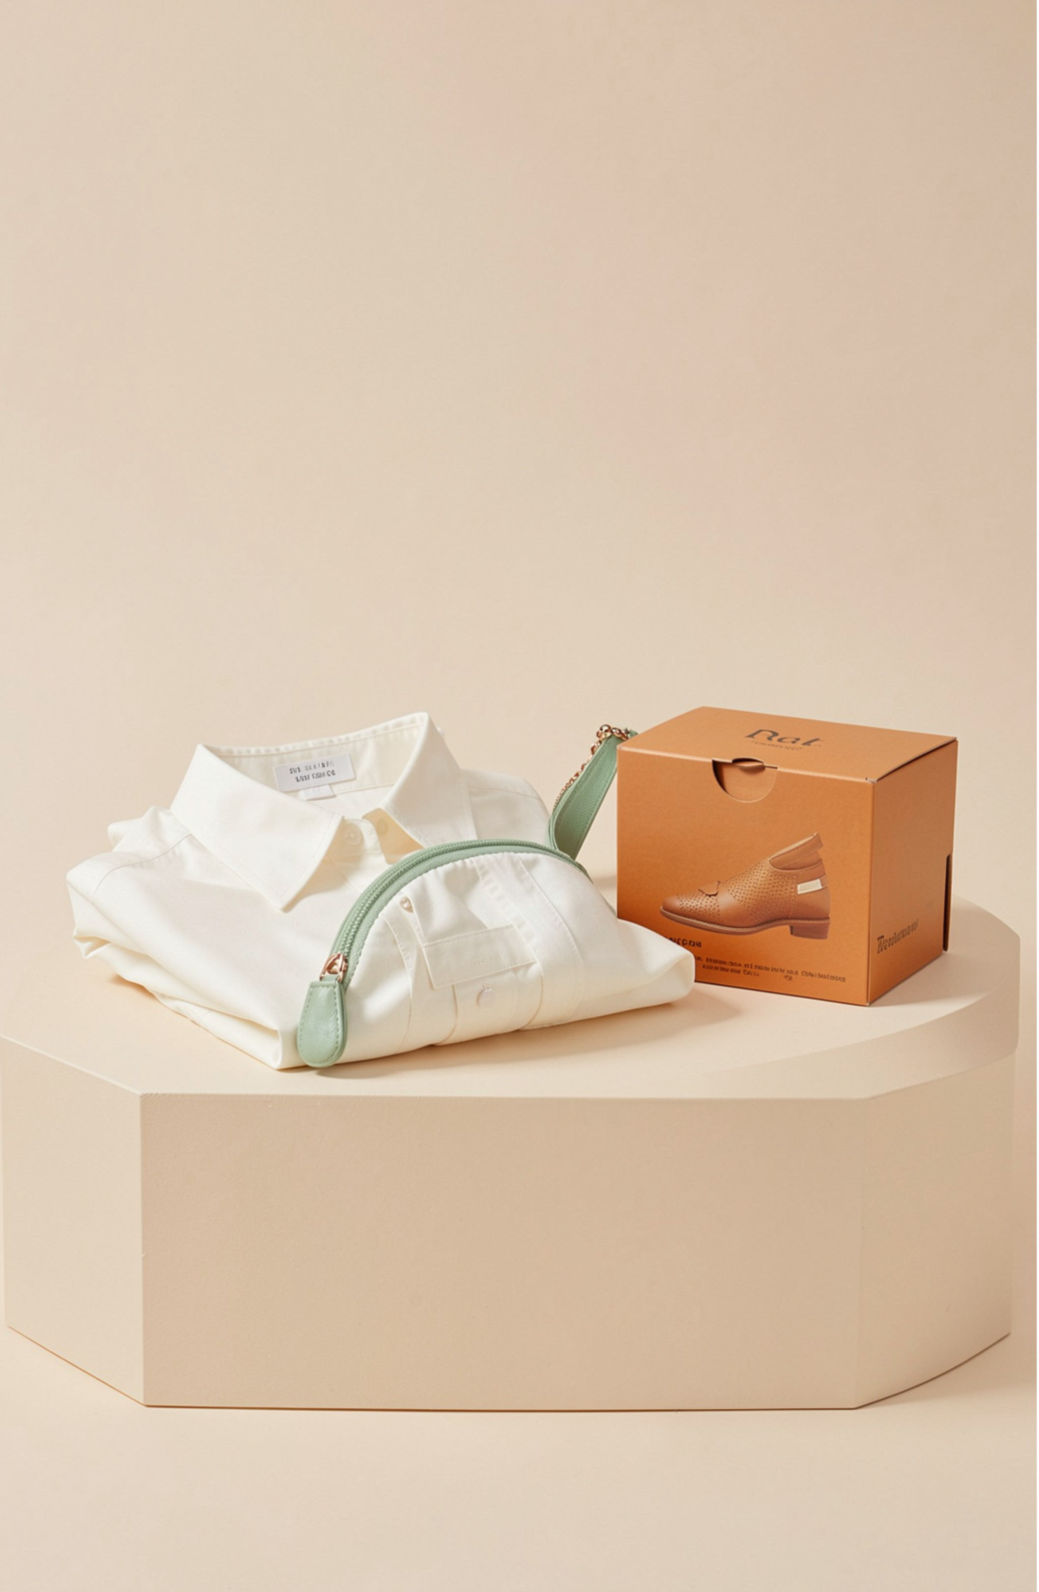
FROM EVIDENCE TO LEARNING
Three controlled tests can turn evidence into growth learning
Cross-sell Clothing and Accessories: Build complementary recommendations around Blouse, Shirt and Dress; track average purchase value, total purchase value and units per order against a holdout.
Build baskets locally: Test bundles or threshold offers in California, Alabama and Minnesota; compare against a matched baseline and account for discount cost when available.
Target by behaviour, then validate: Test age/gender/category recommendations and evaluate subscriber engagement separately; scale only on incremental lift.
Success line: Each action is an investigation, not a guaranteed outcome.

Slide 9
MANAGEMENT TAKEAWAY
Scale where the data is concentrated, learn where the signal is strongest
Top five insights: $233,081 total value; Clothing and Accessories are 76.5% of value; Blouse leads item totals; location averages vary more than totals; promotion differences are small
Monitor: category mix, product ratings, local basket value, subscriber engagement and incremental lift.
Cannot establish yet: profitability, marketing ROI, month-over-month growth, retention and customer lifetime value.
Next step: add dates, order IDs, product cost, promotion cost, returns and customer-level history to connect sales patterns to commercial impact.
Management takeaway: prioritise experiments around the existing value engine, then scale only where controlled evidence proves the economics.

