Slide 1

Capstone Rides Data Analysis

Slide 2
Objective:
RIDE IT is a multi-service mobility platform that connects riders with reliable transportation.
Our goal is to analyze driver-related data to uncover key trends, patterns, and performance metrics — and use these insights to propose smart, impactful strategies that boost driver engagement and satisfaction.

Slide 3

Business Overview
36.77K total drivers with total of 5.89M rides
Drivers Opted for PHV: 5651(15.37%) , TAXI: 31321(85.18%) and Both: 201 members only.
75% of the Drivers opted to receive marketing notifications
From overall Bookings we can see 81.8% ride completion rate and 18.2% cancellation rate.
Peak activity on these days (Friday-Saturday: 939K-914K rides)

Slide 4
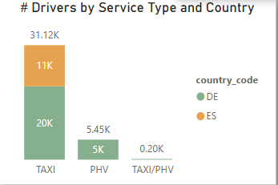
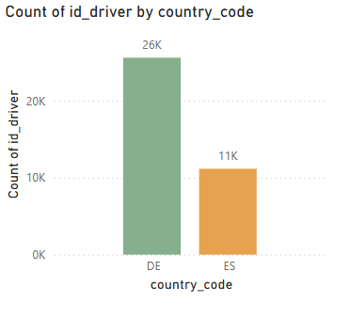
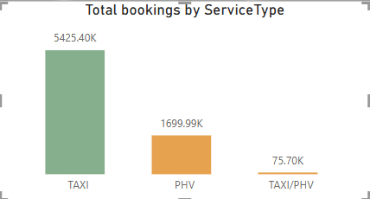
Market Size
25M total offers generated 7.20M bookings at 28.4% conversion rate
Germany having more drivers 25.6K than Spain 11.17K
Spain Drivers chose TAXI(11.17K) only and majority drivers in Germany chose TAXI(19.95K) , PHV(5.45K) and Both : 201.
TAXI service leads bookings (5.43M) over PHV (1.70M) and Both: 75K+

Slide 5
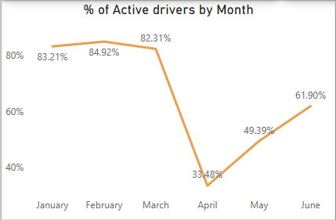
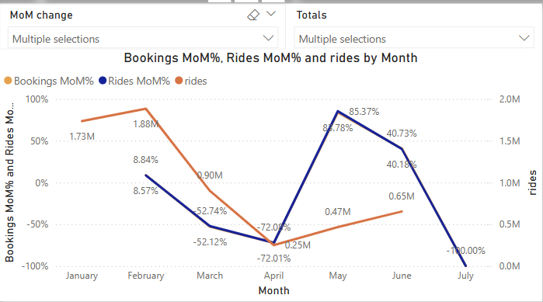
Monthly Trends
Driver activity peaked in February (84.92%) then declined to (33.48%) in April
Again, Recovered from May onwards (49.39% to 61.90% in June)
Offers, Bookings and Rides show similar seasonal pattern with March-April.
Highest Rides done in February 1.88M and lowest in April 0.25M.

Slide 6
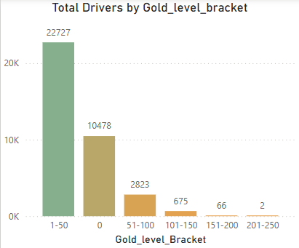
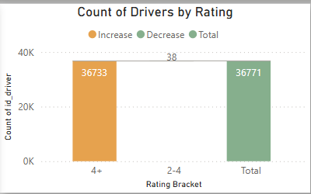
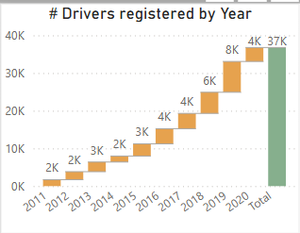
Driver Quality
Balanced rating distribution: 36,733 drivers (4+ stars) vs 38 (2-4 stars)
Constant Drivers registration growth from 2011 – 2019 but less in 2020
Most drivers (22,727) in 1-50 gold level bucket so rides too.
Marketing reach: 17.1K drivers in Germany(25k), 9.1K in Spain receiving promotions(11.17k)

Slide 7
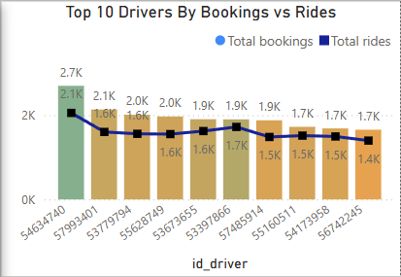
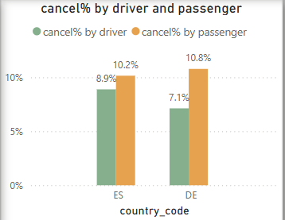
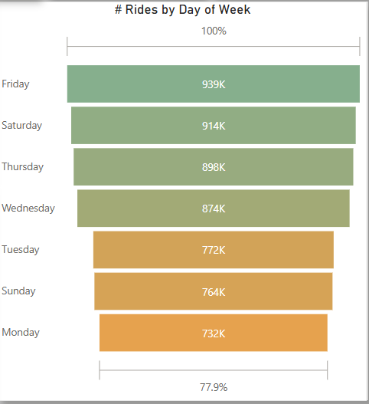
Service Efficiency.
Weekend demand significantly higher than weekdays
Peak conversion period: March-April (41.6% offer-to-ride pct)
Top Drivers maintain consistent 2K+ bookings and 1.7K+ rides
Lower Gold level count Drivers done much rides.
Most cancellations done by passenger(10.2%) and driver(8.9%) in overall bookings

Slide 8
Possible reasons for decline in Offers and bookings
Covid is the main reason for less no of drivers active after march.
Less no of drivers and customers contributed less offers and less bookings.
In Germany as well as Spain they started removing lockdown slowly from may, so that was reason drivers slowly returned to drive and customers started to use the platform.
Possible reason for high offers, bookings and rides in some days for ex: Jan 1 (new year) due to high volume of customer might want to travel.

Slide 9
Recommendations
Set Weekly Targets: Introduce weekly ride goals with bonuses so drivers aim to complete more rides, reducing cancellations.
Gather Feedback via Surveys: Send forms to inactive drivers to understand their concerns and suggest improvements.
Bonus for Notifications Opt-in: Offer a small reward for drivers who enable marketing notifications to boost communication reach and tell them why it is important.
Fix Driver Shortage in Spain: Launch a joining bonus to attract new drivers and improve availability.
Avoid Complicated Rules: Keep policies simple — too many restrictions make drivers and customer's churn.
Offer Small Driver Loans: Provide optional small loans with just 10% weekly repayment from earnings — this supports drivers financially and motivates them to complete more rides consistently.
Give good amount of Bonus for Monthly Top 10 drivers which will motivate other drivers to complete more rides and to reduce cancellations too.

Slide 10
Thank You

