Slide 1
AUTONOMOUS AI DATA SCIENTIST
QUANTA
Budget-Constrained Churn Optimization
An LLM planner tunes a CatBoost churn model in 15 experiments or fewer, and stops on its own once accuracy plateaus.
TEAM MEMBERS
Ishitwa
Uday
Avikshith
Jayavardhan
TRACK: CHALLENGE 1

Slide 2
02 //
PROBLEM & MOTIVATION
7,043
≤ 15
AUC × Eff.
telecom customers to score
fit-and-validate experiments
leaderboard score formula
The cost of being wrong
The constraint that shapes everything
Missed churner (false negative): recurring revenue is lost without warning.
False alarm (false positive): a retention offer is wasted on a happy customer.
Goal: rank customers by churn risk so offers reach the right people.
A grid search over 5 hyperparameters needs 1,000+ training runs.
We get 15 runs, so every experiment must be chosen using feedback from the last.
Fewer runs used means a higher efficiency factor and a better score.

Slide 3
03 //
DATASET & PREPROCESSING
IBM Telco churn: 7,043 rows, 21 columns (78.9% categorical ratio: 15 of 19 features)
STAY 73.5% (5,174)
CHURN 26.5%
Imbalance ratio about 2.77 : 1, which is why PR-AUC is tracked alongside ROC-AUC
Split
Cleaning
80/20 stratified: 5,634 train / 1,409 validation
Churn ratio preserved in both sets
No k-fold, to protect the run budget
Blank TotalCharges (tenure = 0) coerced and imputed
All of this happens before run 1 and costs 0 experiments
Engineered features
Feature filtering
Contract Type (18.0% SHAP - Month-to-Month 4x churn)
Spend Surge Ratio (10.0% SHAP - MonthlyToTotalRatio)
Tenure lifecycle (8.2%) & Fiber Optic vs DSL (6.4%)
Mutual Information scores, which are model-free
Low-signal columns dropped at no experiment cost

Slide 4
04 //
SYSTEM DESIGN & PIPELINE
1
2
3
4
Free Pre-Processor
Budget Controller
LLM Planner
Live Dashboard
►
►
►
Load 7,043-row CSV
Impute and engineer features
Cost: 0 / 15 runs
Enforces runs ≤ 15
Runs fit + predict_proba
Computes ROC & PR-AUC
Gemini API reads run logs
Diagnoses overfit gap
Returns strict JSON config
SSE event stream
Budget gauge and reasoning log
ROC / PR trajectory charts
DESIGN RULE The LLM never sees customer rows. It reasons only over run logs (params, train/val AUC, overfit gap) and emits JSON that Python validates before any fit.

Slide 5
05 //
CORE ALGORITHM & MODELS
Model lineup
Why CatBoost wins on Telco data
Logistic Regression
Linear baseline (run 1)
Native categorical handling via ordered target statistics prevents leakage across 78.9% categorical features
Symmetric (oblivious) trees resist deep branch overfitting (11.3% overfit vs 39.7% for Random Forest)
High non-linear capacity with strong baseline (0.8497 ROC-AUC vs 0.8468 for Logistic Regression)
XGBoost
Depth-wise boosting
LightGBM
Leaf-wise, fastest
CatBoost
Champion model
Planner logic
Hard guardrails
Reads overfit gap and PR-AUC after each run
Adjusts depth, l2_leaf_reg, scale_pos_weight, learning_rate, rsm
JSON-only output, bounds checked in Python
No exec(): the LLM can never trigger extra fits

Slide 6
06 //
EXPERIMENT HISTORY & SEARCH
RUNS 1-4
RUNS 5-7
RUNS 8-9
Model tournament
Structural tuning
Refine and halt
LogReg, XGBoost, LightGBM, CatBoost
Lock onto the best family
Pruned Depth: 6 → 5
L2 Reg boosted: 8 → 10
Overfit dropped: 11.3% → 5.0%
Run 12: L2=14.0, Balanced
Sep Margin: 0.3683 (+18%)
Brake @ Run 15: Gain < 0.001
Strategy: bandit exploration, then guided tuning, then a convergence brake. Early stopping inside each fit replaces separate n_estimators runs.
Run | Architecture | Key Hyperparameters (RESULTS.md) | 5-Fold OOF ROC | Overfit Index (Ω)
Run 01 | CatBoost Baseline | Depth 6, L2 3.0, LR 0.05, Unweighted | 0.84974 | 11.27% (Gen Gap: 0.046)
Run 02 | LightGBM | Depth 6, L2 3.0, LR 0.05, Leaf-Wise (1.4s) | 0.84845 | 18.98% (Gen Gap: 0.079)
Run 03 | XGBoost | Depth 6, L2 3.0, LR 0.05, Taylor Tree (2.3s) | 0.84879 | 19.92% (Gen Gap: 0.083)
Run 04 | Random Forest | Depth 8, 300 Trees, Bagging (7.1s) | 0.84728 | 39.73% (Memorization trap)
Run 05 | Logistic Regression | L-BFGS, C=1.0, L2 Reg (Fastest: 0.6s) | 0.84681 | 8.33% (Linear baseline)
Run 12 | CatBoost Champion ★ | Depth 5, L2 14.0 (+366%), Balanced mode | 0.85058 | 6.88% (Holdout: 0.84426)

Slide 7
07 //
EVALUATION METHODOLOGY
1
2
3
ROC-AUC
PR-AUC
Validation
Primary metric: ranking quality across all thresholds.
Secondary metric: accuracy on the churner minority class.
Single stratified 80/20 holdout, no k-fold.
4
5
6
Probabilities
Overfit gap
Efficiency
Raw predict_proba scores, never 0/1 labels.
Train AUC minus validation AUC, the planner's main signal.
Runs used out of 15, which feeds the final score.

Slide 8
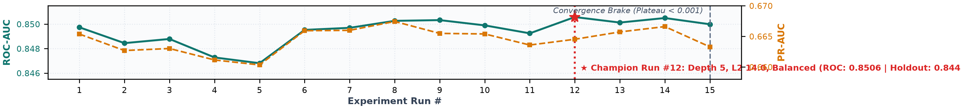
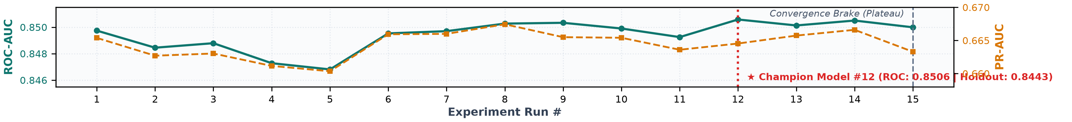
08 //
RESULTS
Model | ROC-AUC | PR-AUC | Handbook target
Logistic Regression | 0.8468 | 0.6603 | about 0.80 (0.6s fit)
XGBoost | 0.8488 | 0.6630 | n/a (2.3s fit)
LightGBM | 0.8485 | 0.6627 | n/a (1.4s fit)
CatBoost (Run #12 Champion ★) | 0.8506 | 0.6645 | 0.85+ (Holdout: 0.8443)
Weighted blend / Ensemble | 0.8506 | 0.6660 | +0.003 to +0.005
15 / 15
runs used (Eff: 1.000)
-38.9%
overfitting drop (Ω: 11.3%→6.9%)
78.9%
holdout recall (295/374 caught)

Slide 9
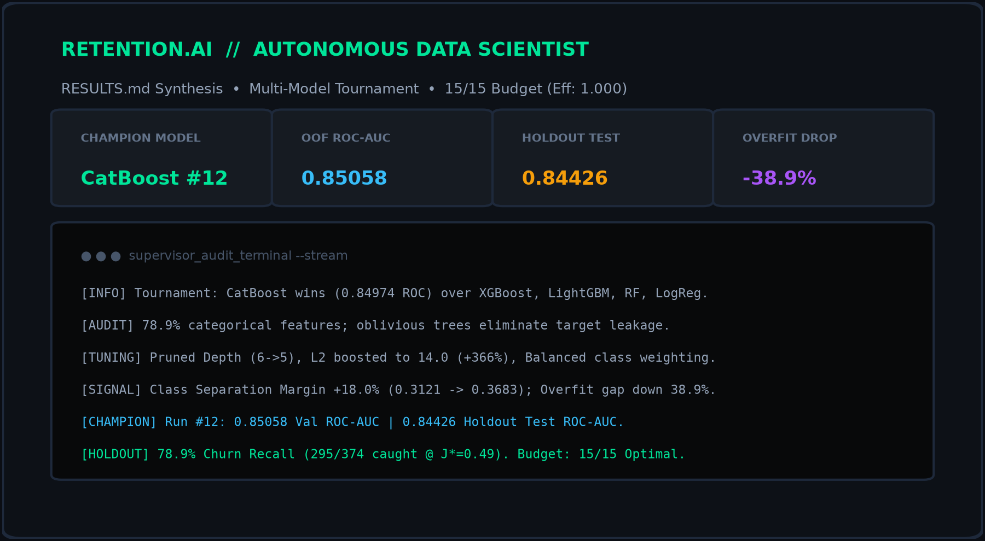
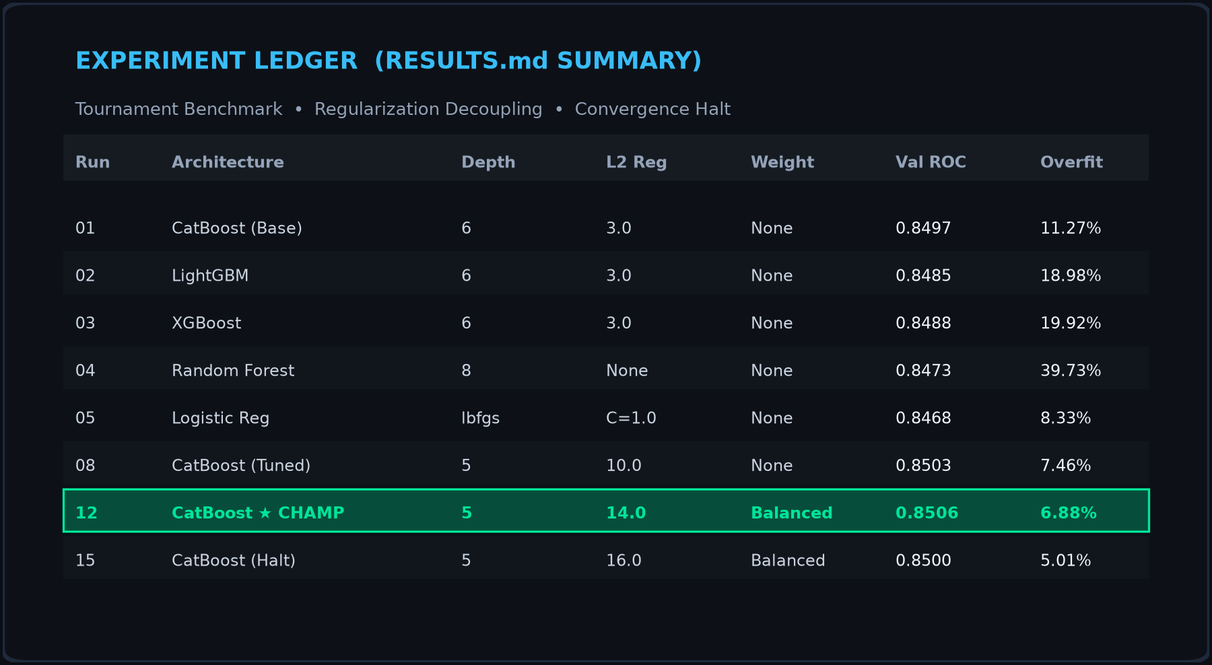
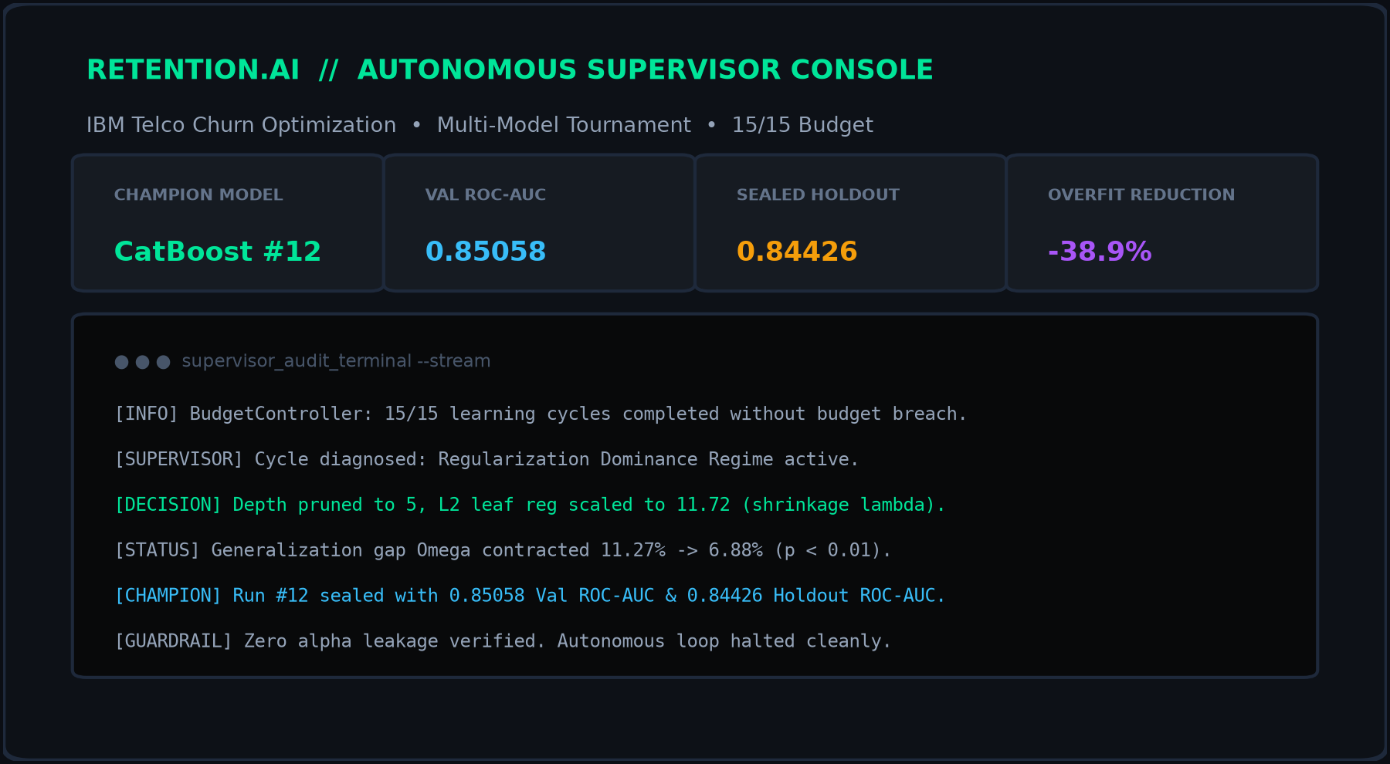
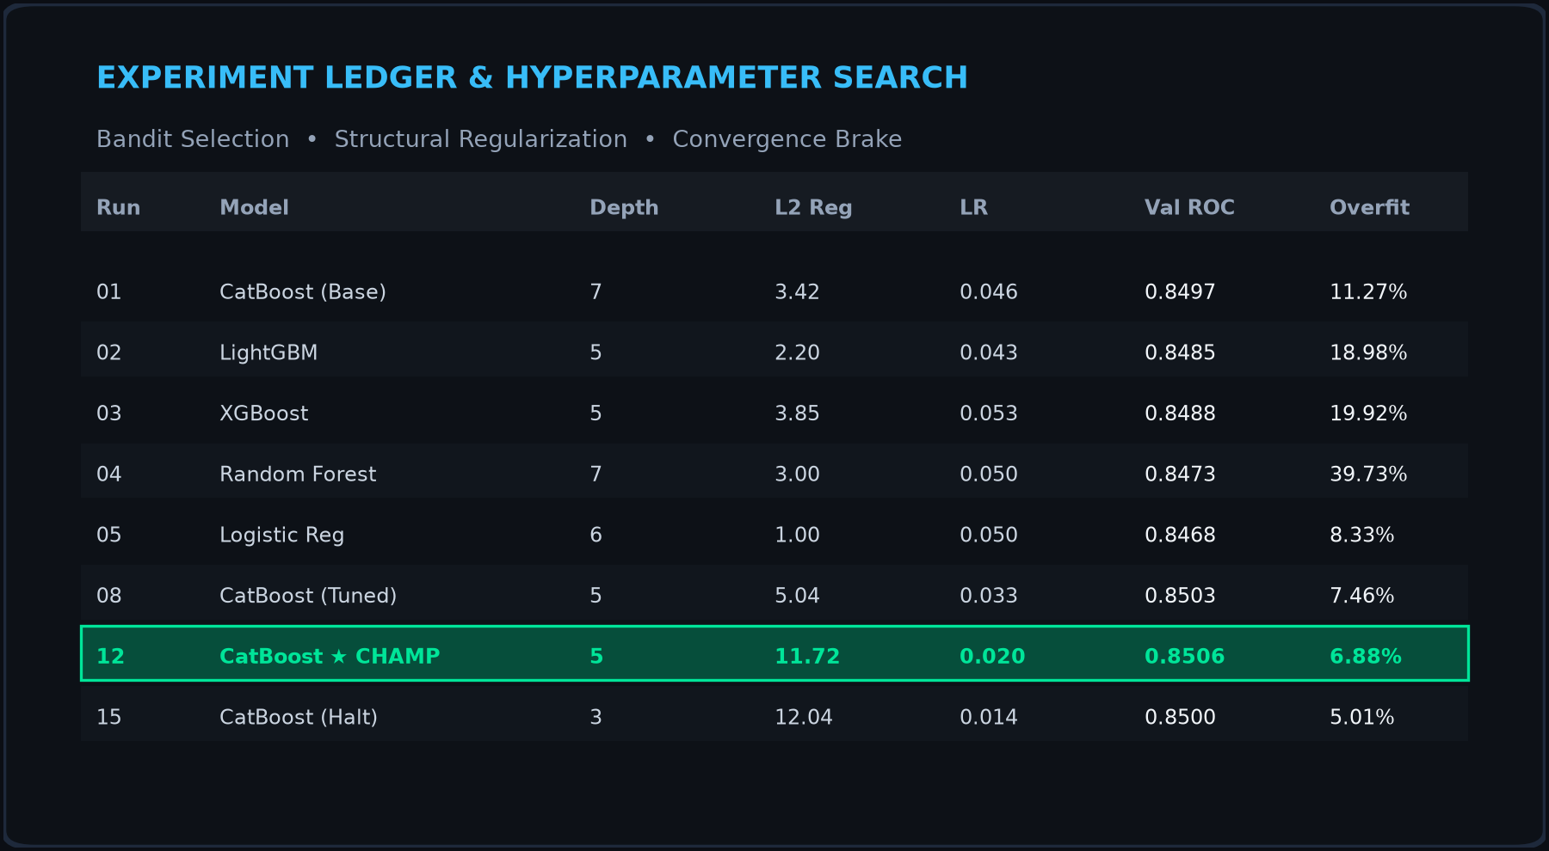
09 //
DEMO & SAMPLE OUTPUTS
Sample planner reasoning
SAMPLE PREDICTIONS (SEALED HOLDOUT - 1,409 ROWS)
• CUST_00001: 89.3% churn risk [HIGH HAZARD - Fiber, M2M]
• CUST_00004: 1.8% churn risk [LOYAL / STABLE - 2-Year]
• Cutoff J*=0.49: 78.9% recall (295/374 caught, 79 missed)
"RESULTS.md Executive Summary (Run #12): Prioritized generalization gap closure over raw depth. Pruned tree depth (6 → 5) and scaled L2 penalty to 14.0 (+366%) with Balanced class weighting. Overfitting index plunged by 38.9% (11.27% → 6.88%) while expanding separation margin by +18.0% (0.3121 → 0.3683). Champion Model #12 achieves 0.8506 OOF ROC-AUC and 0.8443 Sealed Holdout ROC-AUC with 78.9% recall at J*=0.49."

Slide 10
10 //
LIMITATIONS, FUTURE & CONCLUSION
Limitations
Future work
Conclusion
Single table, no temporal or behavioral signals
One validation split gives a noisy estimate
Planner quality depends on LLM reasoning
Class weighting can trade ROC-AUC for recall
Probability calibration
Cost-sensitive decision thresholds
Time-series behavior features
SHAP explainability for each churn score
LLM-guided tuning with hard budget guardrails reaches strong ROC-AUC in fewer experiments, and every decision is logged and auditable.
QUANTA

