Slide 1


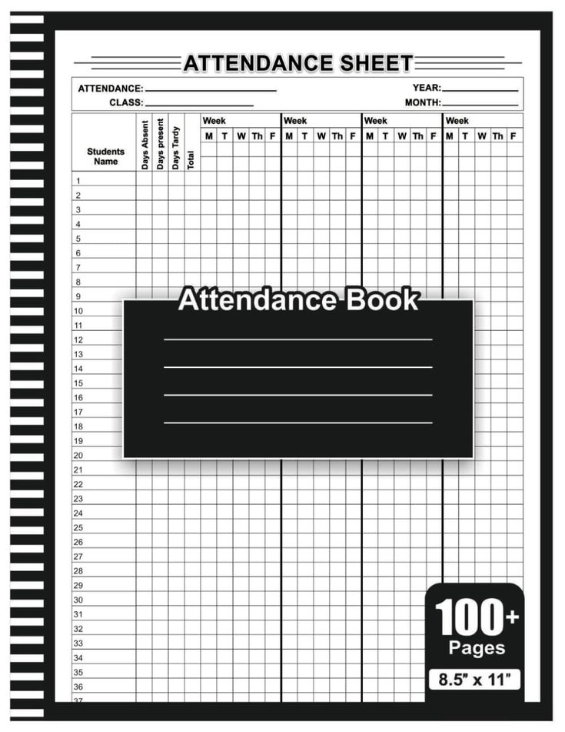


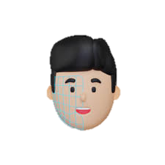
SMART
ATTENDANCE
SYSTEM
VIA FACE RECOGNITION

Slide 2



Welcome
“Welcome to the presentation on our project, Smart Contactless Attendance System using HUSKY LENS & ESP32 .This innovative system leverages IoT and computer vision to automate and simplify attendance tracking . We are pleased to present our work, highlighting its objectives, design, and real-world applications.”

Slide 3




Navigating Our Journey
Introduction & Project overview
Core Functionality
01
02
How hardware and software integrate.
Understanding the core purpose of the Smart Contactless Attendance System
Implementation
Steps
Component Checklist
03
04
Detailed look at essential hardware
and software.
A practical guide to building the system.
Advance Capabilities
05
06
Conclusion
Summing It Up
Exploring potential enhancements
and next steps.

Slide 4

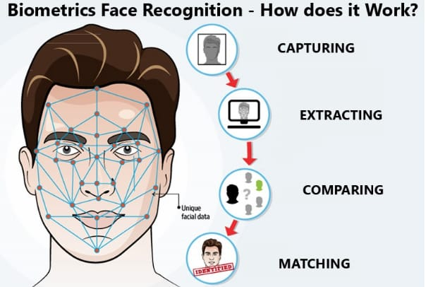

INTRODUCTION
Why Contactless Attendance?
In today's environment, hygiene and automation are paramount. Manual attendance systems are:
Time-consuming and inefficient.
Prone to errors and proxy attendance.
Require physical contact (pens, registers),
posing health risks.
Our solution offers a modern, accurate, and hygienic alternative, streamlining the attendance process for institutions.

Slide 5
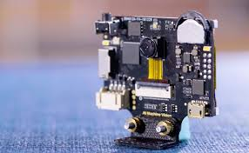
Core Concept
System Objectives
The primary goals of this project are to:
Develop an IoT-based system for automated attendance.
Capture and identify individuals using facial recognition.
Operate entirely contactless.
Log attendance data to a remote google sheet/excel platform.
The system aims for real-time face detection and recognition, automatic attendance
logging, and centralized data storage accessible via a dashboard.

Slide 6
Core Functionality : How it Works
01
02
03
Face Enrolment
Face Capture
Face Recognition
“Student face data is captured for the first time to create a unique profile in the system. This step ensures accurate identification during future attendance marking.”
“The HUSKY LENS captures a live image of the student when they approach the attendance area. This real-time image is sent for processing without any manual intervention.”
“The captured image is compared against stored profiles using embedded facial recognition algorithms. Successful recognition confirms the student’s identity instantly.”
04
05
06
Servo Sweeping
LCD Feedback Display
Data Transmission & Storing
“The servo sweeps from 0° to 180°, scanning the entire classroom to capture all students for complete attendance detection in a single pass.”
“The system displays the recognized student’s name, ID, and attendance status on the LCD in real time, enhancing transparency and user interaction.”
“Attendance data is transmitted to Google Sheets and stored locally on ESP32/SD card, ensuring real-time tracking and secure backup against network failures.”

Slide 7
COMPONENT CHECKLIST
COMPONENTS | PART NO | QUANTITY
HUSKY LENS | SKU: SEN0305 | 1
ESP 32 | ESP32-WROOM | 1
Servo Motor | MG995 | 1
LCD Display | LCD1602 + PCF8574 I²C Module | 1
Breadboard | - | 1
Jumper Wires | - | AS REQUIRES
Battery / Power | 18650 Li-Ion + Boost Converter / 5V Power Bank | 1
USB CABLE | TYPE-C | 1

Slide 8
Essential Components Overview
HARDWARE
HUSKY LENS
“The HUSKY LENS acts as both the eyes and brain, capturing images, processing data, and enabling smart .”
ESP32 — The Central Controller “The ESP32 controls all components, connects to Wi-Fi, and processes data from the Husky Lens to ensure smooth system operation.”
LCD, Servo Motor & Power Supply (5V) “The LCD shows real-time attendance, the servo scans the classroom, and a 5V power supply keeps the ESP32 and all components running reliably.”
SOFTWARE
Arduino IDE
“A platform for programming the ESP32, managing Husky lens camera operations and enabling Wi-Fi-based functionalities.”
Google Sheets API
“Enables cloud-based attendance storage with real-time logging, ensuring centralized access and secure record management.”
Husky Lens Face Recognition “Husky Lens detects and recognizes faces instantly on-device, enabling quick and accurate attendance marking without external processing.”

Slide 9
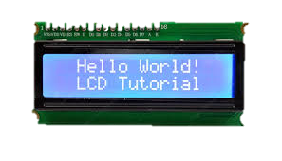
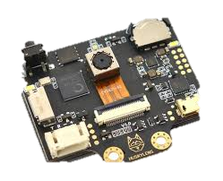

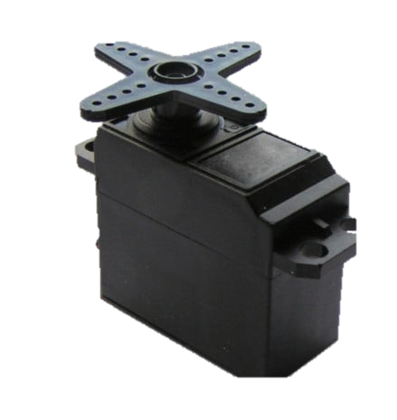

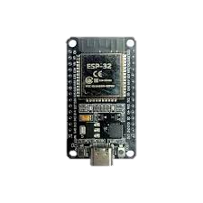
BLOCK DIAGRAM
I2C LCD DIAPLAY
HUSKY LENS
POWER SUPPLY
ESP 32
GOOGLE
SHEETS
SERVO MOTOR
DATA STORAGE &
MARKING ATTENDENCE

Slide 10
Implementation Steps
Component Collection & Setup
ESP32, Husky Lens, Servo Motor, LCD, Breadboard, Jumper Wires, Power Supply.
Hardware Connections
Connect ESP32 with Husky Lens.
Wire Servo, LCD (I²C), and ensure common ground across all components.
🛠️
Software & Environment Setup
Install Arduino IDE
Add ESP32 board support and required libraries (ESP32, Husky lens, Servo, Wire, LiquidCrystal_I2C).
Face Recognition Model Integration
Capture and register student faces via Husky Lens.
Train / encode face data for recognition.
System Programming
Write and upload code for:
Face Detection + Recognition.
Servo sweeping mechanism.
LCD attendance feedback.
Wi-Fi logging to Google Sheets.
💻
🔍
Testing & Debugging
Check individual modules (Servo rotation, LCD output, Wi-Fi connection).
Run end-to-end system test with multiple students.
🎥
Deployment & Demonstration
Mount ESP32 & Husky Lens above the classroom board.
Run live demo: camera scans → face recognized → attendance logged → LCD confirmation → Sheets updated.

Slide 11
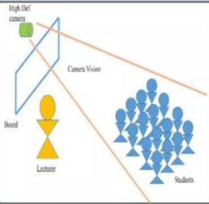
Real-World Scenario
Placing the ESP32 & Husky Lens above the board is ideal. It provides a wide-angle view, minimises tampering, and ensures students face the camera naturally. To handle 50+ students efficiently, consider:
Wide-Angle Lens: Essential for capturing all faces from a distance.
Optimised Lighting: Ensure the classroom is well-lit, possibly adding a small LED for consistency.

Slide 12
SALIENT FEATURES
Contactless & Hygienic
Eliminates physical touchpoints, crucial in
health-conscious environments.
Google Logging
Centralizes attendance data on Google Sheets,
accessible anywhere, anytime.
Accurate & Reliable
Prevents proxy attendance, ensuring precise
records and increased accountability.
Fast & Efficient
Recognizes an entire class of 50+ students
in 2-3 minutes, saving valuable time.
Scalable Solution
Easily adaptable for various settings, including
multiple classrooms, laboratories, and offices.
Modern & Innovative
Showcases the application of IoT and AI in solving
real-world problems, enhancing transparency.
SYSTEM LIMITATIONS
Camera Limitations
Low resolution (2MP OV2640) struggles with long-distance (~20 ft).
Wide-angle lens distortion at edges reduces recognition accuracy.
Poor low-light performance; needs consistent lighting.
Face Recognition Accuracy
Masks, caps, or spectacles reduce detection success.
Similar-looking faces/twins may cause false positives.
Accuracy drops if camera is placed too far or too high.
Processing & Speed
Husky Lens has limited processing capacity.
Large groups (>50 students) may not meet the 2–3 min target.
Multiple moving students can cause delays or missed detections.
Network & Data Issues
Needs stable Wi-Fi for Google Sheets syncing.
Disconnection → attendance not logged.
Risk of latency in large classrooms.
Security concerns if Google Sheets integration is not secured.
Our solution offers a modern, accurate, and hygienic alternative, streamlining the attendance process for institutions.

Slide 13
Future Updates / Enhancements
1.High-Resolution Camera Upgrade
Enhance recognition accuracy in large classrooms and low-light conditions.
Capture finer facial details for improved attendance reliability.
2. AI-Powered Face Recognition
Implement advanced algorithms for faster and more efficient student detection.
Support mask-tolerant and profile-aware recognition for real-world classroom scenarios.
3. Real-Time Dashboard & Servo Control
Enable live monitoring and instant attendance reporting via LCD or web interface.
Provide smooth servo sweep and dynamic feedback for complete classroom coverage.
4. Data Security & System Integration
Encrypt attendance records to ensure secure storage and transmission.
Integrate seamlessly with school or university management systems and cloud backups.

Slide 14
Who Benefits – Target Users & Impact
Students
Quick, hygienic entry without queues or physical cards. Natural flow into classrooms without disruption.
Teachers
Reclaim valuable teaching minutes. Focus on instruction instead of roll calls and paperwork.
Institutions
Access accurate attendance analytics, compliance reports, and real-time monitoring .
Parents
Receive real-time attendance alerts and gain visibility into their child's presence at school.
Government & Boards
Enable standardized attendance tracking across institutions for policy-making and resource allocation.

Slide 15
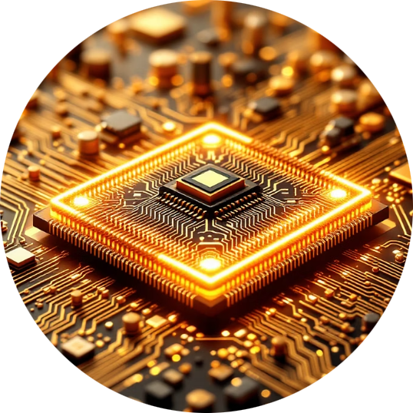



Innovation & Uniqueness
No Complex Training
Anti-Proxy Protection
Pre-trained HuskyLens AI eliminates lengthy model training, enabling instant deployment.
Fraudulent attendance attempts made by students can be eliminated
Offline-First Architecture
Zero Contact
Local storage with intelligent cloud sync ensures data integrity under any network condition.
Completely touchless operation maintains hygiene standards in high-density environments.

Slide 16
Impact & Long-Term Vision
Feasibility & Viability
Immediate Impact
Cost-Effective Hardware
Save 5-10 minutes per class session daily
Eliminate proxy attendance entirely
Complete system under ₹8000 per classroom makes it accessible for budget-conscious institutions.
Reduce attendance errors by 95%
Enhance institutional credibility
Improve data accuracy for compliance
Standard Infrastructure
Operates on existing classroom WiFi networks with no specialized requirements or upgrades needed.
Long-Term Vision
Smart Campus Gates
Simple Installation
Automated entry/exit tracking across entire
campus infrastructure
Plug-and-play setup completed in under 30 minutes with minimal
technical expertise required.
Mobile Integration
Dedicated apps for parents, teachers, and
administrators
Offline Reliability
Functions independently during network outages, ensuring uninterrupted
attendance tracking.

Slide 17
Go-To-Market Strategy
Our strategic approach to market entry focuses on progressive deployment across educational and corporate sectors, beginning with targeted pilot programmes and scaling through strategic partnerships.
Target Institutions
Phase 1: Pilot Deployments
Schools, colleges, corporate training centres, and government educational institutions across India seeking automated attendance solutions.
Launch controlled pilot programmes in 2–5 select institutions to validate technology, gather feedback, and demonstrate real-world effectiveness.
Phase 2: Strategic Partnerships B2G
Phase 3: Nationwide Scale
Establish ERP system integrations and initiate state-level onboarding programmes with education departments for wider adoption.
Deploy across India through established EdTech partnerships, leveraging distribution networks and support infrastructure for rapid expansion.
Pricing Structure
Promotional Activities
Hardware unit: around ₹8,000
Live product demonstrations at education exhibitions
Optional cloud subscription for advanced analytics
Campus trial programmes with performance guarantees
Flexible payment models for institutions
Digital marketing campaigns targeting decision-makers

Slide 18
Cost–Benefit Analysis
₹8K
14h
90-95 %
Unit Cost Range
Time Savings
Accuracy Rate
Investment per device: ₹8000 including hardware and installation
Reduces teacher administrative burden by 14 hours monthly
Eliminates proxy attendance completely with facial recognition verification
Potential Intellectual Property (IP)
Our comprehensive IP strategy protects core innovations whilst establishing strong brand identity and competitive advantages in the educational technology market.
Patentable Innovations
Trademark Protection
Copyright Assets
Low-power facial recognition workflow optimised for classroom environments, plus unique offline-first architecture with seamless cloud synchronisation protocols.
CLASSLENS brand name, distinctive logo design, and compelling tagline—establishing recognisable market identity and brand equity.
Complete software codebase, intuitive dashboard user interface, proprietary recognition algorithms, and all associated documentation.

Slide 19
Future Roadmap
ClassLens is built for evolution. Our vision extends beyond basic attendance to create a comprehensive smart campus ecosystem.
Jetson-Based Advanced AI
1
Upgrade to NVIDIA Jetson platform for enhanced processing power, enabling more sophisticated facial recognition algorithms and faster multi-face detection.
2
3D Liveness Detection
Implement depth-sensing anti-spoof technology to detect sophisticated fraud attempts using masks, videos, or printed photographs.
Smart Campus Integration
3
Expand beyond attendance to library access and exam hall verification for a unified campus identity system.
4
Mobile App Ecosystem
Launch native iOS and Android apps for students, parents, and faculty with push notifications, analytics dashboards, and leave management.
Predictive Analytics Engine
5
Deploy machine learning models to identify attendance patterns, predict at-risk students, and provide early intervention recommendations to educators.

Slide 20
CONCLUSION
This project successfully demonstrates a smart, contactless attendance system using ESP32 & Husky Lens with real-time face recognition, LCD feedback, and automated Google sheet logging. It enhances efficiency, reduces manual effort, and provides a scalable solution for modern educational institutions.
“A step towards smarter, automated, and reliable attendance management.”

Slide 21
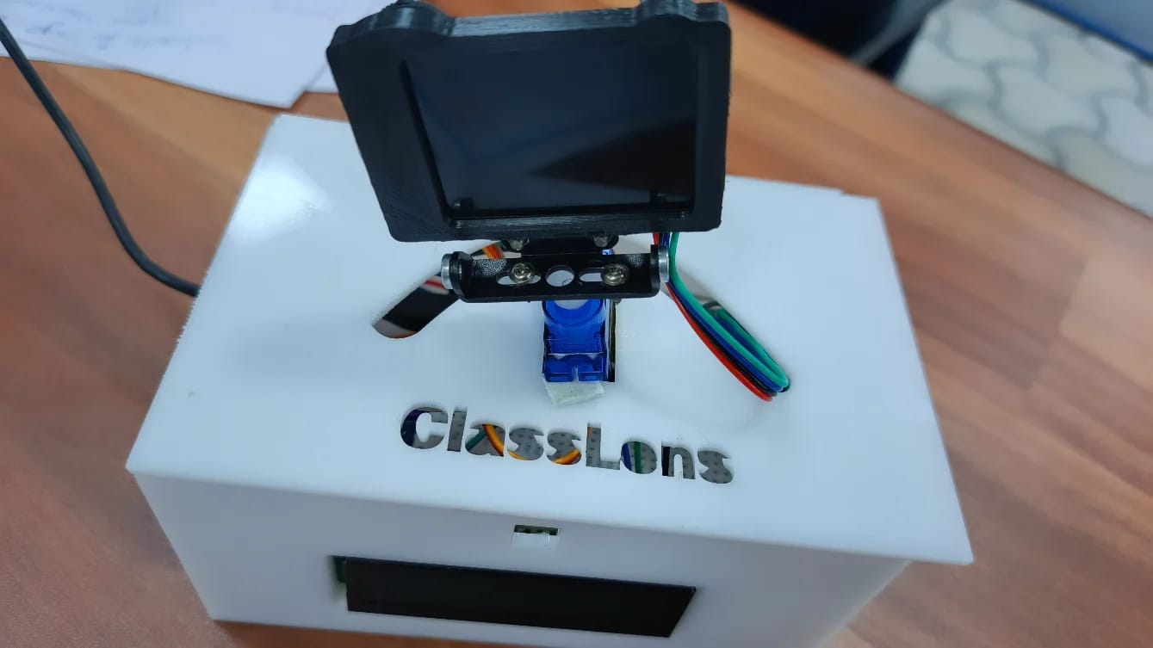
Prototype

Slide 22
Thank you
We truly appreciate your time and kind attention. It was our pleasure to present this work before you.

