Slide 1

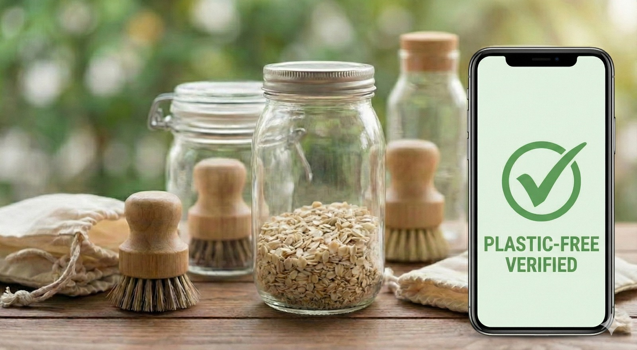

SCAN
GREEN
Plastic-Free Product Checker

Slide 2

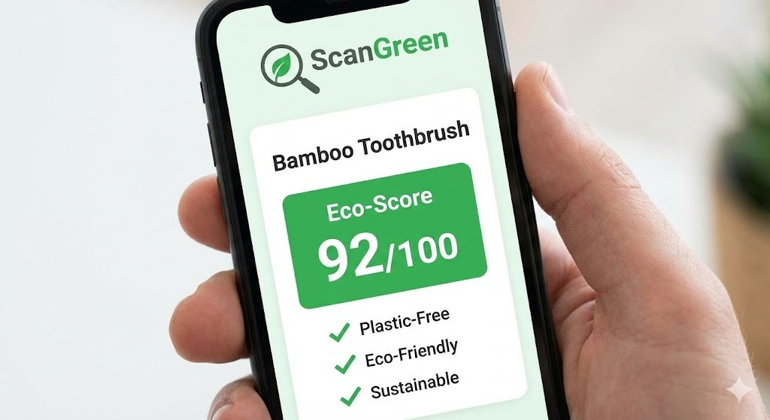
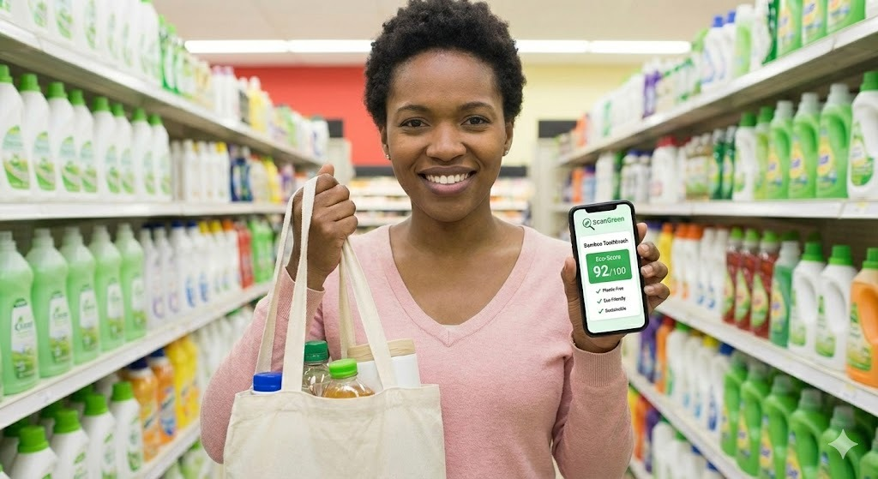
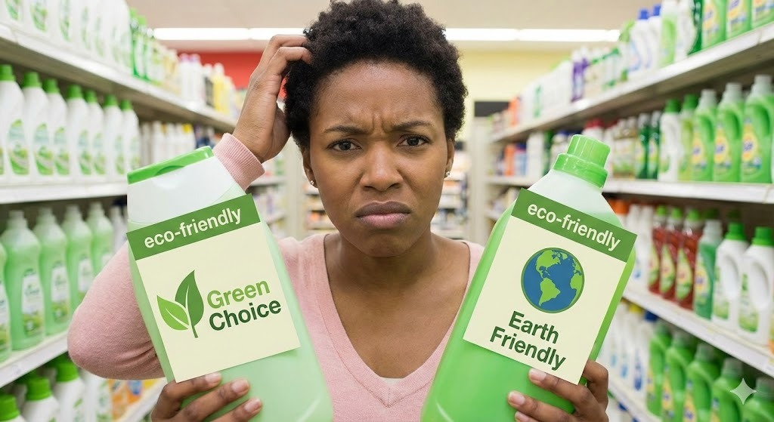
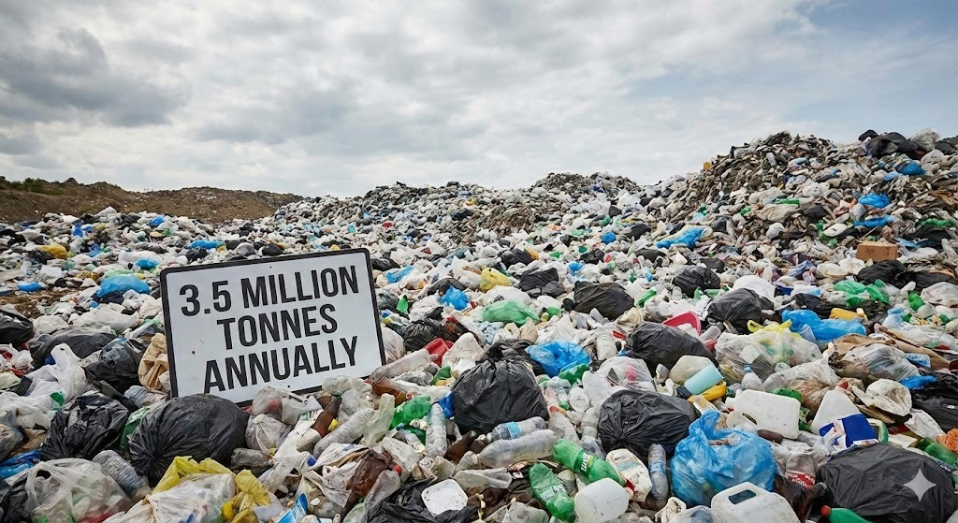
Problem & Why It Matters
❌ The Problem
Consumers cannot easily identify plastic-free or eco-friendly products
Labels are confusing and often misleading (greenwashing)
Lack of clarity leads to excessive plastic waste
🌍 Why It Matters
India generates 3.5 million tonnes of plastic waste annually
Single-use plastics harm land, oceans, and climate
Consumers want sustainable choices but lack decision tools
Solution: ScanGreen
✅ What is ScanGreen?
ScanGreen is an AI-powered product checker that helps users identify whether a product is:
Plastic-free
Eco-friendly
Sustainable
📊 What It Delivers
Clear Eco Score (0–10)
Simple sustainability explanation
Greener alternative recommendations

Slide 3
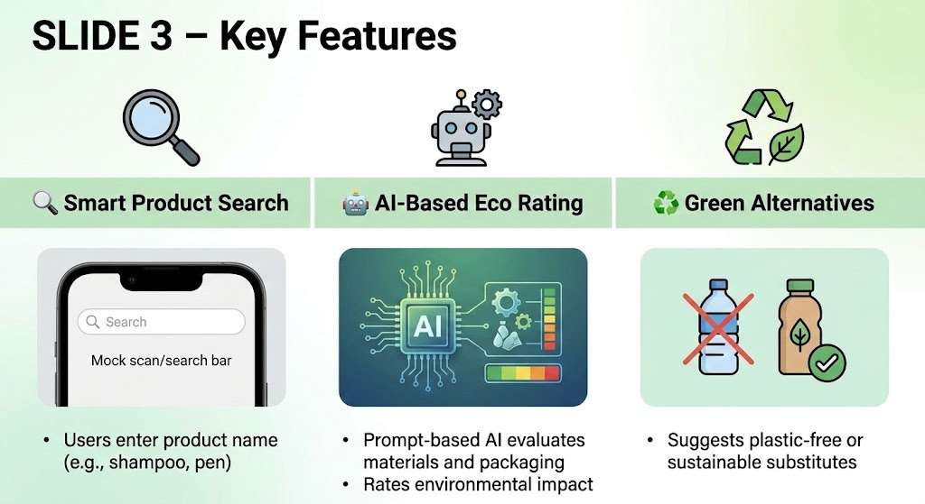

Slide 4
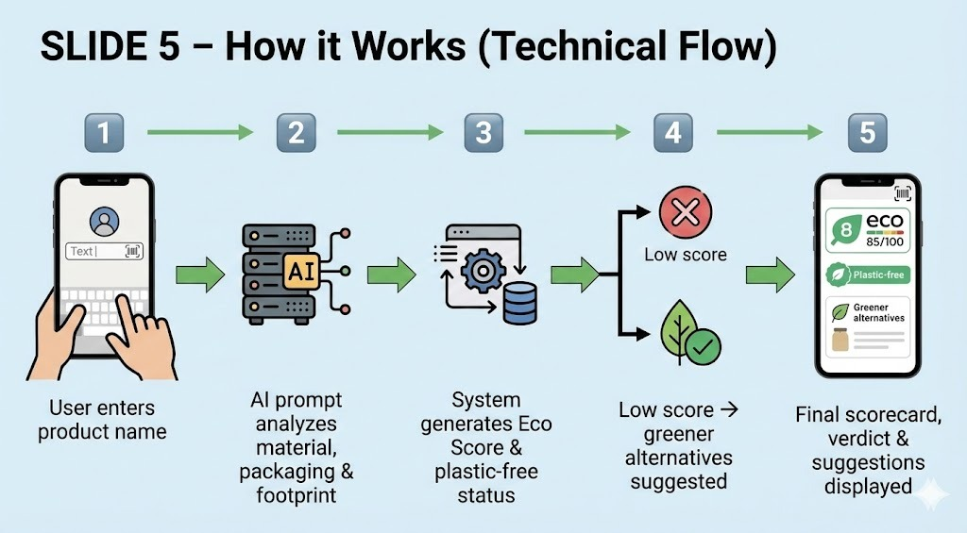
Or
Scan/Upload

Slide 5
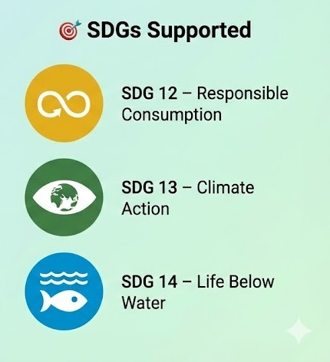
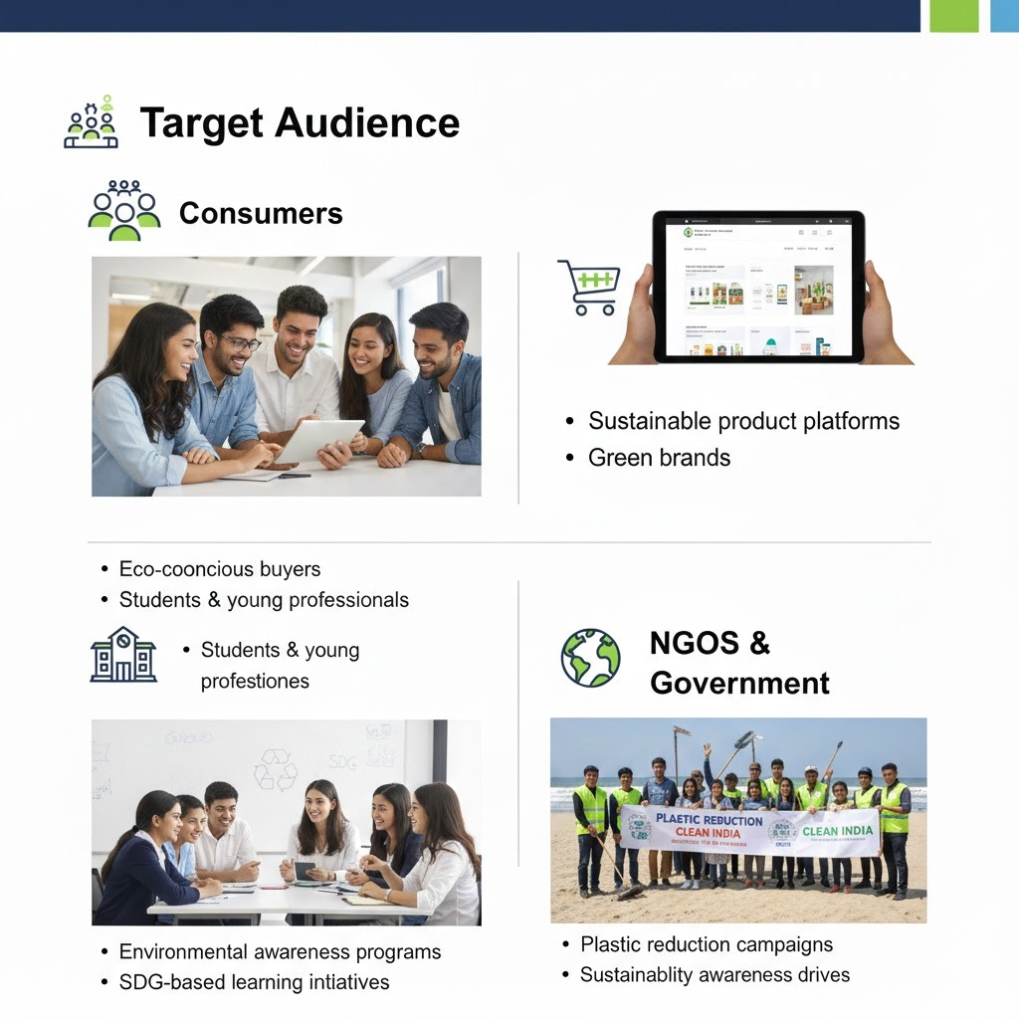

Slide 6
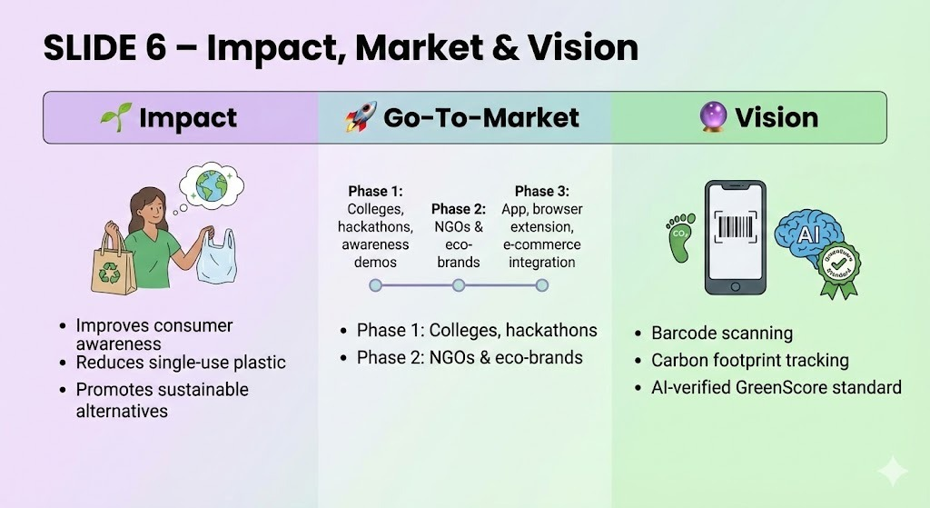
Phase 3: App,browser extension

Slide 7
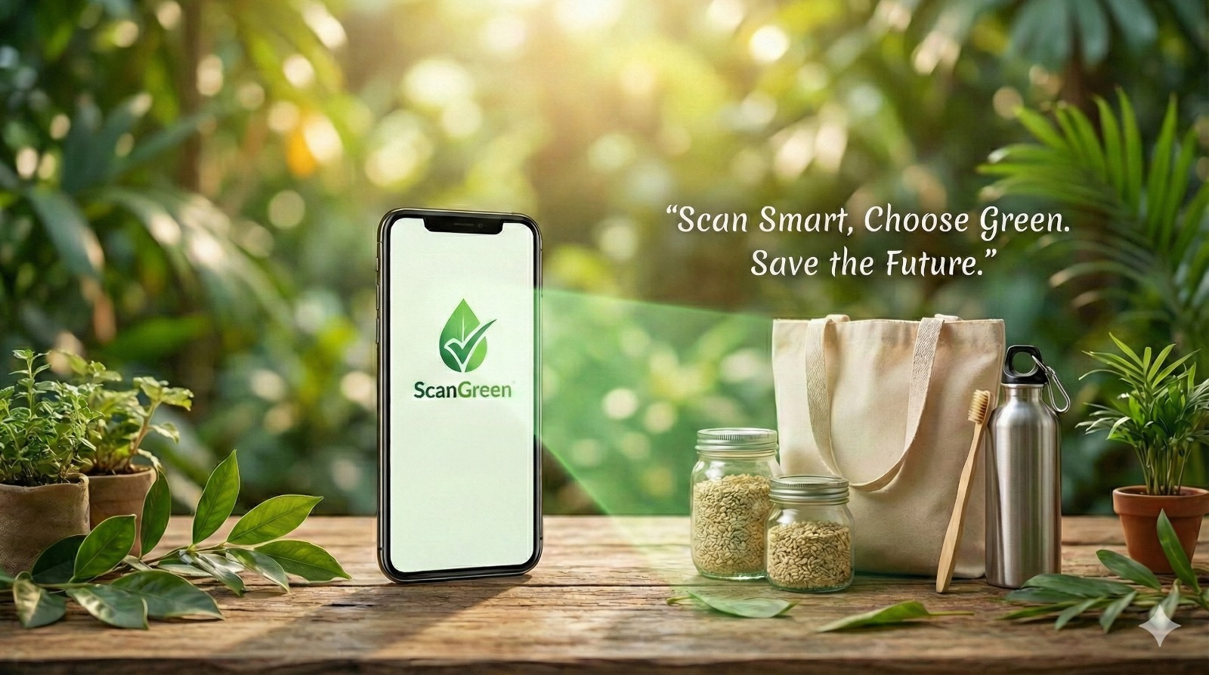
THANK
YOU

