Slide 1
Graph with
Trie – based indexing

Slide 2
Team Members
S.No | Roll Number | Name
1. | CB.EN.U4CSE21408 | Aswin M
2. | CB.EN.U4CSE21441 | Neeli Uday Kumar
3. | CB.EN.U4CSE21442 | Nila Bhaskar
4. | CB.EN.U4CSE21448 | Rithish Abinav N
5. | CB.EN.U4CSE21463 | Abhignya

Slide 3
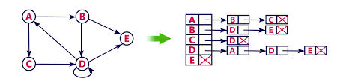
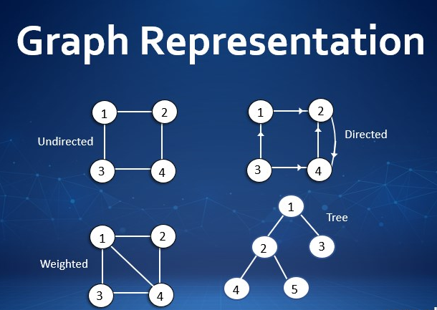
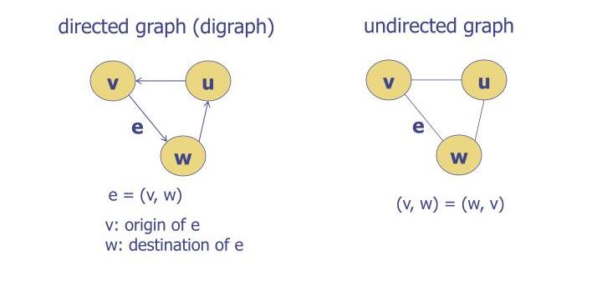
Graphs
Graph is a non-linear data structure.
A graph G= (V,E) is a set of vertices V, and a collection
of edges E which is a subset of VxV.
Edges can be either directed or undirected.
Adjacency List Representation

Slide 4
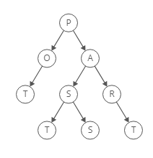
Trie-Based Indexing Data Structure
Trie-based indexing is a data structure that uses a trie, or prefix tree, to efficiently index and retrieve information.
It organizes data in a hierarchical manner, allowing for fast search operations based on prefixes or partial matches.
Trie-based indexing is commonly used in applications such as autocomplete, spell checking, and information retrieval.

Slide 5
Graph with Trie-based Indexing
Hybrid data structures combine the strengths of multiple data structures to efficiently solve complex problems.
This data structure combines the graph representation with the indexing capabilities of a Trie data structure.
Our project focuses on combining Trie-based indexing with graphs to improve efficiency and search capabilities.

Slide 6

Overview

Slide 7
By combining the graph and trie concepts, a hybrid data structure can capture both the hierarchical structure of a trie and the relationship network of a graph. The main idea is to represent the hierarchical structure using trie nodes and use graph edges to represent relationships between different trie nodes.
Here's a high-level overview of how a graph-trie hybrid works:
Each node in the trie represents a common prefix or a full word, depending on the use case. The root node represents an empty prefix or the starting point.
The children of each trie node correspond to the possible extensions of the prefix represented by the parent node. These children can be organized in a variety of ways, such as a list, an array, or a map.

Slide 8
3. In addition to the trie structure, the hybrid data structure maintains graph edges between trie nodes to represent relationships. These edges can be directed or undirected, depending on the nature of the relationships.
4. The graph edges connect trie nodes based on specific criteria or rules. For example, in a social network context, the edges might represent friendships between users, where each trie node corresponds to a user and the edges connect friends.
5. With the hybrid structure in place, you can perform various operations efficiently. For instance, you can navigate the trie structure to search for specific prefixes or words, while also leveraging the graph edges to traverse related trie nodes.

Slide 9
Advantages

Slide 10
The advantages of using graph with trie based-indexing are
Faster searching: Hybrid data structures enable faster searching by combining the strengths of both tries and graphs. Tries are fast for exact match lookups while graphs are better for partial matches. By combining the two, hybrid data structures offer faster searching for both exact and partial matches.
Reduced memory usage: Hybrid data structures use less memory than pure graphs or tries. This is because the hybrid structure can handle more complex data types and more efficiently scale the buckets.
Improved performance: The hybrid data structure can offer better performance than a pure graph or trie by optimizing the data storage and retrieval mechanism

Slide 11
Implementation

Slide 12
Implementation:
The hybrid data structure Graph with Trie based indexing is implemented using the adjasent list, where the main list can be maximum of size 27and all the child lists can be maximum of size 26.
For every node in the main list has a variable is_end which is a booleanf data type and stores True I the character/letter stored in that node is end of any string/word and stores False if it is not.
We are going to use the directed graph for implementation.
This hybrid data structure is mainly used for storing and retriving the strings ,so the operations we are going to perform in this data structure are inserting and deleting a string and searching for the string.

Slide 13
Insertion:
For inserting a string we are going to follow a process where we first will check is the first letter of the string is connected to the root node or not and if not we will connect the root to the first letter. For programming the above case we are going to check is the first letter is present in the first node of the main list which is allocated to store the list of nodes that are connected to the root, if not found then we are going to add that letter in the child list of the root node.
Now we have to connect each adjacent letter in the string one by one that is for the letter (n)th from the initial letter to the final letter in the string is to be connected to the (n+1)th letter. For programming this we are going to insert the (n+1)th letter into the child list of the Nth node in the main list.

Slide 14
Insertion(string)
Check root is connected to string[0]
Connect the root to the string[0]
If No
If Yes
For i in string
Main_list[i].append[i+1]

Slide 15
Let us insert strings "data", "structure".
0
d
s
root
d
a
t
d
a
a
t
a
t
t
t
a
t
s
t
a
u
r
s
t
r
r
r
u
r
u
e
u
u
c
u
c
r
e
c
t
e
t

Slide 16
Searching:
To perform the search we follow a process where we check whether the first letter of the string is connected to root node or not if not connected this function is directly going to return false .If the node is connected to the root then for each nth letter from the initial letter of the string to ending letter of the string we are going to check is the (n+1)th letter is connected or not if not connected then this function is going to return false.
For programming the above case first we are going to check is the first letter of the string is stored in the child list of the root node of the main list, if no we are directly going to return False. If the first letter Is stored then for each letter n in the string we are going to check if the (n+1)th letter is stored in the child list of nth node of the main list, if yes for every letter then we are going to return True, if for any letter the condition fails then we will return False.

Slide 17
Search(string)
Check if the str[0] is in main_list[0]
If No
If Yes
Return False
For i in string
(i+1)th letter in main_list[I[
Return True
If No
If Yes
Return False

Slide 18
Let us search for the string "data".
0
d
s
d
root
root
d
a
d
a
t
a
d
a
t
a
t
a
t
t
t
a
t
t
t
a
u
r
s
a
s
t
r
r
r
u
r
u
e
u
u
c
u
c
r
e
c
t
e
t

Slide 19
Deletion:
For performing deletion without losing or affecting the other strings/words we are going to increase the edge weight for every connection while inserting the string
While a new edge is added.
Now to delete a string from this hybrid data structure we are going to first dearch if the string is present in the graph or not if not return the string is not present in the graph ,if Yes then for every connection of the letters in the string if the edge weight is 1 then we are going to remove that edge/connection and if edge weight is grater than 1 then we are going to decrease the edge weight of that edge by 1.
For programming the above case with the help of the search function first, we are going ind if the string is present in the graph or not, then using the list which stores the ededge weight of every edge, with this list for every edge of the string to be deleted if he edge value is greater than 1 then we are going to decrease it by 1 if the edge value is 1 then we are going to removr that letter from that adjacent child list.

Slide 20
Delete(string)
Search(string)
If No
If Yes
Print(string is not present in graph)
For i in string
Edge_wt[i][i+1] < 2
If No
If Yes
Edge_wt[i][i+1] -=1
Main_list[i].pop(i+1)

Slide 21
Let us delete the string "data".
0
s
s
d
root
d
root
1
root
d
a
a
d
1
1
t
t
d
a
t
a
a
t
a
t
t
t
a
t
1
1
1
t
r
u
r
s
a
1
s
1
1
t
1
r
r
1
r
u
r
u
e
u
1
u
1
c
1
u
c
r
e
c
t
The edge weight is 1 so we can remove the edge
k
The edge weight is 1 so we can remove the edge.
s
e
The edge weight is 1 so we can remove the edge.
s
The edge weight is 1 so we can remove the edge.
The edge weight is 1 so we can remove the edge.
The edge weight is 1 so we can remove the edge.
The edge weight is 1 so we can remove the edge.
Now remove nodes which are not connected to any other nodes

Slide 22
TIME AND SPACE COPLEXITY

Slide 23
insertion:
For inserting the string the time complexity depends up on the length of the string that we are going to insert, so if the length of the string we are inserting is N then the time complexity of inserting string is O(N).
The space complexity for insertion is O(N).
Search:
For searching the string it is going to depend on length of the string so if the length of the string is N then the time complexity of searching the string is O(N).
The space complexity for searching is O(1).
Delete:
For deleting the string the time complexity is going to be the same as searching the string because before deleting the string we have to find where the string is connected so the time complexity to delete the string of length N in the graph containing the verteces V is O(N*V).
The space complexity for deletion is O(1).

Slide 24
Practical
Applications

Slide 25
The practical applications of this hybrid data structure are:
Autocomplete and Spell Checking
Search Engines
Text Mining and Information Retrieval
Phone Directory and Contacts List
Spelling Suggestions
Symbol Tables and Symbol Lookups

Slide 26
CONCLUSION

Slide 27
In conclusion, This hybrid data structure has practical applications in various domains such as network routing, web crawling, and social network analysis. Performance analysis revealed that the hybrid structure achieved efficient graph traversal and indexing operations, resulting in improved query response times and reduced memory usage compared to traditional graph structures.
Insights gained from implementation and evaluation included the importance of balancing trade-offs between indexing overhead and query efficiency, as well as the potential for further optimization through parallel processing and distributed computing. Overall, the hybrid data structure demonstrated significant potential for enhancing graph-based data management and analysis.

Slide 28
THE END
THANK YOU

