Slide 1
Introduction to Natural Language Processing
Vaibhav Srivastav
Vaibhavs10@gmail.com | @vaibhavsriv10 | GitHub - Vaibhavs10

Slide 2
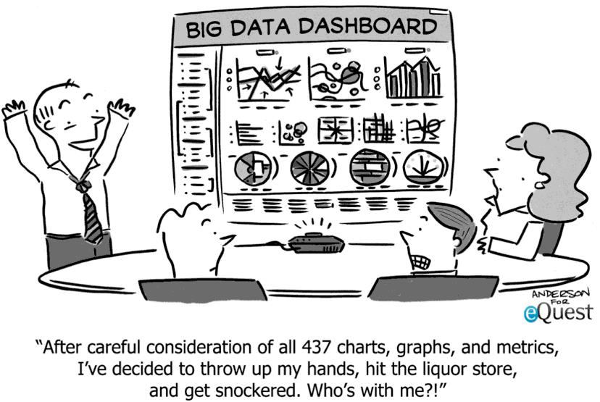
Who am I?
Notes:
I build smart things for the web, and make sense out of data (atleast I try)

Slide 3
The Audience (You!)
Know some A/IM already?
Know some NLP already?
Both / None of the above?
Notes:
To get a sense of the kind of audience we are dealing with?

Slide 4
What is Natural Language Processing?
A field of Artificial Intelligence which enables computers to analyze and understand the human language.
NLP was formulated to build software that generates and understand natural languages so that a user can have natural conversations with his computer.
Notes:
Computers are really powerful, how can we leverage their power to do our day to day jobs without always coding something or the other
For example how can I get to know about the weather in Seattle without explicitly going to my browser and going to a website entering Seattle and then finding about it
Or, how can I write a message to someone without explicitly opening the message app or the keyboard
How can I translate a text from English to Japanese
And so on and so forth

Slide 5
Example?
To find restaurants serving chinese food in gurgaon:
SELECT restaurant_name, restaurant_address FROM restaurants WHERE city = ‘gurgaon’ AND food_type = ‘chinese’
Natural way:
Where can I find some chinese food in gurgaon?
Notes:
In a typical SQL setup this how things work
But this involves coding knowledge and not everyone is a coder :P

Slide 6
Demo: Chatbot
https://d39ec792.ngrok.io
Notes:
Demo consisting of intent based chatbots
Questions:
Hey hey
What are you upto?
What ya upto?
Tell me a joke bruh/ share a laugh with me
What do you do?
What are your hobbies?
How can I connect with you?
Good bye

Slide 7
Natural Language Applications
Text Classification
Text Summarisation
Machine Translation
Search
Linguistic Analysis (Sentiment, LDA, LSI)
Question Answering
Information Extraction
Notes:
Explain each point with examples

Slide 8
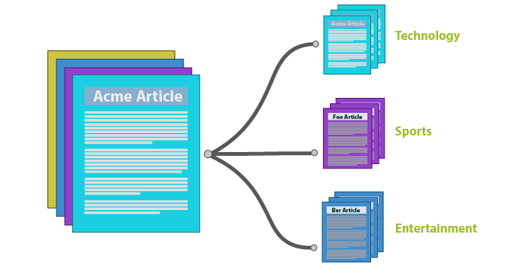
Text Classification
Notes:
Assigning categories to documents, which can be a web page, library book, media articles, gallery etc. has many applications like e.g. spam filtering, email routing, sentiment analysis etc

Slide 9

Text Summarisation
Notes:
Create a summary with the major points of the original document. Technologies that can make a coherent summary take into account variables such as length, writing style and syntax.

Slide 11

Machine Translation
https://translate.google.com/

Slide 12
Demo: AllenNLP
http://demo.allennlp.org/

Slide 13
3 Common Approaches to NLP
Rule-Based Approach
Statistical Analysis
Machine Learning
Notes:
Demo in python

Slide 14
Why is NLP so Hard?
No perfect solution exists
Language itself is a moving target
Computationally complex
Notes:
Experts often disagree on the result
Fixing one thing often causes problem elsewhere
Different cultures, grammer, syntax
Language is constantly evolving (slang)

Slide 15
Way ahead?
Natural Language Processing in Python - http://www.nltk.org/book/
Introduction to NLP - https://www.coursera.org/learn/natural-language-processing
CS224N (Advanced) - http://web.stanford.edu/class/cs224n/
Introduction to Information Retrieval (Book)
Foundations of Natural Language Processing (Book)

Slide 16
Questions?

