Slide 1
Sign up for a free account on Heroku

Slide 2
Your Django application comes with in-built sqllite databse.
But heroku uses, postgresql.
Mac: brew install postgresql
Ubuntu: sudo apt-get install postgresql postgresql-contrib
->run makemigrations && migrate

Slide 3
Getting Started
virtualenv venv
source venv/bin/activate
pip install django-toolbelt
Notes:
https://devcenter.heroku.com/articles/getting-started-with-django

Slide 4
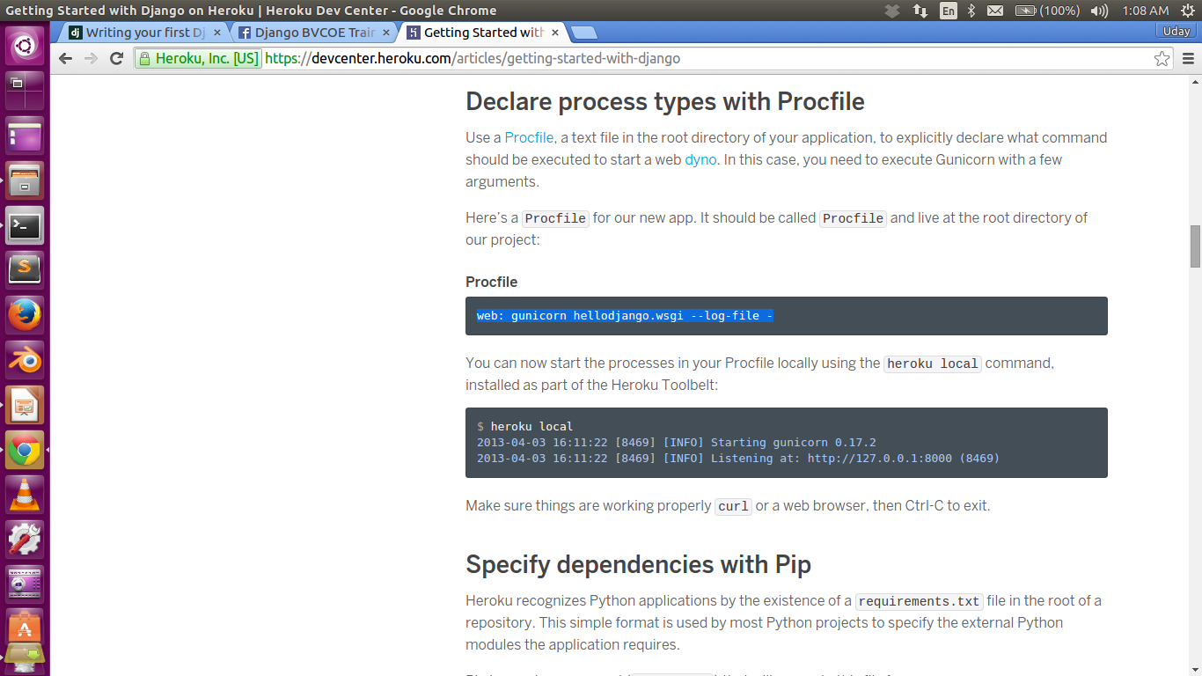
Procfile(contains commands to run the Django app)

Slide 5
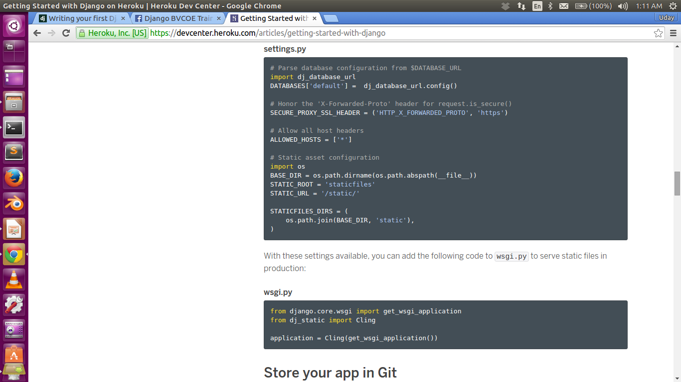
Django Settings

Slide 6
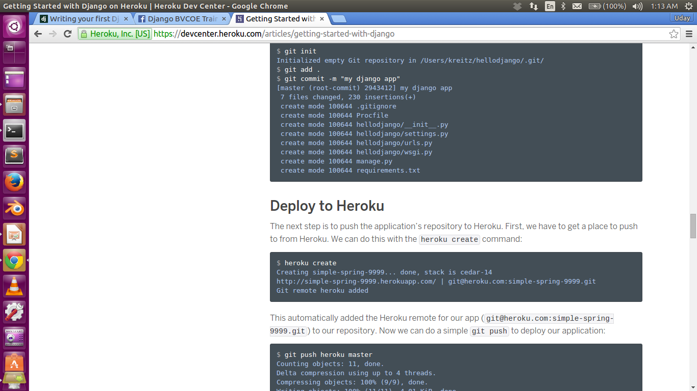
Deploying using Git
(->heroku create yourwebsitname)

Slide 8
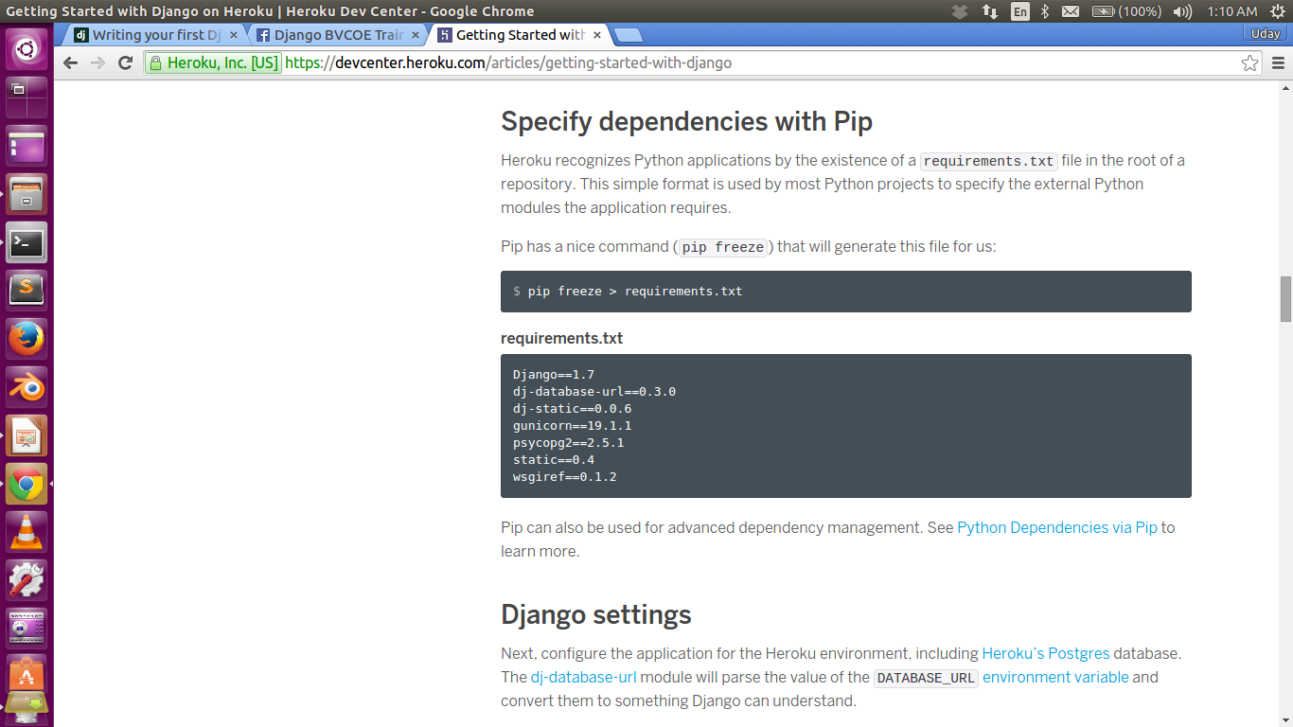
Requirements.txt

