Slide 1
Making Django Project
django-admin startproject task
cd task
python manage.py migrate
python manage.py runserver
Server is running...............

Slide 2
Making Django App
python manage.py startapp taskapp
subl .
Make “static” & “template” folder in taskapp
Make “taskapp” folder in template folder, where you will save your index.html file

Slide 3
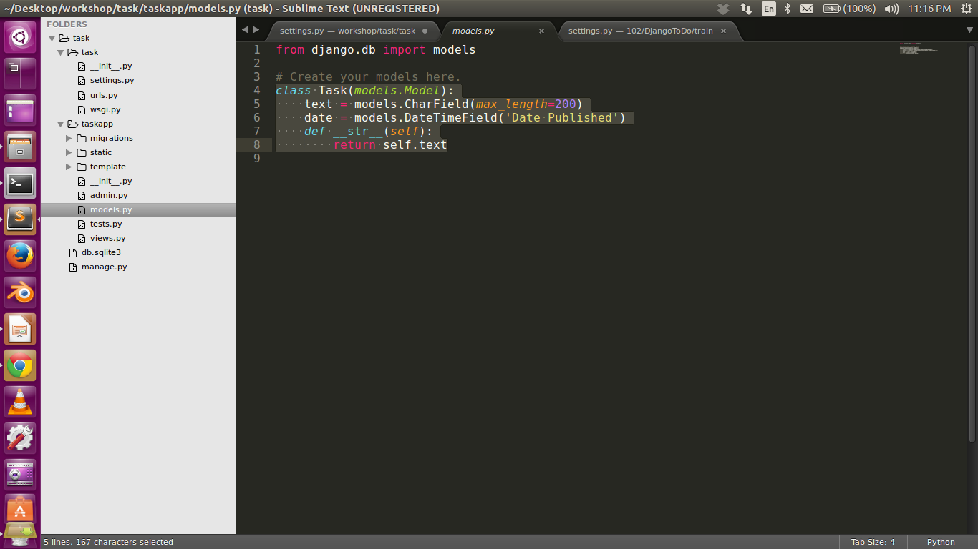
Models.py

Slide 4
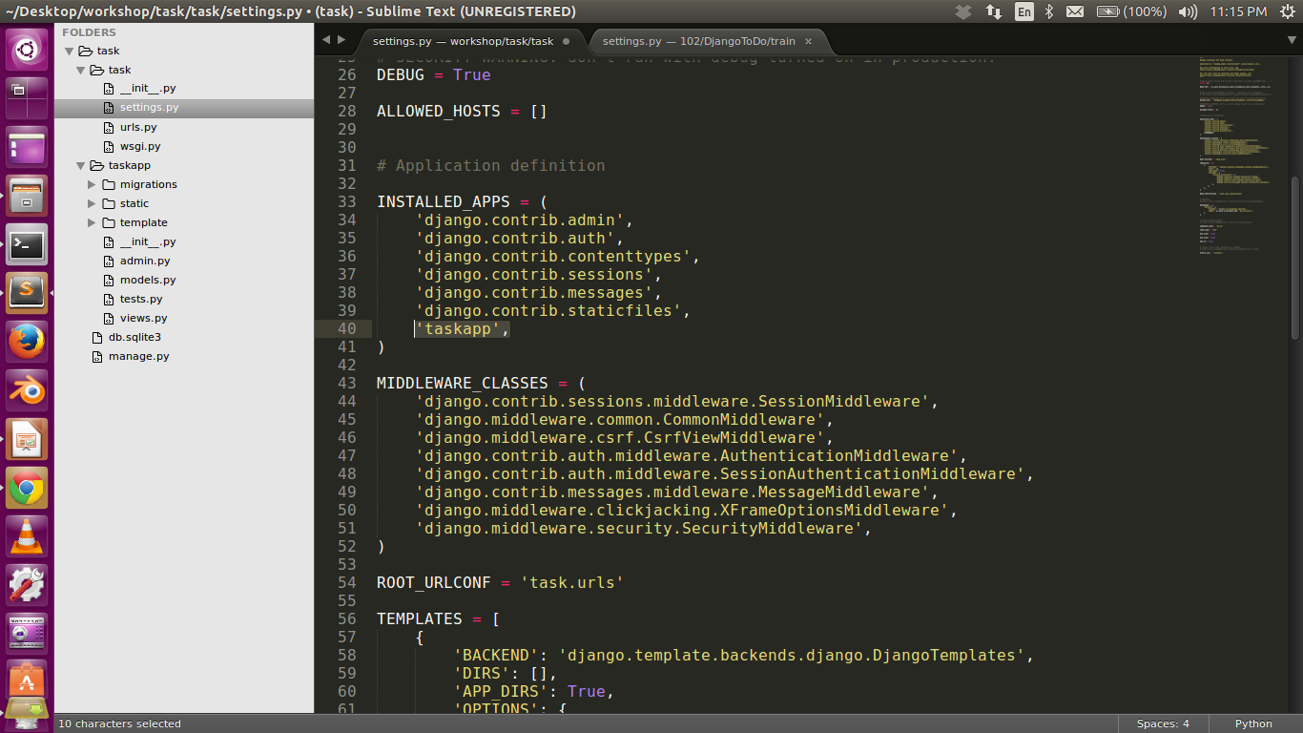
Settings.py

Slide 5
python manage.py makemigrations taskapp
python manage.py migrate
python manage.py createsuperuser

Slide 6
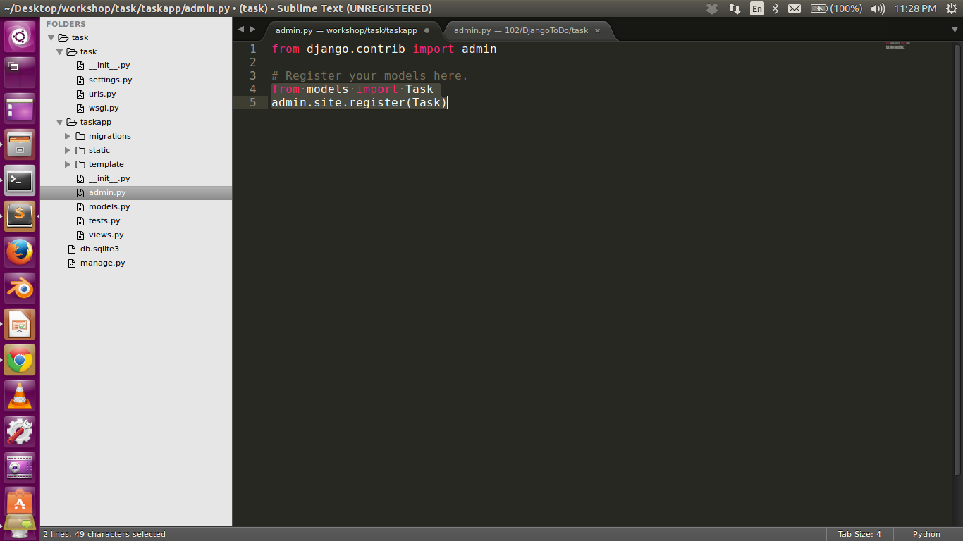
Admin.py

Slide 7
Go to : http://127.0.0.1:8000/admin/
Login
See task class
Can add task from here

Slide 8
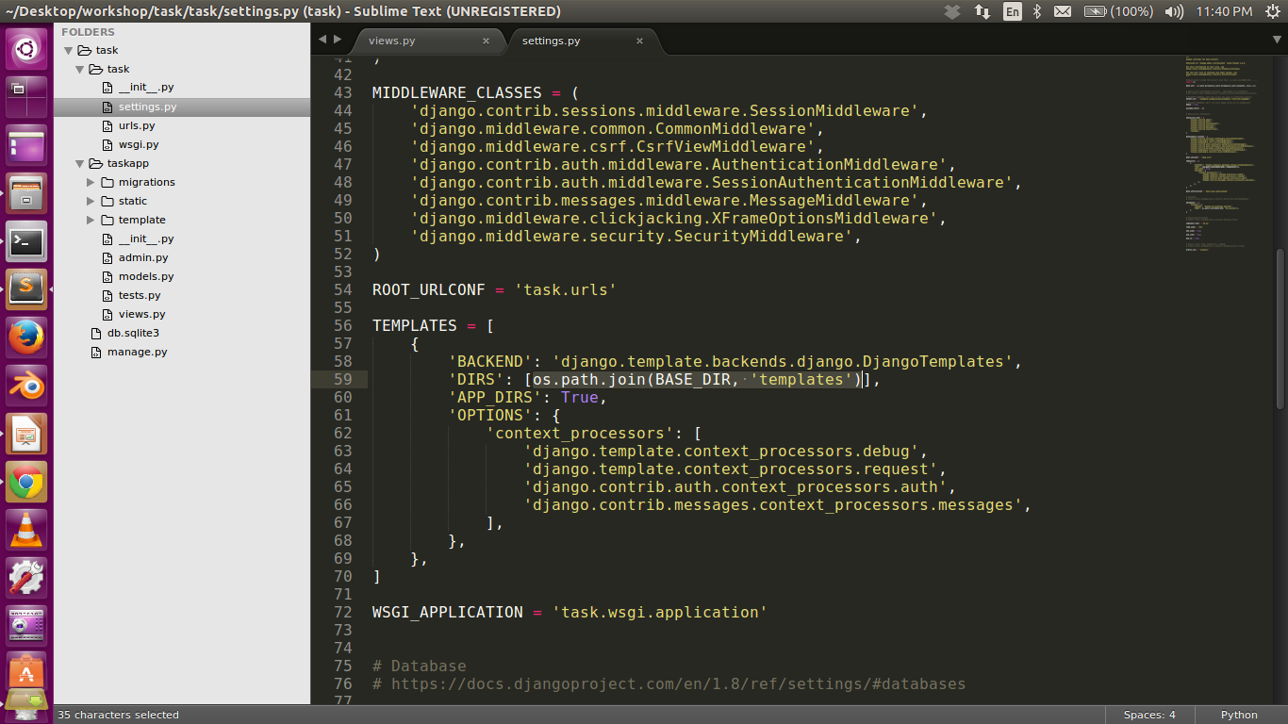
Settings.py

Slide 9
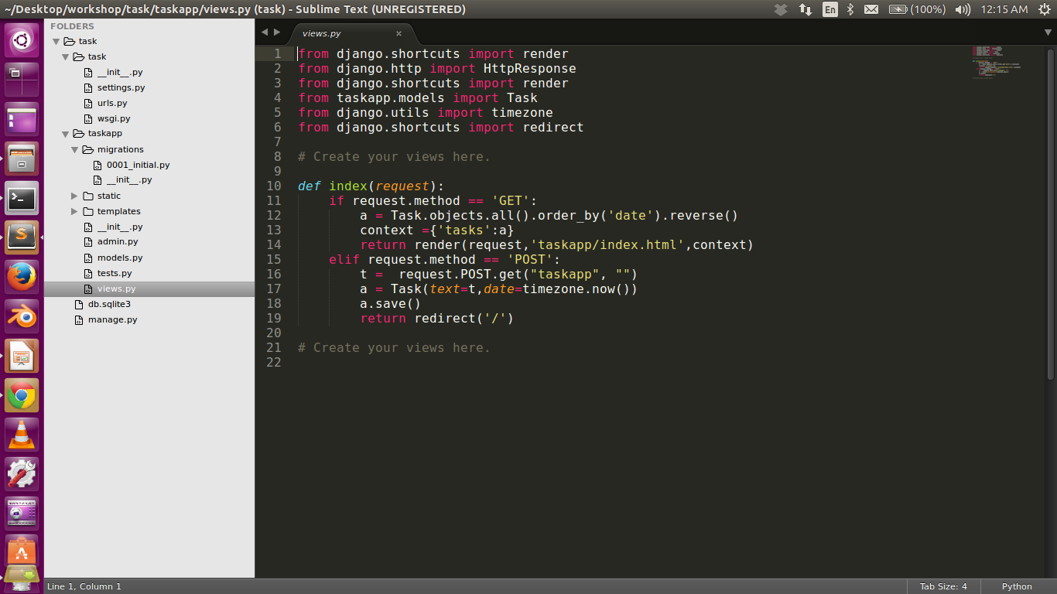
Views.py

Slide 10
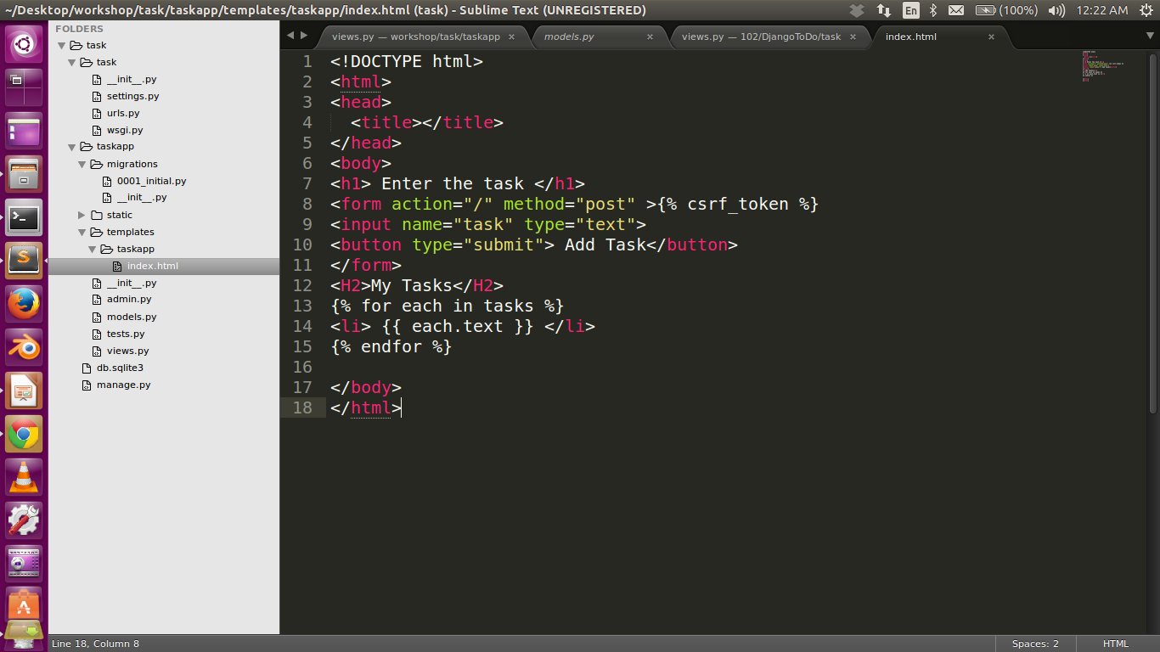
Index.html

Slide 11
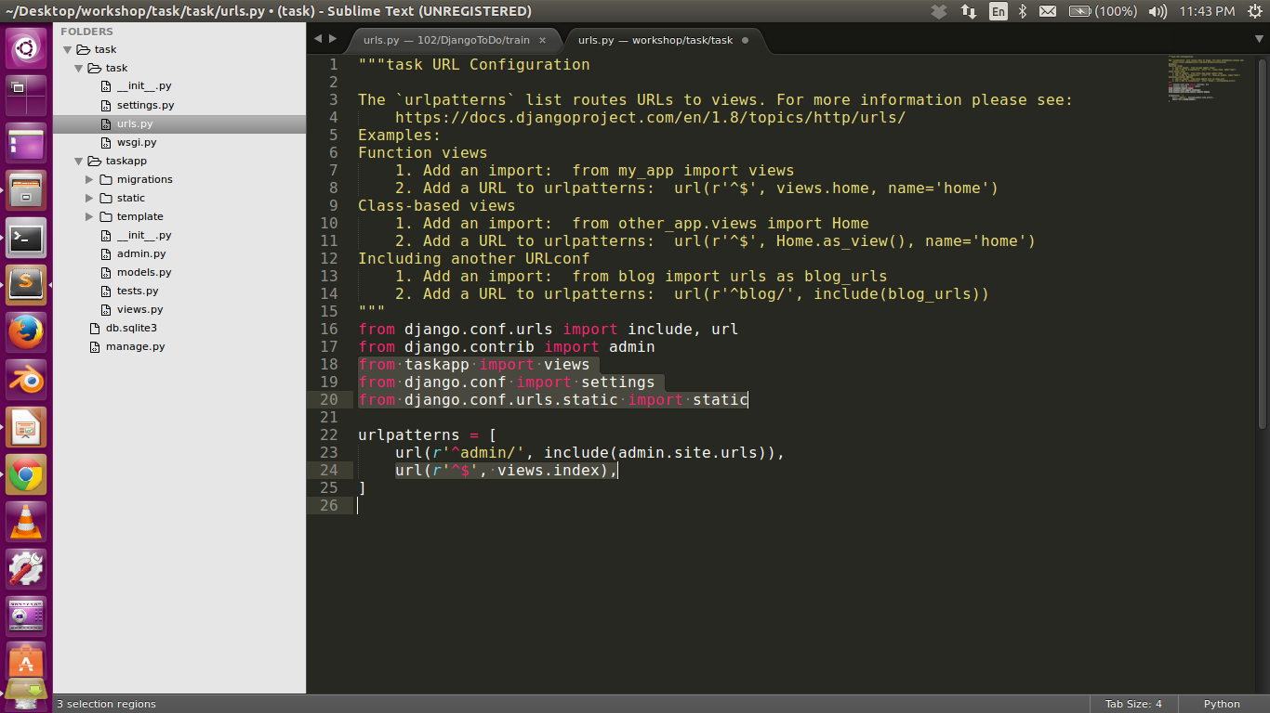
Urls.py

Slide 12
Github
https://try.github.io/levels/1/challenges/1
http://uday1201.github.io/python101/

