Slide 1
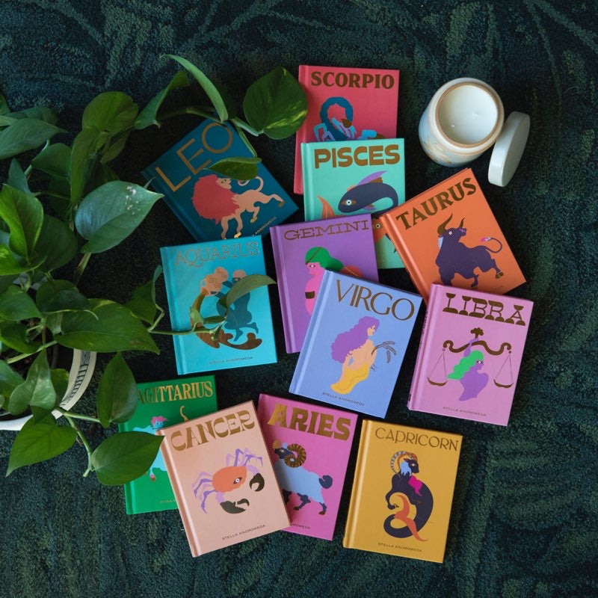
Group #11
IIITH –AI/ML Conversation CHATBOT HACKATHON AWS Alexa | Python | pandas | s3 | lambda | Tfidf Vectorizer | svc
By
Sridhar, Naran, Pallavi, Rushab, Uday, Prashanth
4/3/2024

Slide 2

Problem Statement [ Suggest Book + Zodiac]
OVERVIEW & PURPOSE:
The goal of this hackathon is to build a conversational bot to interact with the user and achieve the desired outcome through the conversation. We shall take a two-pronged approach towards this task.
Use Amazon Alexa APIs to build a bot easily by defining the desired utterances and intents
See how a bot may be built from scratch and understand the underlying logic

Slide 3

Conversation Chat Bot Manager
Solution with Steps:
Created a skill with two intents in Alexa developer portal – for instance, [“capture zodiac”, “suggest book” ]
Created 7 slots for Alexa book intent
Ability to search by any or none of the above slots
Created a parametrized 50 utterances for each intent
Created a slots for the parameters with default amazon values, amazon search query
Wrote a AWS lambda function that takes inputs, process it with data against database(.csv) that was stored in S3
Evaluated the model
Build & Test the model with Alexa search option
Monitor/troubleshoot errors using AWS cloud watch
Author | Publisher | Genre
Series | Character | ISBN
Book format

Slide 4
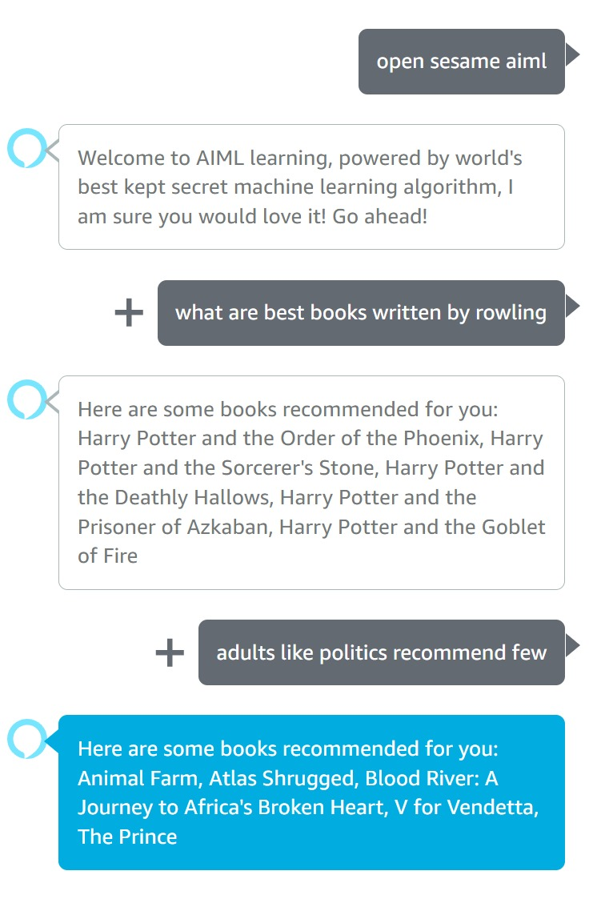
Conversation Chat Bot Manager
Learnings:
Introduced nested lambda – to process the data using pandas
Issues observed while building bot and. For instance, interrupted behavior of Alexa while processing inputs(utterances)
Issues in handling and processing multi intents
Learnt AWS eco system, especially Bot Management

Slide 5


Conversation Chat Bot Manager
Solutions with Steps:
Listed and added utterances for books and zodiac database
Configured slots in param.cfg file - get_Zodiac_Sign| get_Book
Author,
Publisher
Book type
Chat can be by any single parameter
Handled invalid inputs - No intent case
Consolidated data of zodiac and books
Implemented SVC and TfidfVectorizer to identify the right intent
Implemented missing piece of code - {actions and filters}
Training the model
Test the model for accuracy = 100%

Slide 6
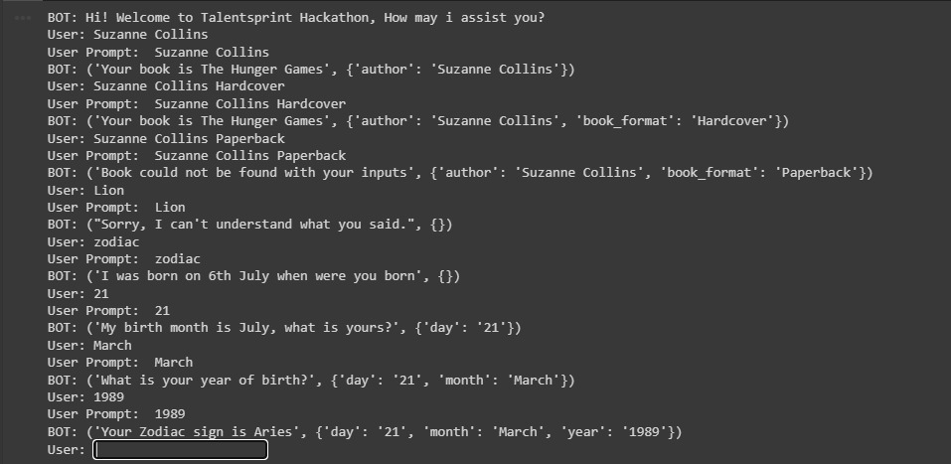
Conversation Chat Bot Manager
Learnings:
Learning curve in understanding the framework and handling of multi intents
Data modeling – utterances | slots | test data

Slide 7

Thank you !
Talent Sprint
Mentors

