Slide 1

VERSION 1.0.0
AI-Assisted
Bank Reconciliation
AI recommends. Humans authorize.
The system documents both.
Uday Gunturu · Bonneville Provisions Co. (fictional) · August 2026

Slide 2

02
THE PROBLEM
EXHIBIT 01
Month-end reconciliation is slow, manual and hard to audit
1,240
Why?
Gaps
bank and book lines in one month, one account, matched largely by eye
The reason for each match or write-off is rarely written down
Auditors find decisions with no evidence and no second check

Slide 3
03
THE APPROACH
EXHIBIT 02
Three layers, and a person at the end of each
01
02
03
Rules
AI scoring
People
Settle exact matches: same amount, date and reference
Proposes the rest, with evidence for and against
Decide every item. Nothing is approved automatically
Person checks the result
Person reviews the proposal
Person authorizes the decision
Every action, by people and by the system, goes on a tamper-evident audit trail

Slide 4
04
HOW A MONTH RUNS
EXHIBIT 03
Four steps, three roles
01
02
03
04
Step 1
Step 2
Step 3
Step 4
Import files
Review
Update reports
Close the month
Checked, then matched
Every item decided
Items confirmed
Signed and locked
Staff Accountant
Staff and Senior
Anyone
Controller
Live demo: one complete August 2026 reconciliation

Slide 5
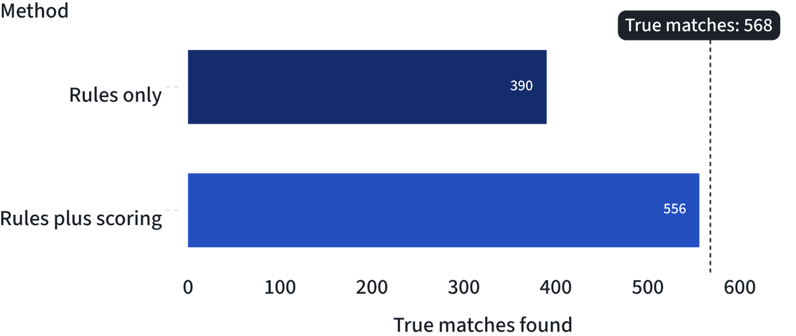
05
WHAT SCORING ADDS
EXHIBIT 04
166 more matches found, and no wrong one
PRECISION
1.0000
in both approaches
Every proposed match was correct: 390/390 and 556/556.
Evaluation Report, section 3
True matches in the August 2026 dataset, measured against its ground truth

Slide 6
06
AUTOMATION WE DID NOT USE
0 / 467
If the system had approved its most confident matches by itself, none of these 467 would have been wrong.
Zero failures is not a zero rate: the error rate could still be up to about 0.6%. So nothing is automatic, by design.

Slide 7


07
CONTROLS BUILT IN
EXHIBIT 05
Every decision is a person’s, and every step is evidence
Human decision. Every item needs a human decision
Separation of duties. A second person approves adjustments, sign-off and reversals
Locked close. Nothing is ever posted to the books. A closed month is locked until a reopening is approved
REVIEW HANDOFF · AUGUST 2026
2,242 / 2,242
566 / 566
audit trail complete, chain intact
approvals correct, signed at −$9,392.35

Slide 8

08
KNOWN LIMITS
EXHIBIT 06
What these results do not prove
One synthetic month
Risk follows the category
Real bank data will be messier.
If the category is wrong, the risk can be too. 8 items.
Confidence tuned on one month
No real login
It is cautious, not overconfident. Error 0.12.
Reviewers pick their name from a list.
Time per item not measured
We report no estimate rather than a made-up one.

Slide 9
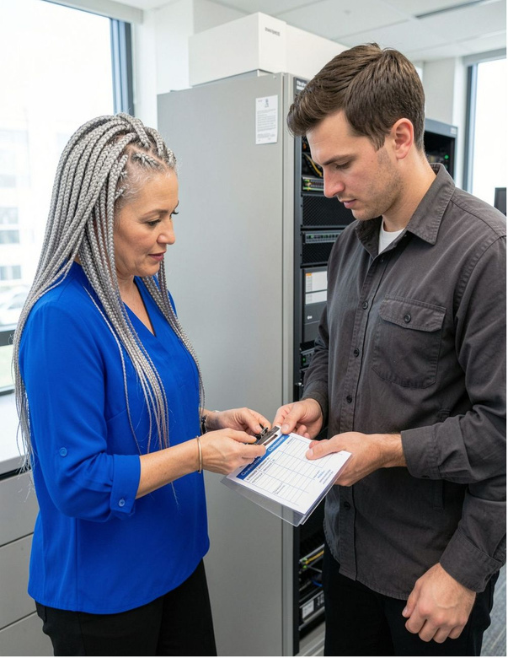
09
BEFORE PRODUCTION USE
EXHIBIT 07
Four things a real deployment needs
01
02
Real sign-in
Several months of real data
Authentication tied to company accounts
To retest matching and recalibrate confidence
03
04
A dollar threshold for risk
A timed review study
So large amounts are always high risk
To measure time per item with real reviewers
CONTROLLED PILOT · READINESS CHECK

Slide 10
10
AI recommends.
Humans authorize.
The system documents both.
254 tests · 7 documents · 4 guides
github.com/uday269/bank_reconciliation
Thank you. Questions?

