Slide 1
District heating pipe network layout using minimum spanning trees
Final presentation: work done after the prelim
CLL798D / CHL7903 Network Science
[Group member names and entry numbers]
12 November 2026
Notes:
Our project is on choosing the pipe layout of a district heating network using graph algorithms. Today we only talk about what we did after the prelim.

Slide 2
Prelim, and what we did after it
At the prelim
After the prelim
MST layouts for Bremen (flat) and Stuttgart (hilly)
Terrain-weighted MST was 3% cheaper in Stuttgart
Stuttgart needs 2 pressure zones
One extra pipe removes 57% of unserved demand
Only one network per city
1. Tested on 120 networks instead of 2
2. Edge-swap search to improve the MST
3. Found which graph property decides cost
4. Tested the 151 m pressure limit
5. Exact ILP to check our greedy redundancy
Also: seasonal load model and sensitivity runs (backup slides)
Notes:
40 seconds. On the left is what we showed at the prelim. The weak point was that everything came from one network per city. On the right is what we did after. Points 4 and 5 were the next steps we had promised at the prelim. I will go through these five one by one.

Slide 3
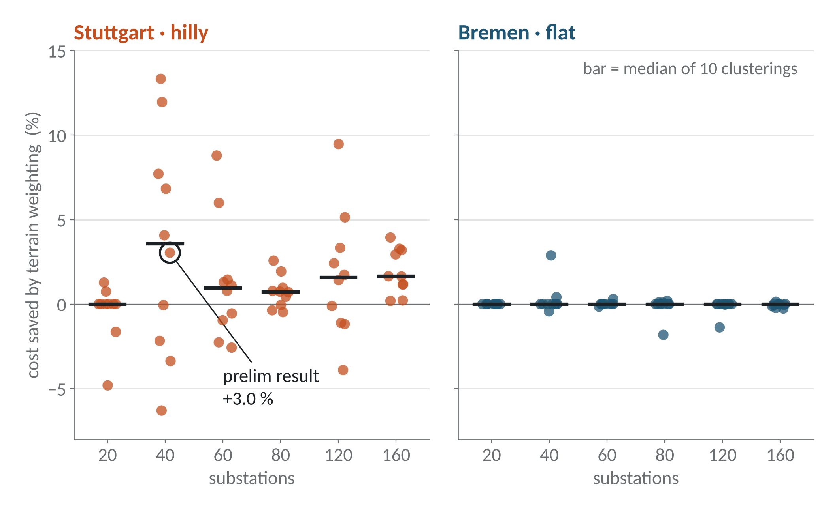
1. The 3% terrain saving changes a lot from network to network
6 sizes x 10 clusterings x 2 cities
Stuttgart: -6% to +13% for the same size
Bremen: zero, as expected
Reason: MST does not see the flow in the pipes
Each dot = one network. Circled dot = prelim result.
Notes:
55 seconds. At the prelim we said terrain weighting saves 3 percent in Stuttgart. That was from one clustering. We repeated it for six network sizes and ten different k-means clusterings. The circled dot is our prelim result. For the same city and same size the saving goes from minus 6 to plus 13 percent. On average it is still positive in Stuttgart and zero in flat Bremen, so the idea is right, but 3 percent was partly luck. The reason is that the MST only looks at edge weights. The real cost also depends on how much flow each pipe carries, and that depends on the whole tree.

Slide 4
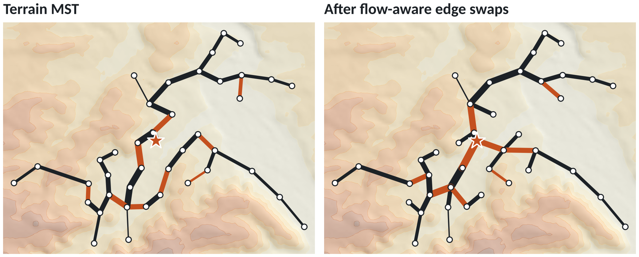
2. Edge swaps give a cheaper tree than the MST
 | MST | Swapped
Cost (EUR/MWh) | 18.07 | 16.48
Length (km) | 32.9 | 33.9
9% cheaper, 3% longer
Better in all 20 networks tested
Works in flat Bremen too
Stuttgart. Orange = changed edges. Star = plant.
Add one edge, remove another edge from the cycle, keep it if the cost goes down.
Notes:
60 seconds. So we tried to improve the MST using the actual cost. We start from the MST. We add one nearby edge, which makes a cycle, and remove another edge from that cycle, so it is again a spanning tree. If the full cost model says it is cheaper, we keep it. We repeat till nothing improves. On the left is the MST, on the right is the result. It is 1 km longer but 9 percent cheaper. We tried it on 10 clusterings in each city and it improved all 20: about 6 percent on average in Stuttgart and 7 percent in Bremen. It also holds for 80 and 160 substations. Since it works in flat Bremen too, our prelim statement that the MST is the right answer on flat ground was not correct.

Slide 5
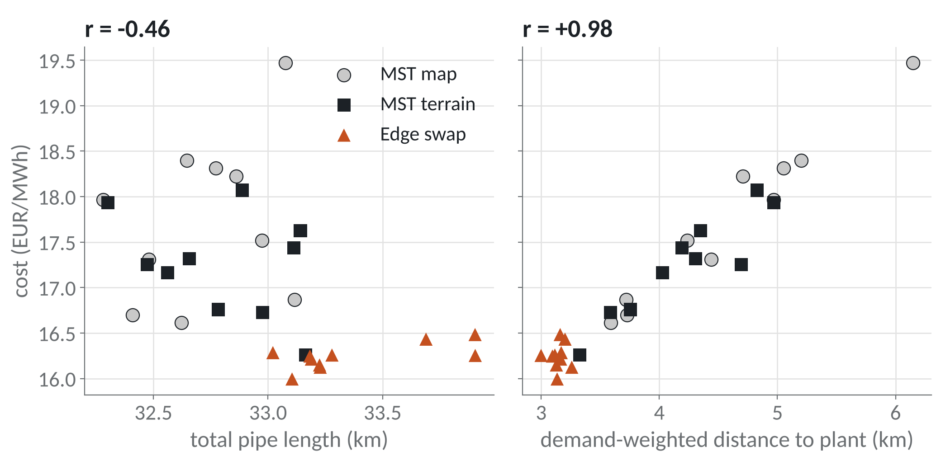
3. Cost depends on distance to the plant, not total length
Total length: no relation with cost
Distance to plant: r = 0.98
MST minimises total length only
Cheapest tree is between an MST and a shortest-path tree
30 Stuttgart trees. r = correlation with cost.
Notes:
50 seconds. Why does the swapped tree cost less even though it is longer? We took 30 trees for Stuttgart and plotted cost against two things. Left: total pipe length, which is what the MST minimises. There is no clear relation. Right: demand-weighted distance from the plant, which is like the average path length to the plant, weighted by heat demand. Correlation is 0.98. So cost is mainly a path length property. Long paths need bigger pipes and more pumping. The MST minimises total weight and a shortest path tree minimises path length. The cheapest tree is in between, and that is what the edge swaps find. Bremen shows the same thing.

Slide 6
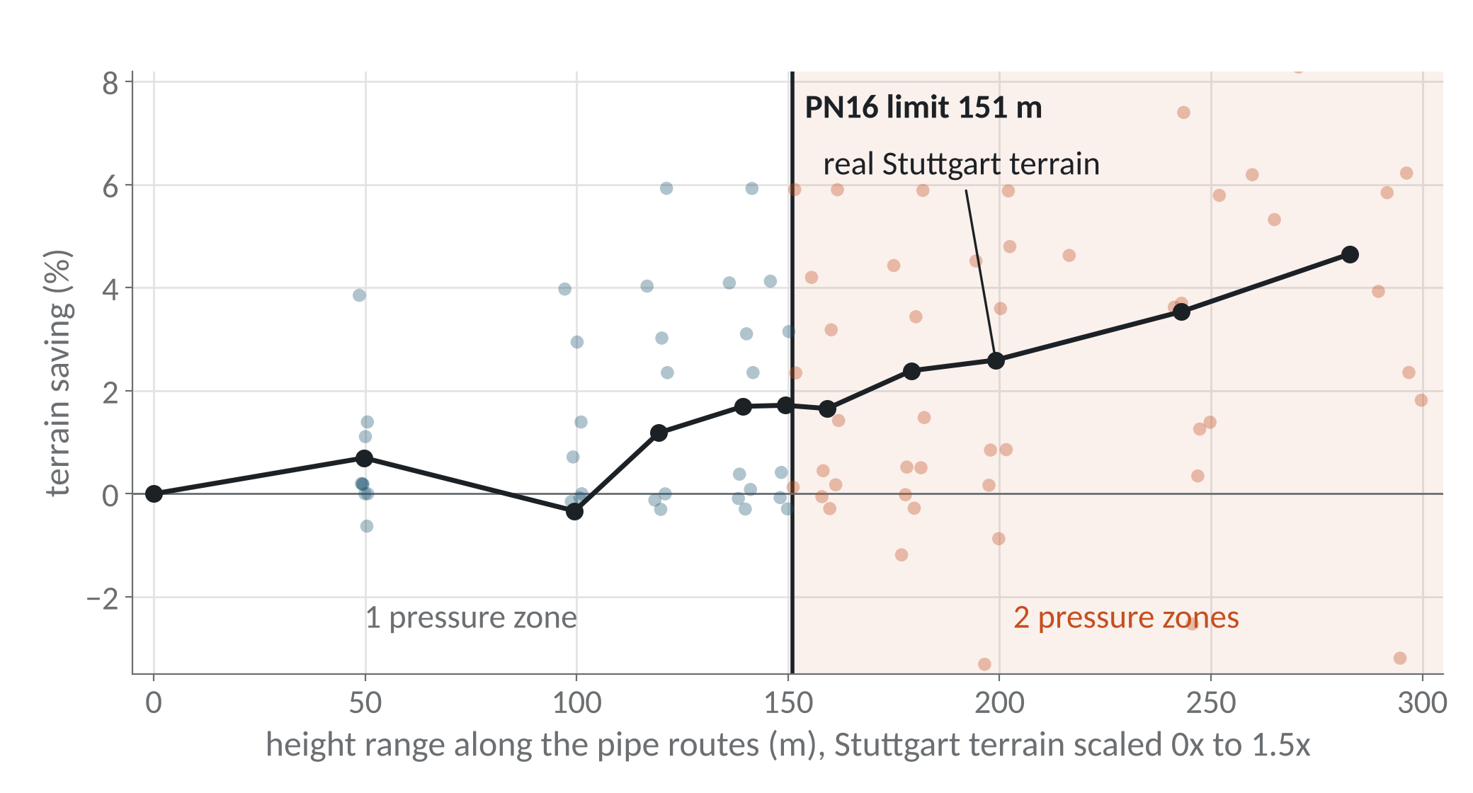
4. Pressure zones switch at 151 m, as predicted
No data for a third district, so we scaled Stuttgart's terrain from flat to 1.5x
1 zone below 151 m, 2 zones above
Terrain saving grows with height: 0% flat, 4.7% at 1.5x
Blue = 1 zone, orange = 2 zones. Black line = average.
Notes:
50 seconds. At the prelim we showed that one PN16 pressure zone can hold 151 metres of height difference, and Stuttgart needs two zones. We had said we would test this limit on a third district. We could not get that data, so we did a controlled test: we took Stuttgart's elevation map and scaled the heights from zero up to 1.5 times. Blue dots are networks that need one zone, orange need two. The switch happens exactly at 151 metres. With the real terrain, Stuttgart needs two zones in all 60 networks we made and Bremen needs one. The black line also shows the terrain saving is real: zero on flat ground and it grows as the terrain gets steeper.

Slide 7
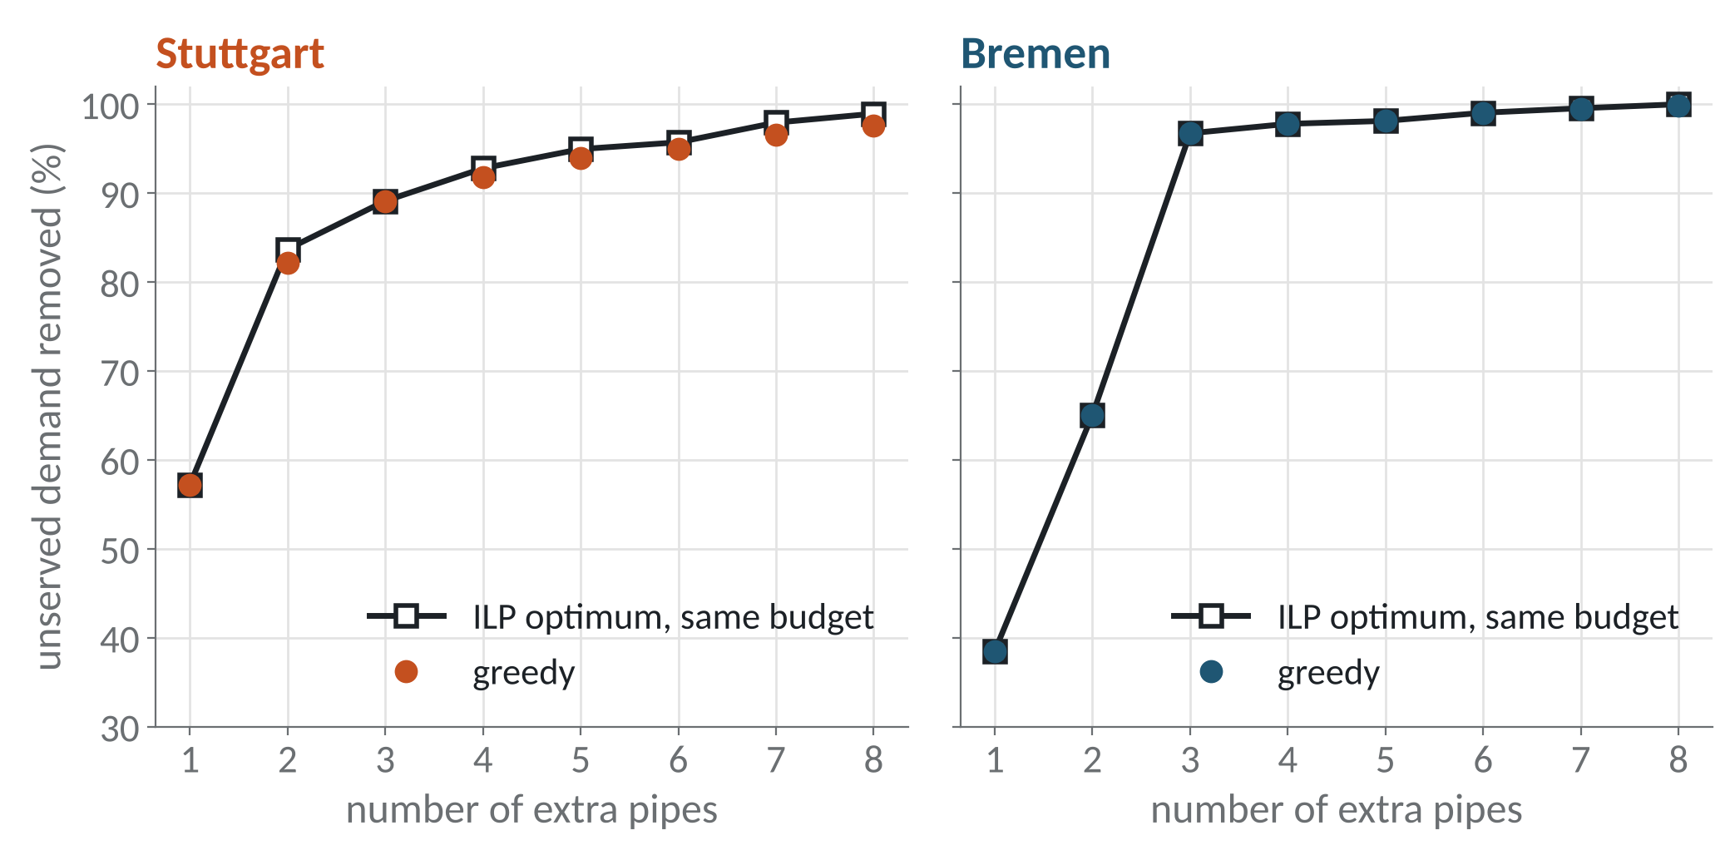
5. Greedy redundancy is close to the exact ILP optimum
ILP: pick extra pipes to protect the most demand
Greedy is within 1.5 points of the optimum
Edge swap + 1 loop: same reliability as MST + 1 loop, 5% cheaper
Notes:
50 seconds. A tree has no backup: if one pipe fails, everything after it is cut off. At the prelim we added extra pipes greedily and promised to compare it with an exact ILP. In the ILP each candidate pipe is a binary variable, and we maximise the unserved demand removed for the same number of pipes and the same budget as greedy. The black line is the ILP optimum and the dots are greedy, for 1 to 8 extra pipes. Greedy is never more than 1.5 points below. For up to 3 pipes we also checked by brute force and it matches. Finally, if we take the edge swap tree and add one loop, we get the same reliability as MST plus one loop at about 5 percent lower cost.

Slide 8
Summary
At the prelim we said | Now
Terrain MST saves 3% | True on average, but noisy for one network | Weaker
MST is best on flat ground | Edge swaps are 6 to 9% cheaper | Wrong
Stuttgart needs 2 pressure zones | Yes, and the 151 m limit is confirmed | Holds
Greedy extra pipe is good enough | Yes, within 1.5 points of the ILP | Holds
Main point: the MST is a good start, but the cheapest tree is a little longer and has shorter paths to the plant.
Limitations: load curve is from a formula, edge swap is a local search, only two cities.
Notes:
30 seconds. To summarise. The terrain saving is real on average but noisy. Our claim about flat ground was wrong. The pressure zone result and the redundancy result both hold. The main point is that the MST is a good starting point, but the cheapest tree is a little longer and has shorter paths to the plant. Thank you.

Slide 9
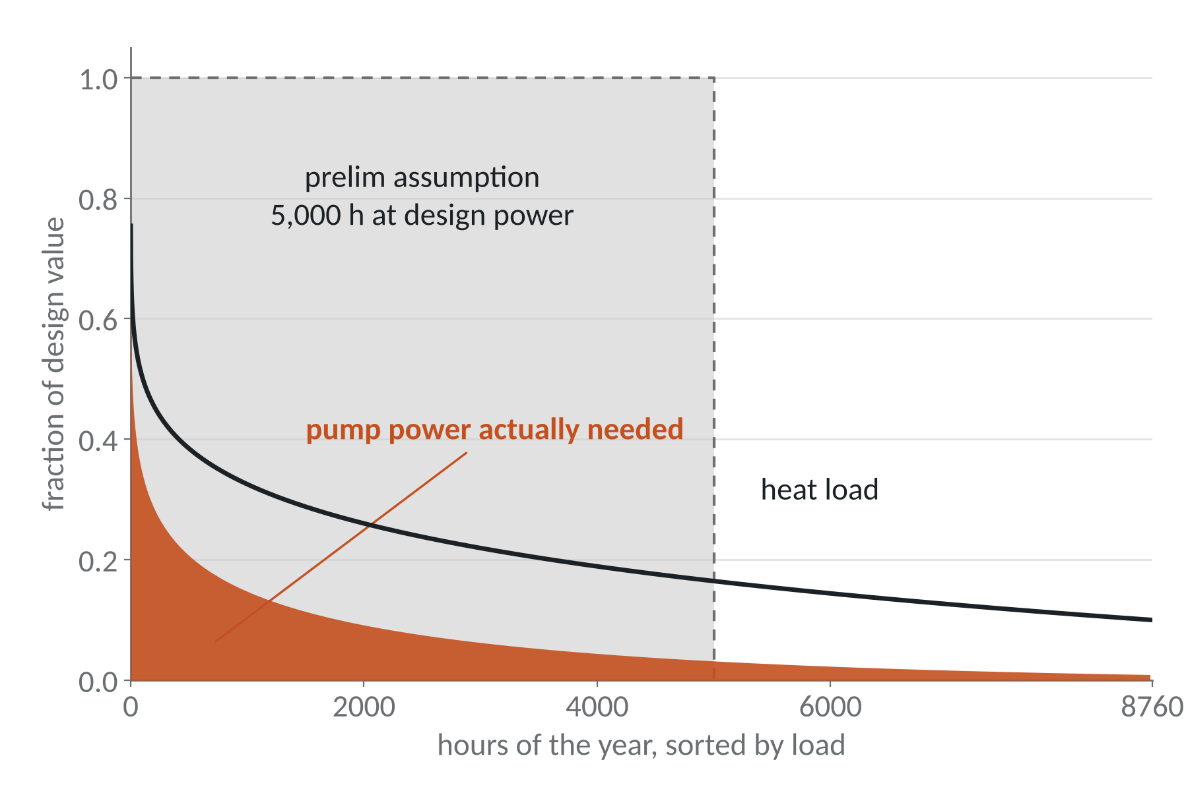
Backup: seasonal load model
Stuttgart MST | Prelim | Seasonal
Pump energy (MWh/yr) | 5,399 | 631
Cost (EUR/MWh) | 22.39 | 18.07
Prelim: pumps at full power for 5,000 h
Now: load follows a yearly curve (Sochinsky formula, assumed)
Costs on slides 4 to 7 use the seasonal model
Notes:
Backup. At the prelim pumping was costed at full power for 5,000 hours. With a load duration curve, pump energy is about 8 times lower.

Slide 10
Backup: sensitivity and network size
Changed (Stuttgart) | Terrain saving | Ranking
Base case | 3.0% | reference
Electricity price ±50% | 1.9 to 4.0% | same
Heat price ±50% | 2.8 to 3.3% | same
Discount rate 2 to 6% | 2.7 to 3.5% | same
Supply/return 90/45 °C | 2.9% | same
Edge-swap gain | Stuttgart | Bremen
40 substations | 5.8% | 6.7%
80 substations | 8.6% | 9.5%
160 substations | 7.8% | 7.9%
Mean over 10, 5 and 2 clusterings.
Notes:
Backup. Prices and temperatures do not change which layout is cheapest. Edge-swap gain holds for bigger networks.

