Slide 1
District heating pipe network layout using minimum spanning trees
Final presentation: work done after the prelim
CLL798D / CHL7903 Network Science
[Group member names and entry numbers]
12 November 2026
Notes:
5 seconds. Our project is on choosing the pipe layout of a district heating network using graph algorithms, based on Gao et al. 2020. Today we only talk about what we did after the prelim.

Slide 2
What we had at the prelim, and what we did after it
At the prelim (9 Sep)
After the prelim
Two real German districts: Bremen (flat) and Stuttgart (hilly), 40 substations each
Terrain-weighted MST was 3.0% cheaper than the normal MST in Stuttgart
Stuttgart needs 2 pressure zones with PN16 pipes
One extra pipe, picked greedily, removed 57% of the expected unserved demand
Everything was on one network per city, costed at full design load
1. Repeated the study on 120 networks
20 to 160 substations, 10 clusterings each, both cities
2. Seasonal load model
pumping and heat loss over the year instead of full load
3. Edge-swap search (new method)
improves the MST using the actual cost; tested up to 160 substations
4. Which graph property decides the cost
total length vs demand-weighted distance to the plant
5. Relief sweep
scaled Stuttgart's terrain from flat to 1.5x to test the 151 m pressure limit
6. Exact ILP for redundancy
optimum for up to 8 extra pipes, compared with our greedy choice
7. Sensitivity runs
prices, supply temperature, pipe pressure class
Notes:
30 seconds. Left is where we stopped at the prelim. The weakness was that every result came from one 40-substation network per city, and pumping was costed as if the network always runs at full load. Right is what we did since. Items 5 and 6 are the two things we had listed as next steps at the prelim: the pressure threshold test and the exact ILP. We also re-ran the prelim code first and all old numbers reproduce.

Slide 3
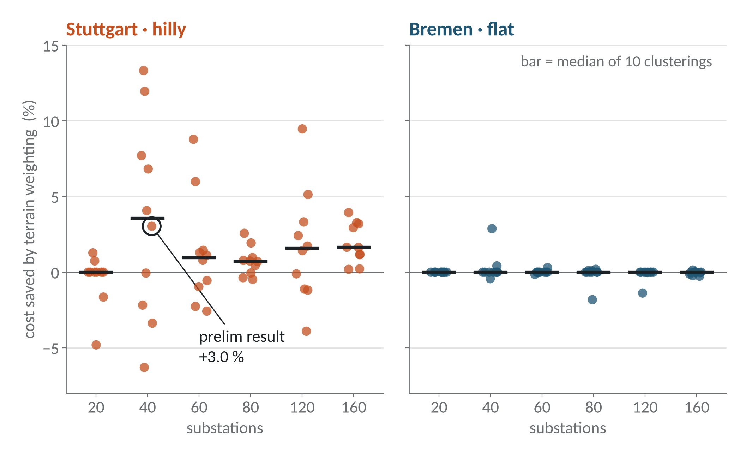
1. On 120 networks, the 3% terrain saving is not consistent
Same method as the prelim, only the k-means seed and the number of substations change
Stuttgart with 40 substations: saving goes from -6.3% to +13.3%
Median over the 50 Stuttgart networks (40 or more substations) is +1.2%. It is negative in 15 of them
Bremen stays at zero in 33 of 50, as expected for flat ground
Why: of the 3.0% in the prelim, 2.7 was lower pumping cost and only 0.4 was cheaper trenching. The MST only sees edge weights, not the flow in each pipe.
Each dot is one network. The circled dot is our prelim result.
Notes:
50 seconds. At the prelim we reported a 3 percent saving from terrain weighting, from one clustering of Stuttgart. We repeated it for six sizes and ten k-means seeds. The circled dot is the prelim number. For the same city and size the saving changes from minus 6 to plus 13 percent just because the cluster centres move. On average it is still positive in Stuttgart and zero in Bremen, so the direction is right, but 3 percent was a lucky draw. When we split the 3 percent by cost component most of it was pumping: the terrain MST changed 3 edges out of 40 and those happened to shorten the main flow path. Kruskal cannot see that because flow is not in the edge weight.

Slide 4
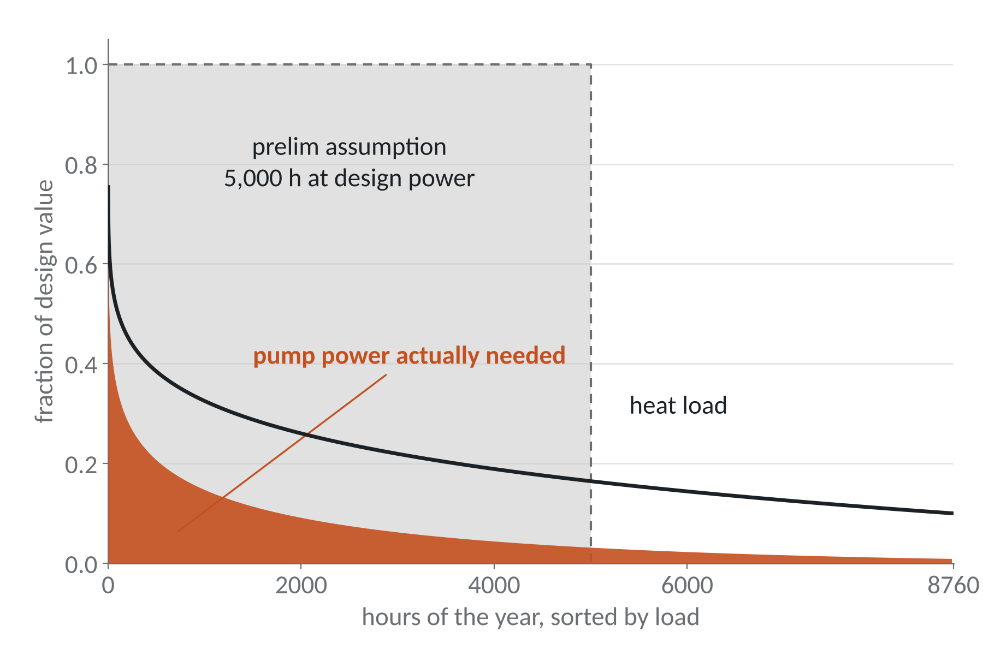
2. With a seasonal load curve, pumping cost is about 8 times lower
Stuttgart, terrain MST, 40 substations
 | Prelim | Seasonal
Pump energy (MWh/yr) | 5,399 | 631
Heat loss (MWh/yr) | 15,141 | 12,357
Cost (EUR/MWh) | 22.39 | 18.07
Terrain saving | 3.0% | 0.9%
Prelim assumed pumps run 5,000 hours at design power
Pump power goes roughly as flow cubed, and full load happens only for a few hours
Cheapest tree also changes: Euclidean Steiner (17.42) now beats rectilinear Steiner (17.65)
Load curve is the Sochinsky formula with 1,800 full-load hours and 10% summer load (assumed, not measured data).
Notes:
45 seconds. In the prelim model the pumps ran at design power for 5,000 hours, the grey box. In reality the heat load follows a duration curve, the black line, and with variable speed pumps the power needed is the orange area. We integrated this over 40 load levels with the same friction and heat loss model, pipe by pipe. Pump energy comes down from about 5,400 to 630 MWh and total cost drops about 19 percent. The terrain saving becomes 0.9 percent. Limitation: the load curve is a standard formula, we do not have hourly data for these districts. All cost numbers on the next slides use this seasonal costing.

Slide 5
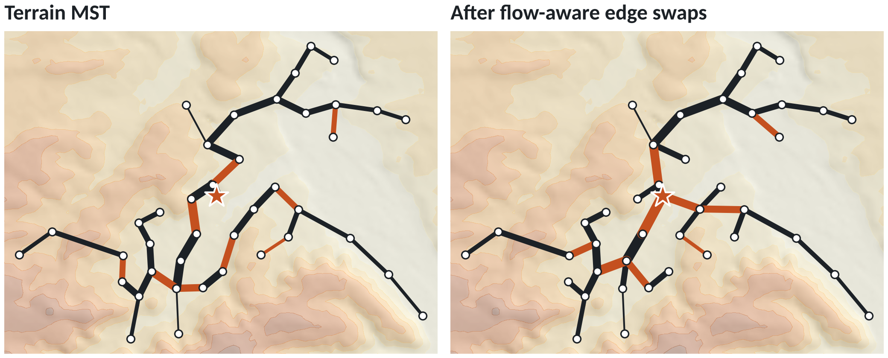
3. Edge-swap search: a slightly longer tree that costs less
Method
Start from the MST. Add one nearby non-tree edge, which makes a cycle. Remove another edge of that cycle. Keep the swap if the full cost model gives a lower cost. Repeat till no swap helps.
 | MST | After swaps
Cost (EUR/MWh) | 18.07 | 16.48
Pipe length (km) | 32.9 | 33.9
Pump head (bar) | 14.2 | 8.6
Longest path (hops) | 21 | 15
Stuttgart, 40 substations. Orange = edges that are different. Line thickness = pipe diameter. Star = plant.
8.8% cheaper with 3.1% more pipe. It also works in flat Bremen, so the MST is the shortest tree but not the cheapest one.
All 20 networks with 40 substations improved: 5.8% on average in Stuttgart, 6.7% in Bremen. It holds for bigger networks: 8.6% and 9.5% with 80 substations, 7.8% and 7.9% with 160.
Notes:
55 seconds. Since MST weights cannot see flow, we optimise the actual cost. This is the edge exchange move on spanning trees: adding a non-tree edge creates exactly one cycle, and removing another edge of that cycle gives a new spanning tree. For every candidate we re-run the full cost model, so pipe sizes, friction, heat loss and pressure zones are recomputed. We only try the 8 nearest neighbours of each node to keep it fast. The result on the right has more branches going directly from the plant. It is 1 km longer but 8.8 percent cheaper, and pump head drops from 14 to 8.6 bar. It improved all 20 networks we tried at 40 substations, and the gain stays around 8 to 9 percent for 80 and 160 substations. It works in flat Bremen too, so our prelim statement that the MST is the right answer on flat ground was not correct.

Slide 6
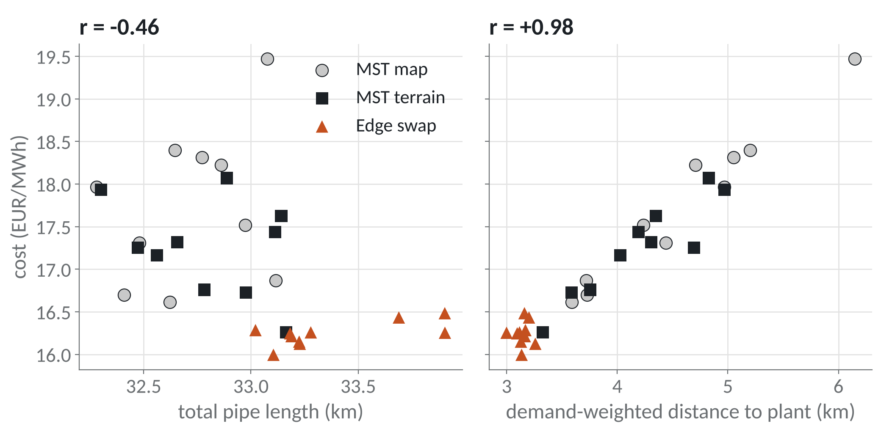
4. Cost follows distance to the plant, not total pipe length
Total length, which is what an MST minimises, explains only 21% of the cost variation (R² = 0.21)
Adding the demand-weighted distance to the plant takes it to 97%
Bremen gives the same picture: r = -0.30 with length, +0.97 with weighted distance
Edge swaps reduce the average depth from 5.7 to 3.9 hops
Stuttgart: 10 clusterings x 3 trees (normal MST, terrain MST, edge swap) = 30 trees, seasonal costing.
In graph terms: the MST minimises total edge weight and a shortest-path tree minimises path length. The cheapest network is in between the two.
Notes:
45 seconds. We then asked which graph property actually decides the cost. For 30 Stuttgart trees we plotted cost against total pipe length, on the left. There is no useful relation, the correlation is even slightly negative. On the right is cost against the demand-weighted distance from the plant, which is like an average path length weighted by how much heat each node needs. Correlation is 0.98. So cost is mostly a path length property, because long paths mean bigger pipes carrying flow further and more pump head. An MST minimises total weight and ignores path length. A shortest path tree, or a star, minimises path length and ignores total weight. The cheapest tree is between these two, and that is what the edge swaps find.

Slide 7
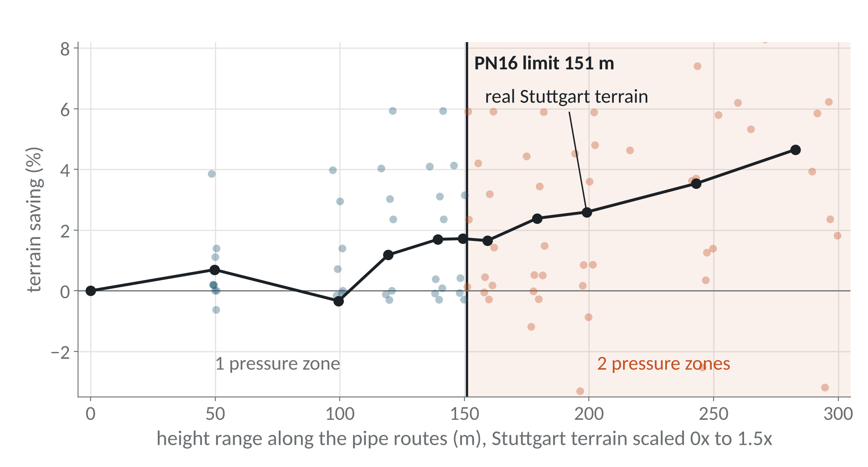
5. Pressure zones: the 151 m limit, tested by scaling the terrain
Real terrain: 2 zones in Stuttgart and 1 in Bremen in all 60 networks of each city
We had planned a third district to test the limit. Instead we scaled Stuttgart's elevations from 0 (flat) to 1.5x
Zones change exactly at the limit: routes spanning 146 to 152 m need 2 zones in 3 of 10 networks, above 156 m in 10 of 10
Terrain saving grows with relief: 0% when flat, 2.6% for real terrain, 4.7% at 1.5x
Each dot is one network (10 clusterings per terrain scale). Blue = 1 zone, orange = 2 zones. Black line = mean.
Notes:
45 seconds. The pressure zone result from the prelim holds: with the real terrain Stuttgart needs two zones in all 60 networks and Bremen one. At the prelim we said we would test the 151 metre limit with a third district. We could not get that data, so we did a controlled test instead: we took Stuttgart's elevation map and scaled the heights from zero to 1.5 times. The number of zones switches from one to two exactly where the height range along the pipes crosses 151 metres, so the limit works as derived. The same sweep also shows the terrain saving is a real effect: it is zero on flat ground and grows steadily with relief, even though individual networks are noisy.

Slide 8
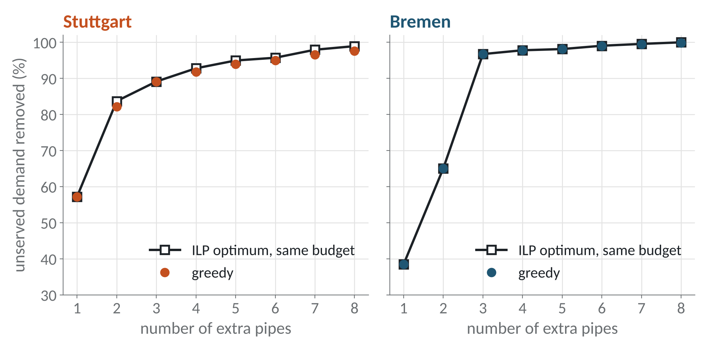
6. Redundancy: greedy is close to the exact ILP optimum
Final design, Stuttgart (mean of 10 clusterings)
Design | EUR/MWh | N-1 served
MST | 17.25 | 30%
MST + 1 loop | 19.39 | 68%
Edge swap | 16.24 | 51%
Edge swap + 1 loop | 18.45 | 67%
N-1 served = demand still supplied after the worst single pipe failure
Edge swap plus one loop gives the same reliability as MST plus one loop at about 5% lower cost
Bremen: 15.11 against 15.95 EUR/MWh
ILP: choose extra pipes (binary) to maximise the unserved demand removed, with the same number of pipes and the same budget as greedy
820 binary variables, solved with HiGHS in under 1 second. For 1 to 3 pipes it matches brute force over all 79 million combinations
Greedy is never more than 1.5 points below the optimum, for 1 to 8 pipes in both cities
Notes:
50 seconds. At the prelim we chose the redundant pipes greedily and said we would check it against an exact ILP. On a tree a new pipe protects exactly the tree edges on the cycle it closes, so it is a weighted maximum coverage problem. We wrote it as an ILP with one binary variable per candidate pipe and one per tree edge and solved it with HiGHS. For up to 3 pipes we also checked it by brute force and the numbers agree exactly. The black line is the ILP optimum for the same budget, the dots are greedy. The largest gap is 1.5 percentage points, so greedy is good enough. On the right we combine everything: the edge swap tree with one greedy loop has the same N-1 reliability as the MST with one loop but costs about 5 percent less.

Slide 9
Summary: what changed after the prelim
Prelim result | After further work | Status
Terrain-weighted MST saves 3.0% in Stuttgart | Noisy for one network; 2.6% on average, grows with relief | Weaker
MST is the right answer on flat ground | Edge swaps cut cost by 6 to 9% in both cities | Not correct
Pumps costed for 5,000 h at design power | About 580 equivalent hours with a seasonal load curve | Corrected
Stuttgart needs 2 pressure zones, Bremen 1 | Same in 60 of 60 networks; zones switch at 151 m | Holds
One greedy extra pipe fixes most fragility | Greedy within 1.5 points of the ILP optimum for 1 to 8 pipes | Holds
Limitations
Load curve is from a formula, we do not have hourly demand data
Edge swap is a local search, so there is no proof it reaches the best tree
The relief sweep scales one city's terrain; a real third district would be a better test
Notes:
25 seconds. To summarise against what we said in September. The terrain saving is real but small and noisy for a single network. Our claim about flat ground was not correct: the cheapest tree is a bit longer and shallower than the MST. The pumping assumption is corrected. The pressure zone result and the redundancy result both hold on much more data and against exact methods. Thank you, we are happy to take questions.

Slide 10
Backup: sensitivity and network size
Stuttgart, 40 substations, one parameter changed at a time (design-load costing)
Demand still served after the worst single pipe failure (terrain MST, mean of 10 clusterings)
Changed | Terrain saving | Ranking
Base case | 3.0% | reference
Electricity price ±50% | 1.9 to 4.0% | same
Heat price ±50% | 2.8 to 3.3% | same
Discount rate 2 to 6% | 2.7 to 3.5% | same
Supply/return 90/45 °C | 2.9% | same
Substations | Stuttgart | Bremen
40 | 30% | 42%
80 | 15% | 29%
160 | 0% | 19%
With more substations, more of the demand hangs on one trunk pipe near the plant, so a tree becomes more fragile.
Ranking (cheapest first): rectilinear Steiner, Euclidean Steiner, terrain MST, normal MST, star. 90/45 °C increases cost by 9% because more flow is needed.
Notes:
Backup, only if asked.

Slide 11
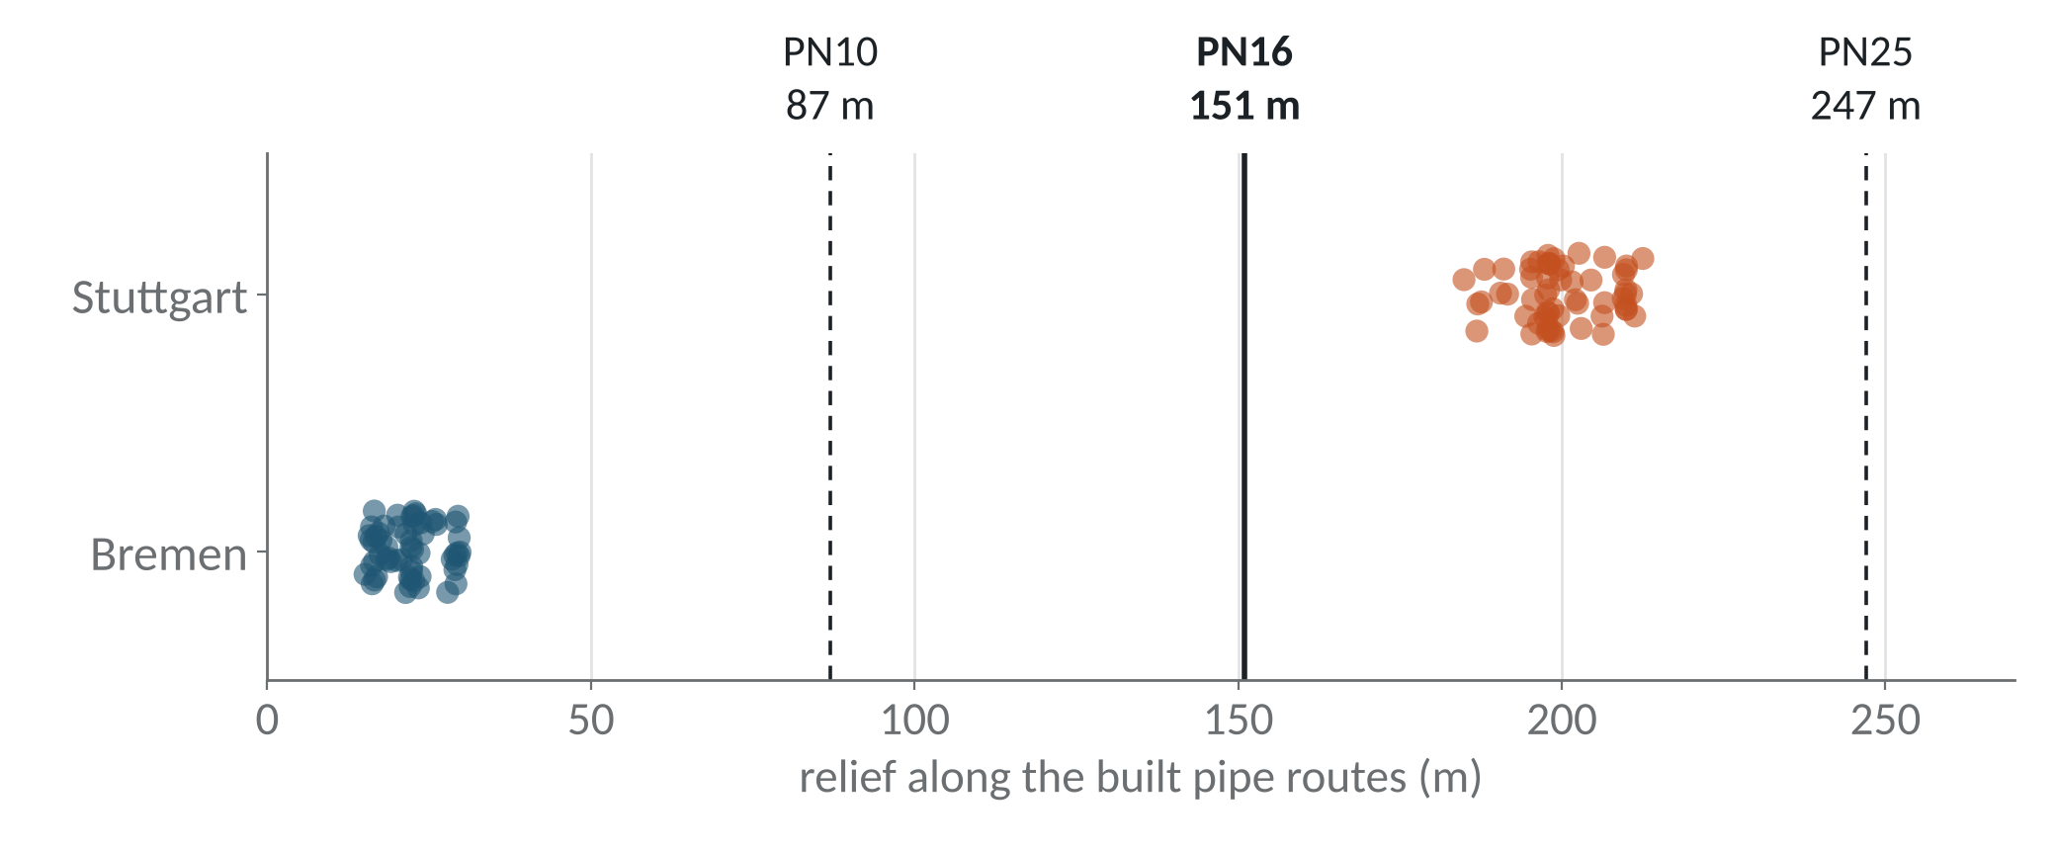
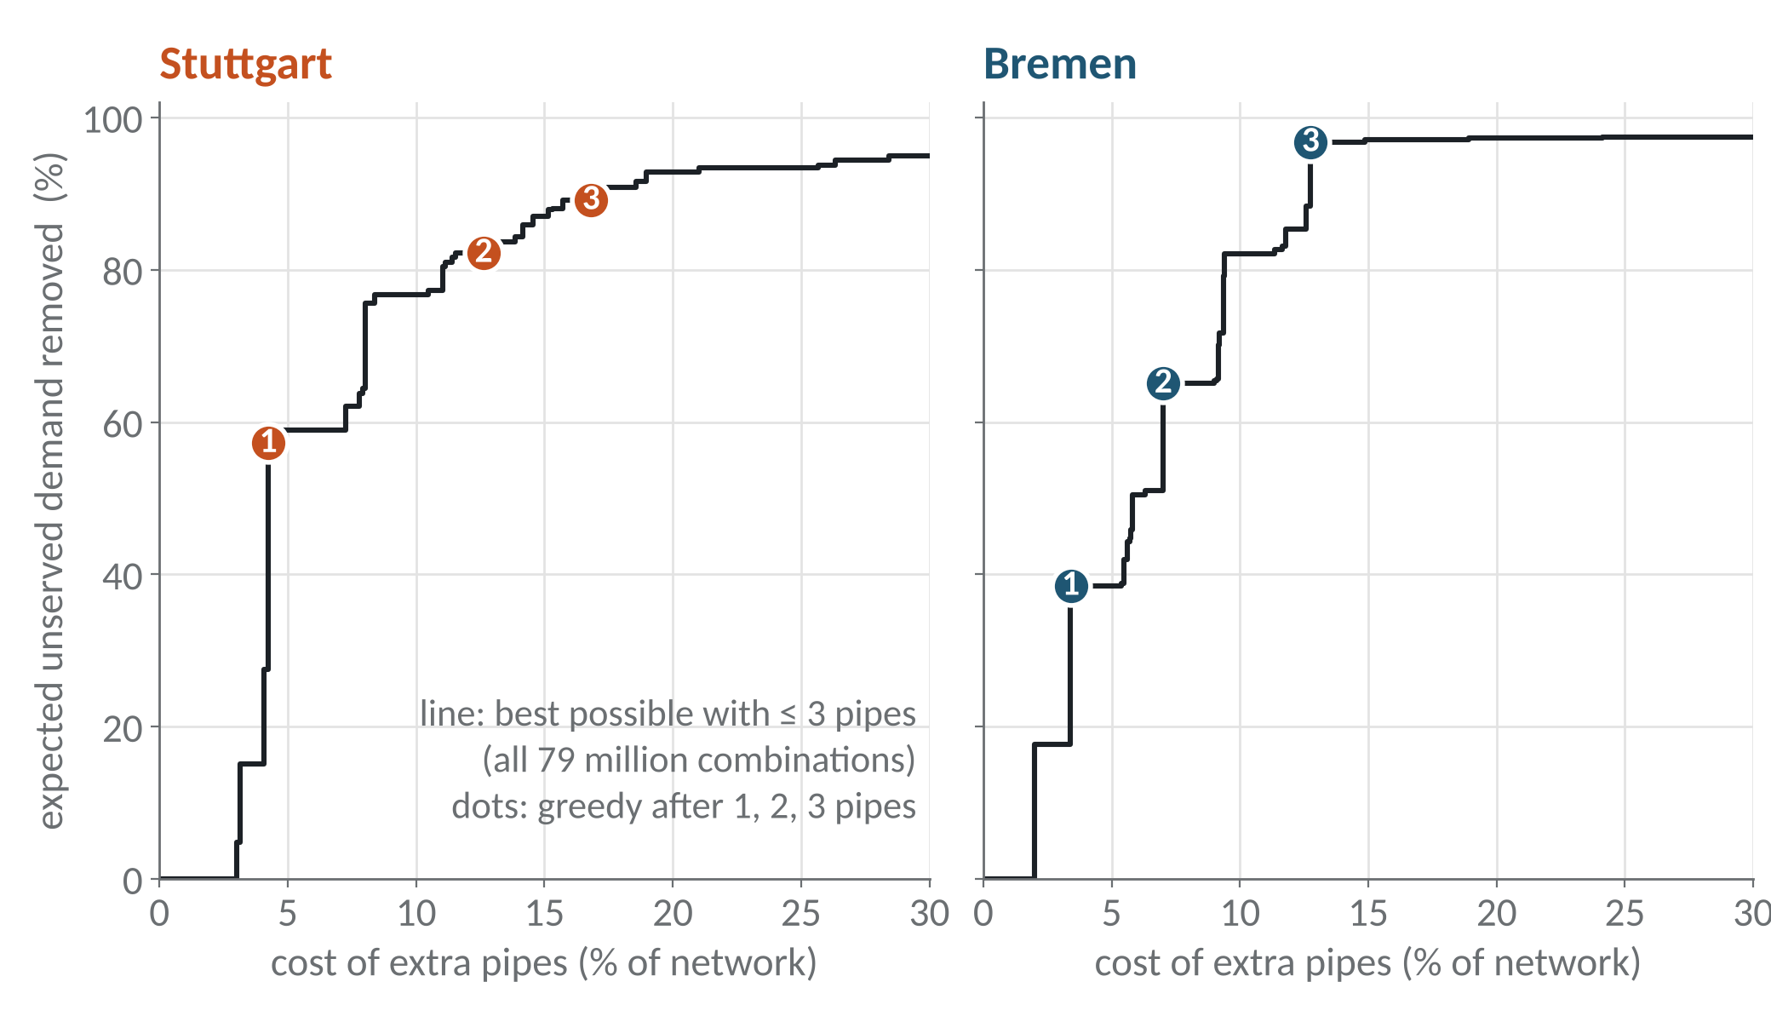
Backup: pressure class and brute-force redundancy check
Relief along built routes, real terrain, 60 networks per city
Greedy against brute force, up to 3 extra pipes
185 to 213 m in Stuttgart, 15 to 30 m in Bremen
PN10 would need 3 zones in Stuttgart, PN25 only 1
Cost changes by only 0.5% between PN10 and PN25
780 candidate pipes, 303,810 pairs, 78.8 million triples per city
Greedy is on the best possible line in 5 of 6 cases
Notes:
Backup, only if asked.

Slide 12
Backup: how each new analysis was run
Analysis | Setup | Check
120 networks | 20, 40, 60, 80, 120, 160 substations x 10 k-means seeds x 2 cities; normal MST and terrain MST costed with the prelim model | Seed 42 with 40 substations gives the prelim numbers (23.09 and 22.39 EUR/MWh)
Seasonal load | Sochinsky duration curve, 40 load levels, supply temperature 110 to 80 °C with load; friction and heat loss recomputed per pipe | Summer load 5 to 20%: terrain saving stays 0.85 to 0.91%
Edge-swap search | Candidates = 8 nearest neighbours of each node; best cycle edge removed; repeat till no improvement; seasonal costing | Starting from normal MST or terrain MST ends within 0.09 EUR/MWh
Cost vs graph metric | 30 trees per city; linear fit of cost on total length, then on length + demand-weighted distance to plant | R² 0.21 to 0.97 in Stuttgart, 0.09 to 0.97 in Bremen
Relief sweep | Stuttgart elevations scaled about their mean by 0, 0.25, 0.5, 0.6, 0.7, 0.75, 0.8, 0.9, 1, 1.25, 1.5; 10 clusterings each | Scale 1.0 reproduces the real-terrain results
Redundancy ILP | max Σ wₑyₑ with yₑ ≤ Σ x of pipes covering e, Σ x ≤ k, cost ≤ greedy budget; x, y binary; scipy milp (HiGHS) | Equal to brute force for k = 1, 2, 3 in both cities
N-1 pipe sizing | Flow LP for normal operation and each single pipe failure; pipes sized for the worst case | Reproduces the prelim cost vs reliability curve
Notes:
Backup, only if asked how a number was produced or checked.

