Slide 1
CLL798D / CHL7903 · NETWORK SCIENCE · PRELIM REVIEW · 09 SEP 2026
Minimum spanning trees don't survive
contact with a hillside
Graph-theoretic topology optimisation of district-heating pipe networks — on two real German networks, real satellite elevation data, and a transport-phenomena cost model.
MST = Minimum Spanning Tree · TAC = Total Annual Cost · SRTM = Shuttle Radar Topography Mission
REAL NETWORKS
Bremen · Stuttgart
ELEVATION DATA
NASA SRTM, 30 m grid
ALGORITHMS
Kruskal · Prim · Steiner
Pathway 1 — reproduce and extend · Gao et al. (2020), Chem. Eng. Transactions 81, 277–282
Notes:
TITLE - 15 s. One line: 'We asked whether the minimum spanning tree, which is the standard answer for pipe network layout, survives contact with real terrain. It does not, in three separate ways.' Then move straight on.

Slide 2
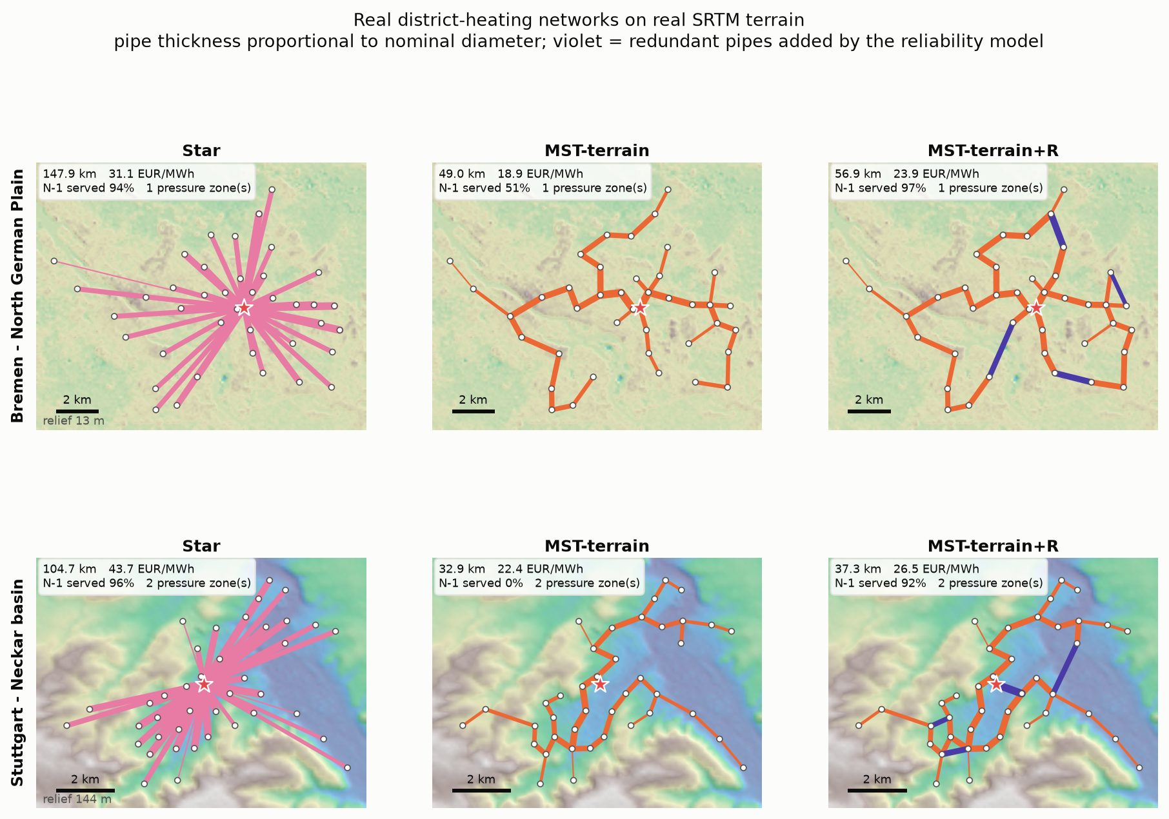
02 SETUP · PROBLEM, DATA, METHOD
A pipe network is a graph, and the topology is the design decision
THE GRAPH
V = 1 plant + 40 substations
E = every feasible trench route
layout = spanning tree
candidates = 41^39 ~ 10^62
Minimum Spanning Tree (MST): the cheapest loop-free layout that still reaches every consumer.
REAL HEAT DEMAND
859 GWh/y
67,314 households (AixDHN, RWTH Aachen)
REAL ELEVATION
29,248 points
NASA satellite data, sampled every 25 m along every candidate route
A district-heating network pipes hot water from one central plant to every building in a city district. The buried pipe layout is 80-90 % of lifetime cost, so choosing the topology IS the design decision.
RELIEF = HEIGHT RANGE
63 m vs 282 m
flat Bremen vs hilly Stuttgart
Notes:
SETUP - 45 s. Nodes are substations, edges are candidate trenches, a valid layout is a spanning tree, and there are 10^62 of them so you need an algorithm. Two REAL German networks from the AixDHN census dataset, real household demand, real SRTM terrain. Bremen is flat at 63 m relief, Stuttgart is 282 m. That contrast is the controlled experiment. Note the star on the left is 3x the pipe length. Move on quickly.

Slide 3
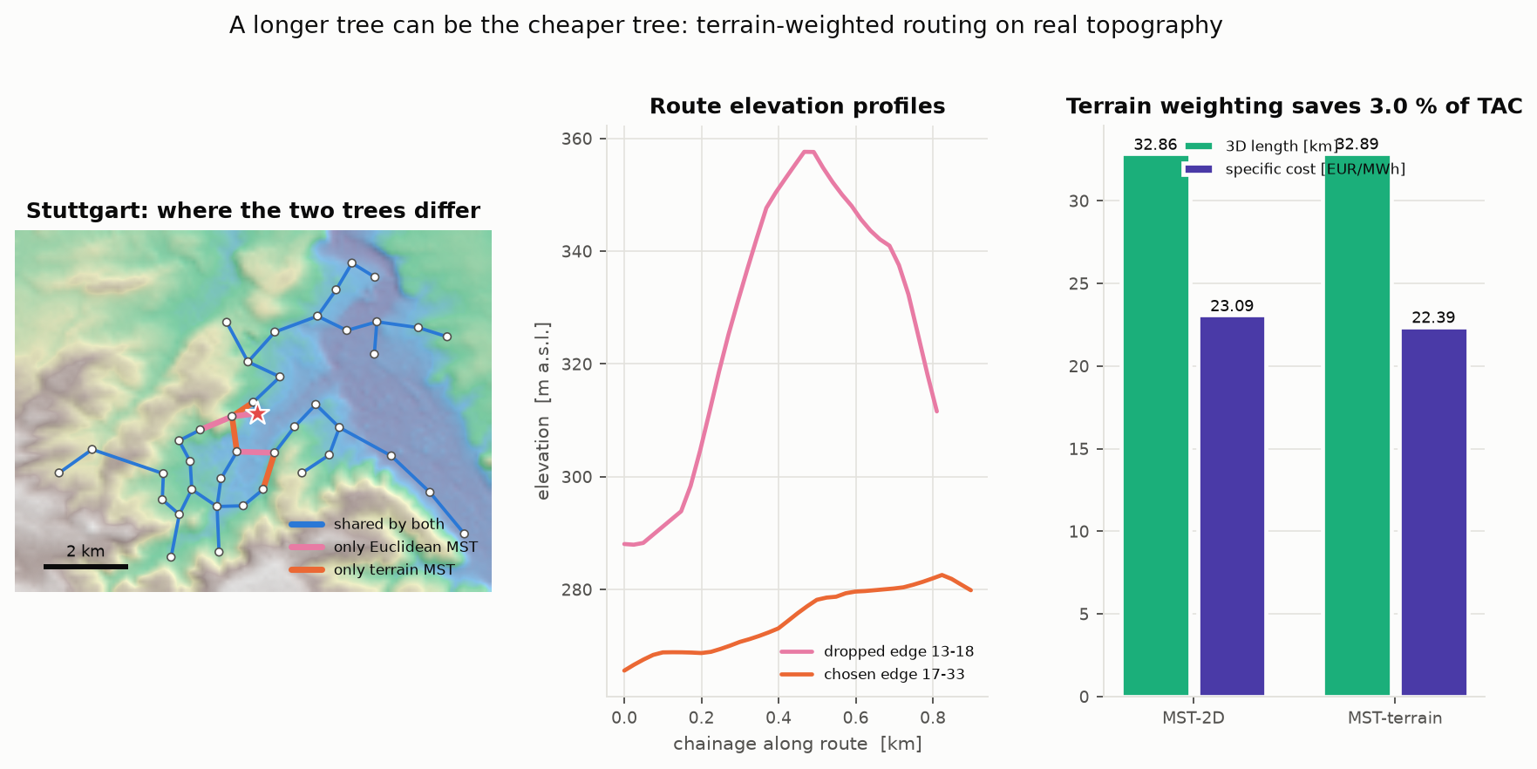
03 RESULT 1 · TERRAIN-WEIGHTED ROUTING
A longer tree can be the cheaper tree
STUTTGART · HILLY
−3.0 % cost
total annual cost 23.09 → 22.39 EUR per MWh delivered, for a tree that is 0.03 km LONGER
BREMEN · FLAT
0.0 %
terrain weighting returns the identical tree — the control works
WHAT WE CHANGED
Edge weight is no longer straight-line distance, but true slope length × a trenching multiplier that rises with gradient. Minimum length = minimum cost only on flat ground.
Notes:
RESULT 1 - 55 s. We replaced straight-line distance with terrain-weighted construction cost: 3D slope length times a trenching multiplier that rises with gradient, sampled on the real DEM. In Stuttgart this changes which tree is optimal and saves 3% of total annual cost - for a tree that is LONGER in metres. In flat Bremen it returns the identical tree, which is the control experiment behaving exactly as it must.

Slide 4
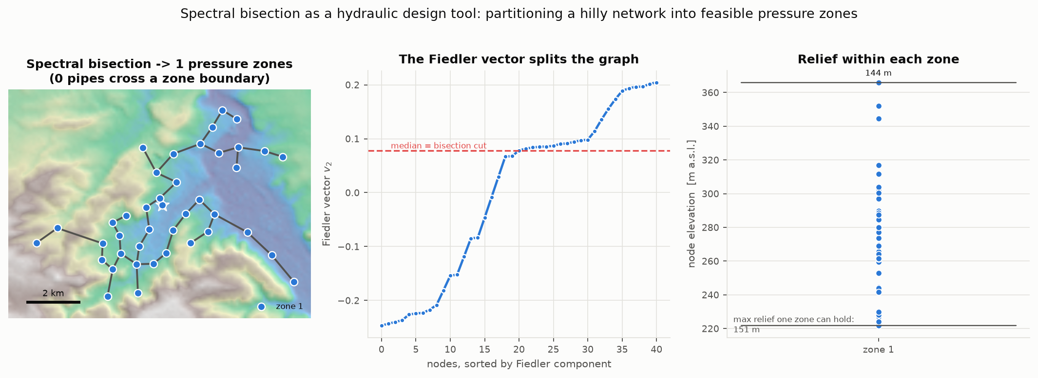
04 RESULT 2 · HYDRAULIC FEASIBILITY
In Stuttgart the cost-optimal tree cannot legally be built
STATIC PRESSURE
p(z) = p₀ + ρg(z₀ − z)
ρgΔz over 282 m 26.3 bar
PN16 pipe rating 16.0 bar
one-zone limit 151 m
PRESSURE ZONES NEEDED
Stuttgart 2 Bremen 1
PN16 = Pressure Nominal: pipe rated to 16 bar. An exchanger station splits the network so neither half exceeds it.
SPECTRAL BISECTION AT WORK
Where to split is a balanced minimum cut — separate by elevation, cut as few pipes as possible. The Fiedler vector of the Laplacian is the classical relaxation of exactly that.
Notes:
RESULT 2 - 55 s. The binding terrain constraint is NOT pumping cost. In a closed supply/return loop the static head cancels - the return leg gives it back - so pumping is friction only. What does not cancel is the static pressure the pipe must physically hold: 282 m of relief is 26.3 bar against a PN16 pipe class. One zone can hold 151 m. So Stuttgart needs two pressure zones and Bremen needs one. We choose where to split with spectral bisection of the Laplacian - that is a balanced minimum cut, because every pipe crossing a boundary needs an exchanger station. Course material doing real engineering.

Slide 5
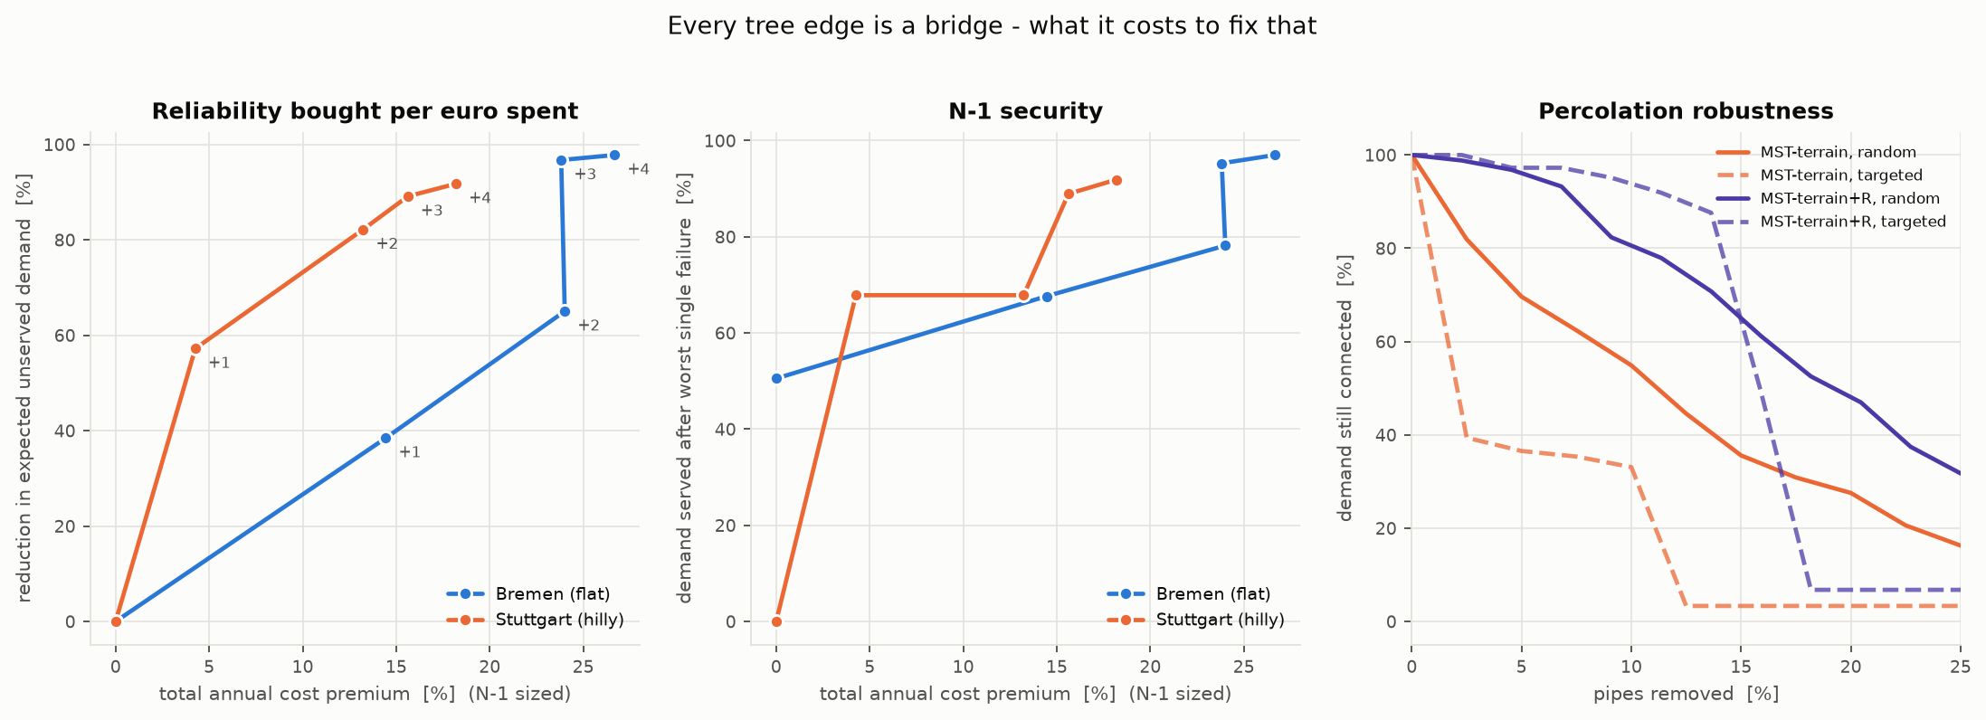
05 RESULT 3 · RELIABILITY
Every tree edge is a bridge — and Steiner trees make it worse
STUTTGART · N-1 = LOSS OF ANY ONE PIPE
topology EUR/MWh brdg served
Star 43.72 40 br 95.6 %
MST-terrain 22.39 40 br 0.0 %
RSMT Steiner 20.87 59 br 0.0 %
MST-terrain +R 26.46 17 br 91.9 %
DOES A STEINER TREE FIX IT?
RSMT = Rectilinear Steiner Minimal Tree: extra junction points are allowed, so it is shorter and cheapest here. But it is still a TREE, and it concentrates flow into shared trunks — so it is MORE fragile, not less.
ONLY A LOOP FIXES IT — FOR 4.3 %
One redundant pipe: −57 % Expected Unserved Demand (EUD); N-1 survival rises 0 → 68 %.
Notes:
RESULT 3 - 60 s. Structurally, every edge of a tree is a bridge, so any single pipe failure strands everything downstream. This answers a question we were asked: does a Steiner tree fix it? No. A Steiner tree is still a tree. RSMT is the CHEAPEST topology we found at 20.87 EUR/MWh, but it has 59 bridges against the MST's 40, because Steiner points concentrate flow into shared trunks. Steiner solves cost; only cycles solve faults. Adding one redundant pipe costs 4.3% and removes 57% of expected unserved demand. Note the star is the most RELIABLE topology - that is the trade-off in one line.

Slide 6
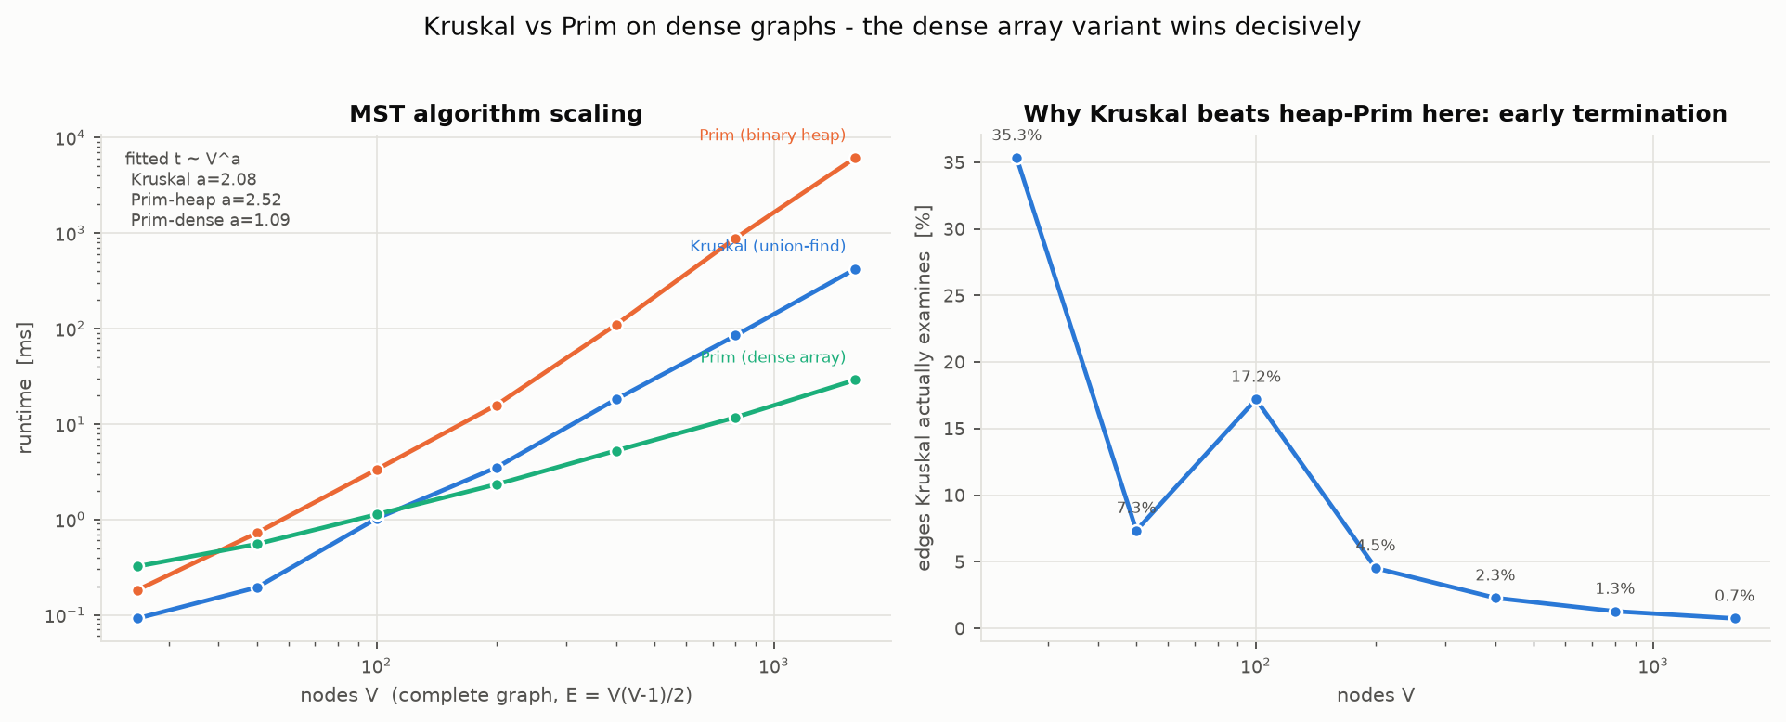
06 RESULT 4 · ALGORITHMS AND THE REPRODUCTION
Kruskal vs Prim, and two findings against the source paper
V = 1600, E = 1,279,200
Kruskal union-find 420 ms
Prim binary heap 6114 ms
Prim dense array 28.8 ms
WE WERE WRONG, AND MEASURED IT
We predicted density favours Prim. It favours DENSE Prim — 212× faster than the heap version. Kruskal wins by early exit, examining 0.7 % of edges.
PAPER FINDING 1
Table 2 is not self-consistent: the Star/MST cost ratio implies 357 kg/s, the absolute cost implies 87.5 — 3×.
PAPER FINDING 2
Their Euclidean Steiner / MST length ratio 0.86555 sits below the proved Du-Hwang lower bound √3/2 = 0.86603.
Notes:
RESULT 4 - 50 s. All three MST implementations written from scratch and verified to return identical tree weight. Our own earlier slides predicted that a dense graph favours Prim. The measurement says it favours the DENSE ARRAY Prim - 212x faster than the heap version - while heap Prim is the worst choice. Kruskal beats heap Prim by terminating early, examining 0.7% of the sorted edge list. On the reproduction: we matched the paper's MST column exactly, but found its Table 2 is not internally consistent, and its reported Steiner ratio sits below a proved geometric lower bound. If asked, we also re-derived their heat transfer coefficient independently to 0.16%.

Slide 7
07 CONCLUSION
Terrain belongs in the weight. Pressure class belongs in the constraints. Reliability belongs in the objective.
COST
−3.0 %
terrain-weighted MST, Stuttgart
FEASIBILITY
2 zones
PN16 exceeded by 10 bar
RELIABILITY
+4.3 % → −57 %
cost premium vs unserved demand
ALGORITHMS
212×
dense Prim over heap Prim
On flat ground a minimum spanning tree is the right answer. On real terrain it is neither minimum-cost nor necessarily buildable — and because every tree edge is a bridge, it is never robust.
NEXT
Exact ILP bound on the greedy redundancy · seasonal part-load · a third district to test the 151 m threshold
DATA
AixDHN (RWTH Aachen, MIT) · NASA SRTM 30 m · EN 253 · Eurostat · Persson & Werner (2011)
Notes:
CLOSE - 20 s. One sentence: terrain belongs in the edge weight, pressure class belongs in the constraints, reliability belongs in the objective. Then stop and take questions. Do NOT read the four numbers aloud - they are there for the audience to scan.

Slide 8
08 REFERENCE · NOT PRESENTED
Abbreviations and data sources
ABBREVIATIONS
MST Minimum Spanning Tree
ESMT Euclidean Steiner Minimal Tree
RSMT Rectilinear Steiner Minimal Tree
TAC Total Annual Cost
EUD Expected Unserved Demand
N-1 loss of any one component (single contingency)
DN Diameter Nominal - standard pipe size
PN16 Pressure Nominal - pipe rated to 16 bar
DEM Digital Elevation Model
SRTM Shuttle Radar Topography Mission (NASA)
LP Linear Programming
lambda_2 algebraic connectivity (Fiedler value)
DATA AND SOURCES - ALL REAL, ALL CITED
AixDHN
RWTH Aachen EBC, MIT licence - real German district heating areas, demand and census cells
NASA SRTM 30 m
elevation, via the OpenTopoData API
EN 253
European standard for pre-insulated bonded pipe - the diameter catalogue
Persson & Werner 2011
district-heating trench cost function
Valincius et al. 2015
pipe failure rates, 0.02-0.31 per km-year
Eurostat H2 2025
German industrial electricity, 0.1922 EUR/kWh
Gao et al. 2020
the reproduced paper, Chem. Eng. Trans. 81
Notes:
BACKUP - do not present. Jump here in QnA if asked what an abbreviation means or where a number came from. Full provenance for every value is in docs/DATA_SOURCES.md.

