Slide 1

WELCOME TO HELPING HANDS

Slide 2
Participant details
Presented By:
K.Mounika
182U1A0536
3rd year
Department of computer science and engineering,
Geethanjali institute of science and technology.

Slide 3
CONTENTS
INTRODUCTION
01
BLOCK DIAGRAM
02
MODULES
03
ADVANTAGES AND DISADVANTAGES
04
FUTURE SCOPE
05

Slide 4
INTRODUCTION
HELPING HANDS ARE BETTER THAN PRAYING LIPS
Aim:The main intention of helping hands is to spend money for the student who are in a sick condition
for eg:if there are 2000 students in a college,if each student gives 5 Rupees per week,then it becomes 20 Rupees per month
Like this,on 2000 students we can get 20,000 per month and for 5 months we can get one lakh
half of the amount we can spent on student based on requirement
If any students gets hospitalized,then this money will be helpful for those students according to particular college

Slide 5
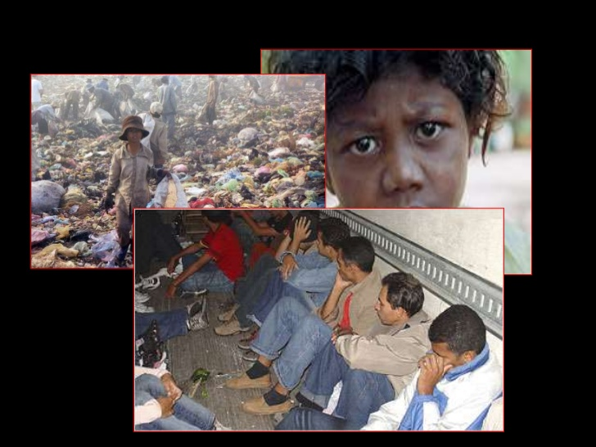
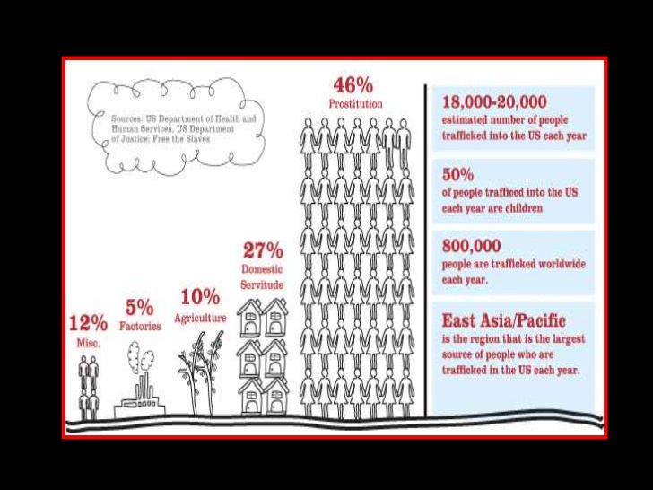
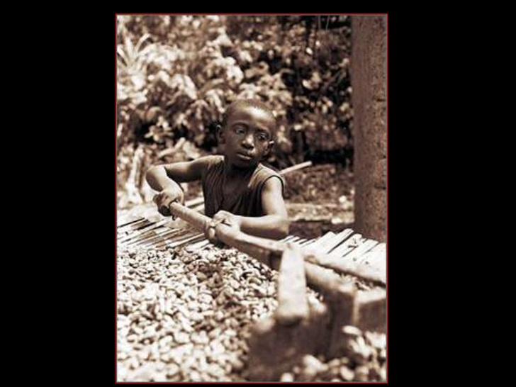

BLOCK DIAGRAM
HOMEPAGE SIGN UP
DETAILS and FUND COLLECTION
Store in DB

Slide 6
HOME PAGE
CONTACT US
ABOUT US
SIGNUP
STUDENT FUND
TEACHER FUND
PARENT FUND
In this project you will get to know how to develop one welfare like helping
Hands using html,css,java script.
It’s the good way to implement helping hands welfare in order to be supportful
For students who are under poor family.

Slide 7
HARDWARE REQUIREMENTS
Processor : INTEL(5th generation)
Ram : 8GB
Hard disk : 10GB
Key board : Standard Window keyboard
Mouse : Two or three button mouse
Monitor : SVGA
Display : 800*600

Slide 8
SOFTWARE REQUIREMENTS
Operating System : Microsoft Windows 10
Programming Languages : Html, Css, JavaScript, Php
Front end : Html, Css, JavaScript
Back end : Php
Text editors : Visual studio and Notepad++
Compilers : Google Chrome, Internet Explorer
and Mozilla Firefox, Safari

Slide 9
MODULES
In these session involving different modules
Homepage Module :
In this module total project homupagee Involved.First you can click menu option, the different options to see like contact us and about us , sign up.You can click one option to see the results of the project...

Slide 10
ADVANTAGES
Helping hands website will tracks the money that how much amount we
Have spent on student
Its used for solving the students problems on money
Helping others can help u live longer
Helping others makes us happy
Helping others promotes positive behaviour in teens

Slide 11
DISADVANTAGES
Its take time to be successed
Time taken to implement
There is no disadvantages in helping others

Slide 12
FUTURE SCOPE
In upcoming days its helpful for parents also not only for students
In futhers days I can develop using react.js,angular
This helping hands will be hepful in future
Helping hands are better than praying lips

Slide 13
THANK YOU
For given this opportunity

