Slide 1
WATERFALL VS AGILE
Requirements Gathering
Requirements Gathering
Design
VS
Design
Planning
Planning
Development
Development
Testing
10 Key Differences
Testing
Maintenance
Pros & Cons
Maintenance
Situational Uses

Slide 2
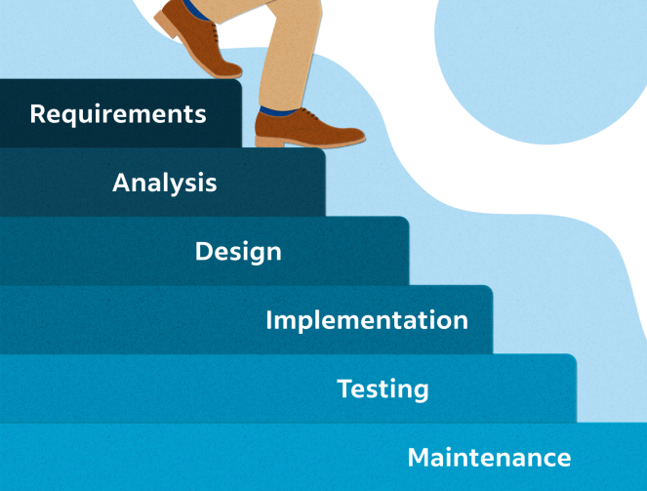
What is waterfall ?
The waterfall project management method is a linear, step-by-step approach that's ideal for projects with a clear scope and predictable timeline.
It involves rigorous planning upfront to ensure that the project stays on track, with progress tracked closely and issues addressed promptly.
The Waterfall model usually includes five project management stages (or phases):
1: Initiation 2: planning 3: execution 4: monitoring/control 5: closing

Slide 3
Waterfall Methodology – Pros & Cons
Pros
Cons
Supports all planning to be completed up front with a clear roadmap for every stage of the project
Changes require significant re-planning and adjustment to long-term plans
Utilizes a clear, structured approach
Challenging to see the value of completed tasks throughout the project if only released at the end
Easy to track progress, identify risks, and manage project budgets
Long delivery timeline, slow time to market
Project manager holds significant authority over the project, plan, and value delivery
Value of projects is low until the very end, meaning any pivots cause high sunk costs vs. delivering value

Slide 4
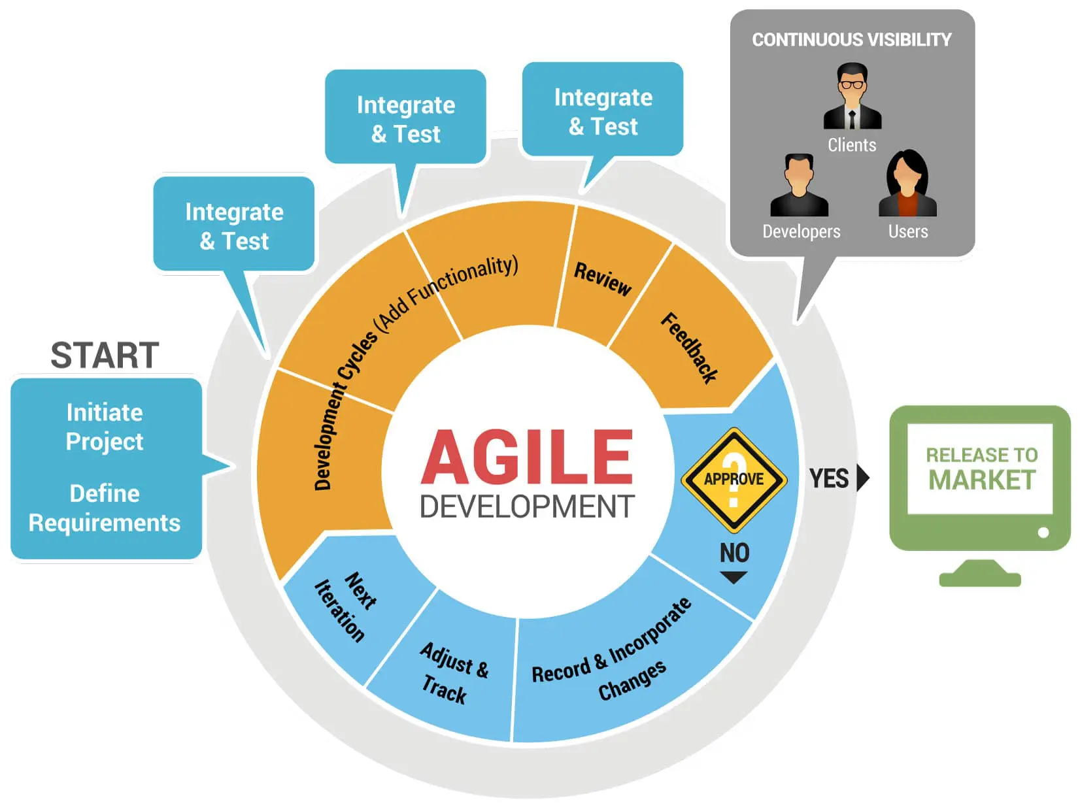
What is Agile?
Agile project management is a flexible and iterative approach that enables teams to quickly adapt to changing project requirements and deliver high-quality results within shorter timeframes.
Agile methodologies are about:
Teamwork
Constant refinement
Customer satisfaction
Breaking big projects into bite-sized pieces

Slide 5
Agile Methodology – Pros & Cons
Pros
Cons
Can handle changes to requirements along the way, regardless of size
Requires customer involvement to allow teams to identify and analyze customer needs
Shorter feedback loops mean faster ability to pivot
Project manager holds little authority; focus on facilitation and process instead
Clear visibility of current/active work items and ability to see progress on tasks over time
Less predictable while more time and commitment is needed.
Support for engineering discipline and upfront testing, improving quality
Allows for additional feature requests which may add cost or time

Slide 6
10 key differences between waterfall and agile
WATERFALL | AGILE
ROLES
PLANNING
SCOPE
Waterfall strictly assigns roles to project team members, with specific duties and responsibilities defined for each team member
Agile model empowers team members to collaborate on different aspects of the project over time, leading to a more self-organizing team structure.
In waterfall, planning is a linear process done at the beginning of the project, with all requirements and objectives laid out in detail upfront
Agile planning is a continuous process throughout the project's life cycle, with adjustments made as new information or requirements emerge.
The waterfall methodology generally discourages changes to the project's scope, even with change requests used correctly. Time and cost are the main constraints.
Agile is more adaptable to changes in scope, with the development team able to adjust quickly as requirements change.

Slide 7
WATERFALL | AGILE
TIME FRAMES
SPEED
DELIVERY
FLEXIBILITY
The waterfall method is designed for long-term projects with predetermined timelines. The project is completed linearly, with each phase dependent on the previous one.
Agile, however, uses short iterations to deliver value rapidly, allowing teams to adjust plans over time and achieve shorter time frames.
Waterfall projects tend to take longer because all requirements must be agreed upon before development can begin.
Agile projects, on the other hand, are usually delivered more rapidly than waterfall projects due to the iterative development cycles used in agile.
Waterfall requires the completion of all tasks before any work can be released.
Agile allows for quick delivery of projects with shorter lifecycles, as each iteration delivers a workable product.
Waterfall is less flexible and resistant to change once the project's scope has been defined.
Agile encourages teams to respond quickly and adaptively to changes during the development process.

Slide 8
WATERFALL | AGILE
TESTING
DOCUMENTATION
COMMUNICATION
In waterfall, testing is usually done at specific milestones, often towards the end of the project.
Agile emphasizes incremental testing to identify and resolve issues throughout the development process
Waterfall relies heavily on documenting each step in detail to ensure that all team members are on the same page.
Agile relies on minimal documentation, focusing on self-organizing teams and collaboration
In waterfall, communication is more formal, with
detailed communication plans and progress reports shared across multiple stakeholders.
Agile emphasizes informal communication, with frequent interactions between individuals or small groups of stakeholders

Slide 9
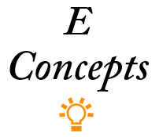
WHEN TO USE WATERFALL METHODOLOGY:
Simple scope and requirement gathering
Clear and linear sequence of tasks
Predictable deliverables based on set deadlines
Structured processes
Rigid quality control measures
Long-term commitment from all parties involved
WHEN TO USE AGILE METHODOLOGY:
Complex deliverables
Frequent iterations and refinements
Rapid delivery times
Emergent requirements
Collaborative environments
Multiple stakeholders

