Slide 1

ANALYSING AND PREDICTION OF AMCAT SCORES

Slide 2
About me
"I am Vaddi Uday Kumar, currently in my 3rd year of B. Tech in Data Science at Aditya Institute of Technology and Management, Tekkali“
Why I want to learn Data Science?
I want to learn data science because it combines my love for problem-solving with the chance to discover patterns and insights from data. In today’s world, data science skills are in high demand across many industries, creating exciting job opportunities. By mastering data science, I can help businesses make better decisions and drive innovations that benefit society. I also enjoy that the field is always changing, with new technologies and methods, which means there’s always something new to learn.
linkedin url: https://www.linkedin.com/in/udaykumarvaddi/
Git url: https://github.com/uday8695

Slide 3
Objective of the project:
Perform univariate and bivariate analyses on the columns of the dataset to understand the data given and get better insights and knowledge from the dataset by removing missing values, redundant data and find relationships ,outliers among variables . Performing visualizations on the variables for better understanding of the dataset.

Slide 4
Dataset Overview
The dataset contains around 40 independent variables and 4000 data points. The independent variables are both continuous and categorical in nature. The dataset contains a unique identifier for each candidate.

Slide 5
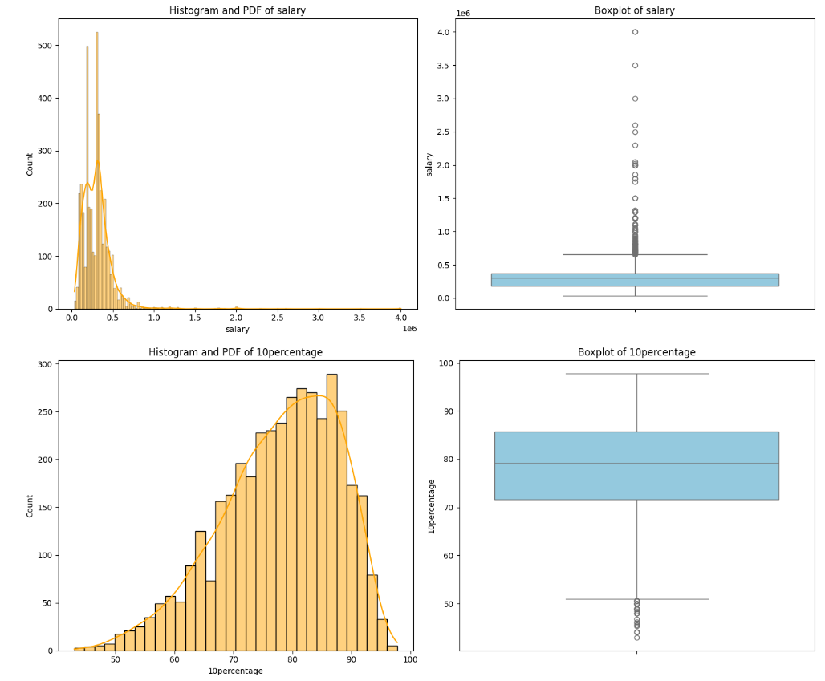
Univariate Analysis
This report explores the distribution of individual variables (one at a time) from the dataset, focusing on key features such as Salary, Gender, CollegeTier, and various test scores. Univariate analysis helps to understand the central tendency, spread, and distribution of data for each variable.
The univariate analysis reveals important insights about the distribution of salaries, gender representation, and test scores. Salaries tend to be right-skewed, with most candidates earning in the lower to middle salary range. Test scores are generally normally distributed, with programming skills showing the greatest variability.

Slide 6
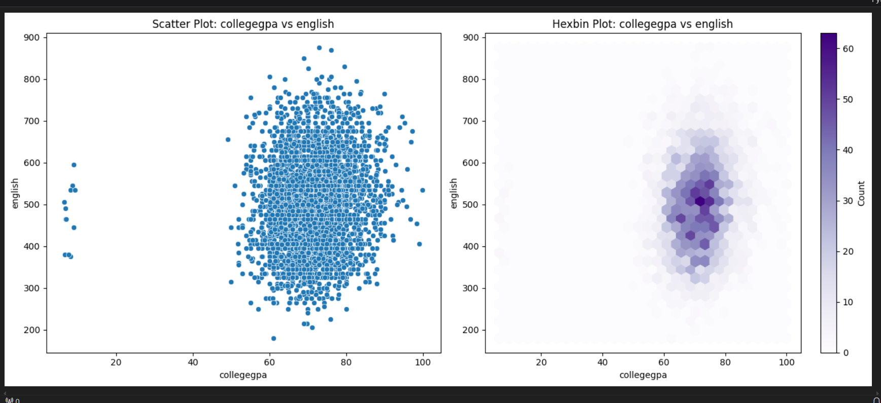
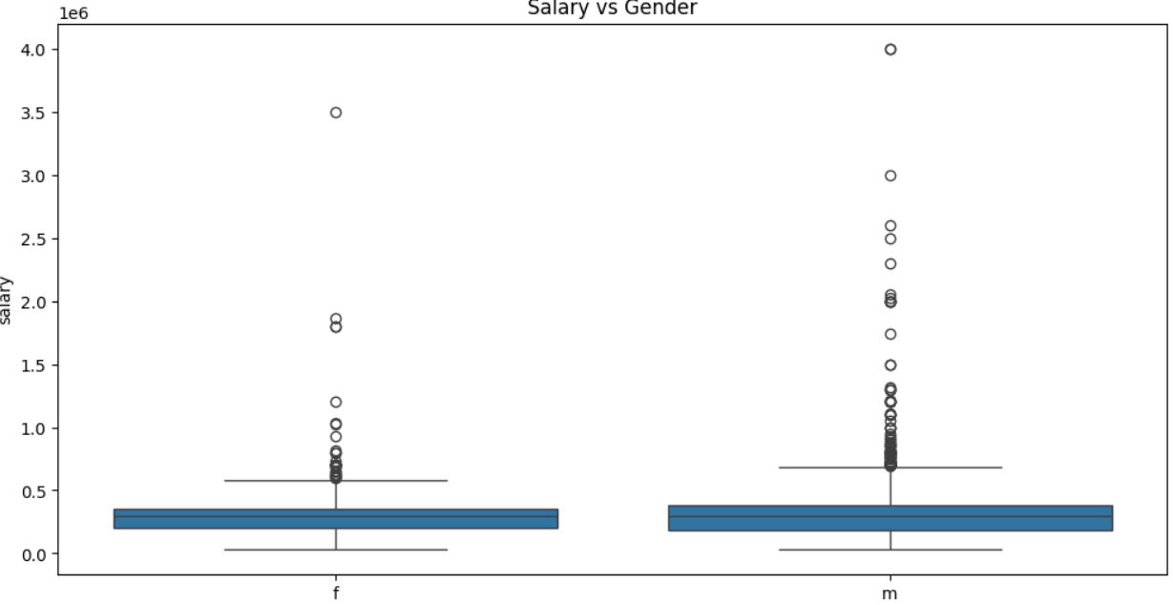
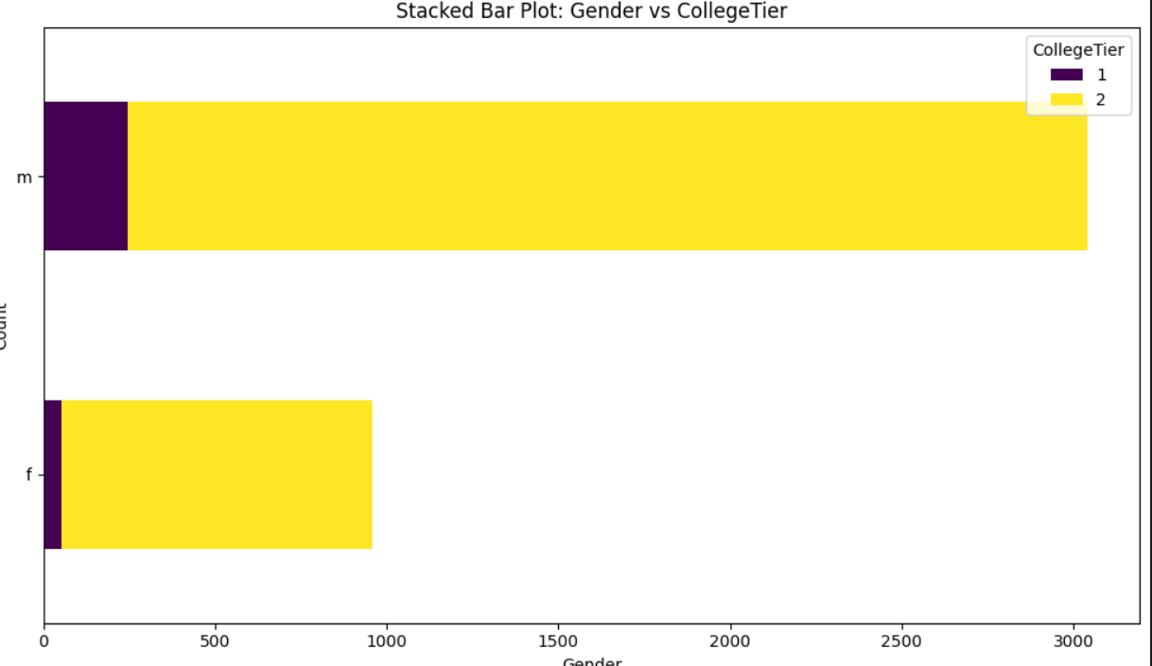
Bivariate Analysis
This report explores the relationships between salary and key variables like Gender, CollegeTier, and Test Scores to understand how these factors correlate with salary.
The bivariate analysis reveals that CollegeTier and ComputerProgramming scores have a stronger relationship with salary, while Gender and other test scores show weaker correlations. These insights can help in identifying factors that influence salary trends.

Slide 7
Conclusion
The salary data is skewed to the right, meaning most people earn less, but a few individuals earn much higher salaries than the average.
Males seem to hold more jobs across different cities and may have higher salaries on average compared to females.
The analysis reveals that test scores, are not the sole determining factor. The Computer programming score shows the strongest positive relationship with salary, followed by Quant and Domain scores, but these relationships remain weak.
Further analysis could explore the combined effect of these test scores with other factors such as experience, job location, and educational background to provide a more complete understanding of salary determinants.

Slide 8

THANK YOU

