Slide 1
Introduction to programming (Python)
Session #1

Slide 2
Typical compute layers
Power of layers
ABSTRACTION
Python script
Application libraries
Operating system
Firmware + Device drivers
Hardware

Slide 3

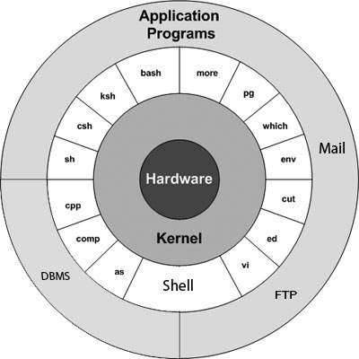
UNIX

Slide 4
Source code
Human readable/writeable instructions to computer
A Compiler or an Interpreter converts this source code into machine assembly language (x86, ARM etc)
Syntax
Making sure a script contains text that the underlying interpreter can successfully parse and convert to assembly language
Semantics
The contents of a script are trying to accomplish one or more specific goals

Slide 5
Example
some_variable = 7 #OK
some_variable, 7 = #Not OK
Some variable = 7 #Not OK
# Everything that follows a ‘#’ is a comment and is for human readability only
# Interpreter does not care about these
# These are however super important because syntax is not always good in communicating the overall idea of that piece of code

Slide 6
Typical script
# /usr/bin/python3
# File: even_number.py
def is_even(number) -> boolean: # This line starts at column 0
boolean_result = (number % 2 == 0) # This line starts at column 4
return boolean_result # This line starts at column 4
if __name__ == ‘__main__’: # Python uses indentation to define scope
print(is_even(3))
print(is_even(32))

Slide 7
Everything has a State
boolean has 2 states: true, false
integer has 2^32 states: 0, 1, 2, …, 2^32 -2, 2^32 – 1
char has 256 states: 0, 1, …, 254, 255
A program.py is made up of Booleans, integers, chars, classes, lists, dicts, sets etc.
So, program.py can be in so many states
Out of these possible states, there are only a few valid states
Out of these valid states, typically, there is only one START and one END state
program.py, at any time during its run, must be in one of the valid states
A bug will cause program.py to go to an invalid state

Slide 8
Visualizing State
Universe = Valid + Invalid
Invalid = Universe – Valid
Valid| = Universe – Valid
| in superscript denotes complement-of
Universe
Valid
Invalid

Slide 9
State in source code
Q. How does a piece of code get into valid state?
A. Using the control statements such as if, while, for etc.
Let’s say number is an integer
number can be in 2^32 states
If a piece of code wants to print only numbers that are less than 50, then we have:
Universe = All integers
Valid states = All integers less than 50
Invalid states = All integers greater or equal to 50
This is achieved in code using:
if number < 50:
print(number)

