Slide 1

SU22: DATA VISUALIZATION: 8101
Final Project Paper
Analysis of Cricket
Work done by: Uday S Boni

Slide 2
Motivation
Cricket, being the second most popular sports in the world, is widely followed across the globe.
Cricket has widely evolved over the years with initial days cricket being played over 5 days (Test Cricket), to 1 day cricket (ODI Cricket), to the latest format where cricket is played just for 3 hours (T20 Cricket).
It would be interesting to visualize relative accomplishments of each country in this sport over the years in different formats or how the players have fared in comparison with players from other countries
This analysis/visuals would help Sports audience to understand internals of Cricket

Slide 3
Existing Work

Slide 4
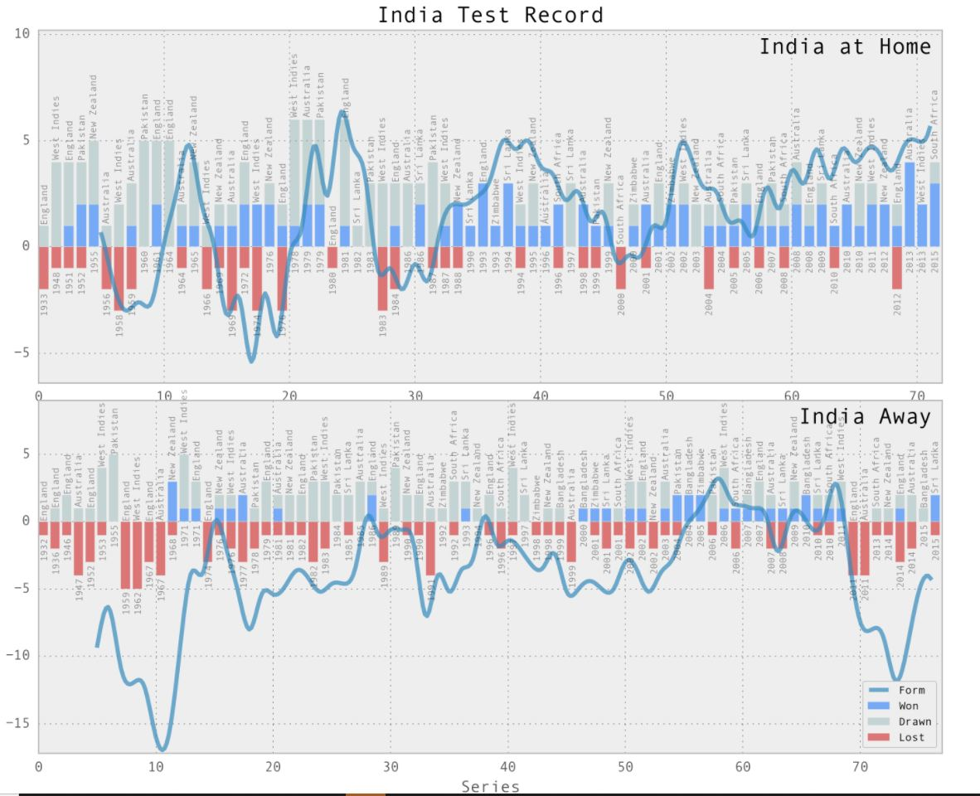
Existing visualization – Showing Test record for India
Image Reference: https://www.reddit.com/r/Cricket/comments/499uhs/indias_test_record_data_visualization/

Slide 5
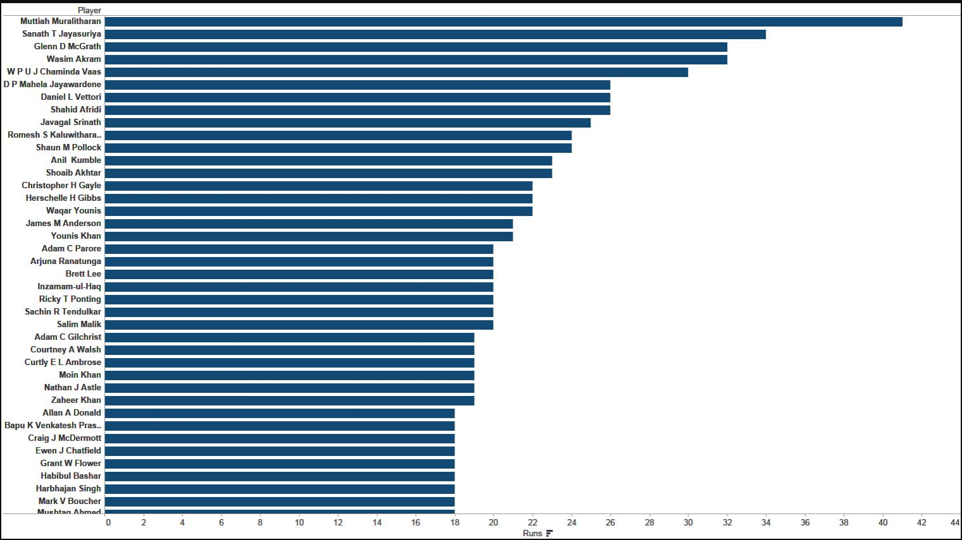
Existing visualization – Showing Number of times 0 runs scored
Image Reference : https://www.edupristine.com/blog/cricket-data-visualization-with-tableau

Slide 6
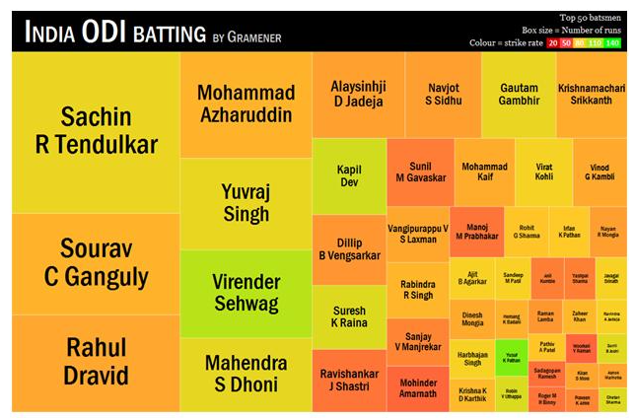
Existing visualization – Showing Runs scored by Indian players
Image Reference : https://analyticsindiamag.com/data-visualization-a-pov-from-gramener/

Slide 7
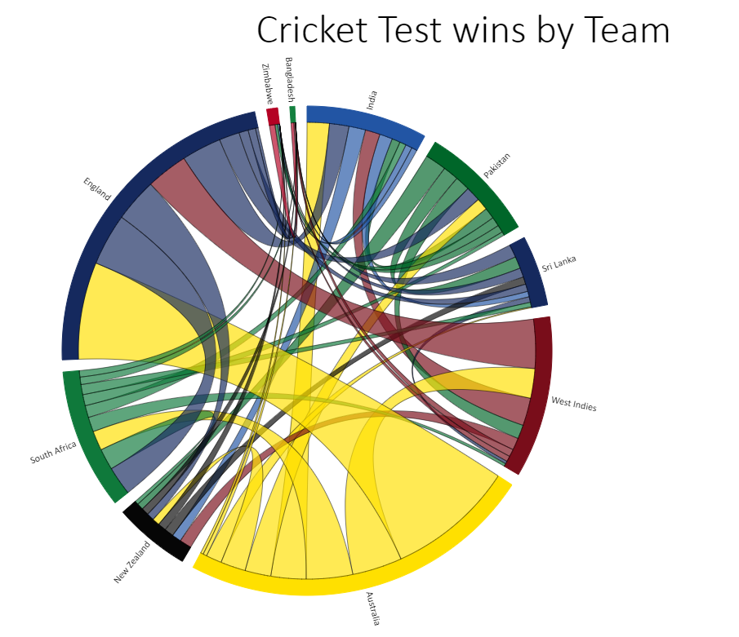
Relevant visualization – Number of wins in Test matches between the countries
Image Reference : https://codepen.io/veereshai/full/pmvwC

Slide 8
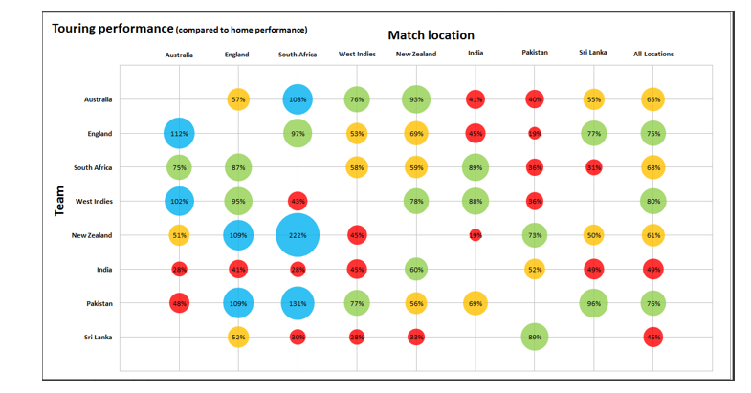
Relevant visualization - % of Abroad Wins for the countries
Image Reference: https://truii.com/data-curio-blog/sports-statistics/cricket-hardest-place-tour/

Slide 9
Objectives

Slide 10
To create some visualizations which will help the user to understand how the countries have adapted to the different formats in this sport. This can be illustrated using the following techniques :
TRENDS
Changes that happened over time. For example, will look at the changes in the number of matches won across the years for each of participating countries as well as how players have fared over the years.
Visualization of more variables in the same plot. For example, how countries have fared in different formats
RANKINGS
List the top 15 most runs scored by the participating players in history across formats
List the top 15 most wickets taken by the participating players in history across formats

Slide 11
COMPARISON
Wins between two nations in each of the three formats
Home Vs Away number of win or loss
Win/loss/Tied match results for each country in each format
STATS
Total matches played in each of different formats
Number of players that have played for each country
Number of wins for each country

Slide 12
Data and Methods

Slide 13
Data Processing
Cricinfo Statsguru Data (Kaggle)
Match Results
Batting and Bowling Data
Players Data
Data Cleansing using Pandas Dataframe
Merging of different datasets using merge() function
Use of pycountry library to fetch the ISO country information

Slide 14
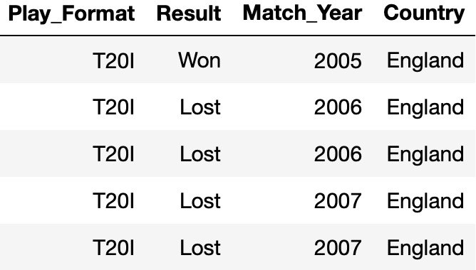
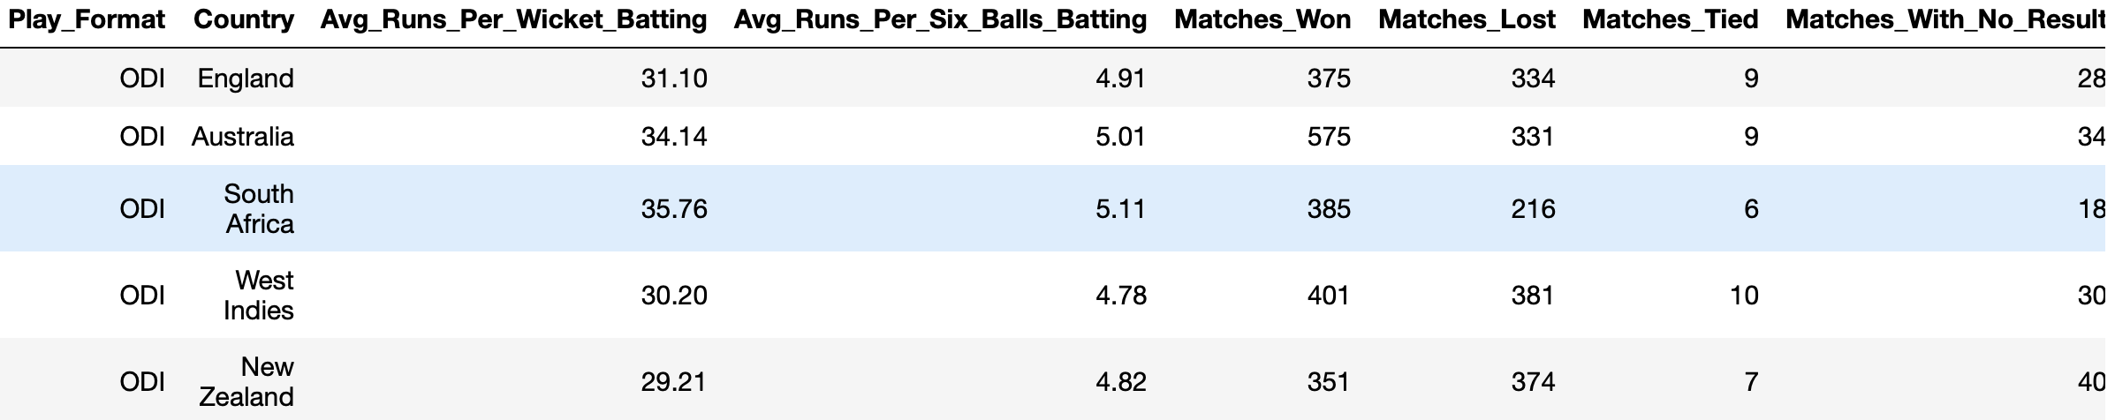
Data
Match Results Data
Batting Data

Slide 15
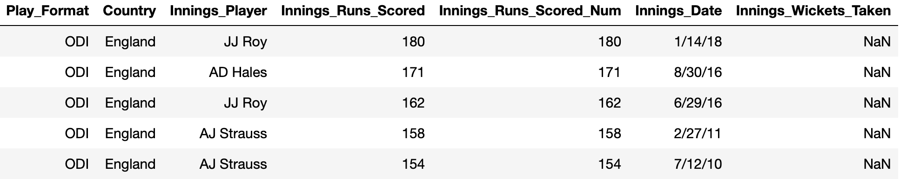
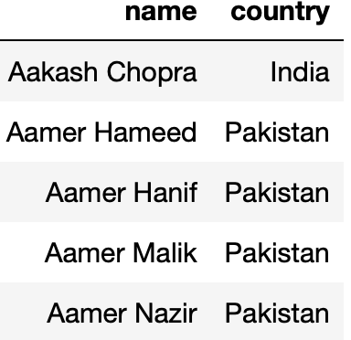
Data
Bowling Data
Players Data

Slide 16
Methods
Data visualization methods that have been used to show visualizations with the data are as below :
Area Chart - The number of matches played so far in each format since the beginning of Cricket or past 20 years
Bubble/Bar/Line Chart - Number of matches won by each country per format across the decades
Stacked Bar Chart – Showing win/loss statistics for different countries per format
Sunburst Chart - Showing win/loss statistics for different countries per format
Pair Plot – Showing Average Runs scored per Wicket in different formats
Box Plot with Strip Plot - Win/Loss Ratio for each country in each format
Bar/Pyramid Chart – Wins in Home Vs Away for each country in different formats
Race Chart – Batting/Bowling stats for top 15 players in the world
Bubble Matrix Chart – Wins for each country against each other
Parallel Coordinate plot: Each format win/loss/no result stats
Visualization Libraries used for visualizations are
Matplotlib, Seaborn, Plotly, Altair, Parallel Coordinates, Bar Chart Race

Slide 17
Visualization Methods

Slide 18
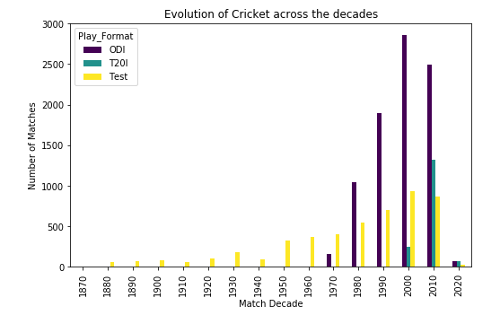
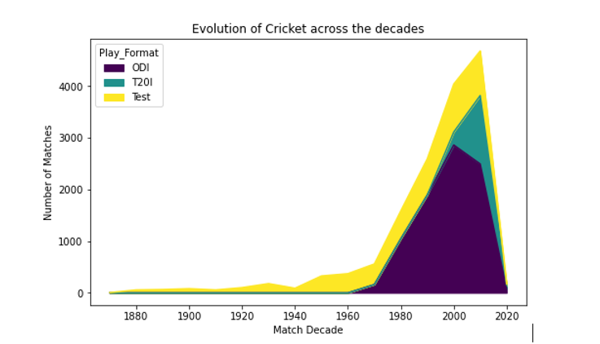
Bar/Area Chart – Number of matches played for each format across the decades

Slide 19
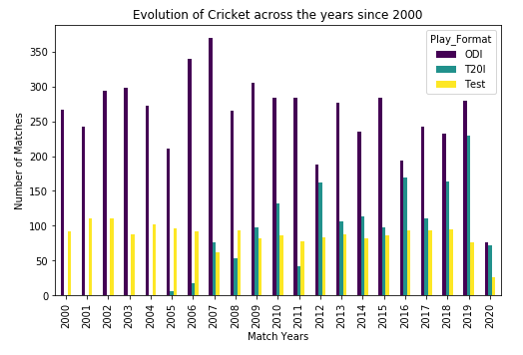
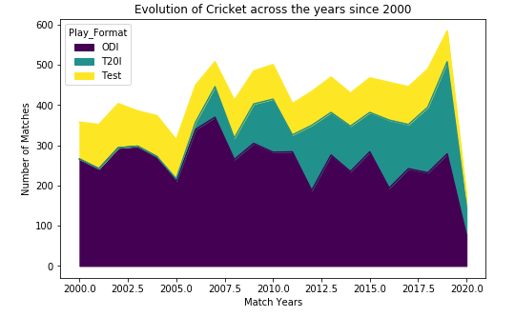
Bar/Area Chart – Number of matches played for each format per year since 2000

Slide 20
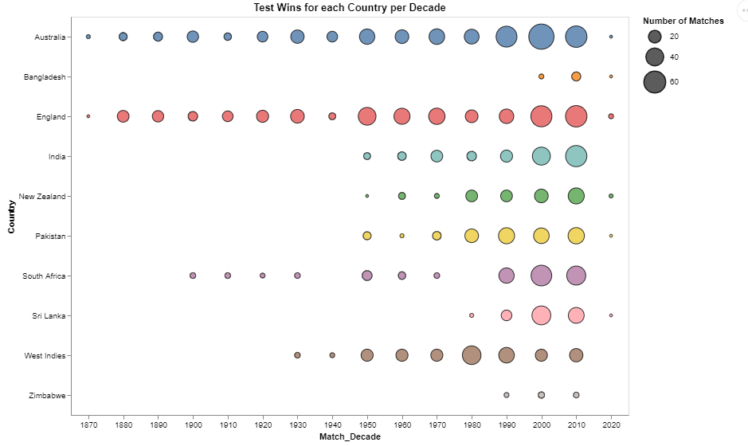
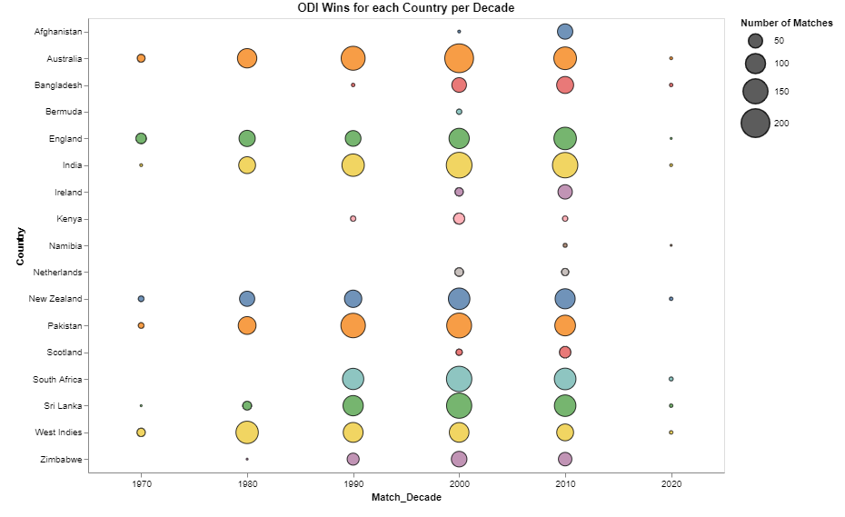
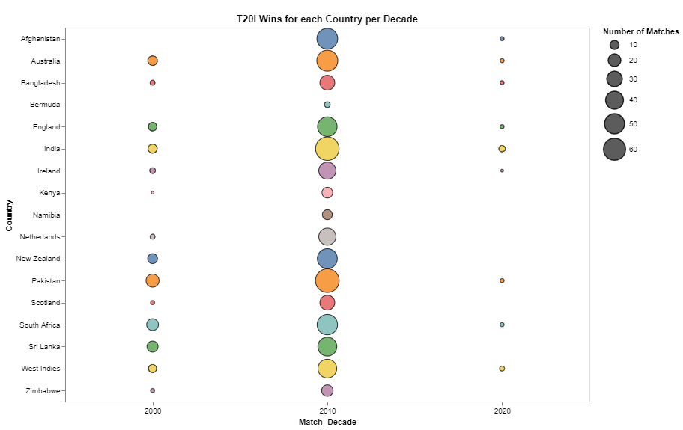
Bubble Chart - Number of matches won by each country per format across the decades

Slide 21
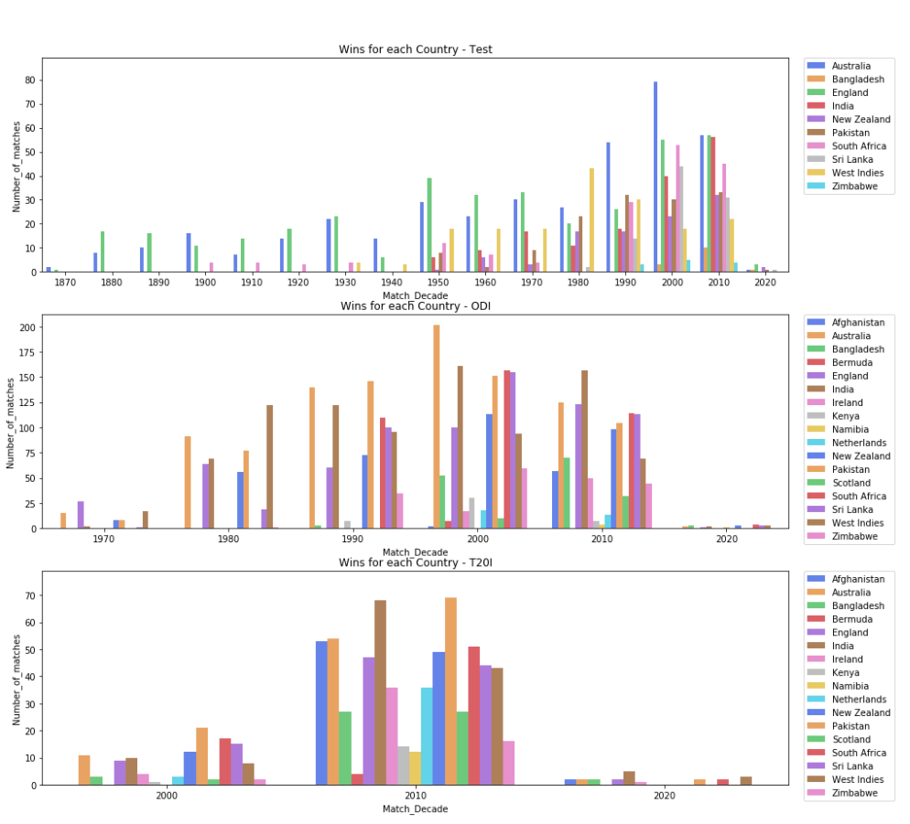
Bar Chart - Number of matches won by each country per format across the decades

Slide 22
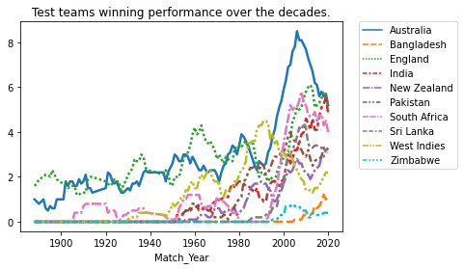
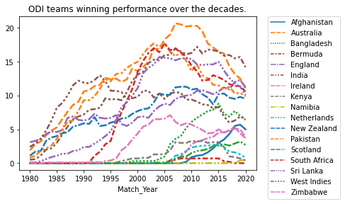
Line Chart - Number of matches won by each country per format across the decades

Slide 23
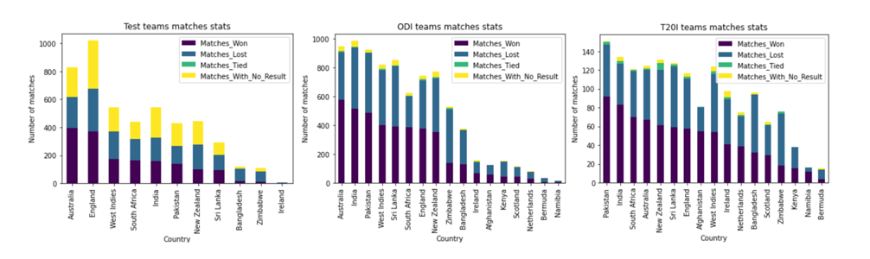
Stacked Bar Chart – Showing statistics for different countries per format

Slide 24
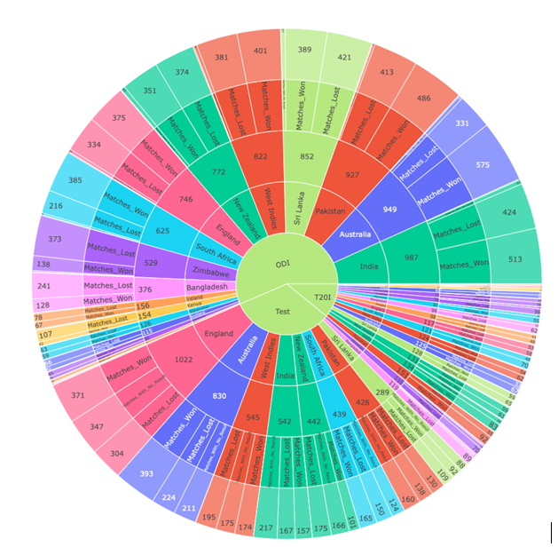
Sunburst Chart - Showing statistics for different countries per format

Slide 25
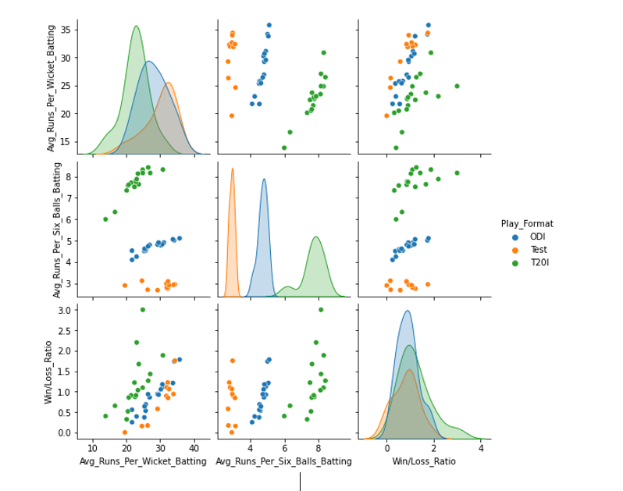
Pair Plot – Showing Average Runs scored per Wicket in different formats

Slide 26
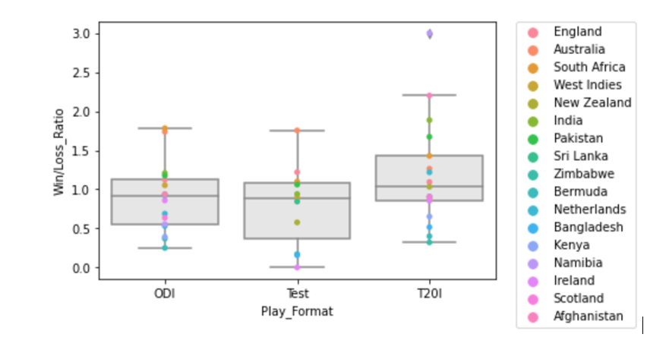
Box Plot with Strip Plot - Win/Loss Ratio for each country in each format

Slide 27
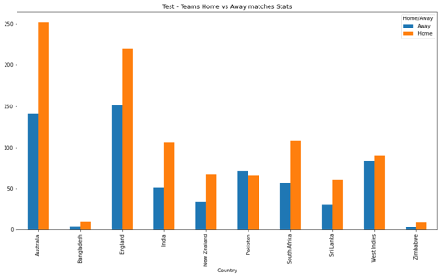
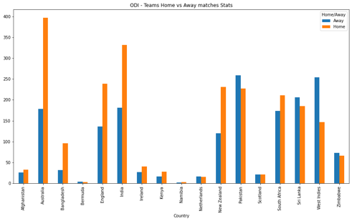
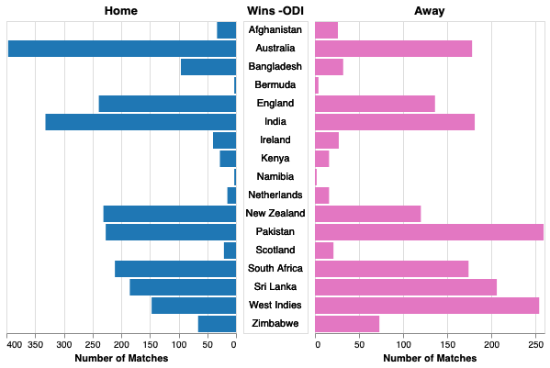
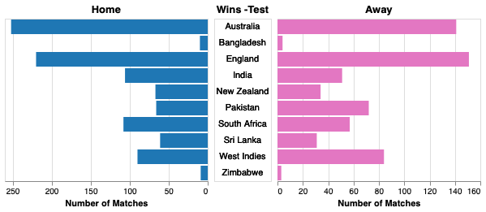
Bar/Pyramid Chart – Wins in Home Vs Away for each country in different formats

Slide 28
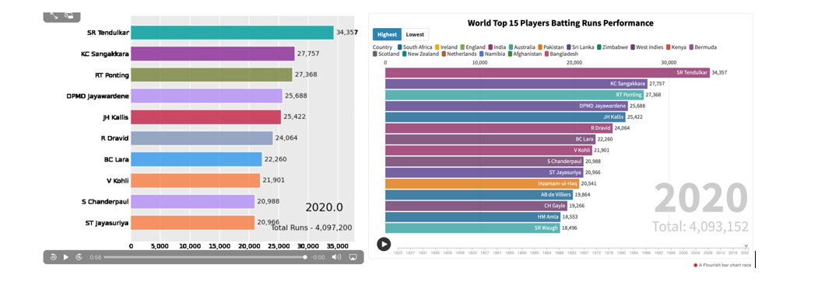
Race Chart – Batting stats for top 15 players in the world

Slide 29
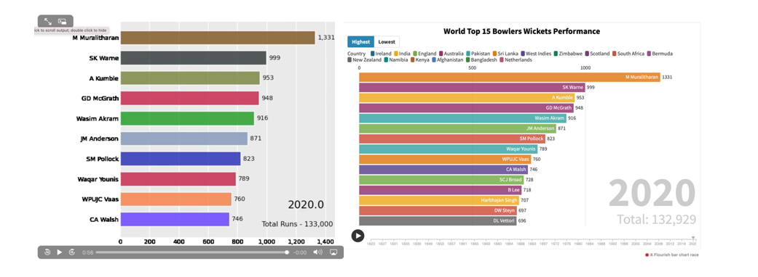
Race Chart - Bowling stats for top 15 players in the world

Slide 30
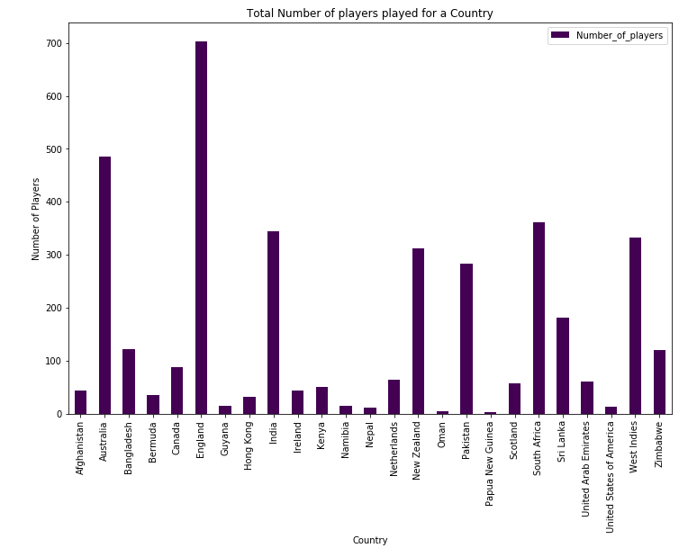
Bar Chart – Number of players playing cricket for each country

Slide 31
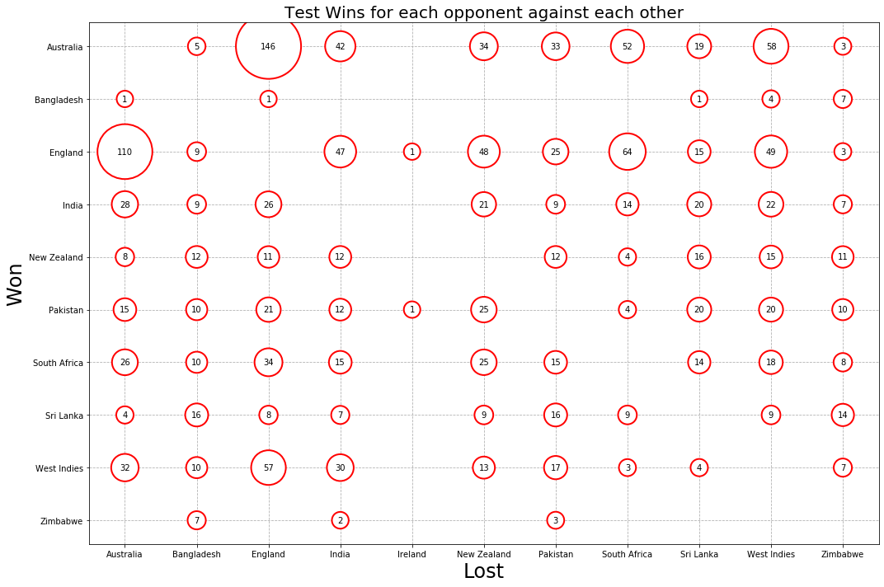
Bubble Matrix Chart – Wins for each country against each other

Slide 32
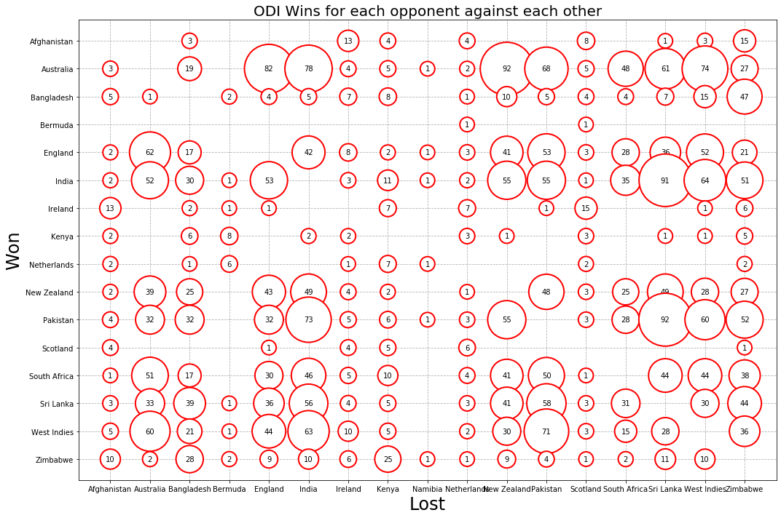
Bubble Matrix Chart – Wins for each country against each other

Slide 33
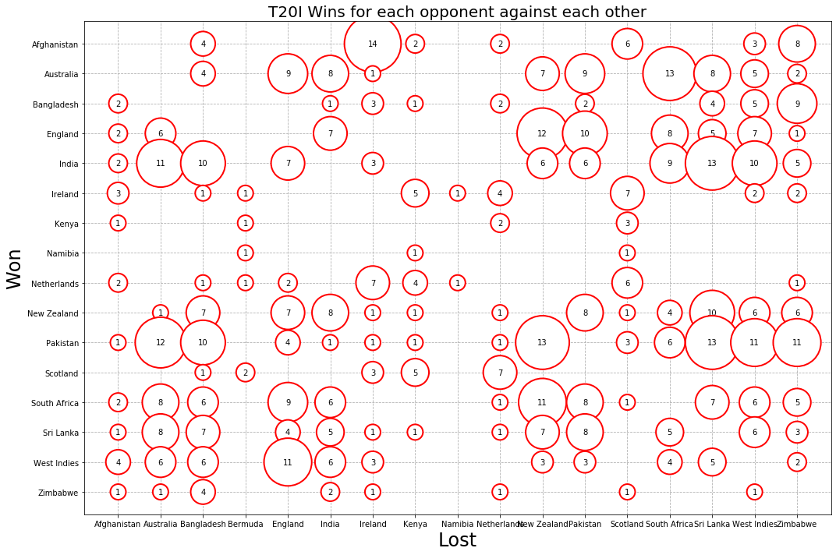
Bubble Matrix Chart – Wins for each country against each other

Slide 34
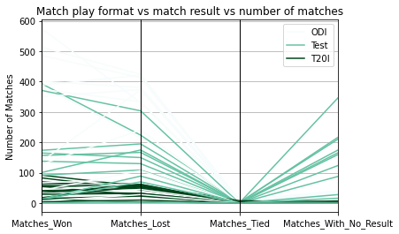
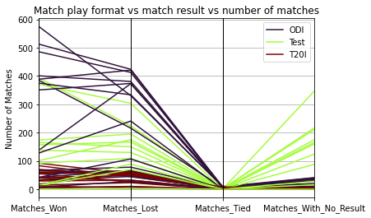
Parallel Coordinate plot: Each formats win/loss/no result stats
colormap='BuGn'
colormap='turbo'

Slide 35
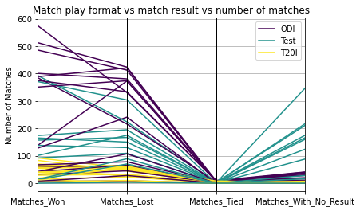
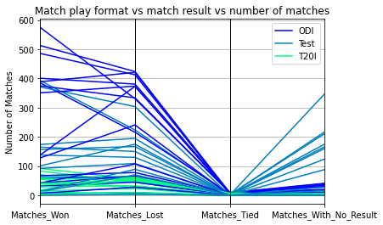
Parallel Coordinate plot: Each formats win/loss/no result stats
colormap='viridis'
colormap='winter'

Slide 36
Insights from Visualizations
There are three popular formats in International Cricket played across world and those are Test, ODI and T20I
Cricket started with test Matches in 1870’s but with the start of ODI’s cricket became more popular.
With the advent of T20I format, cricket got fast popularity and more and more countries started playing cricket.
Players who plays longer time in international cricket there are high chances to get themselves added into top players list
Most of countries perform better at home grounds rather than foreign grounds.
Not all countries are consistent performer across all formats of the game
In Test cricket, there are high chances of No results, but with ODI and T20I cricket, almost every match have a result.
Few countries like India, Australia, England, South Africa, Newzealand, Pakistan are top performers.

Slide 37
Future Work
As a next step to further visualize the data, may be:
Predict the match result based on previous outcomes
References
GitHub Code:
https://github.com/udayIU/DataVisualzation
https://github.com/udayIU/DataVisualzation/blob/main/Final_Project_Evolution_of_Cricket_uday.ipynb

