Slide 1

Powell EBOOK Store Data Analysis (Apr 2024)

Slide 2
Content
Business Case – To identify the top features impacting the Powell’s eBook stores, Customers average monthly spendings and Customers likelihood to subscribe to the eBook service. Also, develop a regression model to estimate each customer's average monthly spending and build a classification model to identify customers likely to subscribe to the eBook service.
Data Collection –obtained as a URL website, Powells eBook stores April 2024 data,
Data Preparation – Qualitative and quantitative data preparation techniques were used to find the predictor variables.
Data Visualization – Visualized data using Tableau and python packages.
Exploratory Data Analytics – Performed segregation of features and determined the features that most impact the Customers average monthly spending and likelihood to subscribe to eBook service.
Predictive Analysis with Machine Learning – Performed machine learning to train and predicted customers average monthly spending and likelihood of subscribing to eBook service using python packages.

Slide 3
Data Preparation
Total number of records: 16519
No duplicate values found
Following Variables with missing values were found:
Title: 99.46% (16431 records)
Middle Name: 42.2%(6985 records)
Suffix: 99.98% (16517 records)
Street Address2: 98.32% (16243 records)
Missing values treatment:
Title: 99.46% (16431 records): Since more than 20% data was missing, we ignored this variable.
Middle Name: 42.2%(6985 records):Since more than 20% data was missing, we ignored this variable.
Suffix: 99.98% (16517 records): Since more than 20% data was missing, we ignored this variable.
Street Address2: 98.32% (16243 records): Since more than 20% data was missing, we ignored this variable.

Slide 4
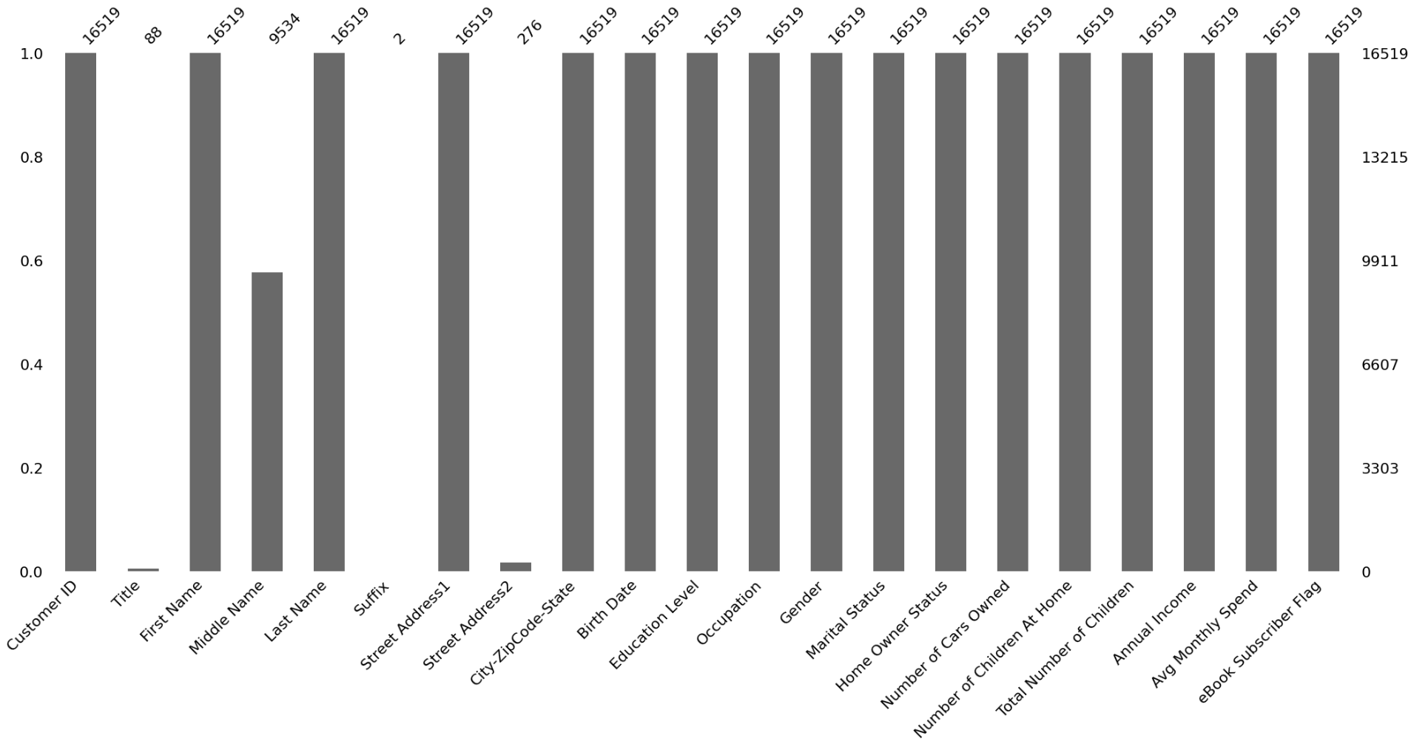
Data Preparation (contd..)
Display of Missing number proportion from Python package missingno.

Slide 5
Data Preparation (contd..)
Feature engineering:
Variable: City-ZipCode-State, Feature splitting used, to separate a string column (City-ZipCode-State) into its
individual, constituent features: City, ZipCode and State.
Variable: BirthDate, Date and Time Feature Engineering used, converted string column (BirthDate) into proper datetime object, fixed incorrect date interpretations (like future birth years) and calculated the current Age.
#Apply the string split method and return the split parts as new, separate columns.
data[['City', 'ZipCode', 'State']]=data['City-ZipCode-State'].str.split('-', expand=True)
# Convert 'Birth Date' to datetime objects
data['Birth Date'] = pd.to_datetime(data['Birth Date'], format='%m/%d/%y’)
# If a birth year is after the current year, subtract 100 years
data.loc[data['Birth Date'].dt.year > datetime.now().year, 'Birth Date'] -= pd.offsets.DateOffset(years=100)
# Calculate age
data['Age'] = datetime.now().year - data['Birth Date'].dt.year

Slide 6
Data Visualization
Data visuals are created using Tableau, AutoViz(Python package) where charts are plotted using the independent variables against the dependent variable(Avg Monthly Spend, eBook Subscriber Flag).
These charts help us in getting a preliminary idea about the relationship between the independent variables and the dependent variable(Avg Monthly Spend, eBook Subscriber Flag).

Slide 7
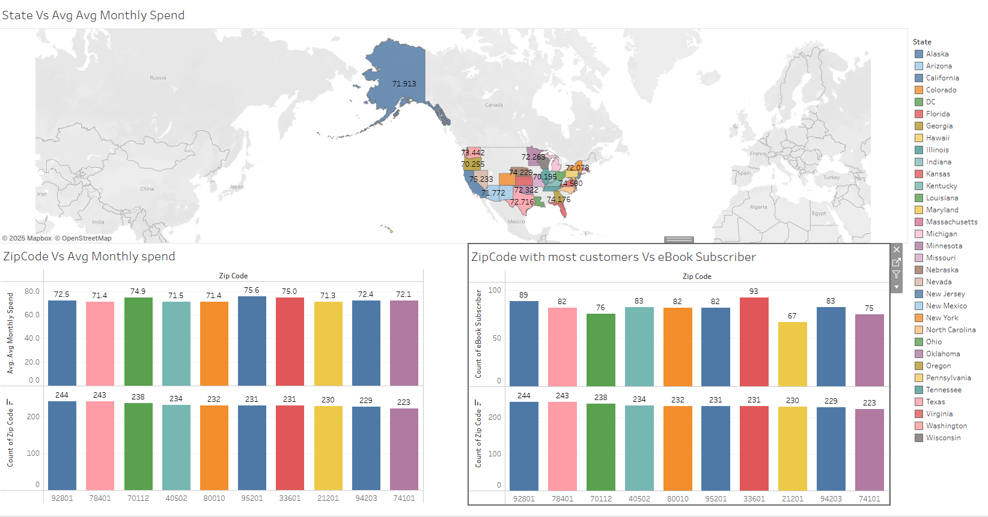
Location Visualization
Customers Location does not seem to affect the Avg Monthly spend or eBook Subscription.

Slide 8
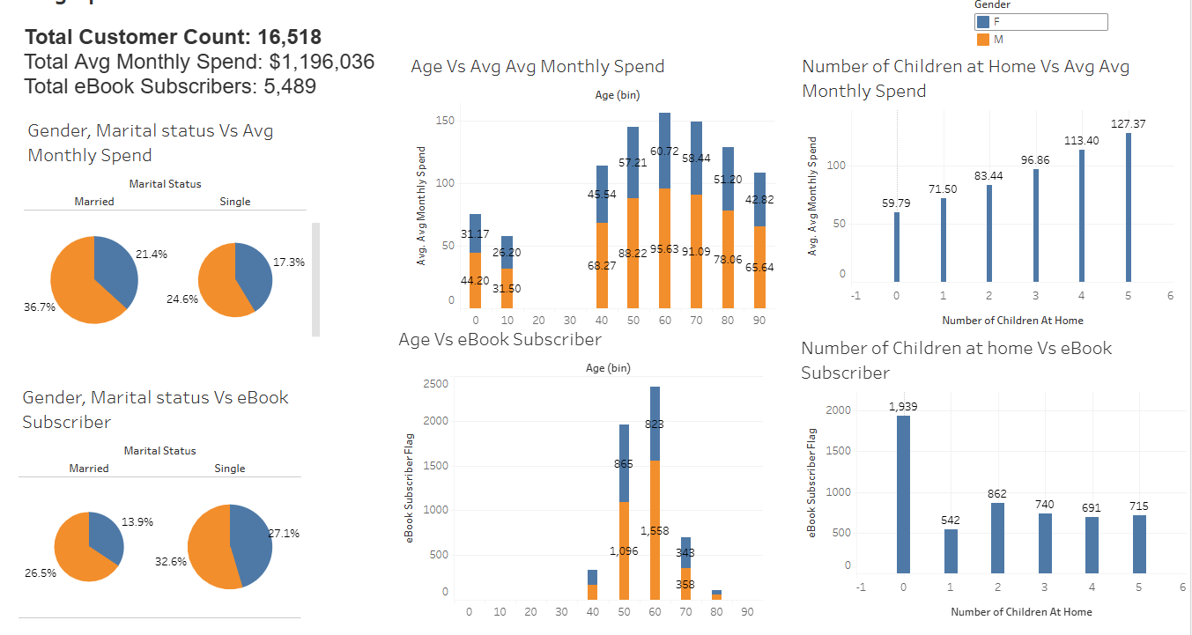
Demographics Visualization :Gender, Marital status, Age
Customers who are male have a higher proportion of Avg monthly spend. Customers who are single have high no. of eBook store subscriptions. More the no. of Children at home higher is the Avg monthly spent.

Slide 9
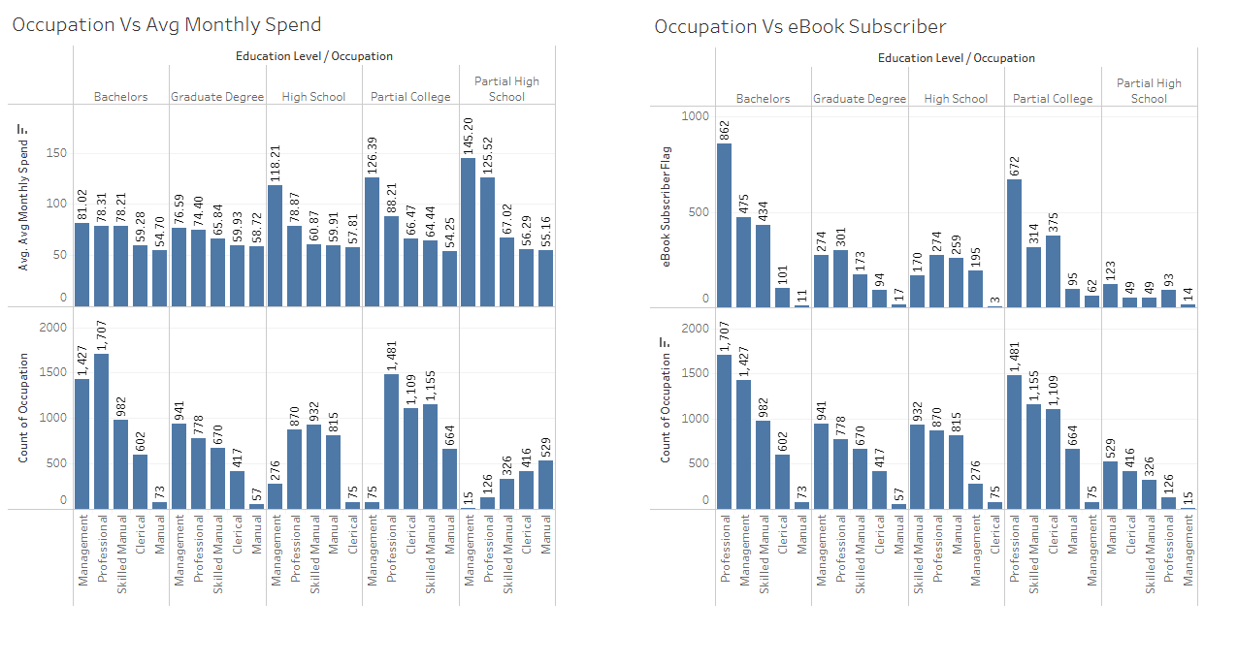
Demographics Visualization : Education, Occupation
Customers with occupations, Professional, Management, Skilled Manual have higher Avg Monthly Spend and highest number of eBook Subscribers.

Slide 10
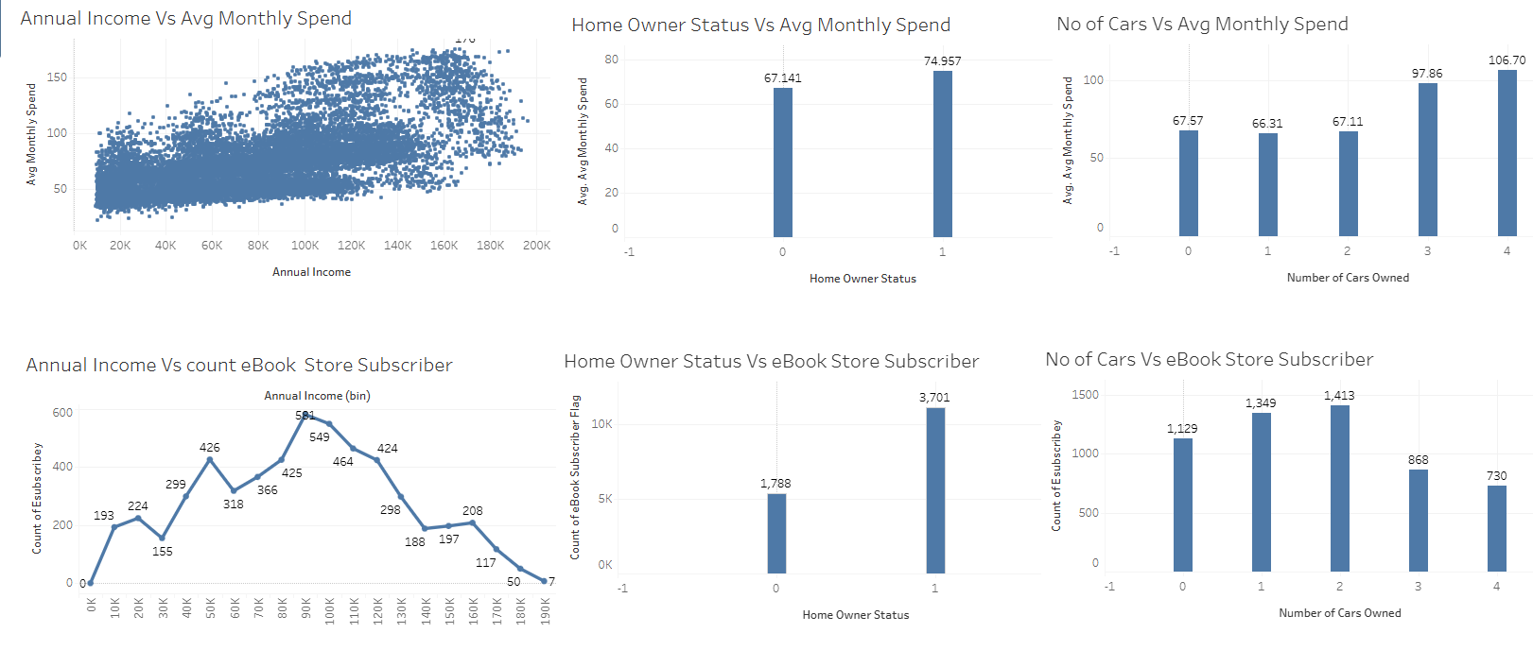
Financial, Asset Visualization
Avg Monthly Spend tend to increase as Annual Income increases. Home Owners have higher Avg Monthly Spend and eBook Subscribers. As Number of cars owned increases Avg Monthly Spend increase.

Slide 11
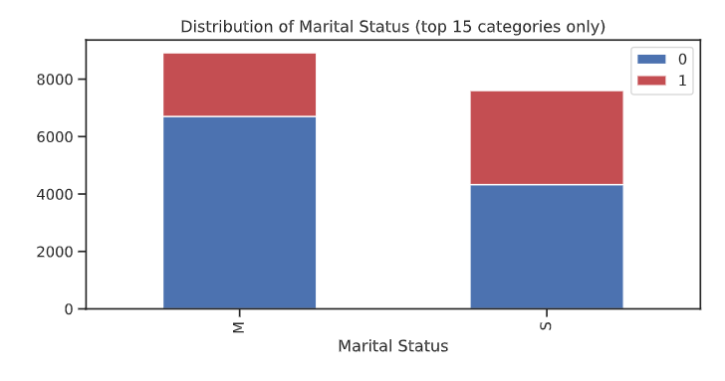
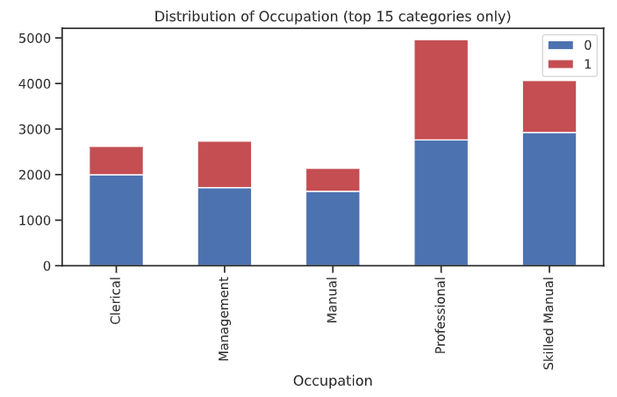
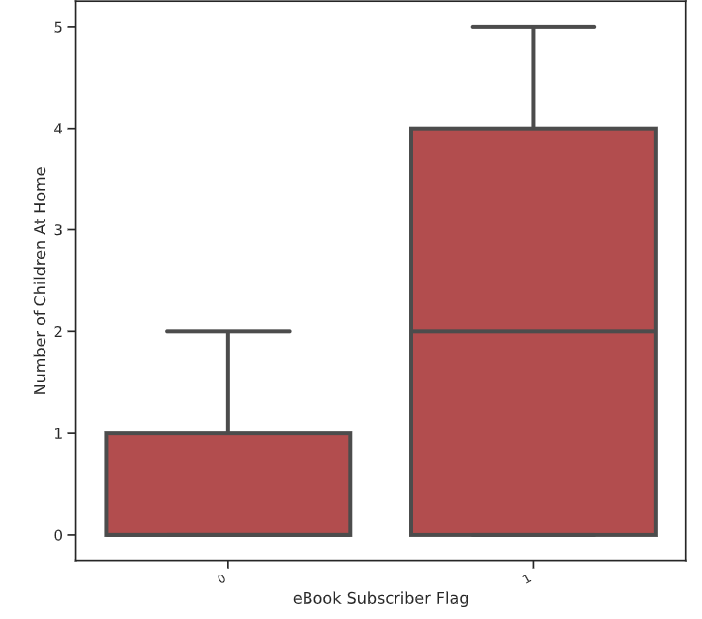
Visuals of eBook Subscriber Flag comparisons from AutoViz
Customers who are married, Customers with more no. of children at home and customers in occupations, Professional, Management, Skilled Manual have highest number of eBook Subscribers.

Slide 12
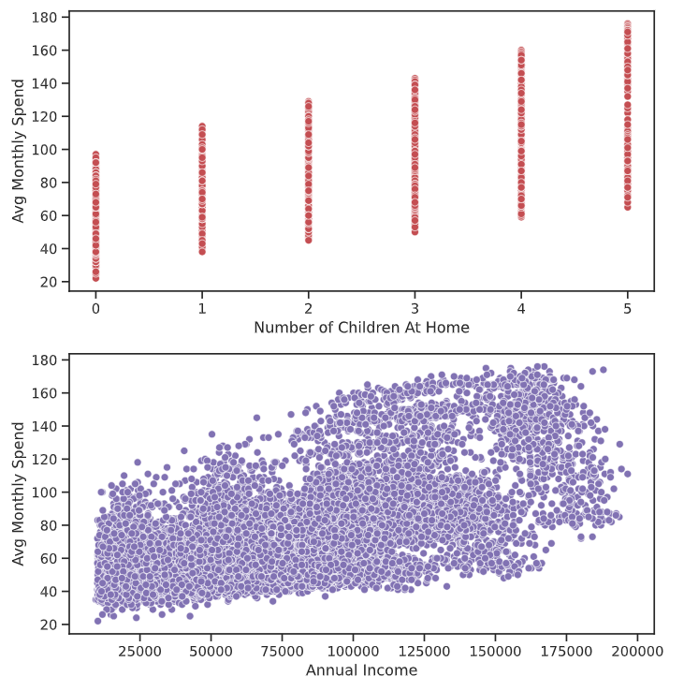
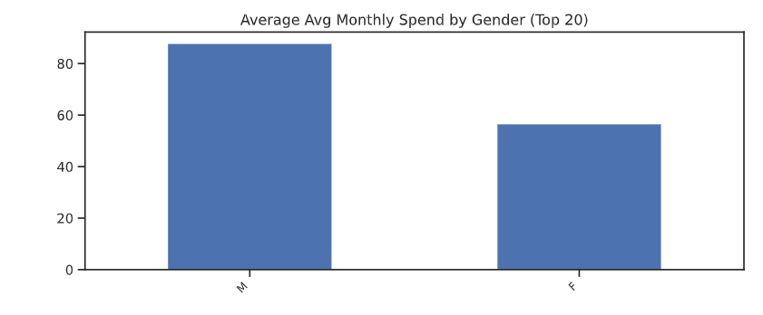
Visuals of Avg Monthly Spend comparisons from AutoViz
Customers who are Male, Customers with more Number of children at home and Customers with high Annual income will have large Avg Monthly Spend.

Slide 13
Exploratory Data Analysis
The Features (i.e., variables) are segregated into multiple Categories namely:
Dependent Variable (Y) – This is the target Variable(Avg Monthly Spend, eBook Subscriber Flag) which is to be predicted
Noise Features : Variables which would not have a significant impact on the value of target variable.
Redundant: Variables that are duplicates of other variables
Feeder variables: Variables that are derived based on the dependent variable
Predictor Variables : Variables which were considered to have an impact on the target variable

Slide 14
Exploratory Data Analysis (contd..)
Features Categories for Dependent Variable 1
Dependent Variable 1 | Avg Monthly Spend
Noise Variables due to Missing Data
Noise Variables
Predictor Variables
Customer ID
First Name
Last Name
Age
Annual Income
Education Level
Gender
Home Owner Status
Marital Status
Number of Cars Owned
Number of Children At Home
Occupation
ZipCode
Total Number of Children
Title
Middle Name
Suffix
Street Address1
Street Address2
Redundant Variables
City
State
Birth Date
Ignored Variable (for Dependent Variable 1 analysis) | eBook Subscriber Flag

Slide 15
Exploratory Data Analysis (contd..)
Features Categories for Dependent Variable 2
Dependent Variable 2 | eBook Subscriber Flag
Noise Variables due to Missing Data
Noise Variables
Predictor Variables
Customer ID
First Name
Last Name
Age
Annual Income
Education Level
Gender
Home Owner Status
Marital Status
Number of Cars Owned
Number of Children At Home
Occupation
ZipCode
Total Number of Children
Title
Middle Name
Suffix
Street Address1
Street Address2
Redundant Variables
City
State
Birth Date
Ignored Variable (for Dependent Variable 2 analysis) | Avg Monthly Spend

Slide 16
Statistical Significance Tests Analysis
Significance and Correlations Analysis was performed to identify list of features which impact the Avg Monthly Spend
Top 3 Categorical features impacting the Avg Monthly Spend
1. Gender
2. Occupation
3. Marital Status
Top 3 Numerical features impacting Avg Monthly Spend
Independent Variable
Number of Children At Home
Annual Income
Total Number of Children
Least impacting features on Avg Monthly Spend : Home Owner Status, Education Level, ZipCode, Age

Slide 17
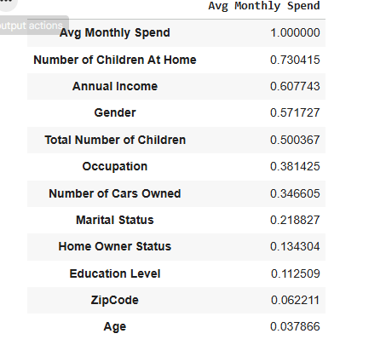
Statistical Significance Tests Analysis (contd..)
Listed the associated features in the descending order of influence on the target variable(Avg Monthly Spend)
Note: Numerical values are the absolute value of the correlation coefficients. Absolute value provided to easily sort the variables by the magnitude of their association with the target variable. None of the features have a negative correlation.

Slide 18
Statistical Significance Tests Analysis
Significance and Correlations Analysis was performed to identify list of features which impact the eBook subscriber flag
Top 3 Categorical features impacting the eBook subscriber flag
1. Marital Status
2. Occupation
3. Gender
Top 3 Numerical features impacting eBook subscriber flag
Independent Variable
Number of Children At Home
Annual Income
Total Number of Children
Least impacting features on eBook subscriber flag :, Educational Level, ZipCode, Home Owner Status

Slide 19
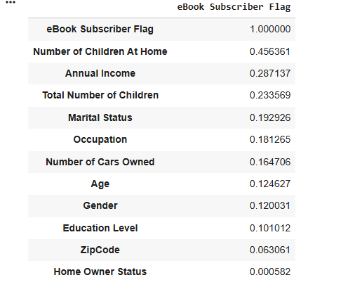
Statistical Significance Tests Analysis (contd..)
Listed the associated features in the descending order of influence on the target variable(eBook subscriber flag)
Note: Numerical values are the absolute value of the correlation coefficients. Absolute value provided to easily sort the variables by the magnitude of their association with the target variable. Age has negative correlation.

Slide 20
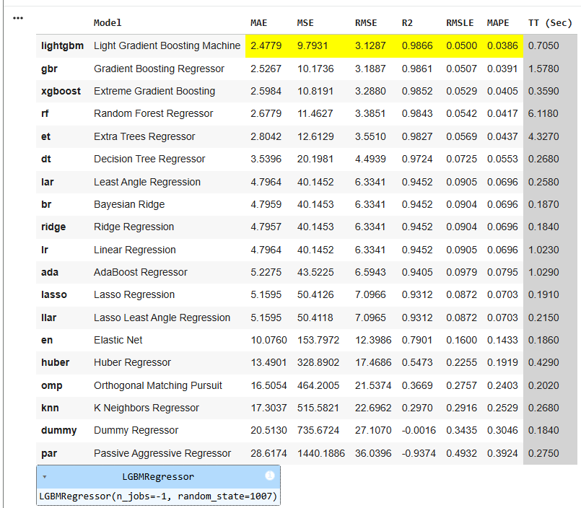
Predictive Analysis with Machine Learning
Target variable=‘Avg Monthly Spend'
Leaderboard
Note: Using python packages, regression modules were imported, Machine Learning setup was configured and models were compared. The output is leader board shown here.

Slide 21
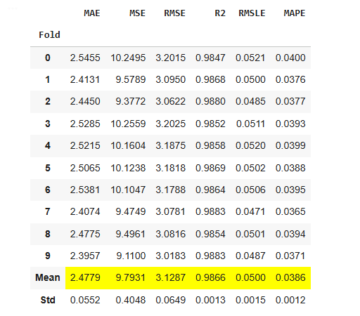
Predictive Analysis with Machine Learning(contd..)
Built an ML model with the best algorithm
Target variable=‘Avg Monthly Spend'
Note: Trained ML model with the best algorithm(‘lightgbm’), from the leaderboard from the previous slide. This performs 10-fold cross-validation and evaluates the model based on various metrics. Predicted average monthly spend using the best model.

Slide 22
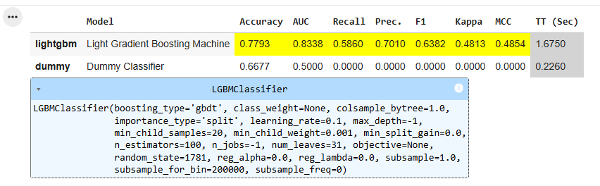
Predictive Analysis with Machine Learning(contd..)
Target variable='eBook Subscriber Flag'
Leaderboard
Note: Using python packages, regression modules were imported, Machine Learning setup was configured and models were compared. The output is leader board shown here.

Slide 23
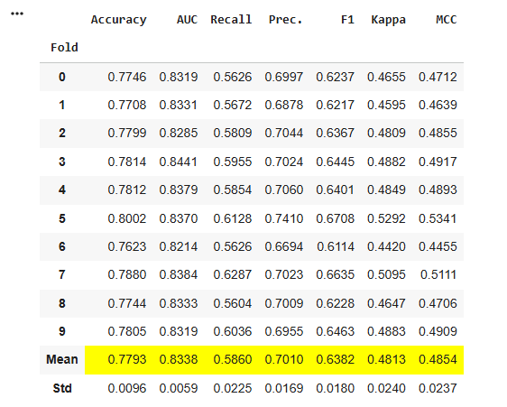
Predictive Analysis with Machine Learning(contd..)
Built an ML model with the best algorithm
Target variable='eBook Subscriber Flag'
Note: Trained ML model with the best algorithm(‘lightgbm’), from the leaderboard from the previous slide. This performs 10-fold cross-validation and evaluates the model based on various metrics. Predicted 'eBook Subscriber Flag’(whether a customer is an eBook subscriber or not) using the best model.

Slide 24
Questions?

