Slide 1



PIQoS: A Programmable and Intelligent QoS Framework
Udaya Lekhala and Israat Haque
Computer Science
Dalhousie University, Halifax

Slide 2
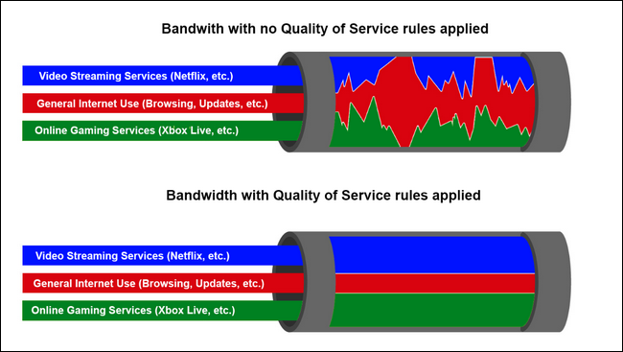
Importance of Quality of Service (QoS)
Different applications (e.g., VoIP, file-transfer ) demand different quality factors (e.g., delay, throughput)
Service providers must satisfy users as per the QoS demand of applications
Demand-based resource allocation is a must to offer QoS

Slide 3
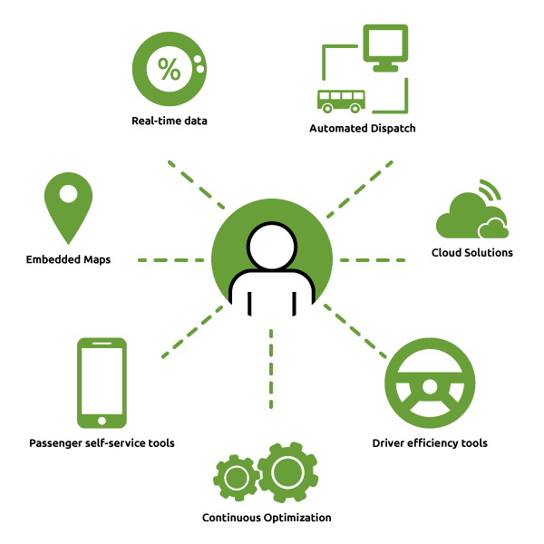
Dynamic and Intelligent QoS
According to CISCO VNI 2018 report
Broadband speeds will nearly double by 2022
IP video traffic will globally be 82%of all IP traffic by 2022
Internet gaming traffic will grow nine fold from 2017 to 2022
Explosion of applications and traffic dynamics pose challenges on QoS
Congestion, high bandwidth demand, dynamically changing network conditions, applications’ requirements, and failures
Automated error detection and root cause analysis can lead to an efficient QoS provisioning
We need a programmable and intelligent framework

Slide 4
Road Map
Background
PIQoS architecture
Experimental setup
Model evaluation data
Discussion on results
Conclusions

Slide 5
Software Defined Networking (SDN)
SDN decouples control plane (control logic) from data plane (forwarding hardware)
Programmable
switch
Switch
Control plane
Control plane
Data plane
Control plane
Data plane
Data plane
Data plane
Control plane
Data plane
Data plane
Traditional networking
Software-Defined networking

Slide 6
SDN Architecture
SDN Logical Layers and Architecture (IETF RFC 7426)
Applications, Orchestrations
e.g., Path computation
Loop avoidance
REST API (works with http)
NOX, ONOS, ODL, …
OpenFlow, NetConf, …
Switch, Router, …

Slide 7
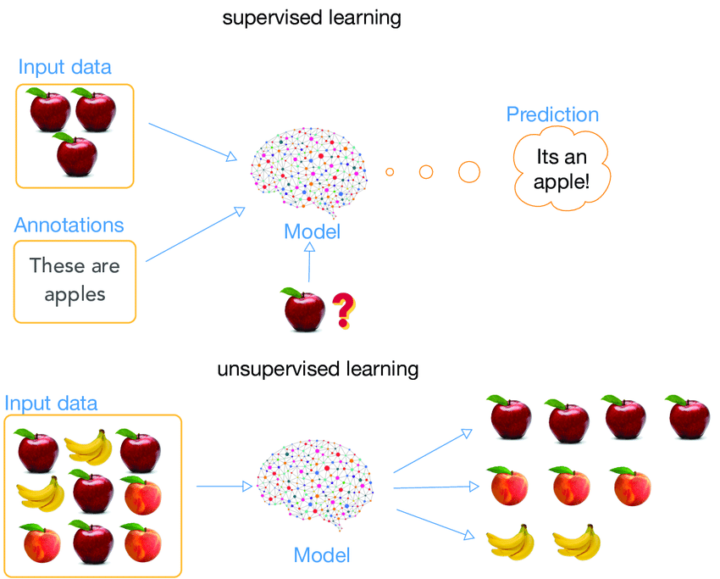
Supervised vs. Unsupervised Machine Learning Algorithms
Supervised algorithms use labeled data sets to create models, while unsupervised learning uses unlabeled data
Each of these algorithms is better suited for a particular type of application
classification, regression or clustering
Different learning algorithms can be used to solve the same problem
The best choice depends on the requirements of each scenario
performance and accuracy constraints
Source:https://www.researchgate.net/publication/329533120_Background_Augmentation_Generative_Adversarial_Networks_BAGANs_Effective_Data_Generation_Based_on_GAN-Augmented_3D_Synthesizing
Notes:
Current versions: ONOS: Raven ; ODL: Flourine

Slide 8
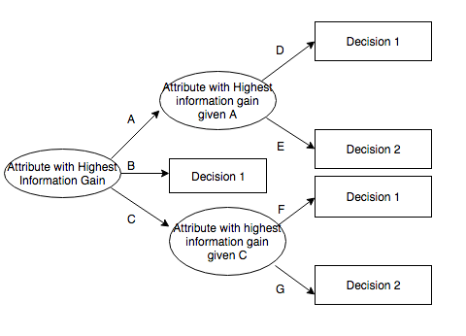
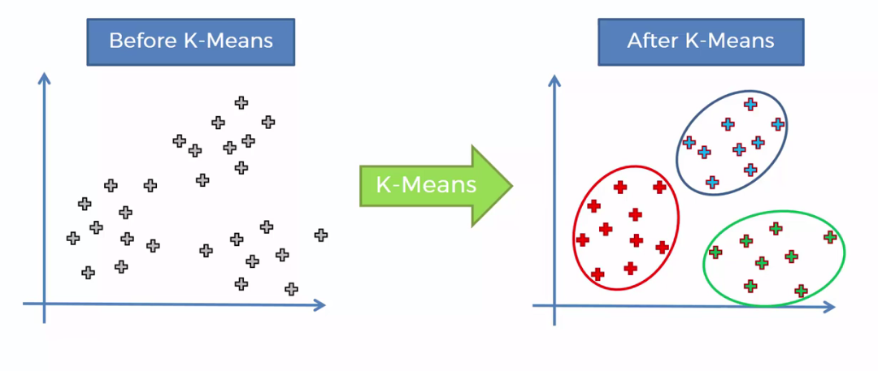
Decision Tree and K-means
Decision Tree
K-means

Slide 9
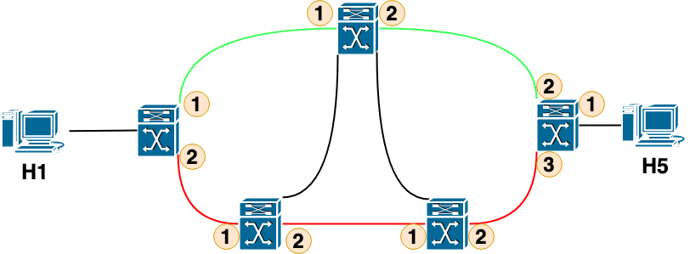
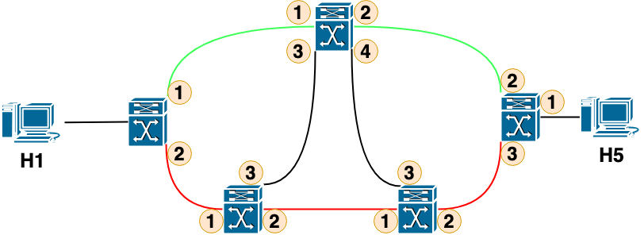
Failure Recovery Scheme: Restoration and Protection
Flow Table
H1--H5--2
Flow Table
H1--H5--1
Flow Table
H1--H5--1
Restoration
Flow Table
Flow Table
Flow Table
H1—H5--G1
Group table
G1:2: 4
Flow Table
H1—H5--G1
Group table
G1:1: 2
Flow Table
H1—H5--1
Group table
Flow Table
H1—H5--G1
Group table
G1:2: 3
Flow Table
H1—H5--G1
Group table
G1:2: 3
Protection

Slide 10
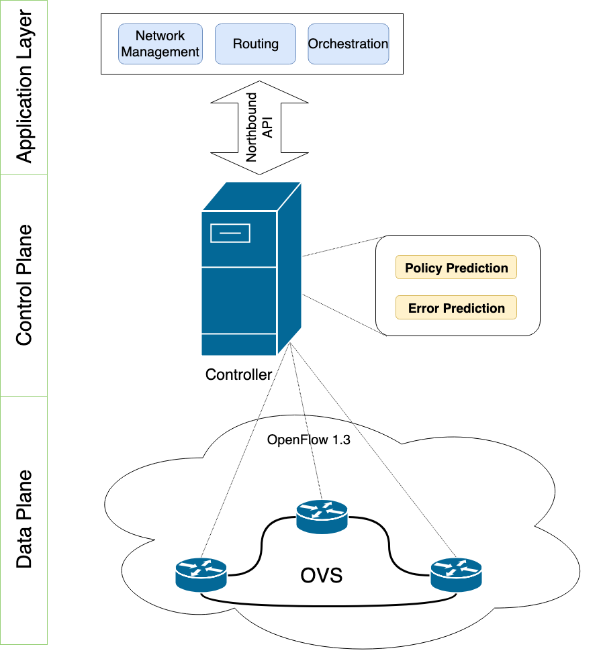
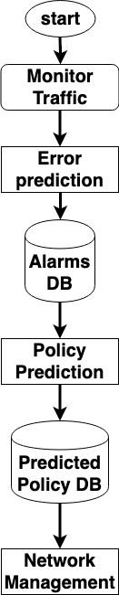
PIQoS Architecture

Slide 11
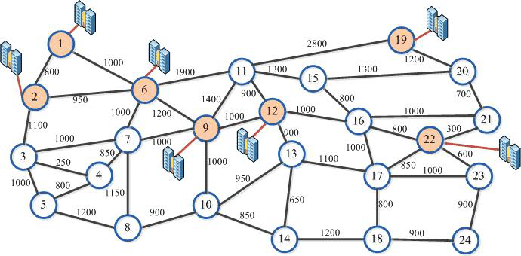
Experimental Setup
Environment:
Emulator: Mininet 2.3
Data plane elements: Open vSwitch 2.9.2
Controller: Ryu 4.24
Experiment Phases:
Ten switch Mininet topology
USNET topology
Performance Metrics:
Failure recovery time
Throughput
Prediction accuracy
USNET Topology

Slide 12
Model Evaluation data
The list of feature used in PIQoS
Feature | Explanation
Time stamp | When a flow starts at a link
Flow ID | ID of a flow or a path
Source Node | Source node of a link in a flow
Destination Node | Destination node of a link in a flow
Source Outport | Port from which a source node sends packets
Destination Inport | Port from which a destination ode receive packets
Packets | Total number of packets sent in a link
Bytes | Number of bytes sent in a link
Linkspeed (B/Sec) | Speed of a link
Source Output Capacity | Maximum capacity of a source output
Destination Inport Capacity | Maximum capacity of a destination inport
Source port Speed (B/s) | Speed at which a source outport sends packets
Destination port Speed (B/s) | Speed at shich a destination inport receives packets
Delay (ms) | Time taken for a packet to be transferred from a source to a destination in a flow
Error Prediction Classification | A flow has an issue or not (error/no error)
Policy Prediction Classification | Classification type (link failure/congestion)
The number of flows and links used for training and testing models
Model | Total flows | Total links | Training flows | Training links | Testing flows | Testing links
Error prediction | 318 | 1020 | 225 | 714 | 93 | 306
Policy prediction | 151 | 465 | 106 | 326 | 45 | 139

Slide 13
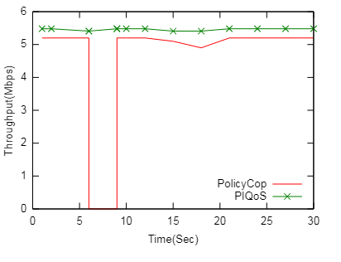
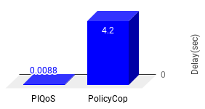
Resiliency of PIQoS
PolicyCop: throughput drops and delay increases as it needs to contact the controller
PIQoS: local recovery improves both the throughput and delay
Local recovery can furthermore offer scalability

Slide 14
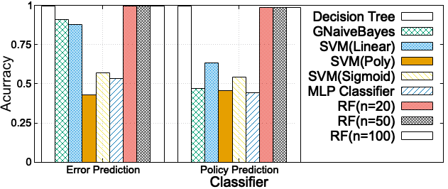
Intelligence of PIQoS (supervised algorithms)
Naive Bayes and SVM have the worst accuracy
Random Forest and Decision Tree have the best accuracy
Random Forest offers good accuracy, which cannot be generalized
Decision tree is the winner

Slide 15
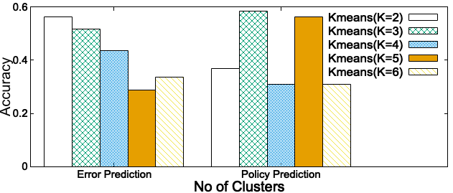
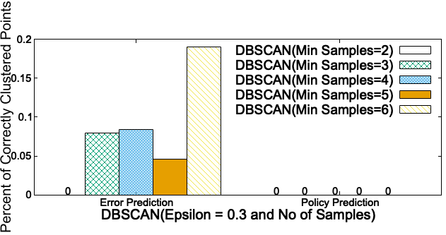
Intelligence of PIQoS (unsupervised algorithms)
Supervised algorithms need label on data, which may not scale with large network
K-means offers best accuracy for two clusters
This accuracy is quite low compared to that of DT
There is a trade-off between accuracy and overhead

Slide 16
Conclusions
Designed a programmable and intelligent QoS framework, called PIQoS
PIQoS pushes link failure recovery at the data plane to improve the delay and throughput
Proposed two learning models for efficient network state diagnosis and selecting corresponding management policies
Implemented the proposed framework in a realistic simulation environment
PIQoS can accurately predict link failure or network congestion and update policy accordingly

Slide 17
Thank you ☺
israat@dal.ca

Slide 18
Quality of Service (QoS)
An important factor for service providers
To offer consistent user experience
Emerging service requirements, network traffic and their dynamics pose a new challenge
Automated error detection and root cause analysis can lead to an efficient QoS provisioning
How can we design a programmable and intelligent QoS framework?

Slide 19
Decision Tree and K-means
Decision tree:
Data is stored in a tree-like structure a node, branch, and leaf-node represent test, decision, and class label, respectively
A decision tree path defines the data classification rules
An attribute that best classify training data is chosen as the root and repeat the same process at each branch until all attributes are covered
K-means:
Partitions data points into clusters
Each cluster of data points has a centroid defined by those data points
At the beginning of the clustering, we can randomly choose K centroids and iteratively optimize their positions

