Slide 1
Project Presentation of Industry Oriented Hands on Experience(IOHE)
ON
Comparative Study of Machine Learning Regression Models for Student Performance Prediction
Supervised By
Dr. Gurpreet Singh
Department of Computer Science and Engineering,
Chitkara University, Punjab
Uday Aggarwal Dept. of CSE Chitkara University Institute of Engineering and Technology Punjab, India aggarwal.uday26@gmail.com | Himanshu Sharma Dept. of CSE Chitkara University Institute of Engineering and Technology Punjab, India himanshuxd888@gmail.com | Hargun Singh Dept. of CSE Chitkara University Institute of Engineering and Technology Punjab, India hargun3574@gmail.com | Drishti Sharma Dept. of CSE Chitkara University Institute of Engineering and Technology Punjab, India sdrishti192@gmail.com

Slide 2
Introduction
This presentation focuses on analyzing and comparing multiple machine learning regression techniques to predict student academic performance.
The study evaluates four models Linear Regression, Ridge Regression, Decision Tree Regressor, and Random Forest Regressor using real-world educational data to determine the most effective approach for predicting final student grades.
Educational data mining has gained significant importance in recent years as institutions aim to predict student performance and provide early interventions. This study compares four supervised regression models using the UCI Student Performance dataset.
The results demonstrate that machine learning can effectively predict student outcomes and help institutions identify at-risk students early.
2

Slide 3
Objective
The main objective of this study is to evaluate and compare the effectiveness of four machine learning regression models in predicting student academic performance.
The study aims to assess each model using standard evaluation metrics such as MAE, MSE, and R² score. Additionally, it seeks to analyze the importance of different features in influencing predictions and to derive meaningful insights that can assist educational institutions in designing early warning systems for improving student outcomes.

Slide 4
Problem Statement
Traditional academic evaluation methods often identify poor performance too late, leaving limited time for corrective actions which affects the final grades of students and leave a negative impact and causes harm in a moral way because the students could not achieve and perform as per their caliber and potential.
This study aims to develop a predictive system that can estimate a student’s final grade in advance using machine learning so that there is ample time for improvements.
By comparing multiple regression models under the same conditions, the goal is to identify the most accurate and reliable model for real-world educational use.

Slide 5
Tools and Technologies
Programming Language
Python – Used for implementation due to simplicity and strong ML support
Libraries
Pandas – Data handling and preprocessing
NumPy – Numerical computations
Scikit-learn – ML models and evaluation
Matplotlib – Data visualization
Dataset
UCI Student Performance Dataset
395 records, 33 features
Target: G3 (final grade)
Environment
Jupyter Notebook / Google Colab – Development and execution

Slide 6
Methodology
This study follows a standardized pipeline to ensure a fair comparison of all models. The UCI Student Performance dataset, consisting of 395 records and 33 features, was used with the final grade (G3) as the target variable. The features include demographic, behavioral, and academic attributes, with prior grades G1 and G2 playing a key role in prediction.
All categorical variables were converted into numerical form using LabelEncoder. The dataset was split into training and testing sets in an 80:20 ratio, and StandardScaler was applied to normalize feature values. The feature matrix included all variables except G3, which was used as the target.
Each model was trained and evaluated under identical conditions using the same dataset and preprocessing steps. This consistent methodology ensures that performance differences are solely due to the models, making the comparison reliable and reproducible.

Slide 7
Model Comparison
This study evaluates four regression models for predicting student performance. Linear Regression is simple and interpretable but limited in handling complex, non-linear relationships. Ridge Regression improves stability by reducing the impact of correlated features, though it still remains a linear approach.
The Decision Tree Regressor captures non-linear patterns through rule-based splits but tends to overfit, especially on smaller datasets. In contrast, the Random Forest Regressor uses an ensemble of multiple trees, reducing overfitting and improving accuracy.
Overall, Random Forest provides the most robust and reliable performance, while linear models offer simplicity with slightly lower predictive power.

Slide 8
Results & evaluation Metrics
The performance of all models was evaluated using Mean Absolute Error (MAE), Mean Squared Error (MSE), and R² score. MAE measures the average difference between predicted and actual values, while MSE gives higher weight to larger errors. The R² score indicates how well the model explains the variance in the target variable, with higher values representing better performance.
Among all models, the Random Forest Regressor achieved the best results with an R² score of 0.8288, along with the lowest MAE and MSE values, indicating high accuracy and strong predictive capability. Linear Regression and Ridge Regression showed similar performance, suggesting limited impact of multicollinearity. The Decision Tree Regressor performed the worst due to overfitting, resulting in higher error values.

Slide 9
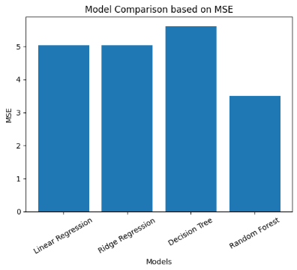
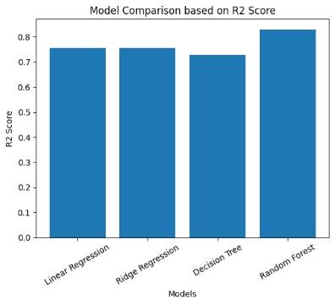
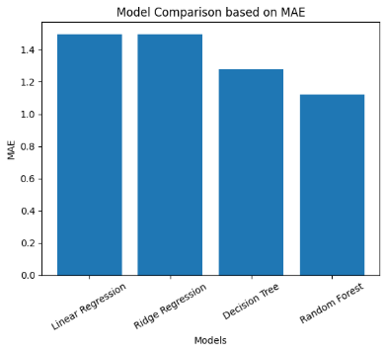
Model Comparison
Performance Comparison of Regression Models
Model | MAE | MSE | R² Score | Rank
Linear Regression | 1.421 | 3.872 | 0.7614 | 3rd
Ridge Regression | 1.418 | 3.855 | 0.7625 | 2nd
Decision Tree | 1.734 | 5.190 | 0.6817 | 4th
Random Forest | 1.147 | 2.838 | 0.8288 | 1st

Slide 10
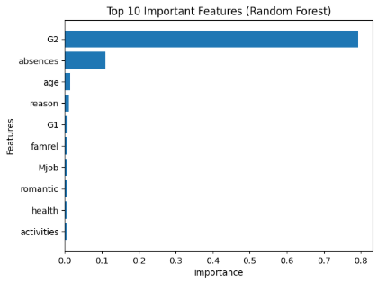
Feature importance(Random Forest)
Feature Importance
G2 (second period grade) is the most dominant feature
Absences has moderate influence
Other features (G1, age, reason, etc.) have minimal impact
Model relies mainly on recent academic performance
Demographic and behavioral features have limited contribution

Slide 11
Conclusion
The results of this study clearly demonstrate that the Random Forest Regressor is the most effective model for predicting student performance, as it achieves the highest accuracy and best generalization among all models. Its ensemble approach allows it to capture complex patterns while reducing overfitting, making it more reliable than individual models.
The study also highlights that academic features, particularly G2 is the strongest predictor of final grades, emphasizing the importance of continuous performance tracking. While linear models offer simplicity and interpretability, they fall slightly behind in accuracy, and Decision Trees struggle with generalization.
Overall, this work shows that machine learning can be a powerful tool for building early warning systems, enabling educational institutions to identify at-risk students early and provide timely support to improve academic outcomes.

Slide 12
Thank You
12

