Slide 1
















CALCULATOR
Supervised By:
RAVEESH SAMKARIA
Submitted By:
Uday Aggarwal 2210990917 ( G-14)

Slide 2
ABSTRACT
This project aims to develop a user-friendly front-end interface for a basic calculator application, catering to diverse user needs and preferences. The primary objective is to create an intuitive design that enhances usability and accessibility, while ensuring efficient functionality across various devices and screen sizes.
The project follows a user-centric design methodology, focusing on understanding user behavior, preferences, and expectations through iterative testing and feedback loops. Through an iterative process of prototyping and refining, the final interface achieves a balance between simplicity and functionality, allowing users to perform basic arithmetic operations with ease.

Slide 3
INTRODUCTION
In an age dominated by digital solutions, the calculator remains a fundamental tool for countless individuals across diverse domains, from education to finance. As technology evolves, so too must the interfaces through which we interact with these indispensable tools. This project introduces a modern and intuitive front end for a calculator application, designed to enhance user experience and functionality.
Through a combination of sleek design, responsive layout, and innovative features, our front end aims to revolutionize the way users engage with this timeless utility. This abstract outline the key objectives, methodologies, and outcomes of our endeavour, offering a glimpse into the future of calculator interfaces.

Slide 4
OBJECTIVE
The objective of the front-end calculator project is to design and implement a user-friendly interface for a basic calculator application. This project aims to create an intuitive and visually appealing user interface that allows users to perform arithmetic calculations conveniently and efficiently. Key goals include:
User-Centric Design
Responsive Design
Accessibility
Clear Input and Output
Compatibility
Efficient Functionality

Slide 5
SIGNIFICANCE
Educational Value: Front-end calculator projects serve as practical educational tools for developers to practice HTML, CSS, and JavaScript skills, while also learning about user interface design and interaction patterns.
Portfolio Building: Developing a front-end calculator allows developers to showcase their proficiency in front-end technologies and design principles, enhancing their portfolio for potential employers or clients.
Accessibility Awareness: By focusing on accessibility features such as keyboard navigation and screen reader compatibility, developers learn to create inclusive software that accommodates users with disabilities.
Problem-Solving Skills: Building a front-end calculator involves solving various challenges, including input validation, error handling, and responsive design, which help developers enhance their problem-solving abilities for future projects.

Slide 6
PROBLEM STATEMENT
Designing and implementing a user-friendly front-end interface for a basic calculator application presents several challenges. The primary problem is to create an intuitive and accessible user experience that accommodates diverse user needs and preferences, while ensuring efficient functionality across different devices and screen sizes.
Key considerations include:
User-Centric Design: The main challenge lies in creating a front-end calculator interface that prioritizes user experience. This involves understanding user behaviors, preferences, and expectations to design an intuitive and user-friendly interface.
Accessibility: Ensuring that the calculator interface is accessible to all users, including those with disabilities, presents a significant challenge. Implementing features such as keyboard navigation, screen reader compatibility, and adherence to accessibility standards is crucial for inclusivity.
Responsive Design: Designing a responsive layout that adapts seamlessly to different devices and screen sizes is another key challenge. Maintaining usability and functionality across various resolutions and orientations requires careful consideration of layout, typography, and interaction patterns

Slide 7
REQUIREMENTS
Software Requirements :
HTML : HTML provides the fundamental structure for web pages, consisting of elements enclosed in tags, which define the content and layout.
HTML documents should adhere to standards and undergo validation to ensure proper syntax, structure, and compatibility across different web browsers and device
Tailwind : Tailwind CSS is a popular utility-first CSS framework that streamlines the process of styling web applications. Unlike traditional CSS frameworks that rely on pre-built components, Tailwind offers a highly customizable approach by providing a vast utility class library. This library includes utility classes for common CSS properties like margins, paddings, flexbox, and more, enabling developers to
rapidly prototype and style their applications without writing custom CSS..

Slide 8
JAVASCRIPT : JavaScript is primarily used for client-side scripting in web development, allowing developers to create dynamic and interactive web pages by manipulating the Document Object Model (DOM) based on user interactions.
JavaScript enables developers to access and modify HTML elements and attributes dynamically, facilitating tasks such as content updates, element creation, removal, and styling based on user actions or events.
CSS : CSS is used to define the presentation and layout of HTML elements on a web page, including aspects such as color, font, size, spacing, and positioning. CSS models elements on a web page as rectangular boxes, comprising content, padding, border, and margin. Developers can manipulate these box properties to control layout and spacing.

Slide 9
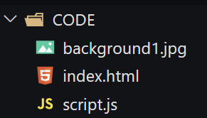
PROJECT DESIGN
Project Overview
This project aims to develop a website using Tailwind. The website will utilize HTML for content structure and Tailwind css for visual presentation, ensuring a user-friendly and engaging experience across various devices (desktop , mobile).
File Structure
The project will utilize a well-organized folder structure for efficient management and future updates.
index.html: Main HTML file containing the overall website structure and content
script.js: JavaScript file containing minor interactive elements

Slide 10
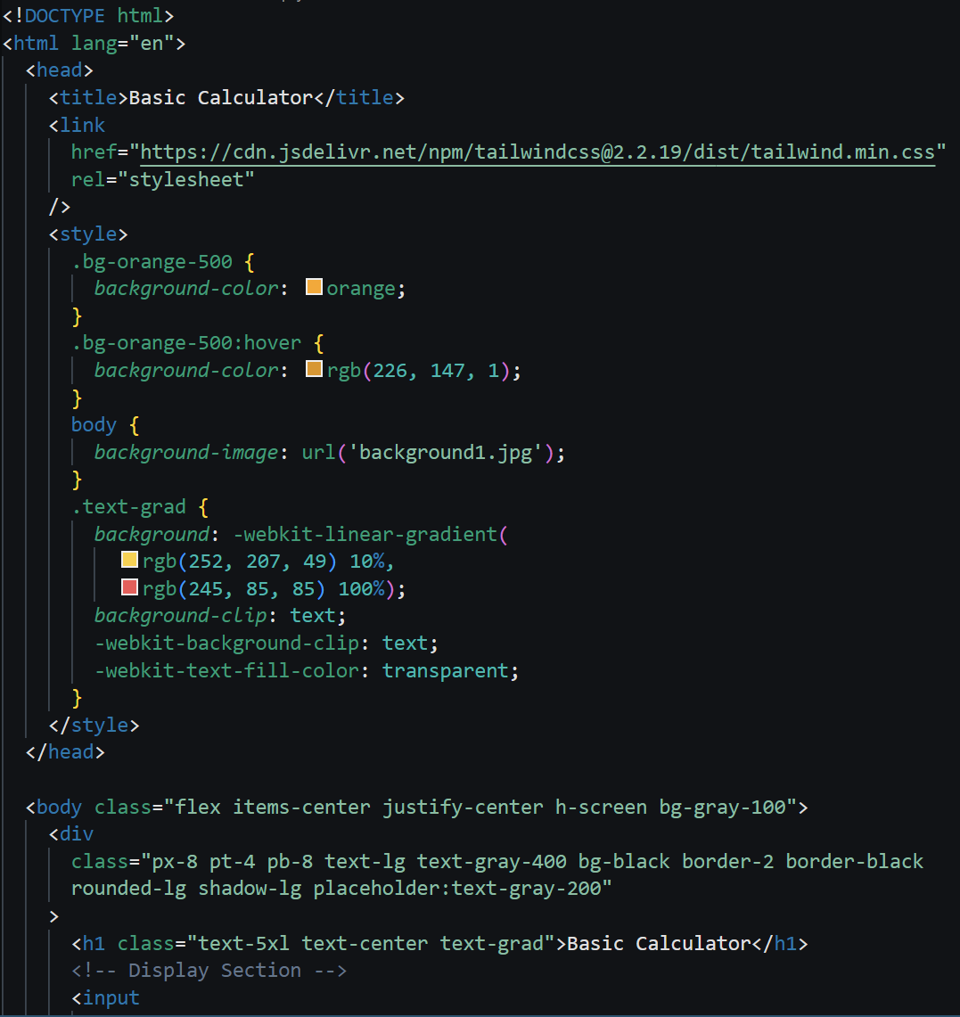
METHODOLOGY
HTML CODE :

Slide 11
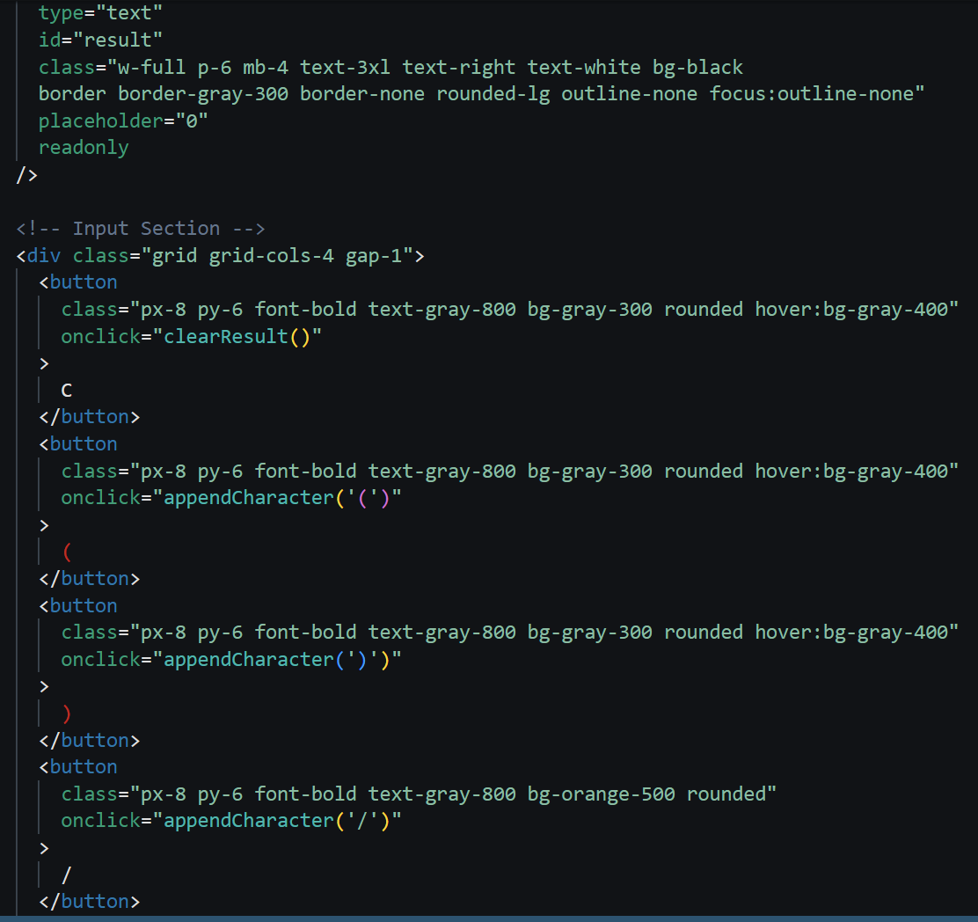

Slide 12
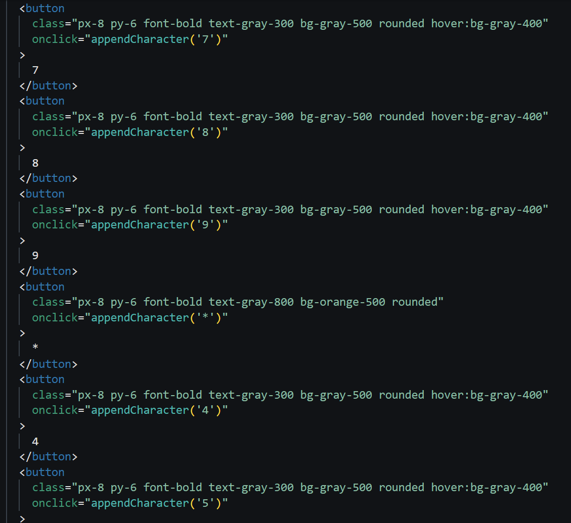

Slide 13
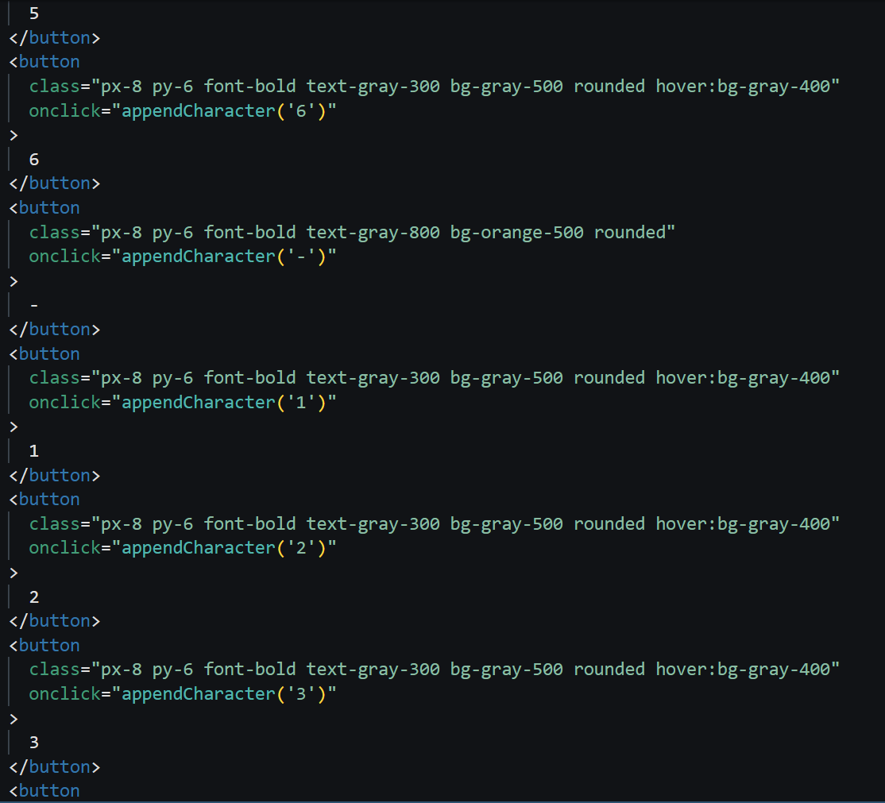

Slide 14
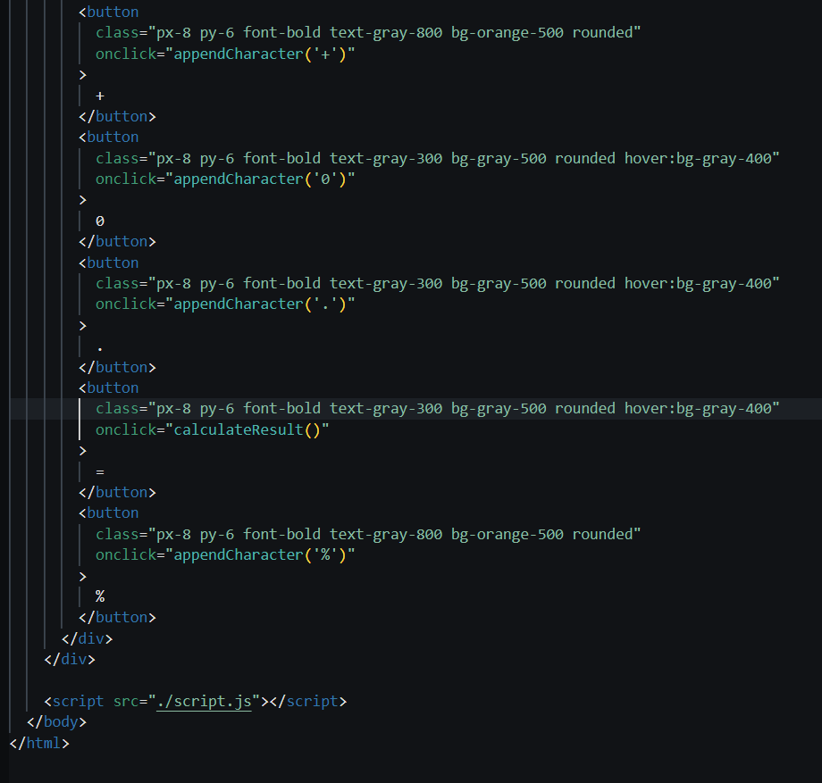

Slide 15
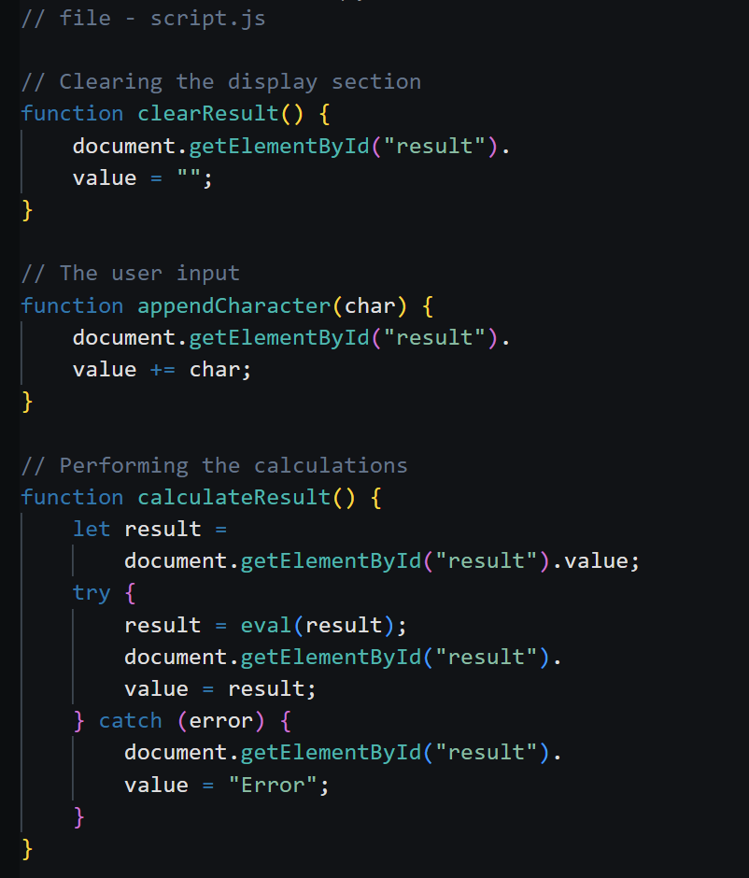
JAVA SCRIPT CODE :

Slide 16
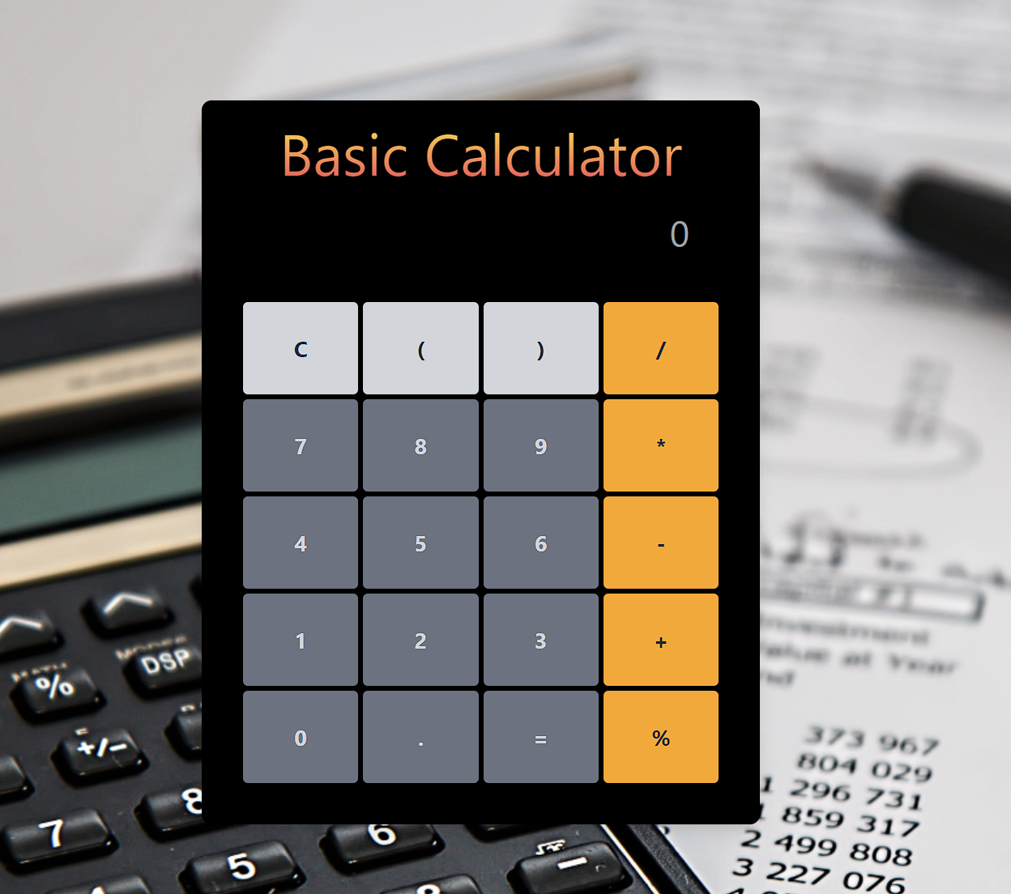
RESULT

Slide 17
References
GitHub Repositories: Search for repositories on GitHub related to live search or filtering projects. Many developers share their code openly, and you can learn a lot from studying their implementations.
CodePen: Websites like CodePen often have demos and examples of live search/filter projects. You can explore various implementations and even fork them to experiment with the code yourself.
YouTube Tutorials: Video tutorials on platforms like YouTube can provide step-by-step guidance on how to create a live search/filter feature using different technologies and frameworks.
Documentation of JavaScript Libraries/Frameworks: If you're using a specific JavaScript library or framework (such as React, Vue.js, or Angular), their official documentation often includes examples and guides on implementing live search/filter features.5. Online Courses: Websites like Udemy, Coursera, or freeCodeCamp offer courses on web development that cover topics like live search/filtering. These courses typically provide structured learning paths and hands-on projects.

Slide 18
CONCLUSION
Accomplishments: Successfully implemented financial calculations scattering to diverse user needs.
User Experience: Prioritized user feedback to refine usability and enhance accessibility.
Accuracy and Reliability: Ensured precision through rigorous validating processes.
Challenges: Overcame technical hurdles while staying aligned with project goals.
Lessons Learned: Gained insights into both financial concepts and development methodologies.
Future Enhancements: Identified avenues for further feature enrichment to better serve users.
Acknowledgments: Gratitude extended to all contributors for their valuable support.
Conclusion: The calculator project significantly advances financial literacy and decision-making capabilities.
Closing Thoughts: Reflecting on the journey, this project stands as a testament to innovation in finance and technology.

