Slide 1
Cyber Shield Analytics

Slide 2
Introduction:
In today's fast evolving cybersecurity landscape, the capacity to detect and mitigate assaults has become vital. The dataset offered here is a methodically created resource for the investigation and identification of cyber risks using machine learning methods. This dataset, which contains 100,000 rows, each representing a unique cyberattack occurrence, provides a comprehensive view of modern cyber threats, including attack types, network protocols, affected systems, and geographic distributions.
This dataset includes a wide range of features that are essential for recognizing and preventing cyber threats. The dataset provides detailed event tracking and time-based trend analysis by providing unique IDs for each attack as well as temporal data gathered in the Timestamp column. Geographic information, such as source and destination countries, improves the dataset, allowing analysts to identify global threat patterns and assess attack origins and targets.
With such precise and diversified properties, this dataset lays a solid foundation for constructing, testing, and refining machine learning-based cybersecurity models, providing great opportunity for both researchers and practitioners to address real-world security issues.

Slide 3
Core Components:
Language:
Python ,Pandas ,Seaborn
Executing the Scripts:
Colab Notebook
Visualization Tool:
Tableau

Slide 4
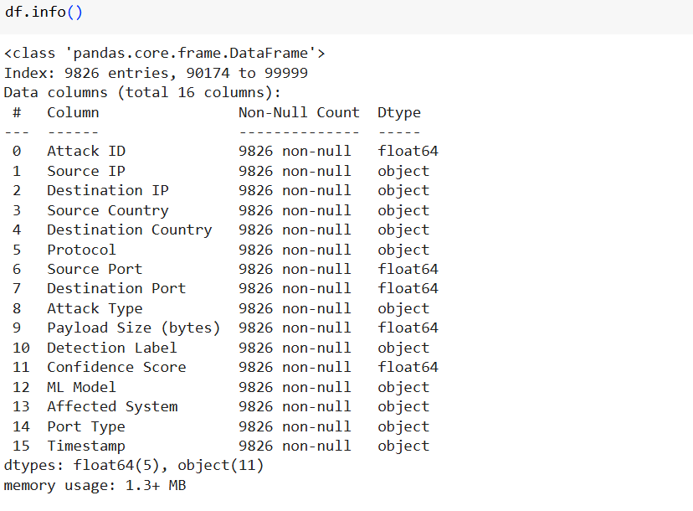
Dataset Information: Cyberattacks detection dataset contains 10000 records with 16 columns

Slide 5
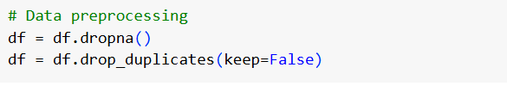

Data Transformation:
Removing duplicates and missing values in dataset.
Generating the transformed output.

Slide 6
Exploratory Data Analysis (EDA):
Distribution of Attack Types
Frequency of Affected System
Top 5 Source Countries for Cyber Attacks
Analysis of Estimated Stolen Data

Slide 7
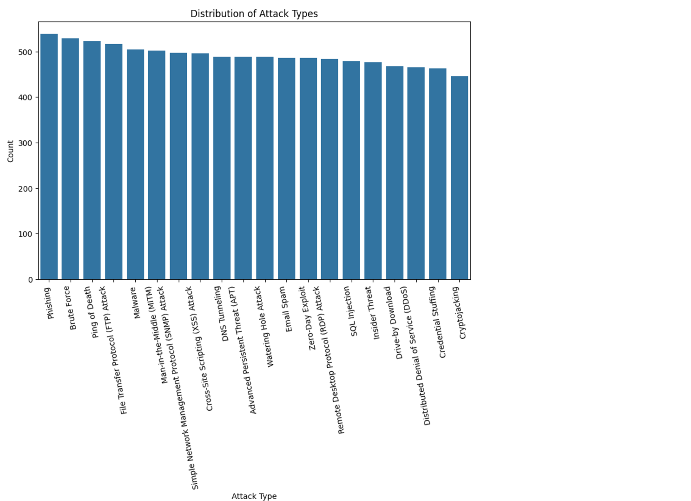
EDA-Distribution of Attack Types:
The graphic depicts a bar chart illustrating the distribution of different assault types in the dataset. The most common sort of assault appears to be phishing, followed by brute force, ping of death, FTP and malware. Overall, the chart shows a fair distribution of attack kinds, with each category well-represented.

Slide 8
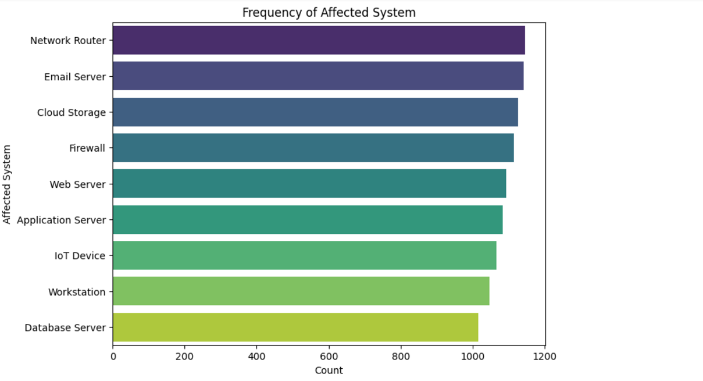
EDA-Frequency of Affected System:
The bar chart indicates the frequency with which different impacted systems are targeted in cyberattacks. Network Router, Email Server and Cloud Storge are the most commonly targeted, Compare to Database servers followed by workstations and IoT devices. The distribution demonstrates varied levels of vulnerability across infrastructure components, stressing the importance of prioritizing security measures for critical systems.

Slide 9
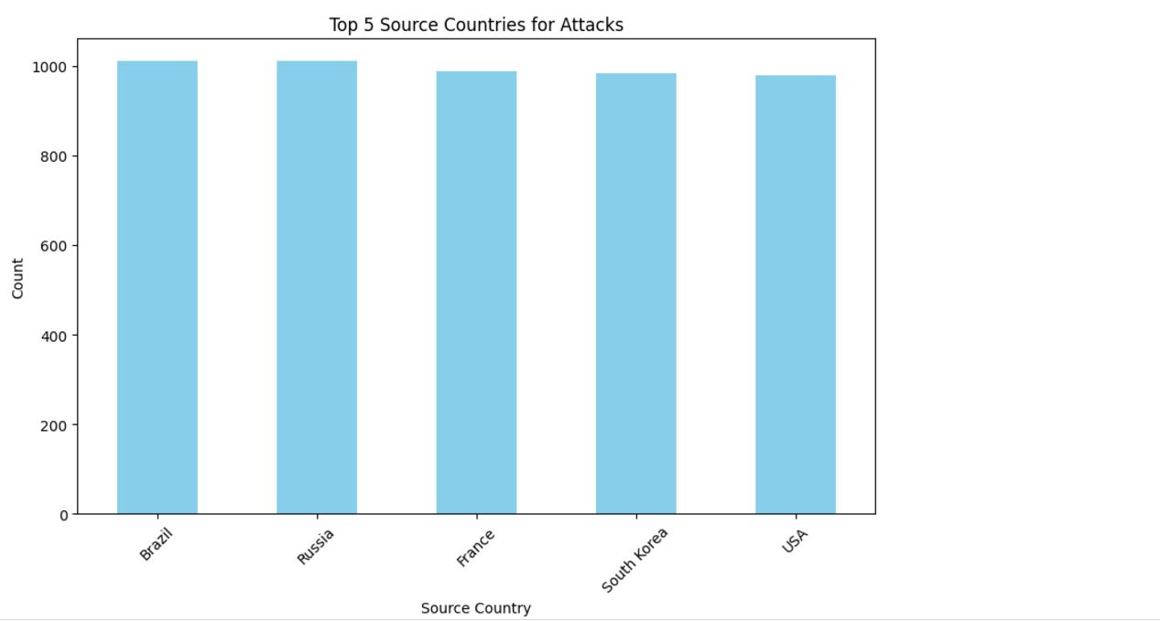
EDA-Top 5 Source Countries for Cyber Attacks:
The bar graph highlights that the top five countries most impacted by cyberattacks are Brazil, Russia, France, South Korea, and the USA. Among these, Brazil has the highest number of registered cases, followed closely by Russia.

Slide 10
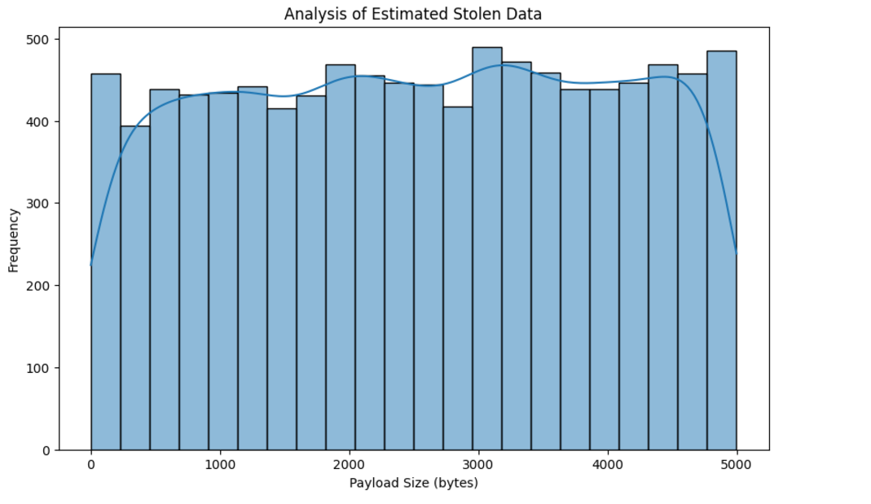
EDA-Analysis of Estimated Stolen Data:
Estimated stolen data is the measurement of data that could have been compromised or taken during a cyberattack. Analyzing this element entails looking at the size, nature, and patterns of data breaches across a variety of characteristics such as attack type, targeted systems, geographical regions, and protocols. This analysis aids in determining the intensity of attacks and their possible impact on companies, individuals, or infrastructures.

Slide 11
Three Hypothesis Questions:
Do the frequencies of identified cyberattacks fluctuate significantly among countries, and which countries have higher detection rates than others?
Is there a considerable difference in attack frequency between different sources, and which ones contribute the most to the total number of attacks?
Do data breach sizes differ greatly between countries, and which countries have the most data breaches?

Slide 12
First Hypotheses Question:
Do the frequencies of identified cyberattacks fluctuate significantly among countries, and which countries have higher detection rates than others?

Slide 13
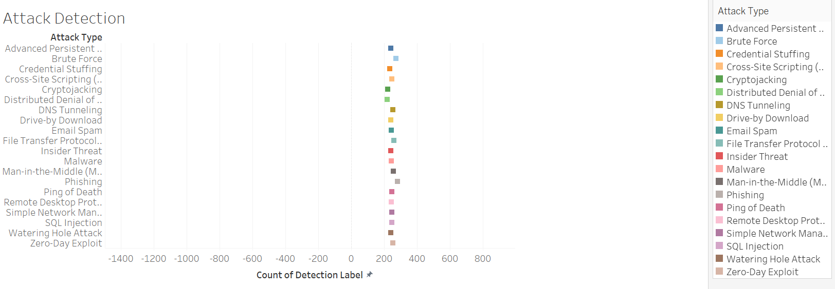
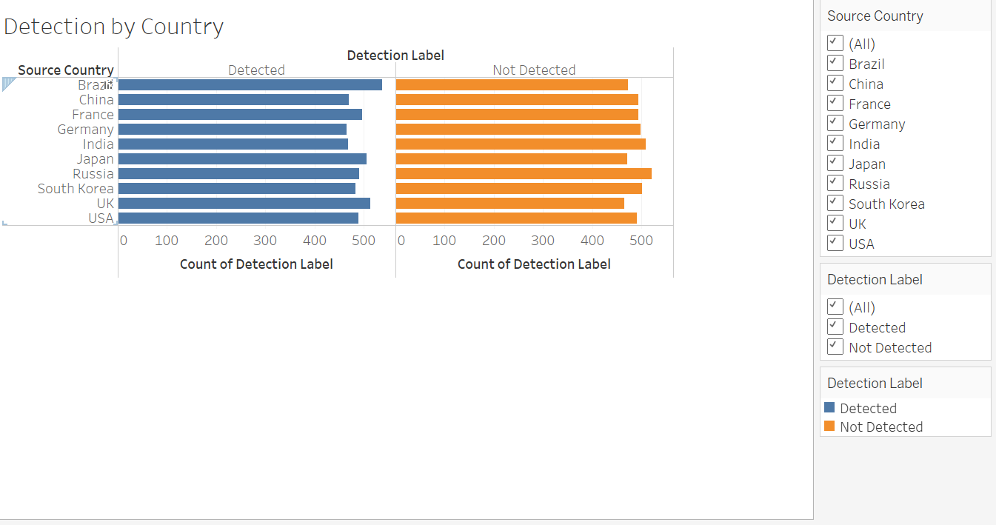
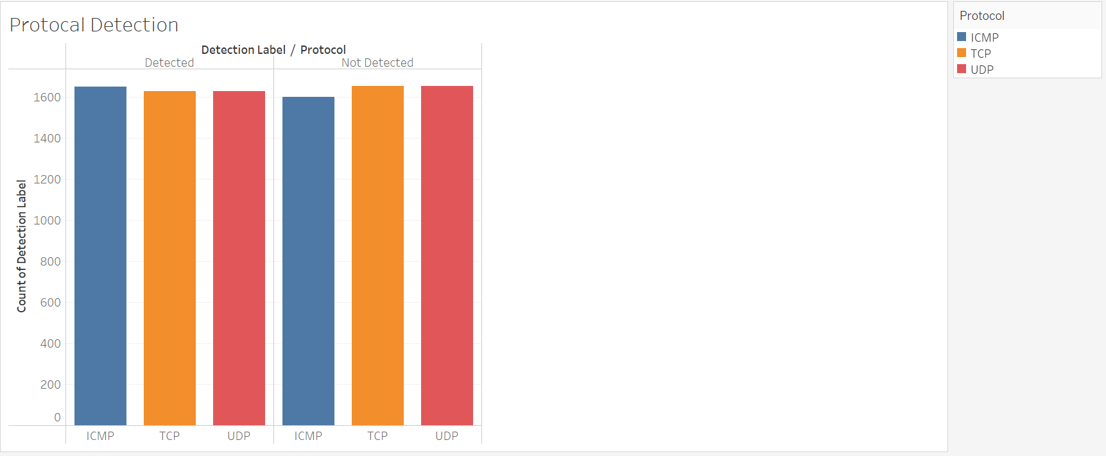
First Hypotheses Output:

Slide 14
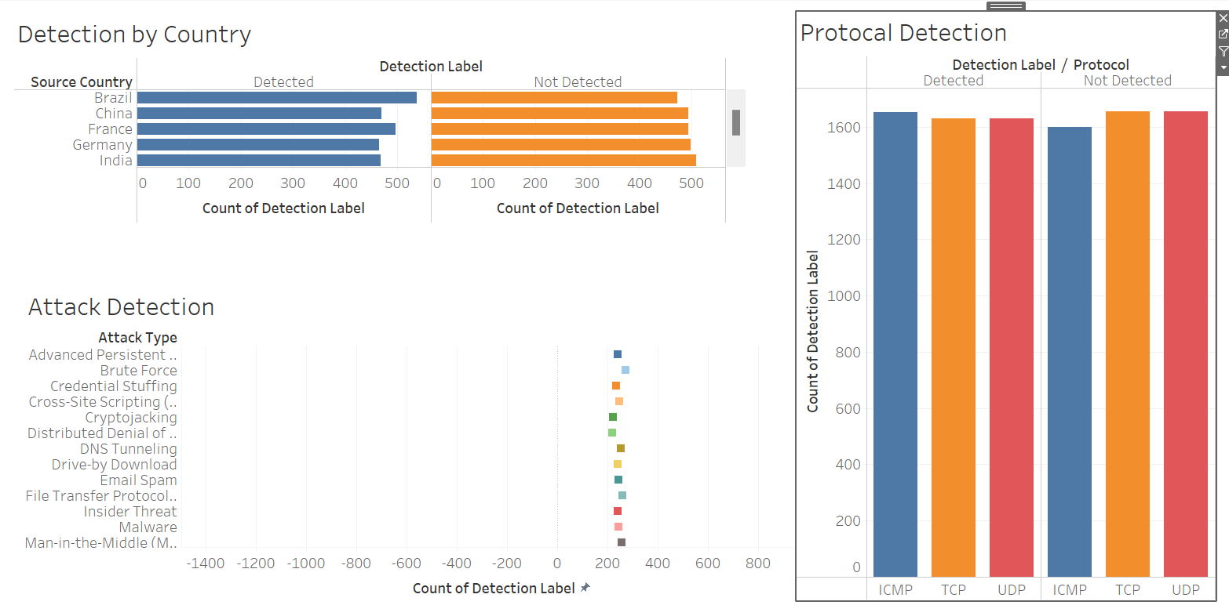
First Hypotheses Dash Board:

Slide 15
First Hypotheses Answer:
After reviewing cyberattack detection data and viewing the graph, it appears that the vast majority of occurrences in all countries go undetected, with only a portion of them classified as cyberattacks.
Among the discovered cases, Brazil and the United Kingdom have the most registered cyberattacks. The remaining countries levels of cyberattack activity are largely comparable, with notable variances.
This stresses the importance of enhanced detection techniques in addressing the enormous volume of undiscovered occurrences worldwide.

Slide 16
Second Hypotheses Question:
Is there a considerable difference in attack frequency between different sources, and which ones contribute the most to the total number of attacks?

Slide 17
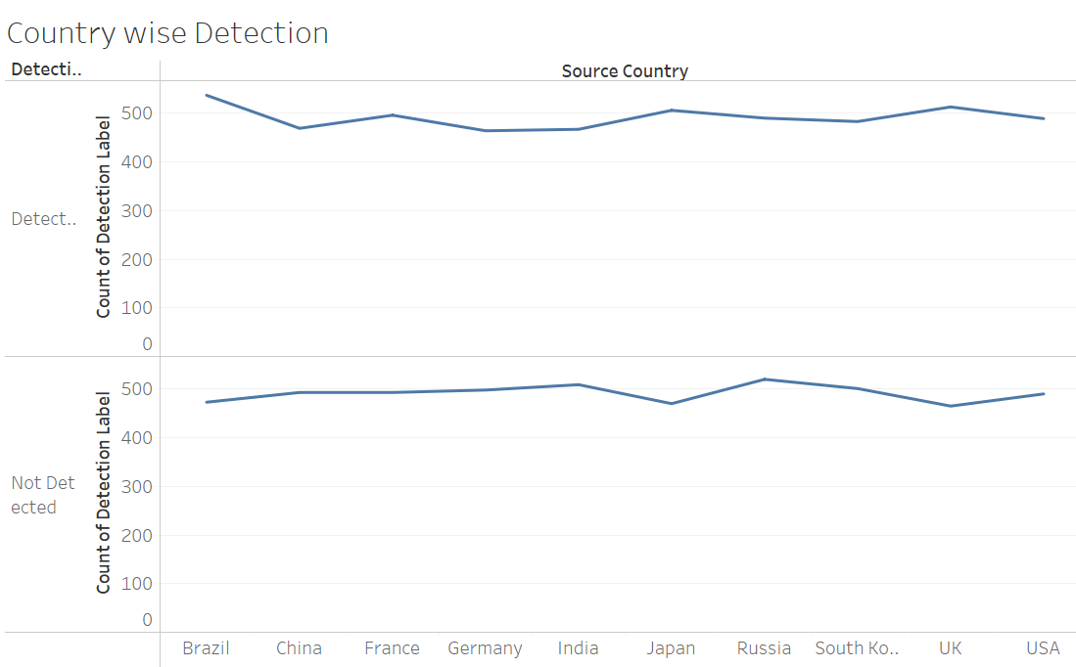
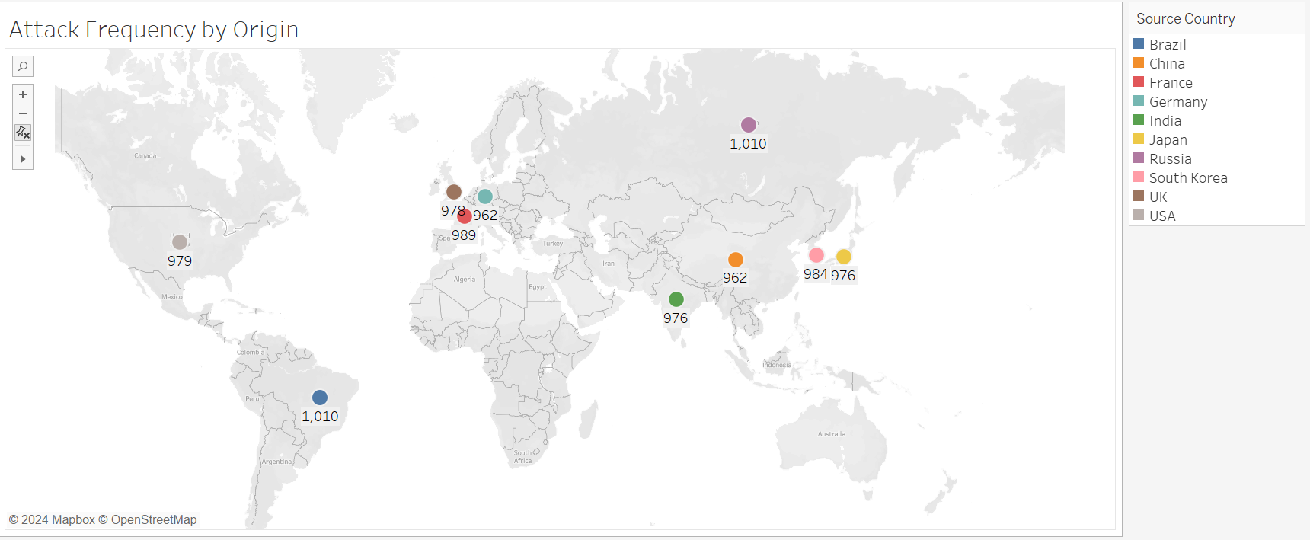
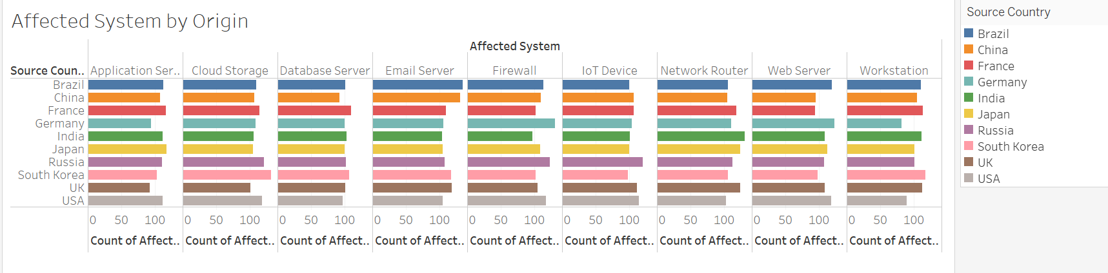
Second Hypotheses Output:

Slide 18
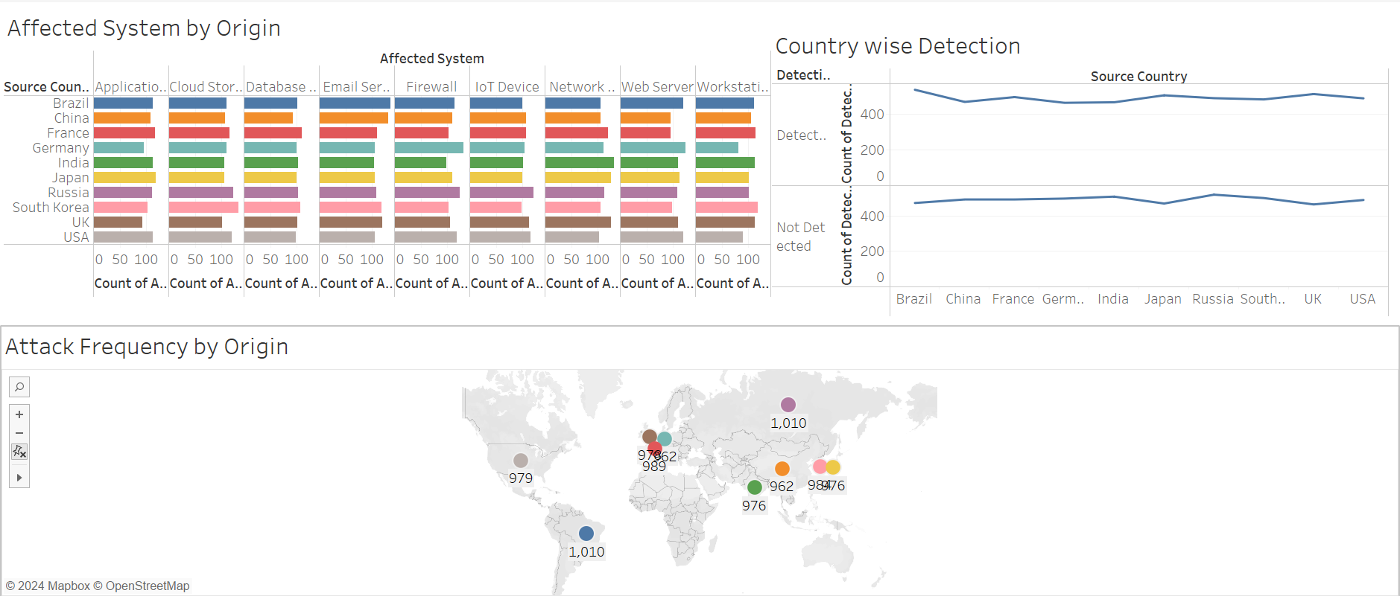
Second Hypotheses Dash Board:

Slide 19
Second Hypotheses Answer:
The graph shows that Brazil and the United Kingdom have the highest number of cyberattacks, far outpacing other countries.
In comparison, most other countries have a rather steady level of cyberattack activity, with instances totaling over 900.
This trend highlights Brazil and the United Kingdom as important hotspots for cyber attacks, emphasizing the necessity for stronger cybersecurity measures in these countries.
Meanwhile, the constancy of assault statistics in other countries demonstrates that cyber dangers are still a global concern, necessitating continual monitoring and effective countermeasures across all regions.

Slide 20
Third Hypotheses Question:
Do data breach sizes differ greatly between countries, and which countries have the most data breaches?

Slide 21
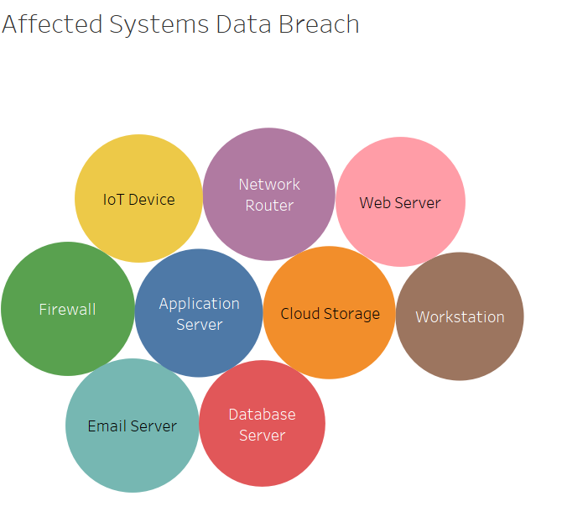
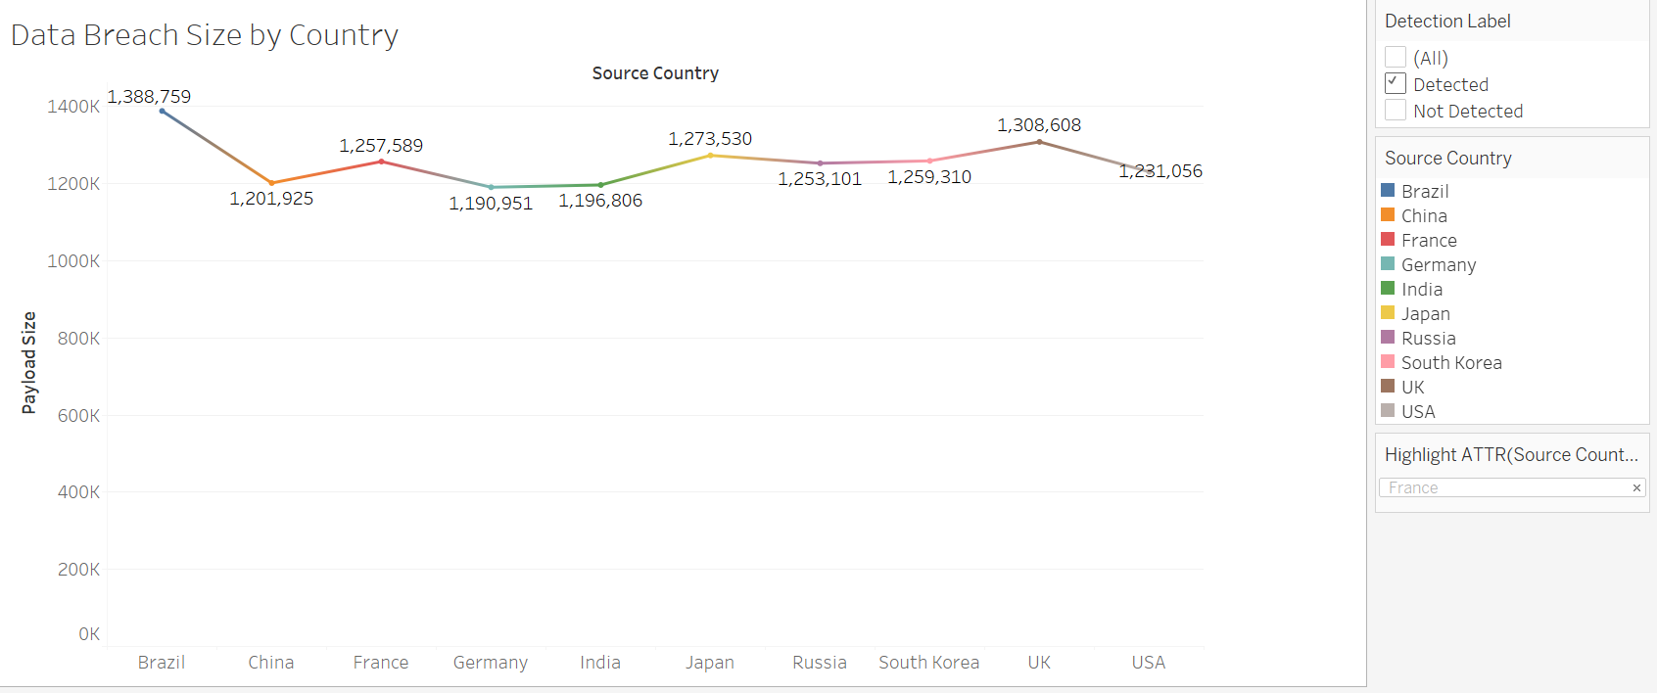
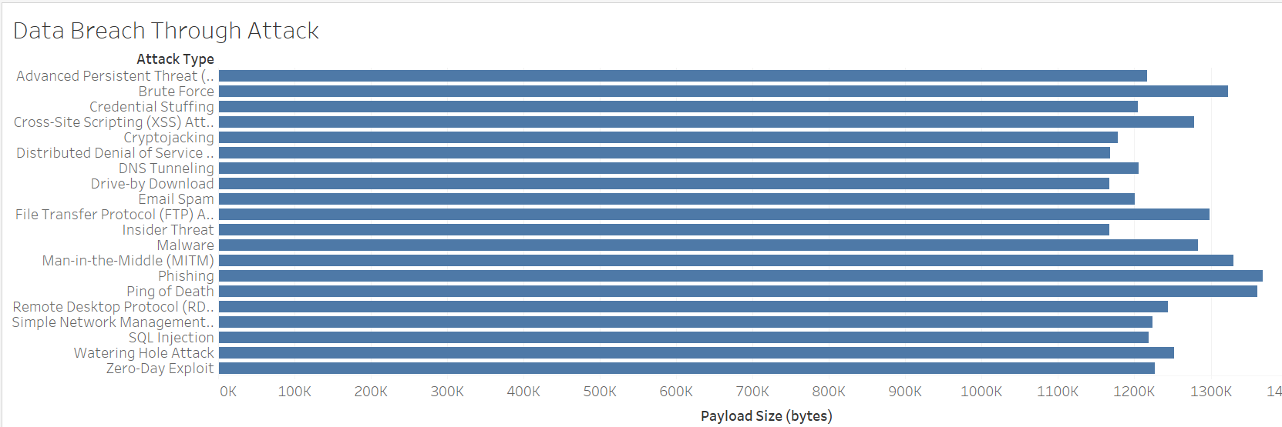
Third Hypotheses Output:

Slide 22
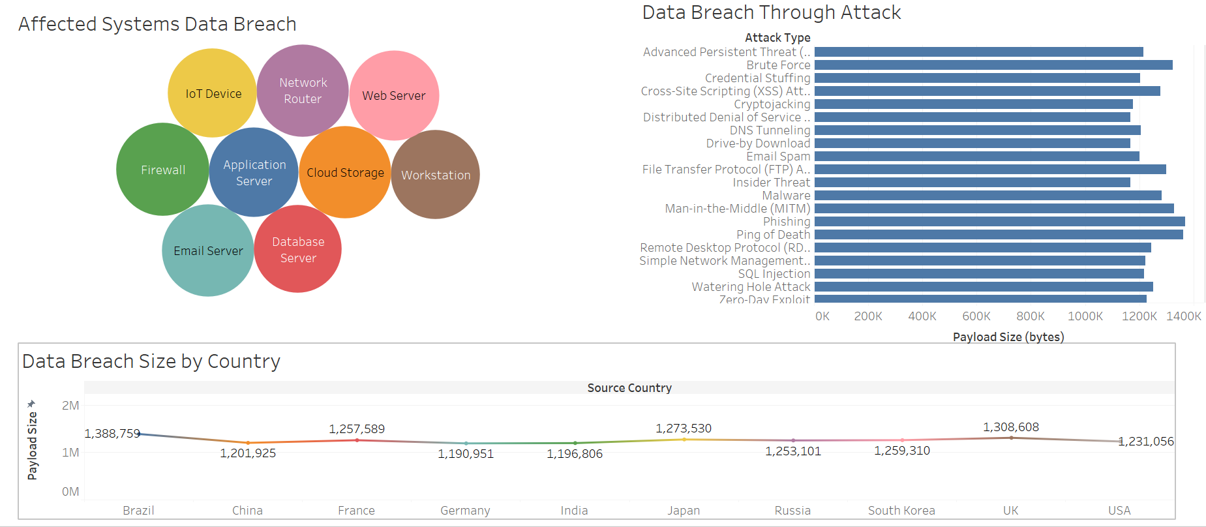
Third Hypotheses Dash Board:

Slide 23
Third Hypotheses Answer:
The graph shows that data breaches are identified substantially more frequently in Brazil, the United Kingdom, France, and Japan compared to other nations such as China, India, and Germany.
This suggests that Brazil and the United Kingdom, in particular, are more vulnerable to cyber threats, either due to greater digital footprints or increased targeting by bad actors.
France and Japan also have relatively high rates of data breaches, indicating persistent difficulty in addressing cybersecurity threats.
In contrast, China, India, and Germany report fewer detected breaches, which could indicate disparities in detection processes, reporting standards, or total threat exposure.
This mismatch highlights the importance of specialized cybersecurity tactics across areas to address their specific difficulties and weaknesses.

Slide 24
Conclusion:
The examination of the cyberattack detection dataset yields some important insights into present cybersecurity concerns. A considerable fraction of cyberattacks in all countries go unreported, highlighting the crucial need for enhanced detection measures worldwide. Brazil and the United Kingdom have the highest number of detected cases, followed by Russia, France, South Korea, and the United States. These regions are significant hotspots that require targeted and comprehensive cybersecurity solutions.
The report also identifies the susceptibility of individual systems, with network routers, email servers, and cloud storage being the most commonly targeted infrastructure components. This highlights the need of prioritizing security for these key systems in order to reduce the impact of assaults.
The most common attack type is phishing, followed by brute force, ping of death, FTP attacks, and malware. This broad distribution of attack types suggests that attackers use a variety of approaches, necessitating the implementation of multi-layered defense strategies in order to successfully handle these threats.
Finally, Brazil, the United Kingdom, France, and Japan have a higher rate of data breaches than China, India, and Germany. This mismatch indicates variances in threat exposure, detection capabilities, and reporting systems, emphasizing the necessity for region-specific cybersecurity policies.
To summarize, this analysis emphasizes the critical need for worldwide collaboration, constant monitoring, and sophisticated detection and preventive strategies to effectively address the expanding cyber threat landscape.

Slide 25
Thank You

