Slide 1
SPOTIFY Data Analysis
Venu Sai Ram Udayabhaskara Reddy K

Slide 2
Core Components:
For writing the code we have used
Python ,Spark,Spark SQL,Seaborn,matplotlib,numpy
For Executing the script used
Databricks
Dataset references :https://www.kaggle.com/datasets/maharshipandya/-spotify-tracks-dataset

Slide 3
Introduction
The current project on which we are working relates to Spotify tracks of various genres and their audio properties.
One of the biggest online music and podcast streaming services is SPOTIFY, which provides a huge selection of music and podcast playlists.
With the use of Python and Spark libraries and with big data models, we would like to investigate the most popular genres from the entire data set in order to determine whether there is a relation between genre and volume that would cause a particular genre's song to stand out at the top of the list.

Slide 4
Problem Statements:
To determine the overall number of original artists?
How many different genres of music altogether?
Sentimental analysis on music type?
Discovered the top five most popular artists?
The TOP 5 Songs with the Longest Length?
The song's length in relation to its level of popularity?
To find loudness of the songs and its popularity?
Derived Top trending genre?
Text mining analysis to print the 20 most common words in the album name?

Slide 5

Data Transformation:
Raw Dataset
Preprocessing Data
Data cleaning (Dedup , Junk, Renaming)
Applied Logic To Derive Solution For Problem Statements
The data set we are working on consist of 21 columns and 114,000 Rows.

Slide 6
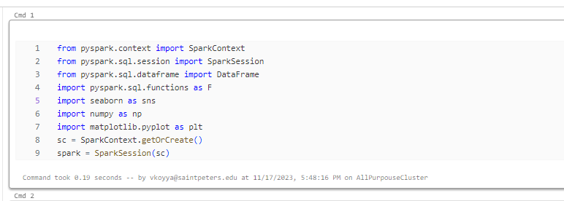
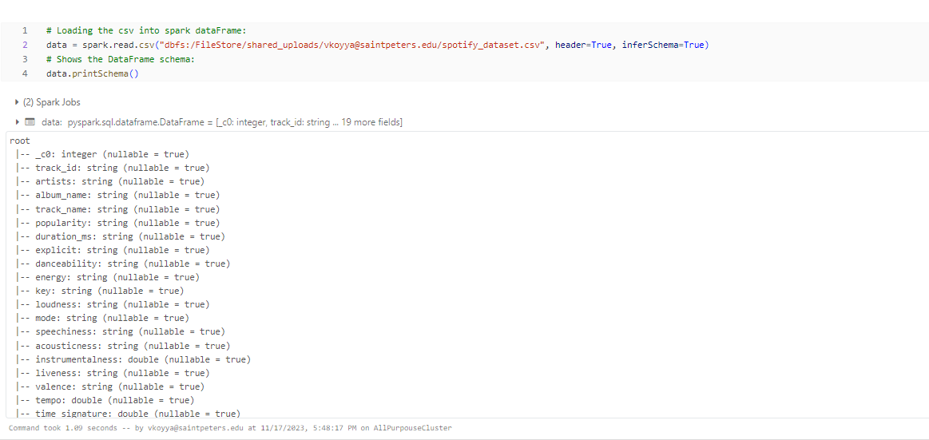
Details of Dataset:

Slide 7
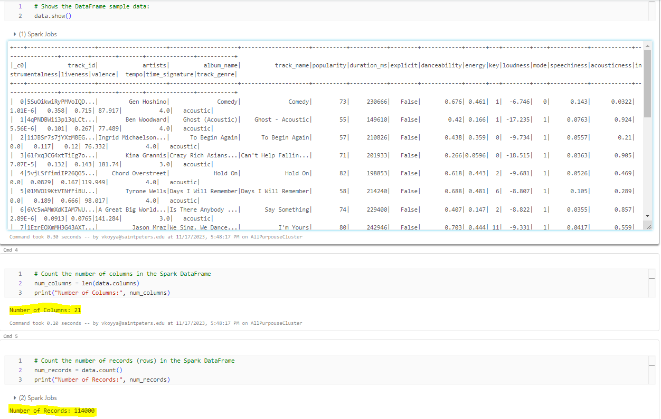
Dataset Information:

Slide 8
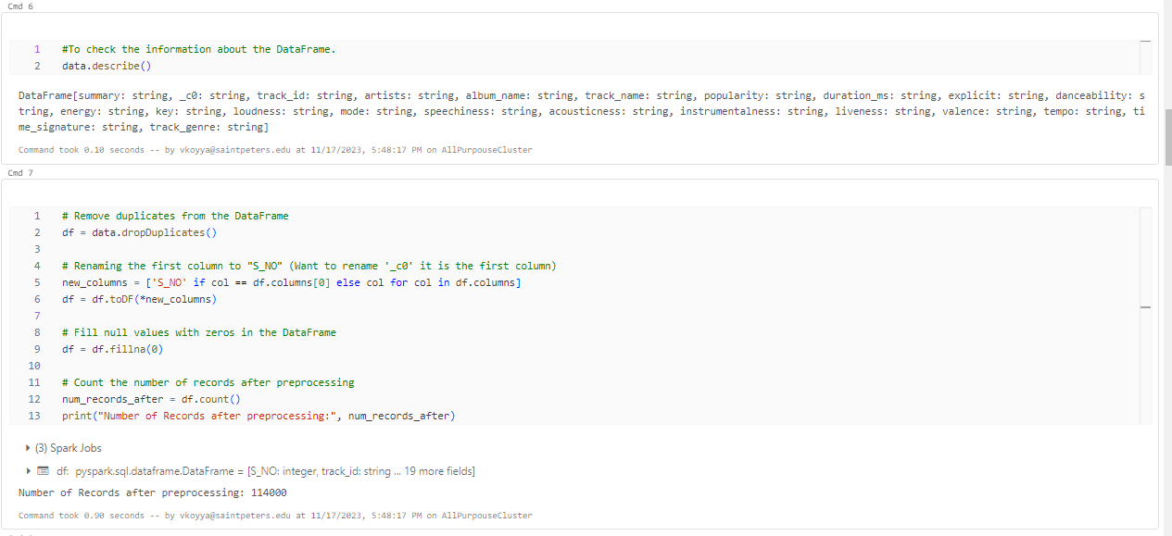
Data Pre-processing:

Slide 9
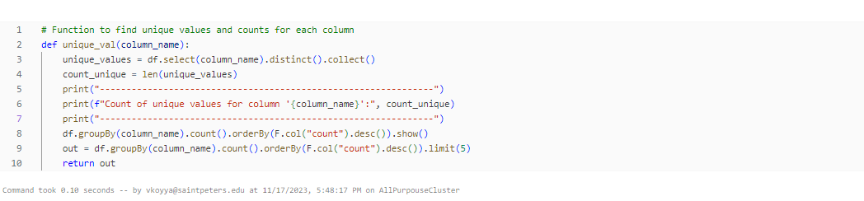
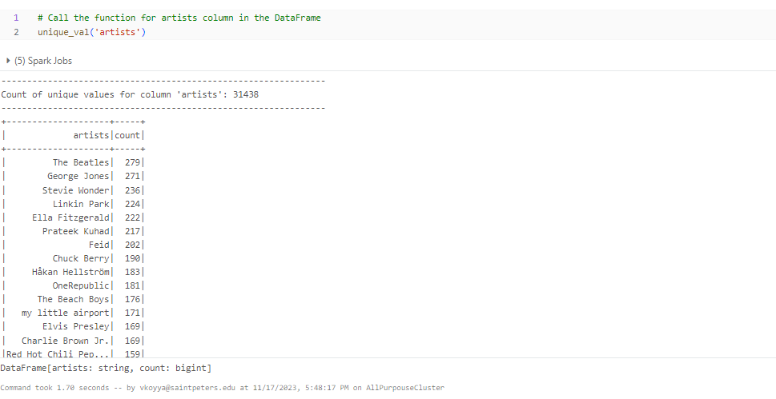
Logic To determine the overall number of original artists:

Slide 10
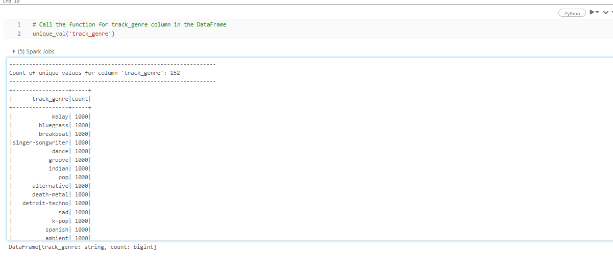
Logic To determine How many different genres of music altogether:

Slide 11
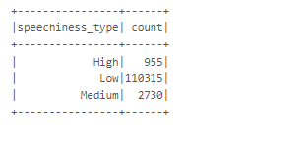
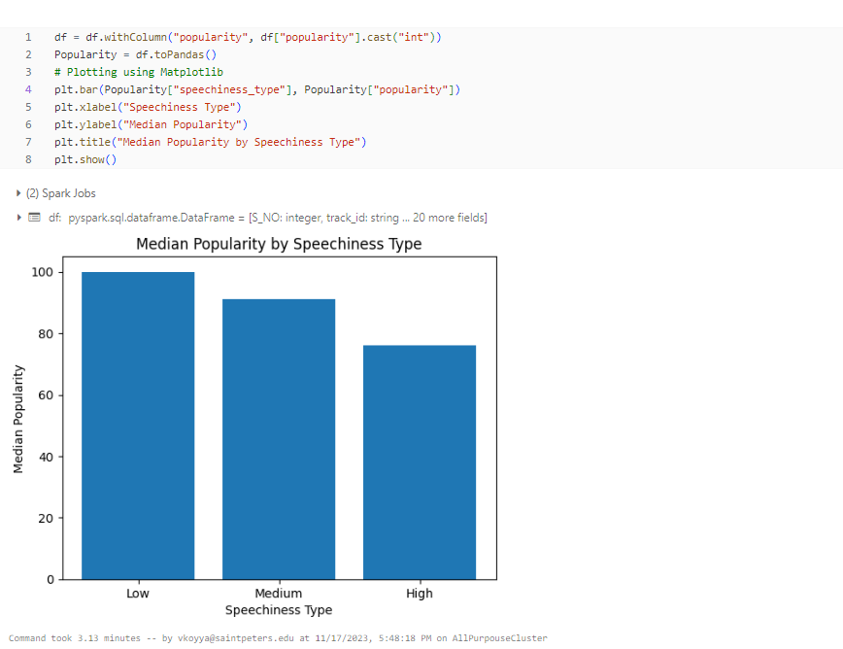
Sentimental analysis on music type:

Slide 12
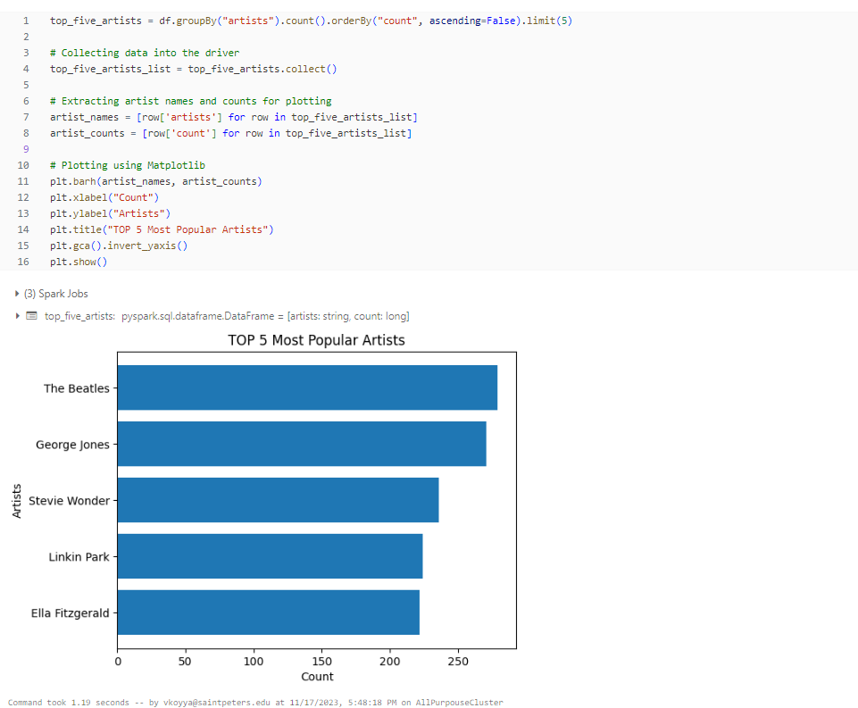
Discovered the top five most popular artists:

Slide 13
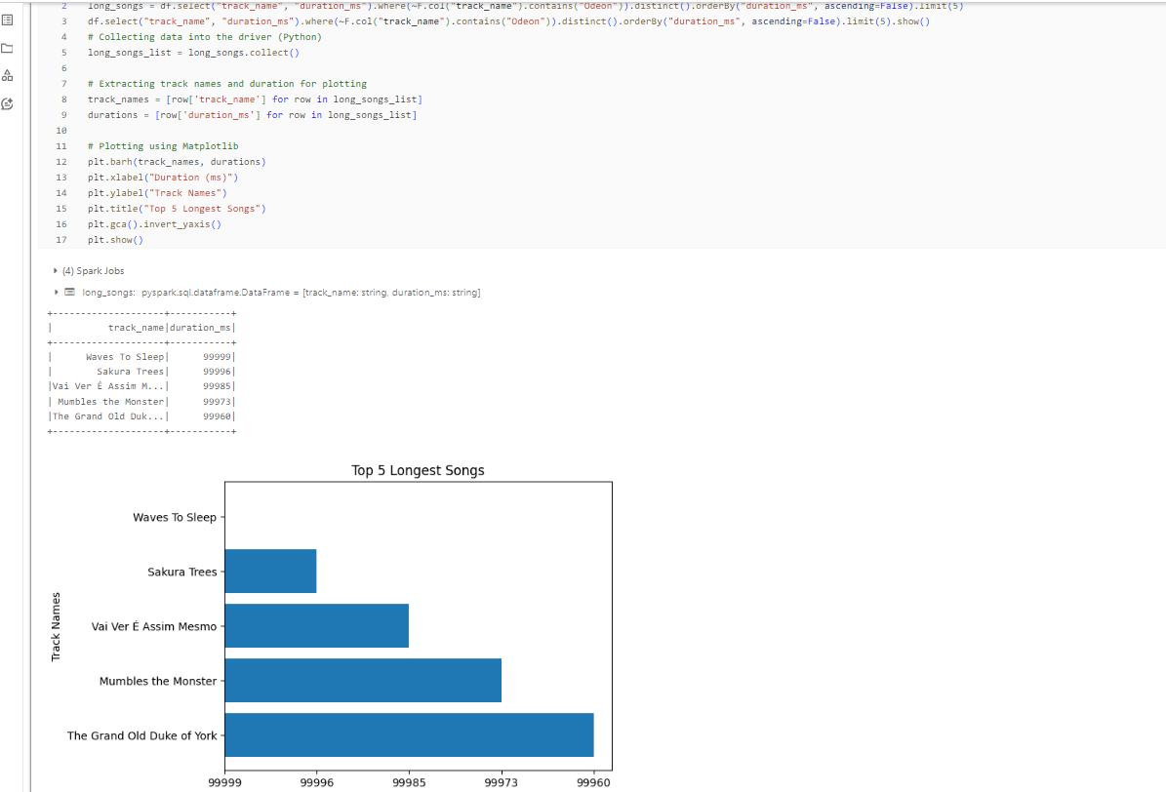
The TOP 5 Songs with the Longest Length:

Slide 14
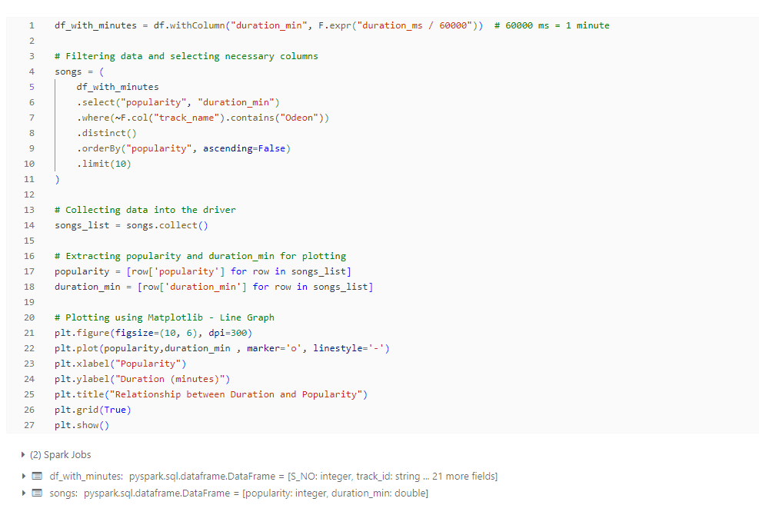
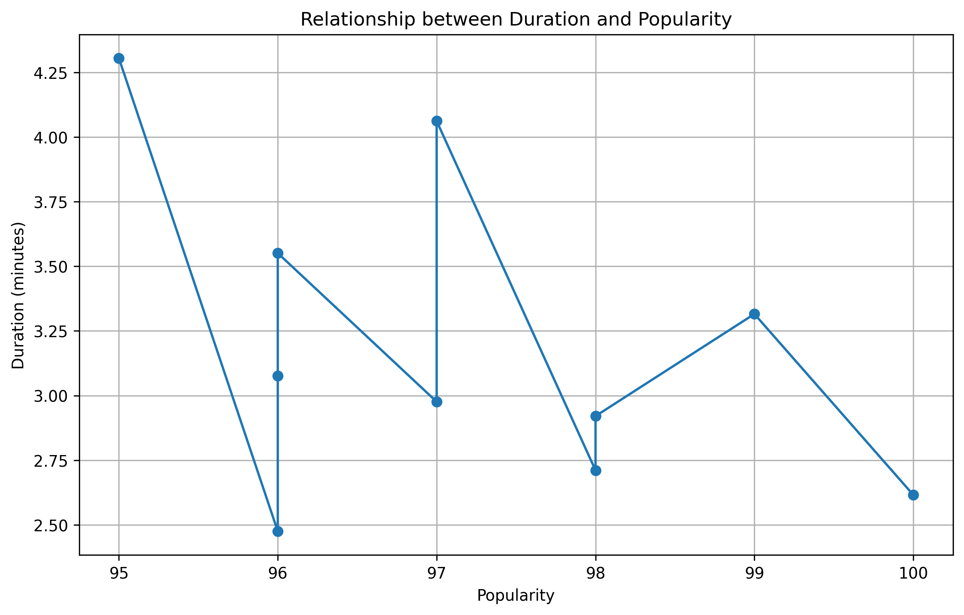
The song's length in relation to its level of popularity:

Slide 15
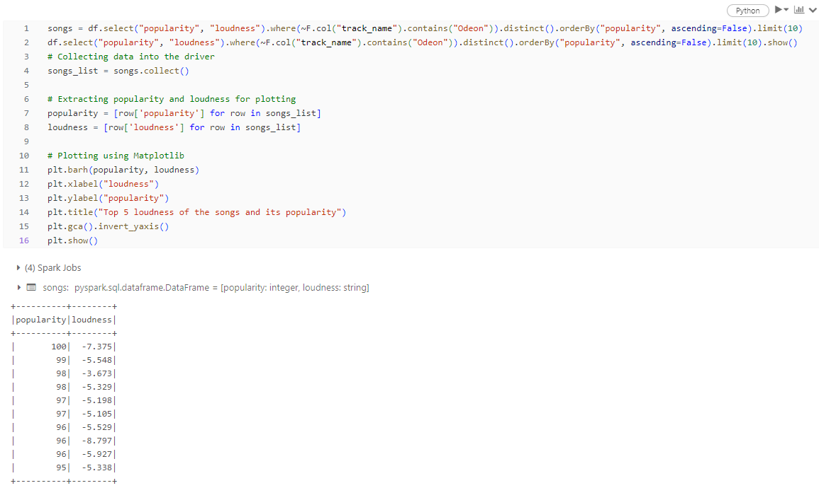
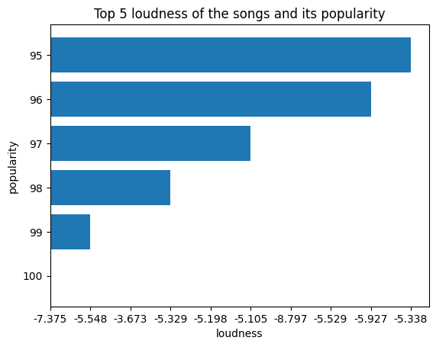
Below is the loudness of the songs and its popularity:

Slide 16
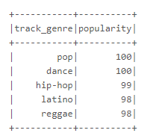
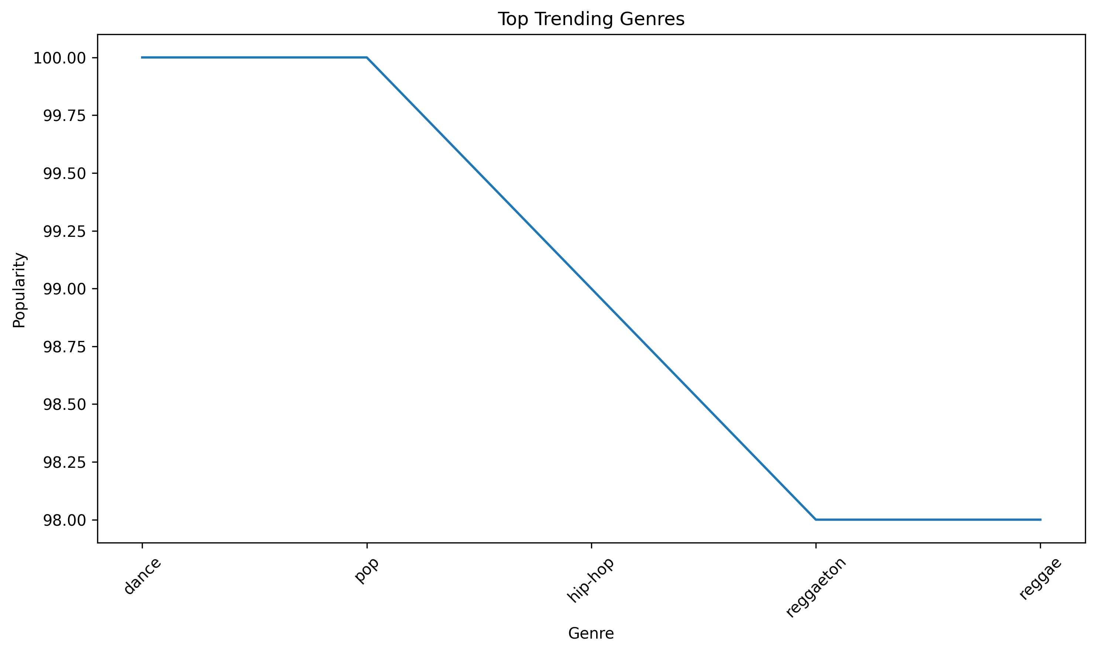
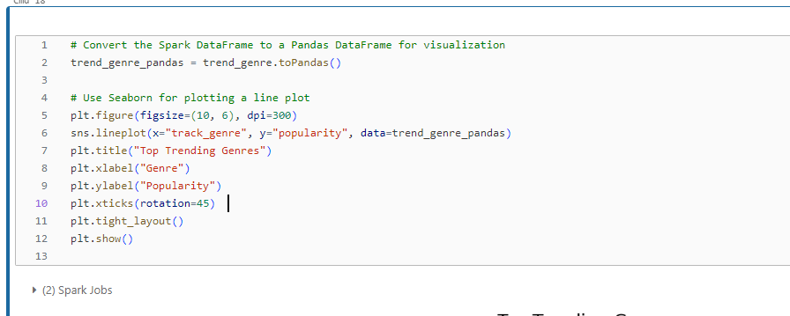
Derived Top trending genre:

Slide 17
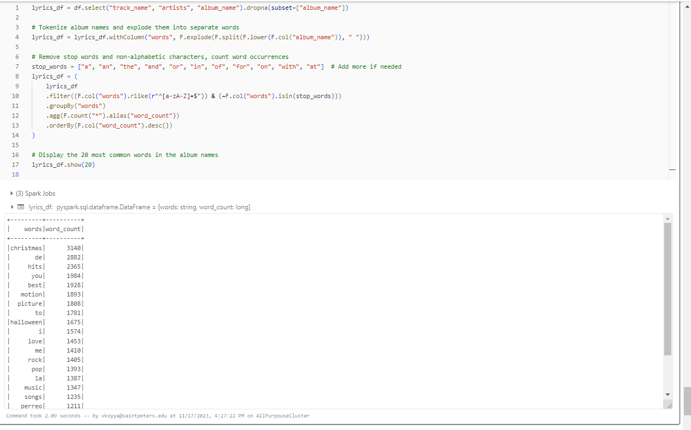
Text mining analysis to print the 20 most common words in the album name:

Slide 18
Conclusion:
As we know Spotify is a music streaming service that provides a wide range of data about music consumption patterns, including song popularity, artist popularity, user listening habits, and more. By analyzing Spotify datasets, we were able to gain insights into various aspects of music consumption, such as:
Popular genres: By analyzing the genres of popular songs and artists, it is possible to identify trends in music consumption and preferences across different regions and demographics.
User listening habits: By analyzing user listening data, it is possible to identify patterns in when and how users listen to music, such as time of day, device usage, and listening duration.
Song and artist popularity: By analyzing streaming and play count data, it is possible to identify which songs and artists are most popular among Spotify users, as well as which songs and artists have seen the most growth in popularity over time.
These insights can be valuable for various stakeholders in the music industry, such as artists, record labels, and music streaming services themselves. By understanding what kinds of music are popular and how users consume music, these stakeholders can make more informed decisions about music production, promotion, and distribution. It is worth noting, however, that any conclusions drawn from analyzing Spotify datasets should be taken with a grain of salt, as the data only represents a subset of the broader music listening population. Additionally, Spotify's algorithms for generating playlists and recommendations are proprietary and not fully transparent, which can make it difficult to draw definitive conclusions about user listening habits.

Slide 19
THANK YOU

