Slide 1
Data Exploration & Visualization
VINEET REDDY
100741272

Slide 2
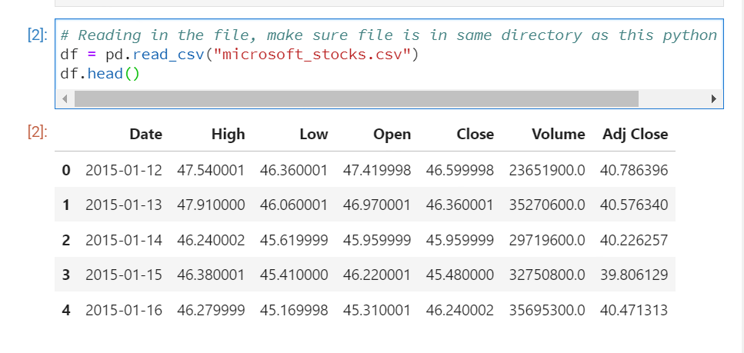
Columns Description
This data is about MICROSOFT STOCKS and this data was from Open Data
The data initially had 10.1K Rows and 14 Columns. After carefully looking at dataset, and doing data manipulation and adding two more columns, final dataset now has 3.1K Rows and 7 Columns. Below is the preview,

Slide 3
Columns Description
DATE: Represents the date of the stocks
HIGH: Range of the stocks
LOW: Range of the stocks
OPEN & CLOSE: Status of the stocks
VOLUME : Volume of the stocks
ADJ CLOSE : Closing rates

Slide 4
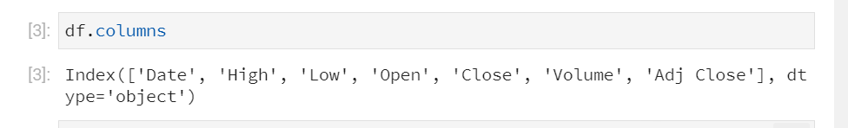
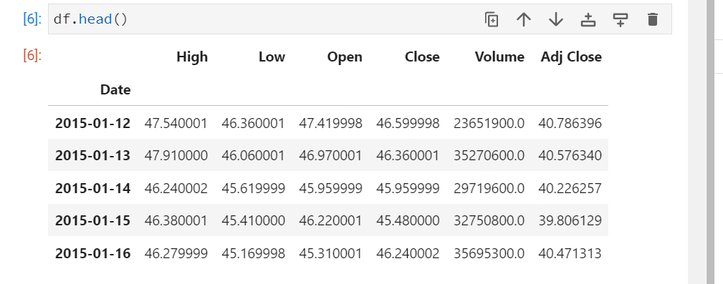
VCBSJvVISUALIZATION OF THE INDEX

Slide 5
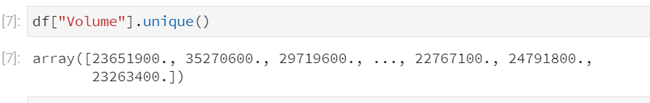
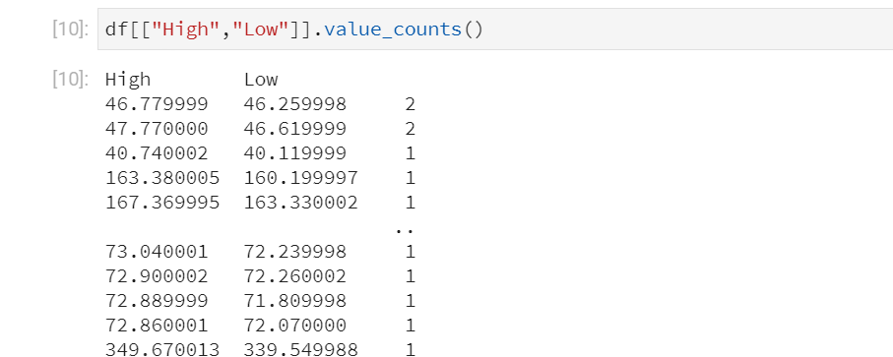
VISUALIZATION OF THE UNIQUE COLUMNS

Slide 6
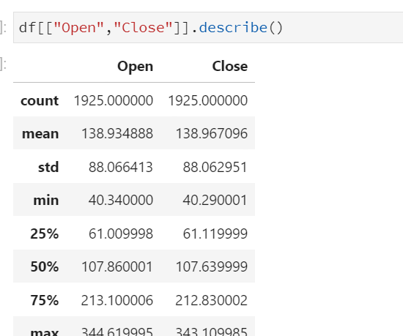
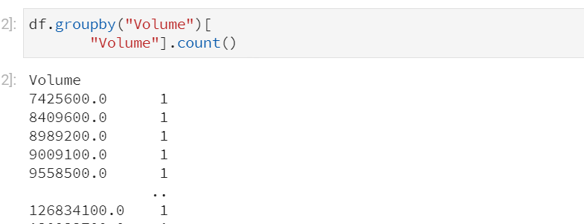

Slide 7
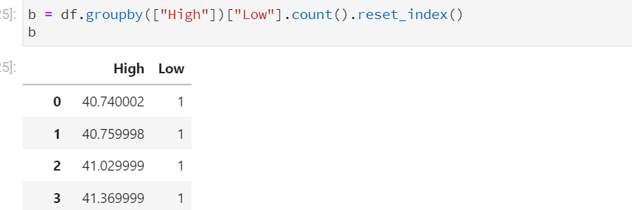
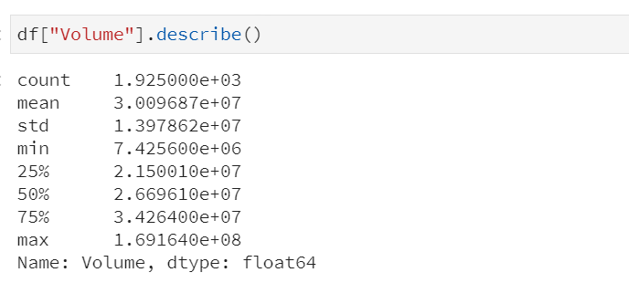
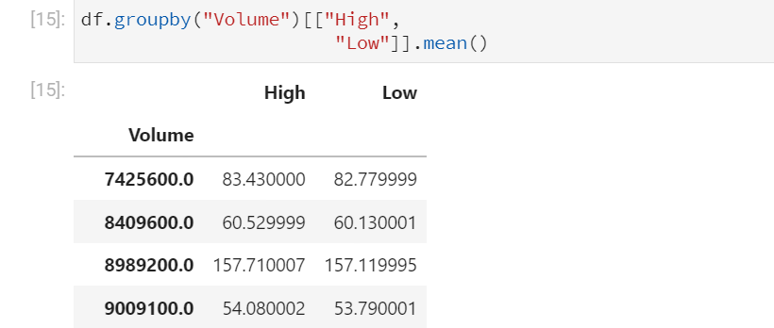

Slide 8
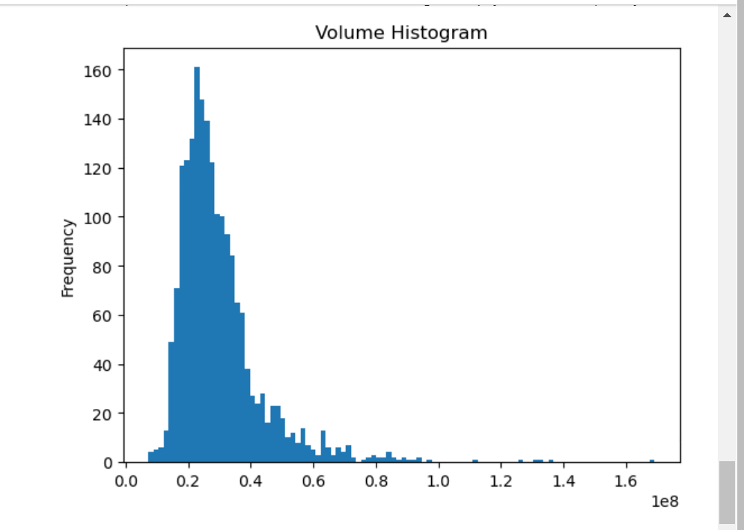

Slide 9
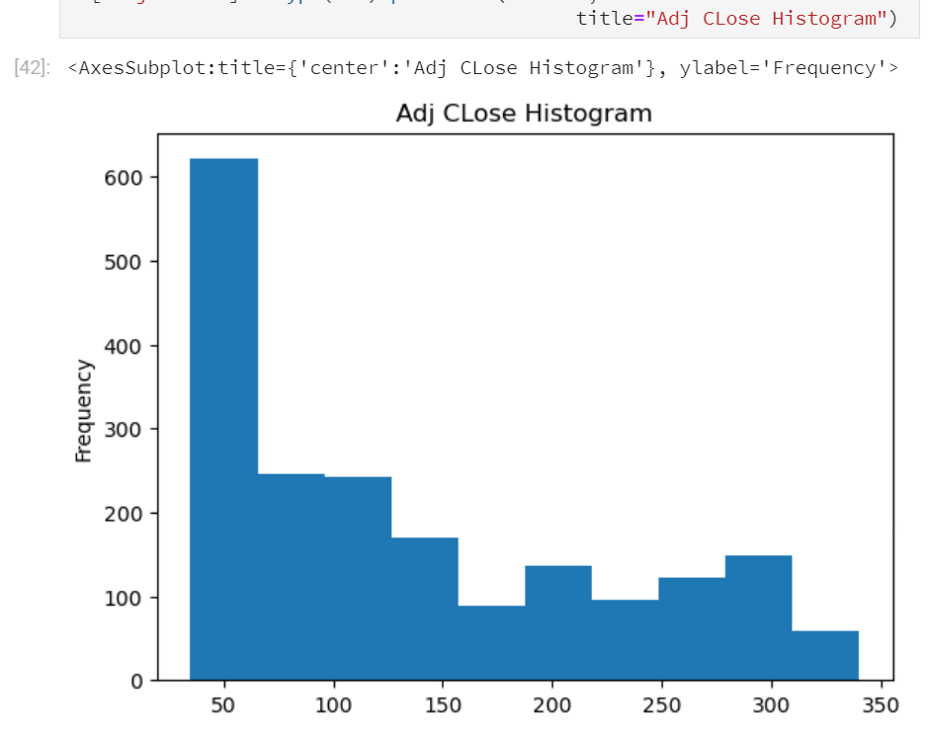

Slide 10
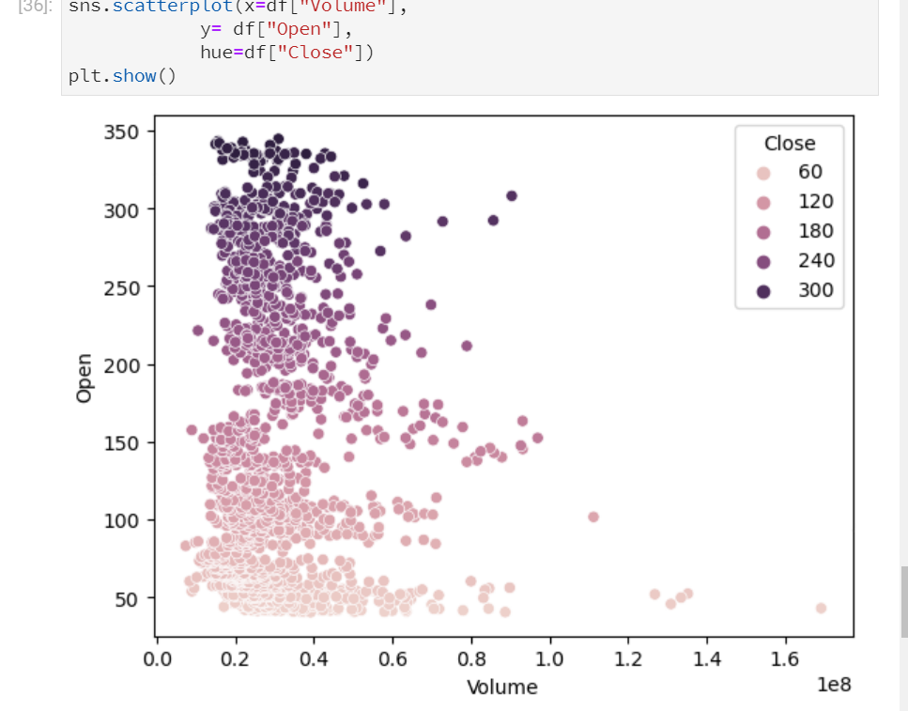
HISTOGRAM SHOWS THE VOLUME WITH THE OPEN AND CLOSE SALES

Slide 11
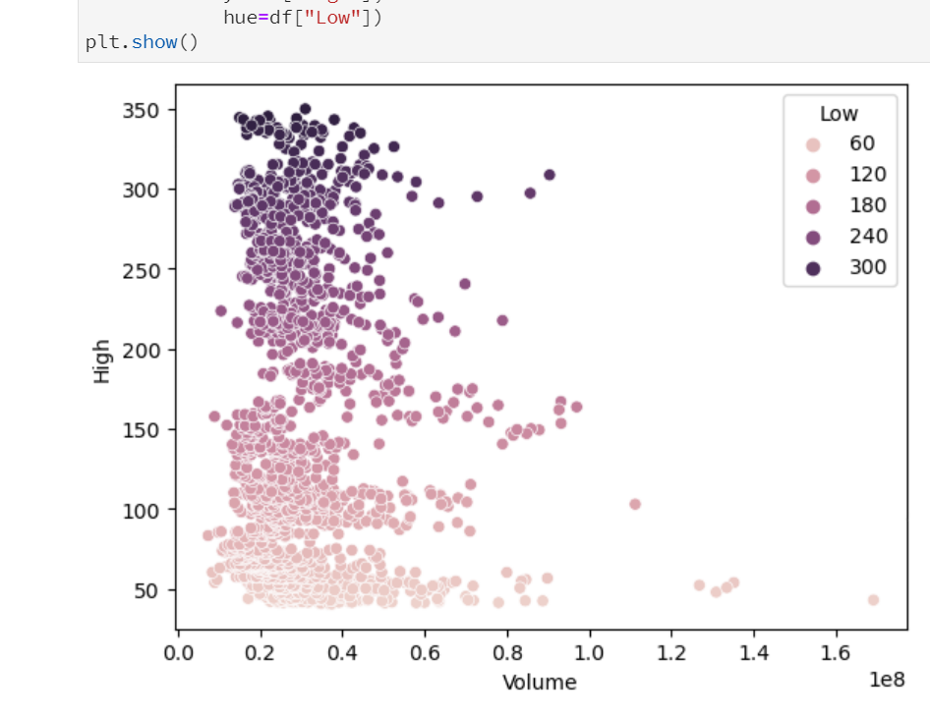
HISTOGRAM SHOWS VOLUME WITH THE HIGH AND LOW SALES

