Slide 1
Data Exploration & Visualization
Client Name

Slide 2
Source Description
Source name = Kaggle
Name of Dataset = Online Retail Dataset
Rows in dataset = 3K
Columns in dataset = 8
The Online Retail dataset is basically giving the info about the items and their description and customerID.
Contributor = Balarama Krishnaiah Kaka
URL = https://www.kaggle.com/datasets/lava18/google-play-store-apps

Slide 3
Columns Description
S.# | Column Name | Column Description
1. | InvoiceNo | The number of invoice
2. | Stock Code | Particular code for the code
3. | Description | Description of the item
4. | Quantity | No.of items
5. | Invoice Date | Dates where the invoice is generated
6. | Unit Price | No.of units taken
7. | CustomerID | The ID customerID of the customer
8. | Country | The country

Slide 4
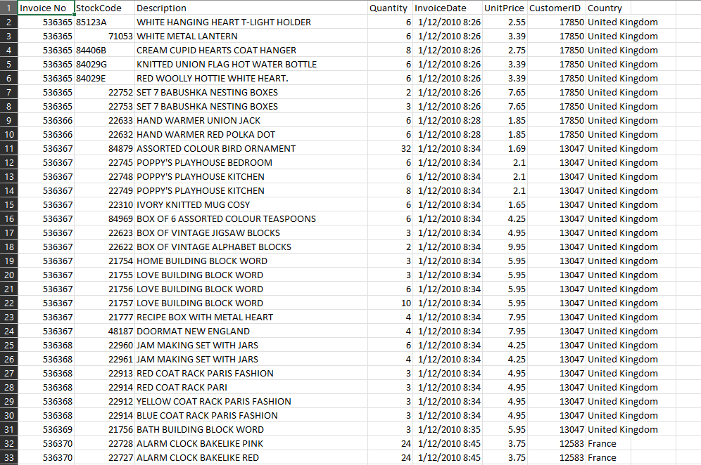
Data Set

Slide 5
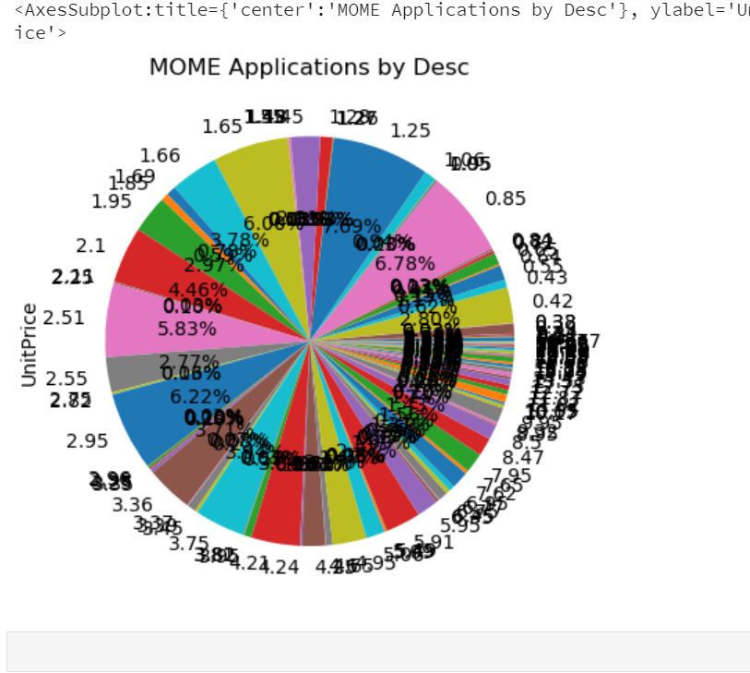
Visualization

Slide 6
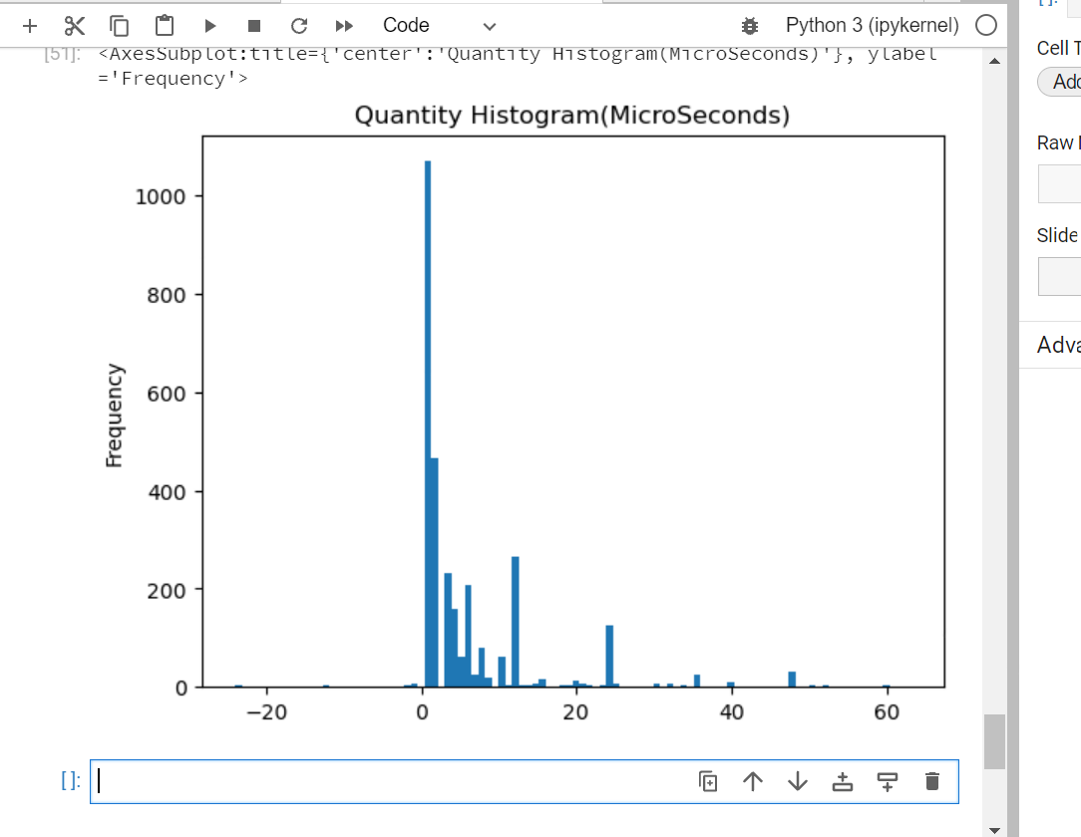
Visualization

Slide 7
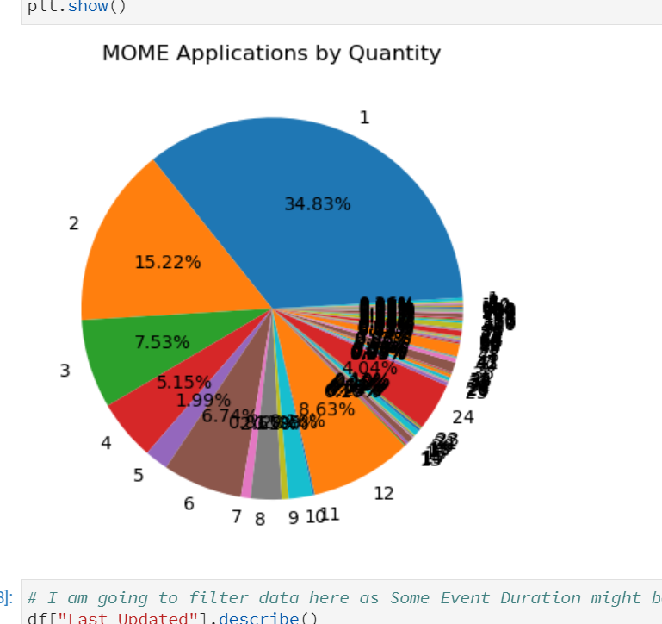
Visualization

Slide 8
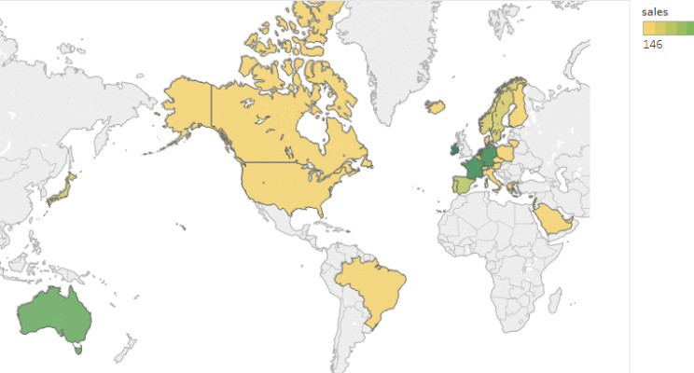
Visualization

