Slide 1
CIVICSENSE AI
Making civic
problem-solving smarter.
AI-Powered Civic Issue Reporting & Resolution
PROJECT PRESENTATION | MERN STACK
TEAM NAME : CODECRAFTERS
Team Members:
241FA04283 – UDAY BAVIREDDY
241FA04348 – HARI KRISHNA THOTA
241FA04E19 – SATHWIK PASUPULETI
Project: https://civicsense-frontend-six.vercel.app/

Slide 2
CIVICSENSE AI / PROJECT PRESENTATION
Introduction & Problem Statement
A citizen-focused platform concept for reporting and resolving local civic issues.
THE PROBLEM
THE PROJECT IDEA
• Civic issues such as damaged roads, waste accumulation, water leakage and streetlight failures affect daily life.
• Reporting can be fragmented across phone calls, offices and informal channels.
• Citizens may not know where to report an issue or how to follow its progress.
CivicSense AI aims to provide a single digital channel where people can submit civic complaints, share relevant details and follow the resolution process.
The goal is to improve visibility, communication and accountability between citizens and civic authorities.

Slide 3
CIVICSENSE AI / PROJECT PRESENTATION
Project Objectives
What CivicSense AI is designed to achieve.
01 Simplify reporting
02 Capture useful details
03 Improve visibility
Offer a clear digital way to submit civic complaints.
Collect issue descriptions, category and location information.
Let users view submitted reports and their current status.
04 Support faster action
05 Build accountability
06 Enable smarter services
Organise reports so responsible teams can review and act.
Create a traceable record from submission to resolution.
Explore AI-assisted classification and prioritisation.

Slide 4
CIVICSENSE AI / PROJECT PRESENTATION
Technologies & Tools Used
MERN stack overview — align the backend/database items with your actual implementation.
M
E
R
N
MongoDB
Express.js
React.js
Node.js
NoSQL database for storing users, reports and status records.
Node.js web framework for defining backend API routes.
Component-based frontend for the user interface.
JavaScript runtime for server-side application logic.
Development tools: VS Code • Git/GitHub • Vercel • Postman

Slide 5
CIVICSENSE AI / PROJECT PRESENTATION
System Architecture & Workflow
High-level MERN architecture for a citizen issue reporting application.
CITIZEN
REACT UI
REST API
NODE.JS
MONGODB
Submit issue
View updates
Forms • Dashboard
Report status
Express routes
Validation
Business logic
Authentication
Users • Reports
Status history
Typical workflow
1 User reports an issue → 2 Frontend sends request → 3 API validates and processes → 4 Database stores the report → 5 User checks status

Slide 6
CIVICSENSE AI / PROJECT PRESENTATION
Features & Functionalities
Present only the features that are currently available in your deployed build.
CITIZEN EXPERIENCE
TRACKING & COMMUNICATION
ADMIN / SMART FEATURES
• Issue reporting form
• Issue category and description
• Location and supporting details
• Personal report history
• Report status visibility
• Issue details page
• Progress or update notifications
• Clear feedback channel
• Review and manage submissions
• Assign or update issue status
• AI-assisted categorisation (if implemented)
• Analytics and trend insights (future/if implemented)

Slide 7
CIVICSENSE AI / PROJECT PRESENTATION
Database Design & API Integration
Conceptual data model and API flow — replace names with your actual schema and endpoints.
SUGGESTED COLLECTIONS
API INTEGRATION (EXAMPLES)
Users
• userId, name, email, passwordHash, role
Reports
• reportId, userId, category, description, location, imageUrl, status, createdAt
StatusUpdates
• updateId, reportId, status, note, updatedAt
POST /api/reports Create a report
GET /api/reports List reports
GET /api/reports/:id View report details
PATCH /api/reports/:id/status Update status
Frontend sends HTTP requests; backend validates input, applies application rules and reads/writes database records.
Security considerations: password hashing • input validation • role-based access • protected API routes

Slide 8
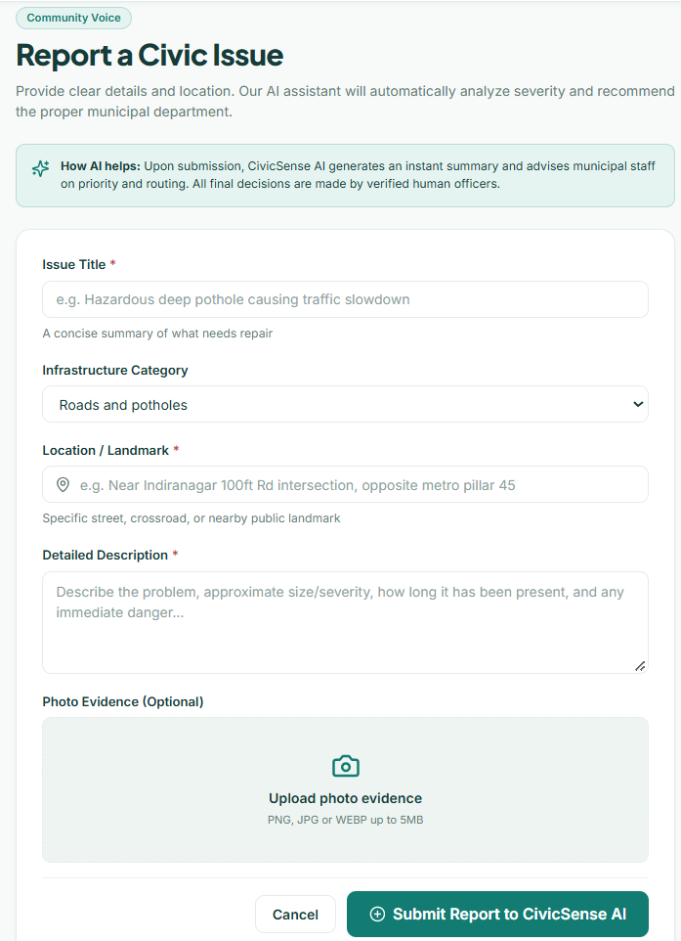
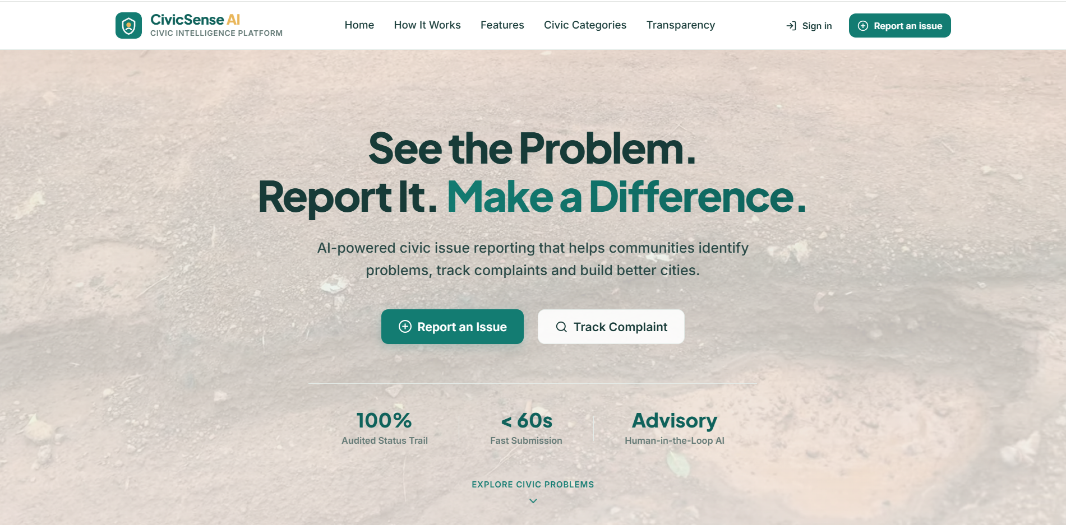
CIVICSENSE AI / PROJECT PRESENTATION
Project Screenshots
01 HOME / LANDING PAGE
02 REPORT ISSUE PAGE

Slide 9
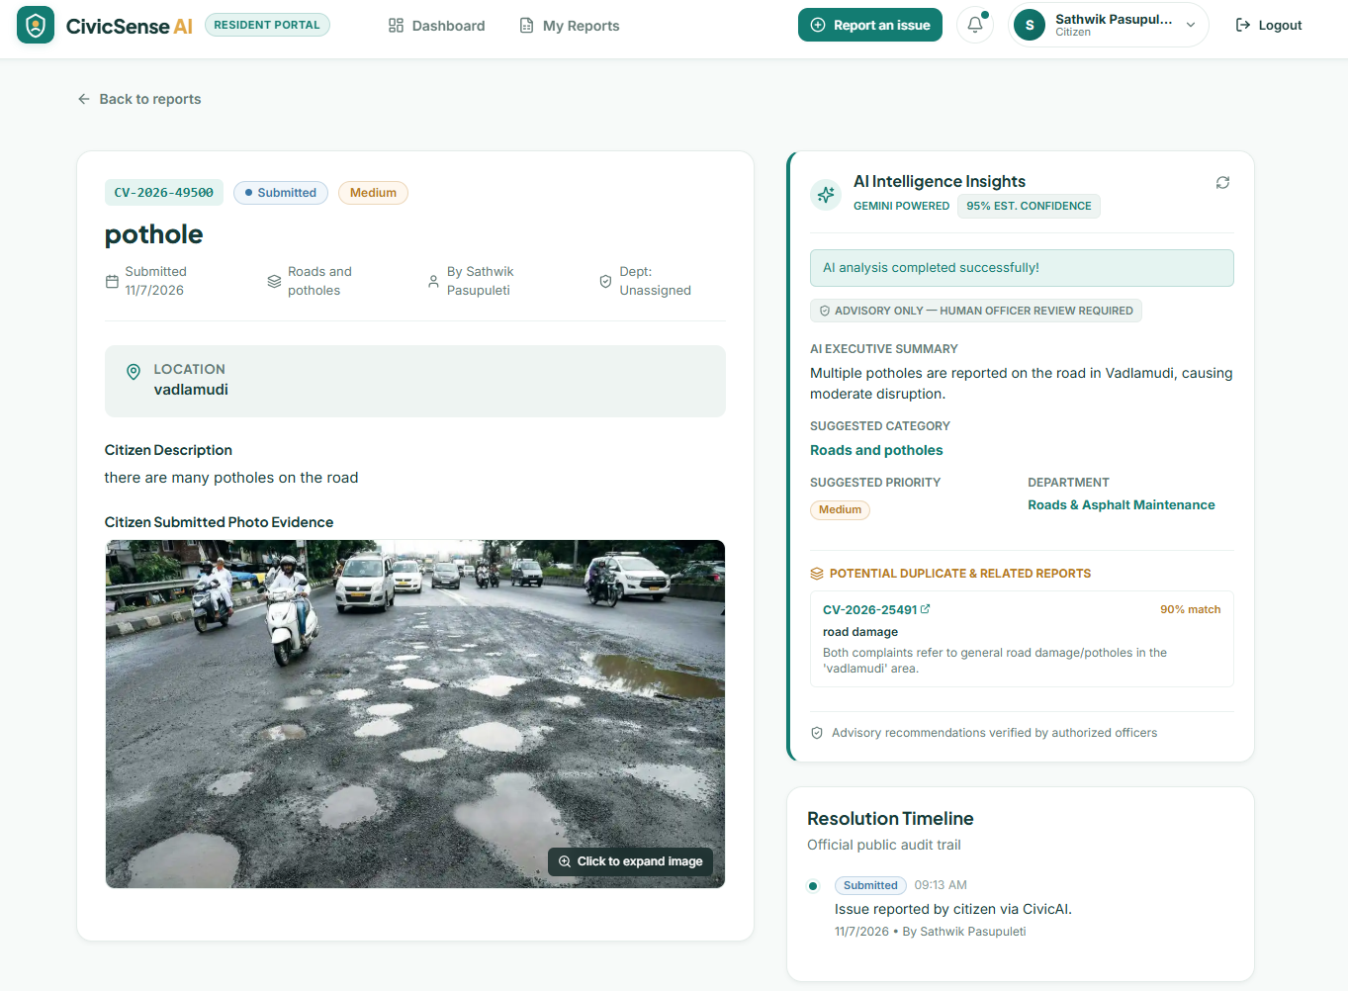
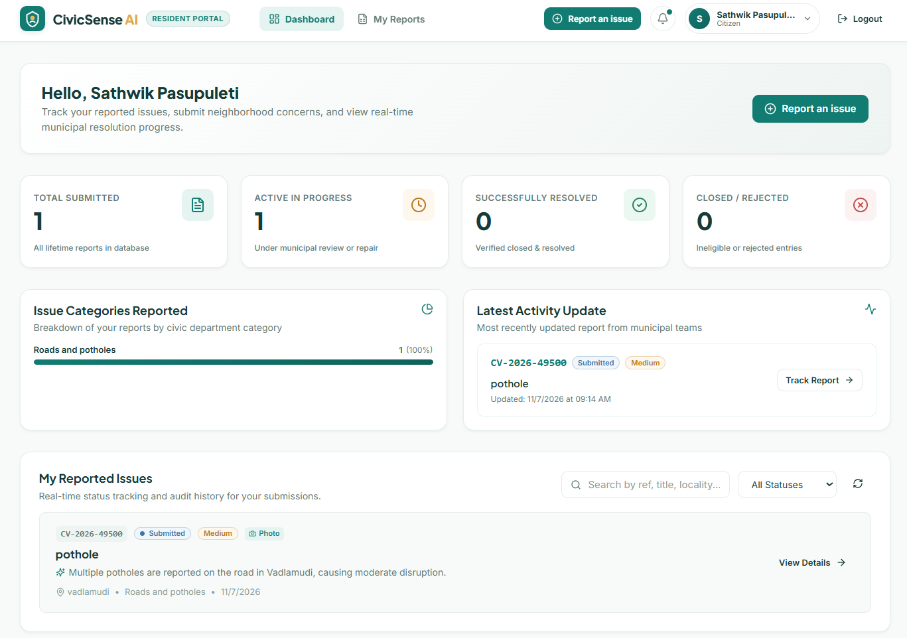
CIVICSENSE AI / PROJECT PRESENTATION
Project Screenshots
03 TRACKING
04 DASHBOARD

Slide 10
CIVICSENSE AI / PROJECT PRESENTATION
Challenges Faced & Future Scope
Use the challenges that reflect your actual development experience.
CHALLENGES TO DISCUSS
FUTURE ENHANCEMENTS
• Designing a simple reporting experience
• Validating user-submitted information
• Handling image and location data
• Connecting frontend, APIs and database
• Managing access and report status
• AI-based issue categorisation and priority scoring
• Map view and geolocation-based reporting
• Live status notifications
• Admin analytics and hotspot detection
• Multi-language support and accessibility
Future goal: move from simply collecting complaints to helping communities and authorities act on them.

Slide 11
CIVICSENSE AI / CONCLUSION
Better reporting.
Clearer progress.
Stronger communities.
CivicSense AI presents a digital approach to making civic issue reporting more accessible and transparent. By bringing reporting, information and progress tracking into one place, it aims to strengthen communication between citizens and civic service teams.
THANK YOU
Project: https://civicsense-frontend-six.vercel.app/

