Slide 1
R23 • 23CD4124 • DEPARTMENT OF CSE (DATA SCIENCE)
CLOUD COMPUTING
Complete Unit-Wise Presentation
Mr.P.Uday Bhaskar (Asst.Prof.)
5 Units · Fundamentals → Architecture → Service Models → Virtualization → Security
☁

Slide 2
COURSE MAP
What This Deck Covers
UNIT I
Cloud Computing Fundamentals
Definition, principles, 5 characteristics, deployment models
UNIT II
Architecture & Infrastructure
Layers, anatomy, networking, migration phases & approaches
UNIT III
Cloud Service Models
IaaS, PaaS, SaaS — characteristics, suitability, pros & cons
UNIT IV
Virtualization in Cloud
VMs, hypervisors, types, role in cloud, app development
UNIT V
Cloud Security & Applications
Security issues, data security, IAM, storage, backup

Slide 3
I
UNIT
Cloud Computing Fundamentals
Motivation, definition, principles, the five essential characteristics, and the four deployment models

Slide 4
UNIT I · FOUNDATION
Why Cloud? Need & Definition
The problem with traditional IT
The cloud answer
High upfront cost of hardware (CapEx)
Resources sized for peak → idle most of the time
Heavy maintenance, patching & upgrades
Slow, inflexible scaling; tied to a location
Pay-as-you-go operating cost (OpEx)
Instant, elastic scaling with demand
Provider handles maintenance & availability
Access from anywhere over the internet
NIST DEFINITION
Cloud computing is a model for enabling ubiquitous, convenient, on-demand network access to a shared pool of configurable computing resources (networks, servers, storage, applications, services) that can be rapidly provisioned and released with minimal management effort.

Slide 5
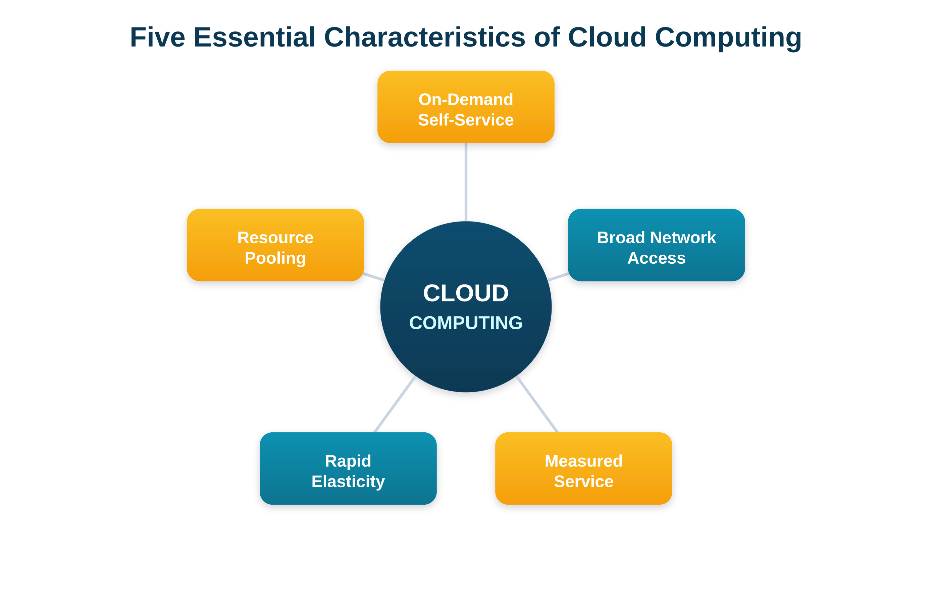
UNIT I · NIST MODEL
Five Essential Characteristics
On-Demand Self-Service Provision resources automatically, no human interaction
Broad Network Access Available over the network to all standard devices
Resource Pooling Multi-tenant pool, dynamically assigned
Rapid Elasticity Scale out/in quickly; seems unlimited
Measured Service Usage metered → transparent pay-per-use billing

Slide 6
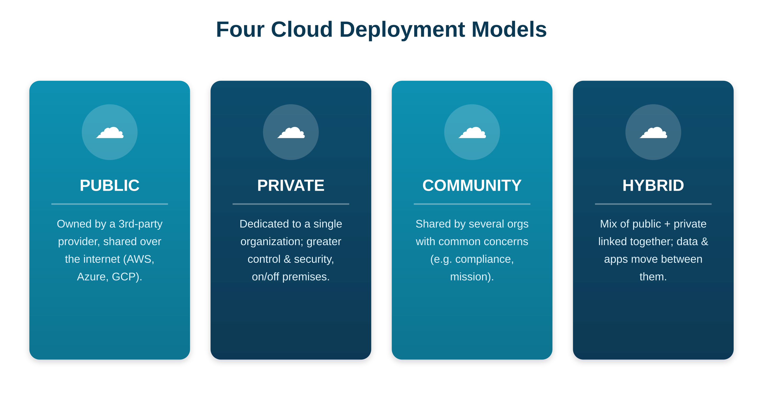
UNIT I · DEPLOYMENT
Four Cloud Deployment Models
Public: Shared, internet-based, lowest cost — AWS, Azure, GCP
Private: Dedicated to one org — control & security
Community: Shared by orgs with common concerns
Hybrid: Public + private combined; workloads move between

Slide 7
II
UNIT
Cloud Architecture & Infrastructure
Architecture, layers, anatomy, networking, managing the cloud, and migrating applications

Slide 8
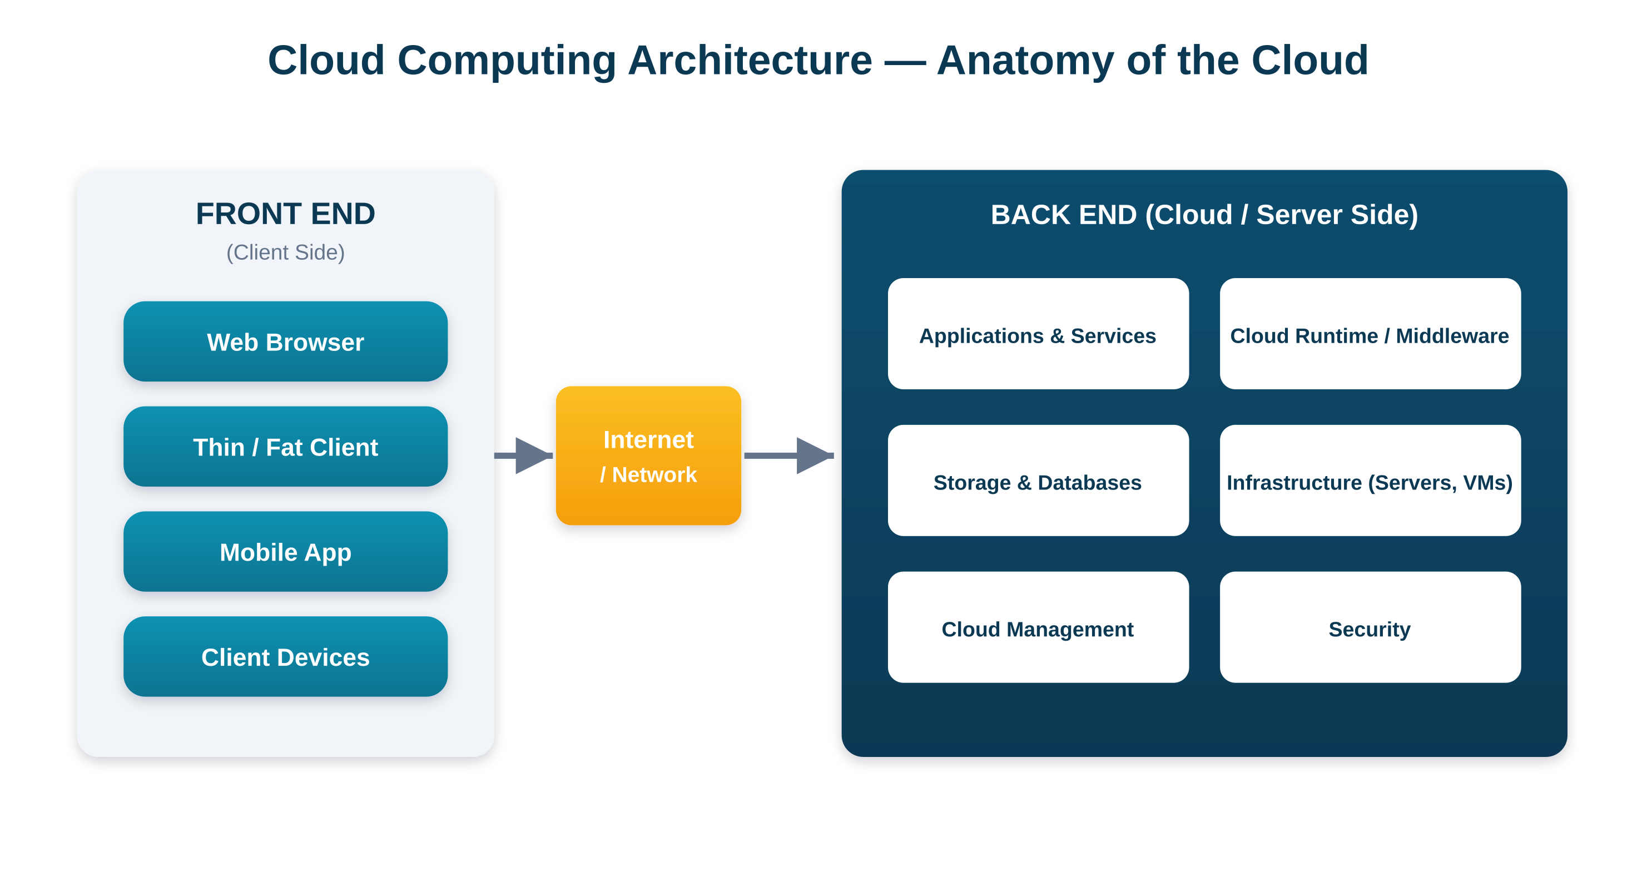
UNIT II · ARCHITECTURE
Anatomy: Front End, Network, Back End
Front End
Client devices & interfaces
Browser, mobile, thin/fat client
Network
Internet / VPN / direct link
CDN & load balancing
Back End
Servers, storage, databases
Apps, management, security
Managed by the provider

Slide 9
UNIT II · LAYERS
Cloud Layers & Managing the Cloud
The four cloud layers (top → bottom)
Application
End-user software (basis of SaaS)
Managing the Infrastructure
Provisioning & resource allocation
Monitoring, fault tolerance, recovery
Patching, security & compliance
Platform
OS, runtime, DB, frameworks (basis of PaaS)
Infrastructure
Virtual compute, storage, network (basis of IaaS)
Managing the Application
Hardware / Physical
Servers, storage, network, data-centre facility
Deployment & configuration
Scaling, availability & performance
Version updates & lifecycle

Slide 10
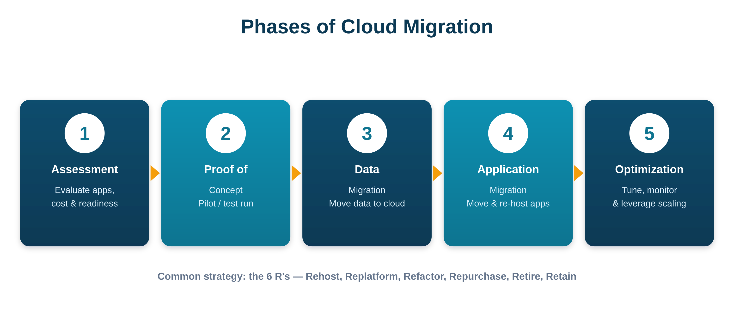
UNIT II · MIGRATION
Phases & Approaches of Cloud Migration
Migration approaches — the 6 R's
Rehost Lift & shift, no change
Replatform Minor cloud tweaks
Refactor Re-architect cloud-native
Repurchase Move to a SaaS product
Retire Decommission unused apps
Retain Keep on-premises for now

Slide 11
III
UNIT
Cloud Service Models
Infrastructure, Platform and Software as a Service — characteristics, suitability, pros & cons

Slide 12
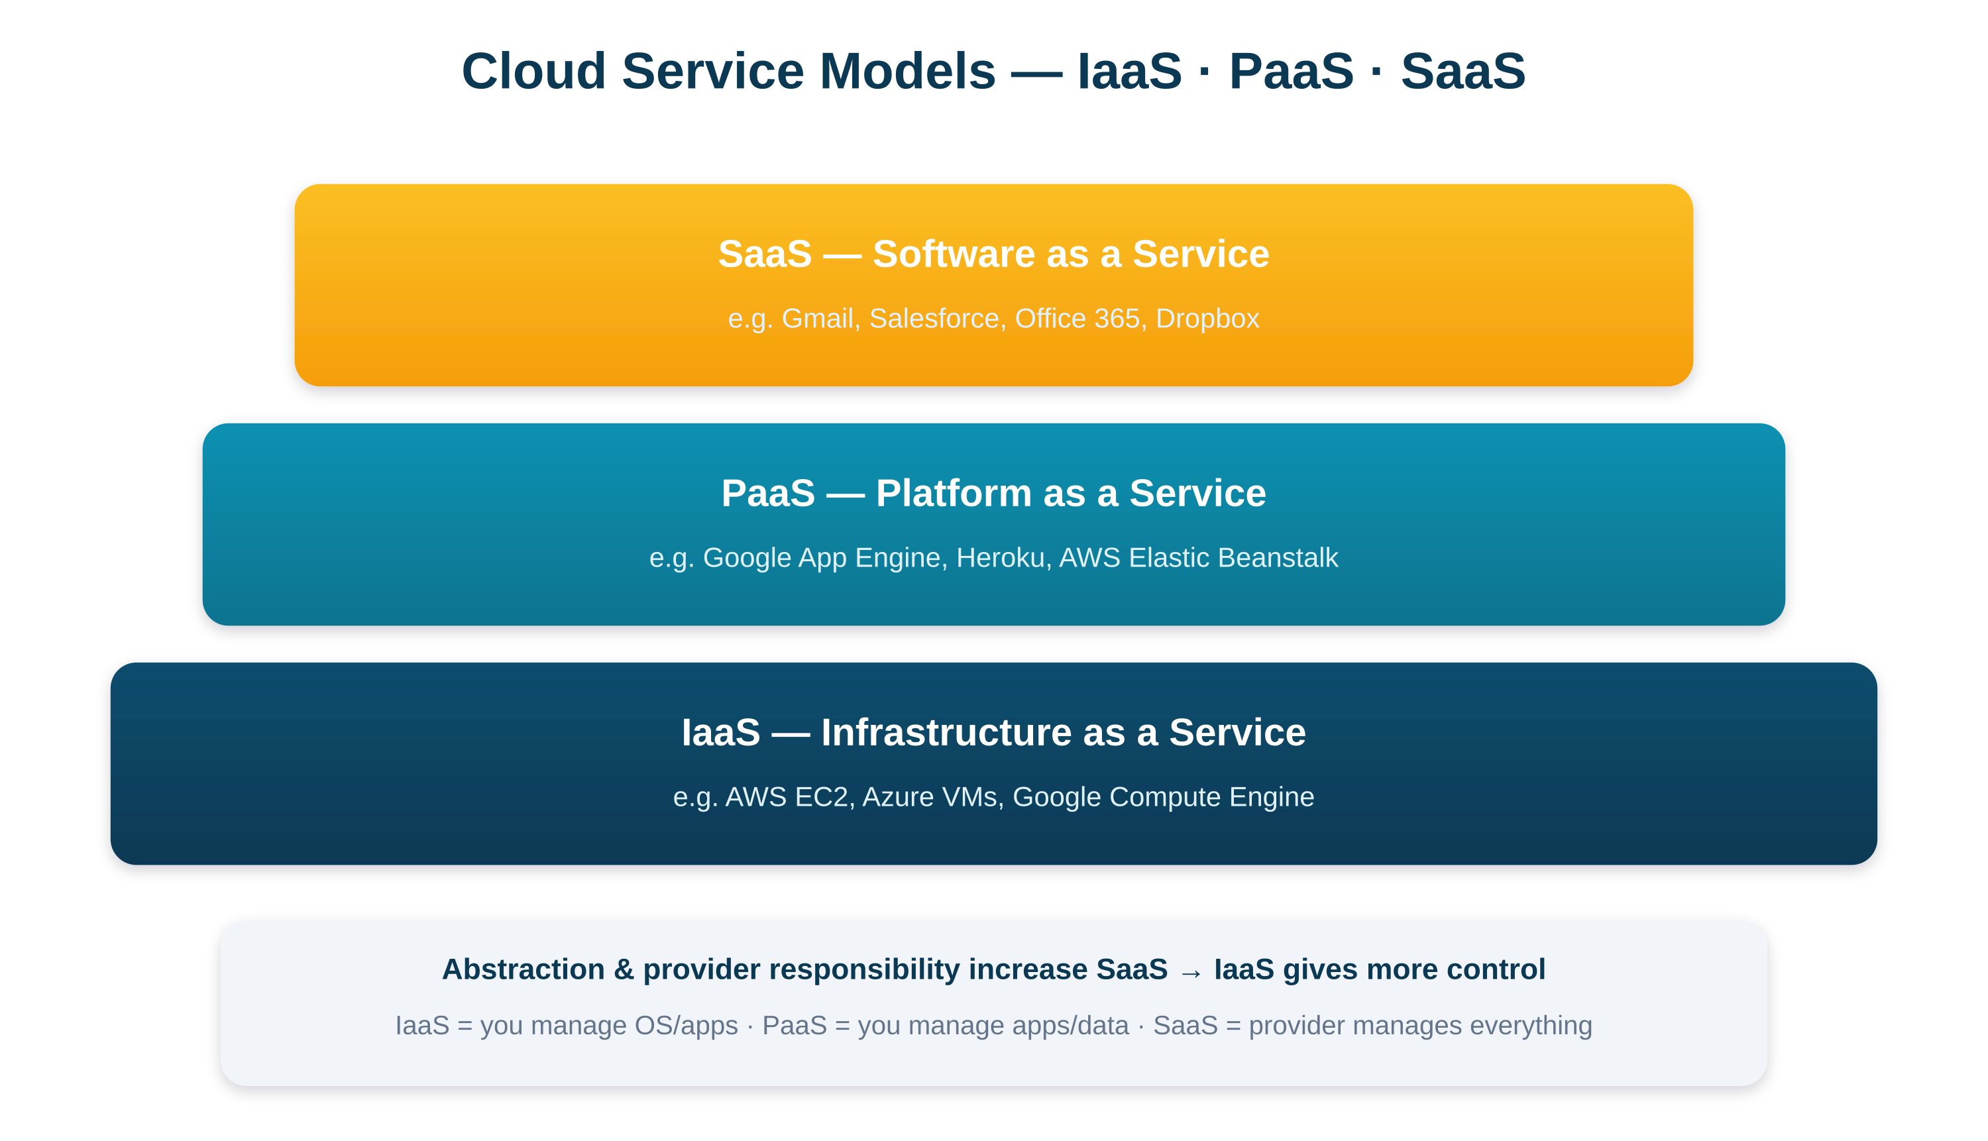
UNIT III · OVERVIEW
IaaS · PaaS · SaaS
IaaS
You manage OS, apps & data. Provider runs hardware & virtualization. Most control.
PaaS
You manage apps & data only. Provider runs everything up to the runtime. For developers.
SaaS
Provider manages everything; you just use the software. Least effort, least control.

Slide 13
UNIT III · DETAIL
Each Model at a Glance
IaaS — Infrastructure
PaaS — Platform
SaaS — Software
VMs, storage, networks on demand
Full OS-level control; pay-per-use
Best for: custom software, variable & HPC workloads
Ready runtime, DB & dev tools
Auto-scaling; focus only on code
Best for: rapid web/mobile app development
Ready apps via browser
Provider manages everything
Best for: end users needing ready tools
PROVIDERS
PROVIDERS
PROVIDERS
AWS EC2 · Azure VMs · Google CE
App Engine · Heroku · Beanstalk
Gmail · Salesforce · M365

Slide 14
IV
UNIT
Virtualization in Cloud
Virtual machines, hypervisors, types of virtualization, its role in the cloud, and app development

Slide 15
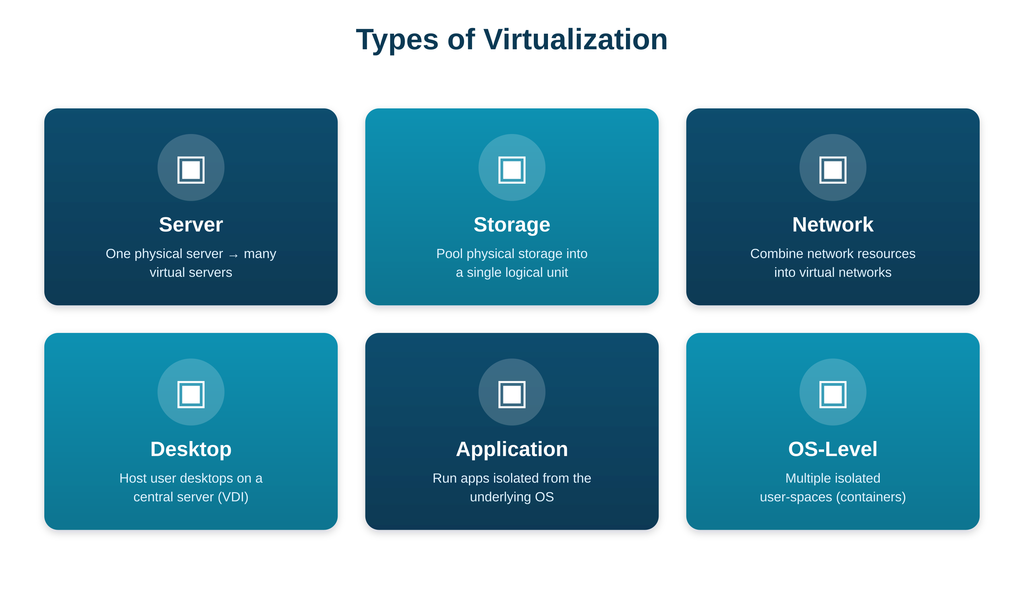
UNIT IV · VIRTUALIZATION
What It Is & Its Types
Definition
Creating a virtual (not physical) version of a resource — server, storage, network or OS. One physical machine is split into many isolated virtual machines.
Why it matters (opportunities)
Server consolidation → better use
Lower cost (power, space, hardware)
Isolation & security between VMs
Rapid provisioning & easy migration

Slide 16
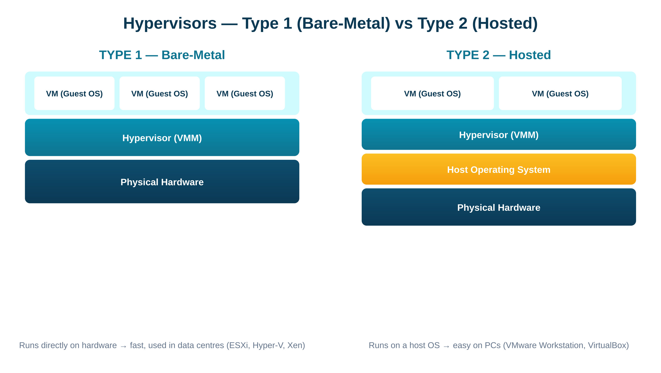
UNIT IV · HYPERVISORS
VMs & the Two Types of Hypervisor
Virtual Machine (VM)
Software emulation of a computer
Runs its own guest OS & apps
Isolated; shares physical hardware
Hypervisor (VMM)
Creates & manages VMs
Allocates hardware, keeps isolation
Type 1 (bare-metal): runs on hardware → fast, data centres (ESXi, Hyper-V, Xen). Type 2 (hosted): runs on a host OS → easy on PCs (VMware Workstation, VirtualBox).

Slide 17
UNIT IV · DEVELOPMENT
Cloud Application Development
Methodologies
Power of the cloud for dev
Agile + DevOps with CI/CD pipelines
Cloud-native: microservices
Containers & serverless functions
Instant, scalable infrastructure
Built-in services (DB, auth, AI/ML)
Global reach & high availability
Pay-per-use lowers experimentation cost
Development platforms
Cloud APIs
AWS, Microsoft Azure, Google Cloud
Google App Engine, Heroku
Red Hat OpenShift
Programmatic access to cloud services
Mostly REST (HTTP) based
Automate & integrate (provision, store, message)
e.g. AWS SDK, Azure REST, Google Cloud APIs

Slide 18
V
UNIT
Cloud Security & Applications
Security issues, data security, IAM, cloud storage, backup & recovery, and real-world case studies

Slide 19
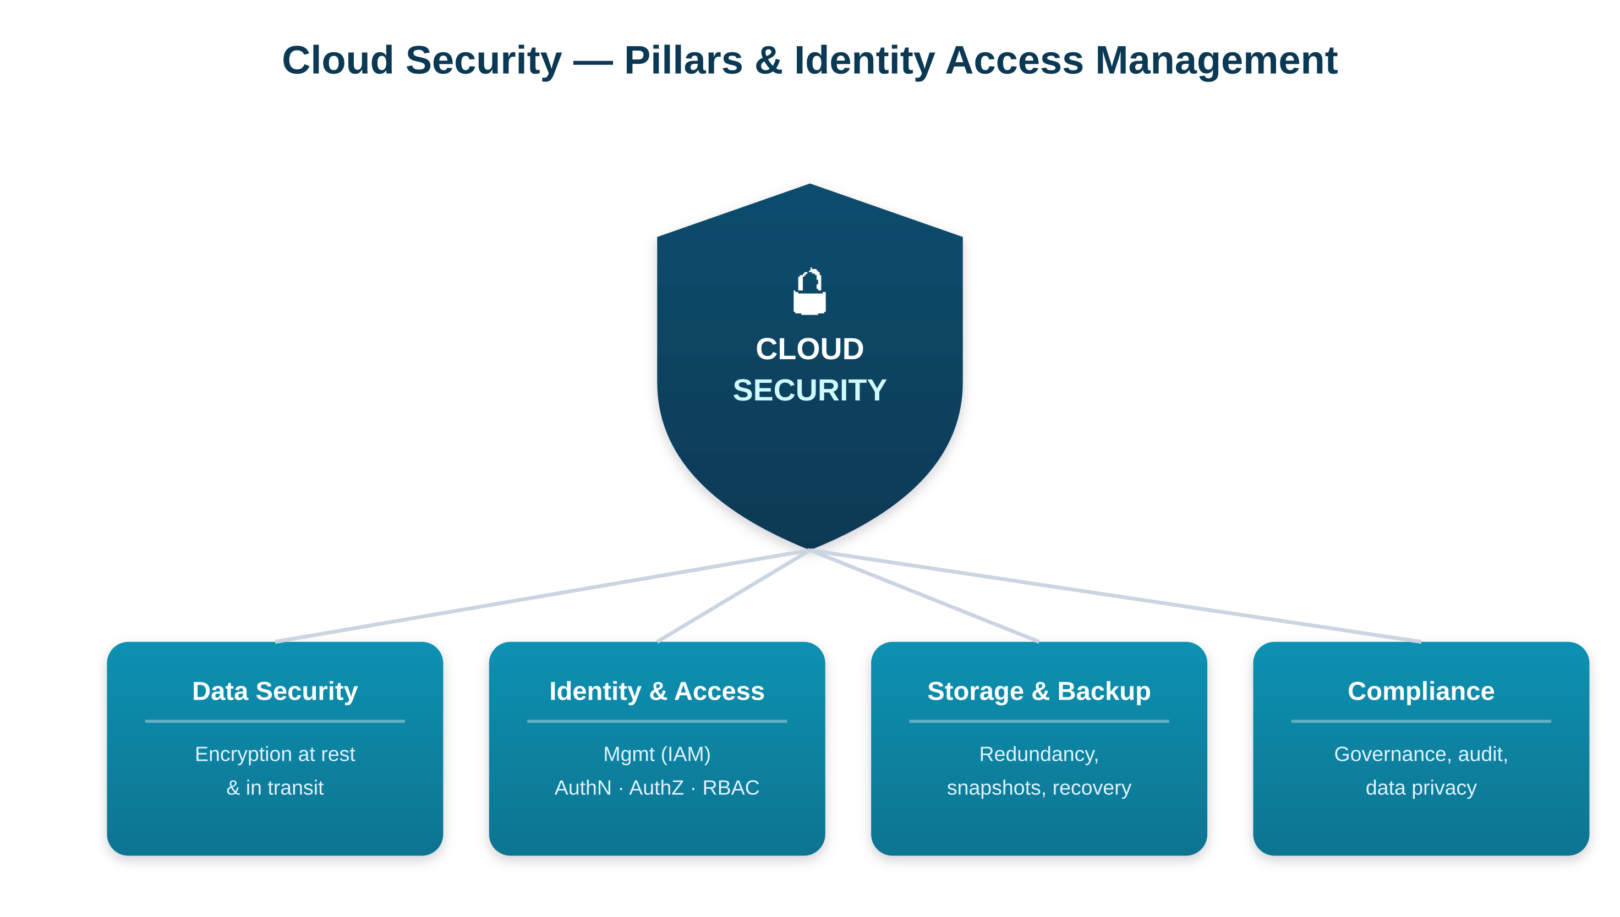
UNIT V · SECURITY
Security Issues & Pillars
Key security issues
Data breaches & data loss
Account / credential hijacking
Insecure APIs & interfaces
Multi-tenancy isolation risks
Insider threats
Compliance & data-residency laws
Data security
Protect data at rest, in transit & in use — encryption (SSL/TLS), key management, masking, backups, access control.

Slide 20
UNIT V · CONTROLS
IAM · Storage · Backup & Recovery
Identity & Access Mgmt (IAM)
Cloud Storage Services
Backup & Recovery
AuthN — verify who you are (MFA, biometrics)
AuthZ — what you're allowed to do
Auditing — log & monitor activity
RBAC — permissions by role
Least privilege & SSO
Object — unstructured data (Amazon S3)
Block — disk for VMs (Amazon EBS)
File — shared file system (Amazon EFS)
Consumer: Drive, Dropbox, OneDrive
Scalable, durable, pay-per-use
Automated backups across regions
Recovery restores data & services
Disaster Recovery (DR) plan
RTO — max time to restore
RPO — max acceptable data loss

Slide 21
UNIT V · CASE STUDIES
Real-World Cloud Security
AWS
Microsoft Azure
Google Cloud
IAM, KMS encryption, security groups; shared-responsibility model. Powers Netflix & Airbnb.
Azure AD identity, Security Center monitoring, enterprise compliance certifications.
Default encryption, Cloud IAM, BeyondCorp zero-trust. Runs Gmail & YouTube.
THE SHARED RESPONSIBILITY MODEL
Provider secures the cloud (physical infrastructure, virtualization) — Customer secures what's in the cloud (data, access management, configuration).

Slide 22
WRAP-UP
Five Units in One Slide
On-demand pay-per-use computing. 5 characteristics; 4 deployment models.
I
Front end + network + back end; 4 layers; migration phases & 6 R's.
II
IaaS → PaaS → SaaS: control decreases, convenience increases.
III
Virtualization underpins the cloud; VMs run on Type 1 / Type 2 hypervisors.
IV
Security issues, data security, IAM, storage, backup (RTO/RPO), shared responsibility.
V

Slide 23
Thank You
Cloud Computing · R23 · 23CD4124
Reference: Essentials of Cloud Computing (Chandrasekaran) · Cloud Computing: Principles & Paradigms (Buyya et al.)

