Slide 1
NETFLIX
David Mijares
Yumi Nakagawa
GROUP #9

Slide 2
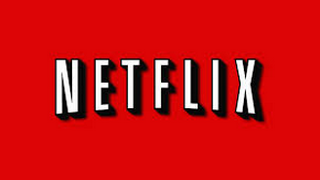
What is Netflix?
Netflix is the world’s largest online DVD movie rental service provider. Around 26,000,000 members access to more than 100,000 titles.
http://www.youtube.com/watch?v=W3mIZMwnX6k

Slide 3
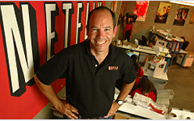
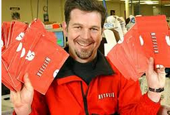
The Founders
Marc Randolph
Reed Hastings

Slide 4
Origins
The company was founded in 1997 in Los Gatos, California.
It started its subscription based digital distribution service in 1999.
Netflix has reported 36.3 million subscribers. (29.2 million in U.S) in April 2013.

Slide 5
Origins
In 2013, Netflix became a “streaming TV network service.”
Netflix started creating its own web series such as Arrested Development; Hemlock Grove, and House of Cards which was awarded a Primetime Emmy Award nomination for Outstanding Series.

Slide 6
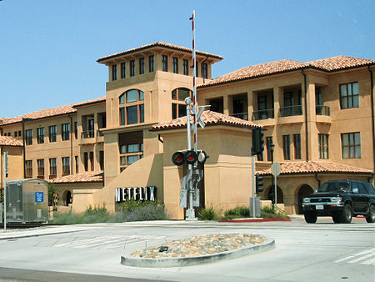
Why was Netflix so Successful?
Right Timing
Good Relationships with Content Providers
Trying New Things
Price the Product Well
Promote Creativity
Netflix Headquarters, California

Slide 7
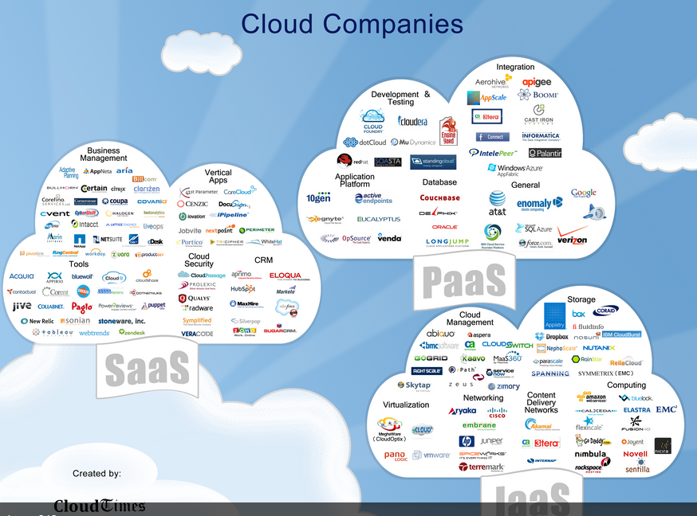
Cloud Computing
http://www.youtube.com/watch?v=RN5sg5Lnyy8

Slide 8
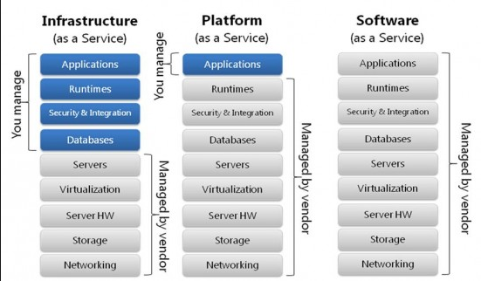
Comparison between Cloud Architectures Picture

Slide 9

PaaS (Platform as a Service)

Slide 10
“PaaS provides all the infrastructure needed to develop and run applications over the Internet. ”
So what are the advantages of using PaaS?
http://www.youtube.com/watch?v=l1E32xVCsRs

Slide 11

What is Hadoop?
http://www.youtube.com/watch?v=9s-vSeWej1U

Slide 12
Genie ~ the Hadoop PaaS
Hadoop is the cloud –based architecture which Netflix uses instead of the data-center based ones.
Genie is the Hadoop Platform as a Service, which provides a higher level of abstraction.
Genie was built to handle certain Netflix requirements that no other platform was able to do.
Genie exposes API’s to submit and manage jobs.

Slide 13
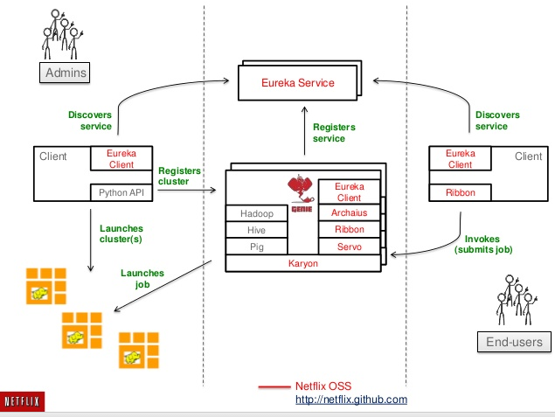

Slide 14


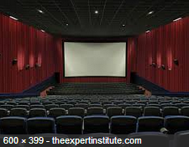
The Netflix Impact

Slide 15
Netflix in Society
How has Netflix affected Society?
Easier and faster access to media data
“ The Customer First ”
Habit change
Big data and entertainment media intersection

Slide 16
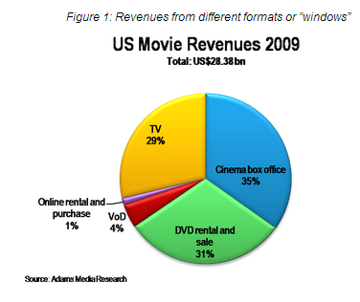
Netflix and the Economy
Netflix vs. The Movie Industry
Blockbuster
The Family Pocket
(Bad Economy == Netflix Happiness)
The Future of Cable

Slide 17
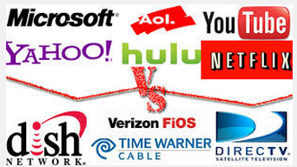
Is Netflix killing Cable TV?
Only 1% of cable subscribers have cut the cord (900,000 households)
Netflix had success with “House of Cards” but most Hit Dramas are still on traditional television.
Netflix rates vs. Cable rates
Netflix convenience

Slide 18
Streaming TV Era
http://www.youtube.com/watch?v=GzDY6bAaJZM

Slide 19
The Future of Netflix

Slide 20
