Slide 1

TITLE : TEXT ENCRYPTION AT CLIENT'S END
SUPERVISOR :
PROJECT
BRANCH : COMPUTER SCIENCE AND ENGINEERING
S.NO | Name | Roll No. | Branch & Section
1. | MOGALI SAI VISHAL | 20951A05F8 | CSE-B
2. | GANTOLA UDAY | 20951A05M7 | CSE-B

Slide 2
Outline
Highlights
Abstract
Problem Performance
Methodology
Working
Conclusion

Slide 3
Highlights
Our’s is front-end application for text encryption that would allow users to input text that they want to encrypt, and then display the encrypted text.
The application would also allow users to input a key, which would be used to encrypt and decrypt the text.
The front-end could have a simple interface with input fields for the text and key, and a button to encrypt the text.
The encrypted text would then be displayed in a separate output field. To make the application more user-friendly, it could also include a copy button for the encrypted text, so users can easily copy and paste it into another program.

Slide 4
Abstract
A huge amount of private data is stored in mobile devices and personal computers: emails with details about our personal lives, passwords that we type into login screens, tax documents that we upload to servers,credit card information,etc..
Since data is unprotected, attackers may figure out ways to look at the data whizzing around the Internet.
That's where encryption comes in: encrypting data means that we scramble the original data to hide the meaning of the text, while still making it possible for the data to be unscrambled using a secret key.
Data is jumbled/scrambled up in a manner so that when it travels through the internet it is completely unreadable, this stops hackers who may intercept the data from seeing

Slide 5
Problem Performance
The performance of text encryption can be affected by several factors, including the encryption algorithm used, the size of the message, and the processing power of the devices involved.
We used AES( stands for Advanced Encryption Standard,) which is a symmetric encryption algorithm used for securing electronic data.
CryptoJS supports AES-128, AES-192, and AES-256. It will pick the variant by the size of the key you pass in. If you use a passphrase, then it will generate a 256-bit key.

Slide 6
Methodology
We built a small website that will encrypt and decrypt information on the client side using JavaScript. The encrypted information can be stored in a database on a server, but never the decrypted version.
We used HTML, CSS, and Javascript to design a website,which helps users to protect their text data. CryptoJS, a javascript library, is used in this process.
CryptoJS is a growing collection of standard and secure cryptographic algorithms implemented in JavaScript using best practices and patterns.
Using this website a user can encrypt his/her text data and upon its use the data can be decrypted.

Slide 7
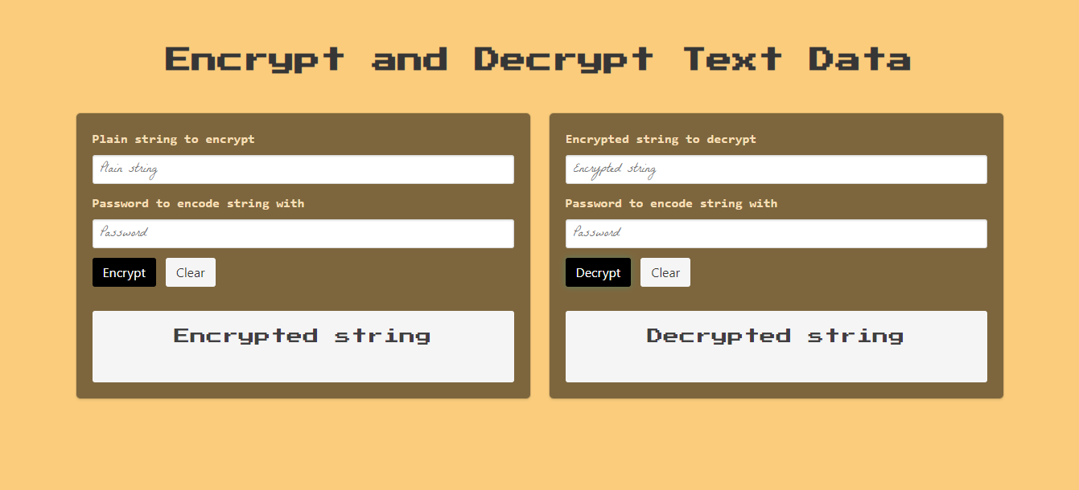
Working

Slide 8
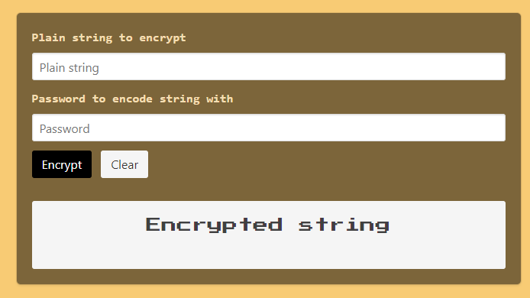
Working

Slide 9
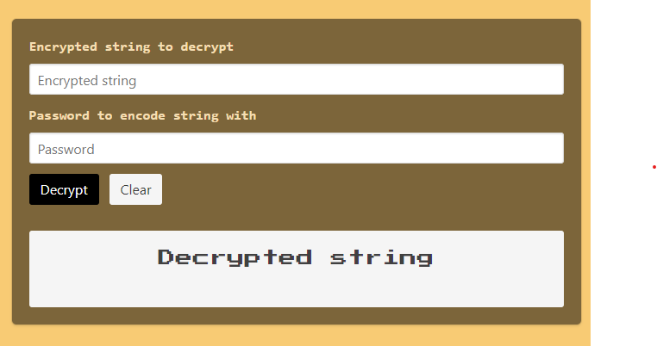
Working

Slide 10
Conclusion
In conclusion, text encryption is an important tool for protecting sensitive information from unauthorized access and ensuring that it remains confidential and secure.
By using encryption algorithms like AES, organizations and individuals can prevent data breaches, comply with legal and regulatory requirements, and build trust between parties.
While implementing text encryption requires careful planning and execution, the benefits of doing so are significant and can provide peace of mind knowing that sensitive information is protected from prying eyes.

Slide 11


