Slide 1
Psychology assignment
SUBMITTED TO,
SUBMITTED BY,
Mrs. Dipali Sabale Mam,
Subject Teacher
Ms. Yogita Helode,
1ST Year PBBSc. Nursing

Slide 2

Topic :- Mental health during covid -19 pandemic
QUOTE -
The strongest people are those who win battles we know nothing about.
TITLE -
Mental health and coping with Covid-19 pandemic.

Slide 3
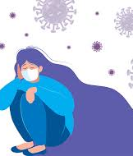
BACKGROUND
There is a major health crisis is going on in the world currently due to a newly emerged zoonotic viral infection known as novel coronavirus disease (covid-19) it is affecting people, globally taking the form of a pandemic in the year of 2020.over the past 1year there is significant increase in mortality &morbidity due to this pandemic ,which is responsible for increasing mental health issues among general population.
There is rising concern about the mental health challenges of the covi-19 patients as well as close contacts, elderly, children's ,youngsters ,and health professionals.

Slide 4
Impact of covid-19
Due to pandemic people are facing lockdown for first time .
There is shortage of medical facilities around country.
Infected people in hospitals & some in quarantine, people are migrating from work places to there native places.
Schools are closed ,online education facilities were started .
This causes universal awareness, anxiety, and distress

Slide 5
Impact on psychological health
Covid-19 outbreak and lockdown
Social distancing and quarantine
Financial crisis
Media,
News,
government

Slide 6
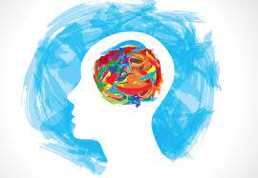
Effect on mental health
Stress
Anxiety
Loneliness
Depression
Irritability
Confusion
Frustration
Phobia
Panic
Fear of contracting
Extremes of consequences – suicide

Slide 7
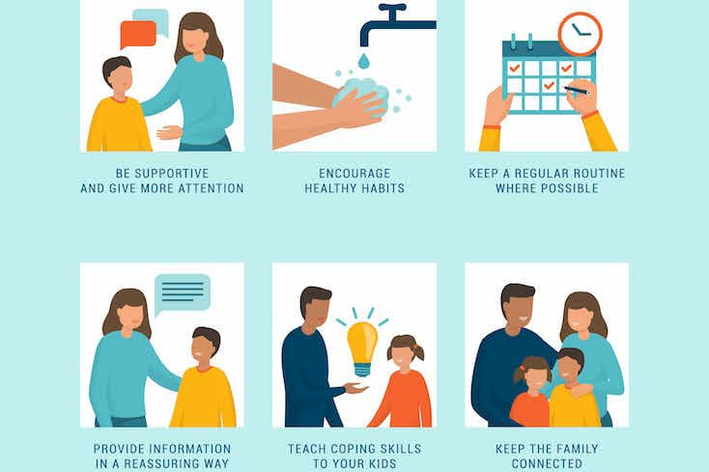

Slide 8
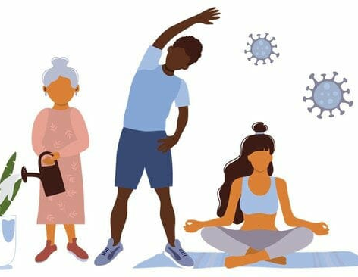
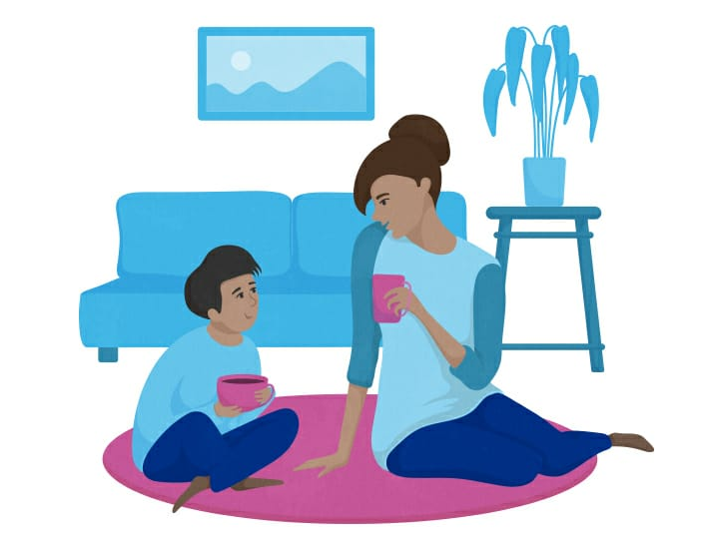
Techniques to prevent & management mental health during pandemic
Meditation
Gardening
Communication

Slide 9
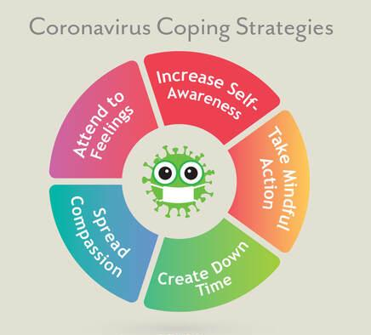

Slide 10
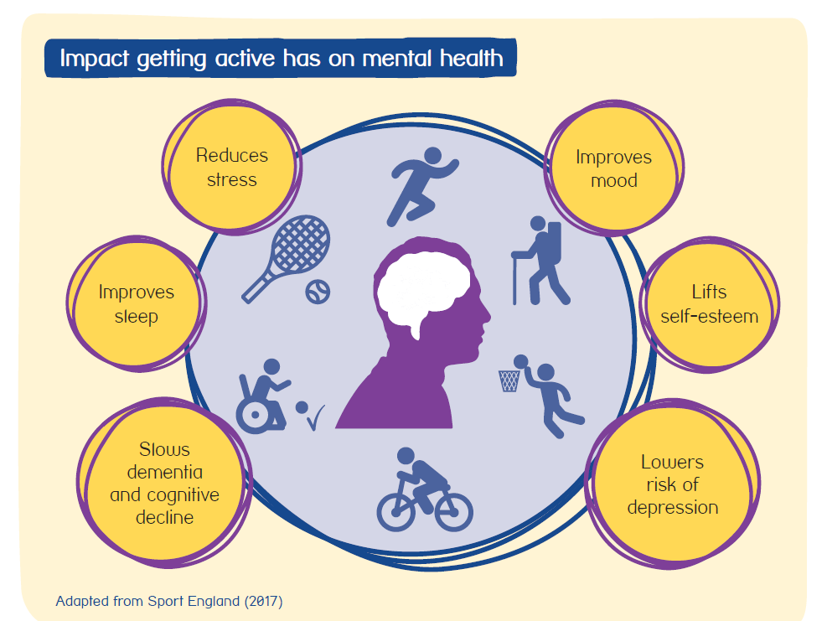
EXERCISE

Slide 11
SUMMARY
In the above presentation on mental health during covid-19 pandemic I have include the following points -
Quote.
Title.
Background of covid-19 and its effect on mental health.
Impact of covid-19 on mental health.
Implications in life.
Techniques to prevent and management of mental health during pandemic.
These intervention mention above will help to manage/prevent mental illness and promote mental health during this pandemic.

Slide 12
REFERENCES
R Sreevani, psychology for nurses , Jaypee brothers.
Laxmi Rana, psychology for graduate nurses, Jaypee.
A .V . Venkatesh Reddy , essential of psychology for nurses , Jaypee.

